Slide 1

UNIT 2 · 9 hours
Speed Control of a DC Shunt Motor (Armature and Field)
Transformers and Electrical Machines
Basic Electrical and Electronics Engineering (EEE103)
Dr. Mitesh Astik · Dept. of Electrical and Electronics Engineering
NMAM Institute of Technology, Nitte · 2025-26
Notes:
Welcome. In this session we study "Speed Control of a DC Shunt Motor (Armature and Field)", part of Unit 2 (Transformers and Electrical Machines) of Basic Electrical and Electronics Engineering.

Slide 2
Learning objectives
U2
Derive the speed equation of a DC motor
Explain armature resistance control
Explain field (flux) control
Compare the two methods and solve numericals
Syllabus context
DC Motor: principle of operation, back EMF and its significance, torque equation, characteristics and speed control (armature and field) of DC shunt motor.
Notes:
By the end of this topic you should be able to do the following. Derive the speed equation of a DC motor. Explain armature resistance control. Explain field (flux) control. Compare the two methods and solve numericals.

Slide 3
Speed equation
U2
N = (V − Ia Ra) / (K φ)
N ∝ Eb / φ
K = ZP/60A (constant)
approximately N ∝ 1/φ
Speed can be varied by changing: V, Ra (armature circuit), or φ (field).
Syllabus methods: armature resistance control and field flux control.
Notes:
From the back emf equation we see speed is directly related to the armature voltage and inversely related to the flux.

Slide 4
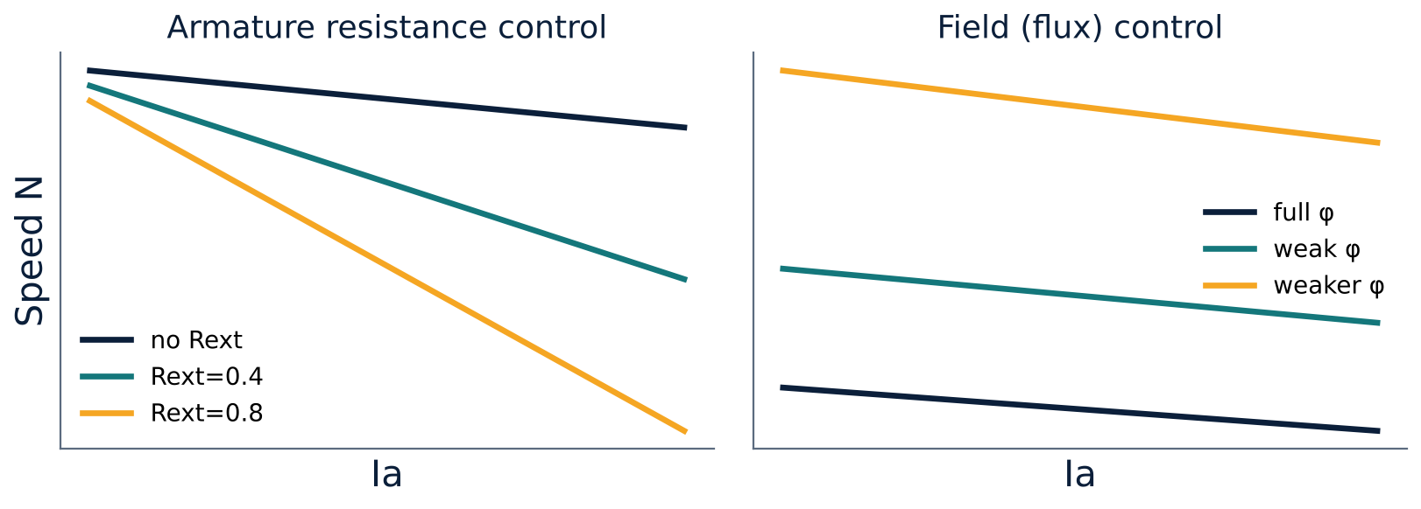
Armature resistance control
U2
Variable resistance Rext in series with the armature.
Field is across the supply, so flux is unchanged.
Ia Ra drop increases → Eb falls → speed falls.
Speed can be reduced below normal only.
Notes:
Adding resistance in the armature circuit lowers the armature voltage and hence the speed.

Slide 5
Armature resistance versus field control
U2
Armature resistance control
Field (flux) control
Speed below rated value
Speed falls with load (poor regulation)
Large I²R loss in Rext, so inefficient
Used for short-time duty or small motors
Speed above rated value
Rheostat in shunt field circuit; weaker flux gives higher speed
Small field current, so very low loss
Limit: very weak field harms commutation
Notes:
Field control is more efficient but only raises speed.

Slide 6
Field control in detail
U2
Rheostat Rc in series with the shunt field.
Increase Rc → Ish falls → φ falls → N rises (N ∝ 1/φ).
Armature current rises when flux is reduced (torque requirement constant: Ta ∝ φ Ia).
Speed range is limited, typically up to 2:1.
Field-open danger: φ residual only → speed runaway; use field failure protection.
Notes:
Never open the field circuit of a running shunt motor.

Slide 7
Numerical: armature resistance control
U2
Problem A 220 V shunt motor, Ra = 0.5 Ω, runs at 1000 rpm with Ia = 20 A. A 2.5 Ω resistance is inserted in series with the armature, load torque constant. Find the new speed.
Constant torque, constant φ → Ia = 20 A unchanged
Eb1 = 220 − 20 × 0.5 = 210 V
Eb2 = 220 − 20 × (0.5 + 2.5) = 160 V
N2 = N1 × Eb2/Eb1 = 1000 × 160/210
Answer: N2 = 762 rpm
Notes:
Speed is proportional to back emf for a constant flux.

Slide 8
Numerical: field control
U2
Problem Same motor. The field flux is reduced by 10 % while Eb stays nearly the same. Estimate the new speed.
N ∝ Eb/φ; Eb ≈ constant
N2 = N1 × (φ1/φ2) = 1000/0.9
Answer: N2 ≈ 1111 rpm
Notes:
In practice Eb changes slightly because Ia rises when the flux is reduced, but the estimate is a good first approximation.

Slide 9
Key takeaways
U2
N = (V − Ia Ra)/(Kφ)
Armature resistance control lowers speed; inefficient
Field control raises speed; efficient, small field current
Never open the shunt field of a running motor
Notes:
To summarise this topic. N = (V − Ia Ra)/(Kφ). Armature resistance control lowers speed; inefficient. Field control raises speed; efficient, small field current. Never open the shunt field of a running motor.

Slide 10
Practice questions
U2
Q1. Explain how the speed of a DC shunt motor is varied by field control.
Q2. Why is armature resistance control inefficient?
Q3. A shunt motor at 1200 rpm: flux reduced by 20 %. Estimate new speed.
Q4. Compare the two methods in a table.
Notes:
Attempt these on your own, then check your working against your notes and textbook. Explain how the speed of a DC shunt motor is varied by field control. Why is armature resistance control inefficient? A shunt motor at 1200 rpm: flux reduced by 20 %. Estimate new speed. Compare the two methods in a table.

