Slide 1

UNIT 2 · 9 hours
Concept of Rotating Magnetic Field
Transformers and Electrical Machines
Basic Electrical and Electronics Engineering (EEE103)
Dr. Mitesh Astik · Dept. of Electrical and Electronics Engineering
NMAM Institute of Technology, Nitte · 2025-26
Notes:
Welcome. In this session we study "Concept of Rotating Magnetic Field", part of Unit 2 (Transformers and Electrical Machines) of Basic Electrical and Electronics Engineering.

Slide 2
Learning objectives
U2
Explain how three-phase currents set up a rotating field
Show that the resultant flux has constant magnitude 1.5φm
Calculate synchronous speed
State how to reverse the direction of rotation
Syllabus context
Three-phase induction motor: concept of rotating magnetic field, principle of operation, constructional features of motor, types: squirrel cage and wound rotor.
Notes:
By the end of this topic you should be able to do the following. Explain how three-phase currents set up a rotating field. Show that the resultant flux has constant magnitude 1.5φm. Calculate synchronous speed. State how to reverse the direction of rotation.

Slide 3
Stator winding and three fluxes
U2
Three identical coils placed 120° apart in space.
Fed from a balanced three-phase supply (120° apart in time).
φR = φm sin ωt, φY = φm sin(ωt − 120°), φB = φm sin(ωt − 240°).
Each flux is pulsating along its own axis; their vector sum is what matters.
Notes:
A balanced three-phase supply sets up three alternating fluxes displaced in space by one hundred twenty degrees.

Slide 4
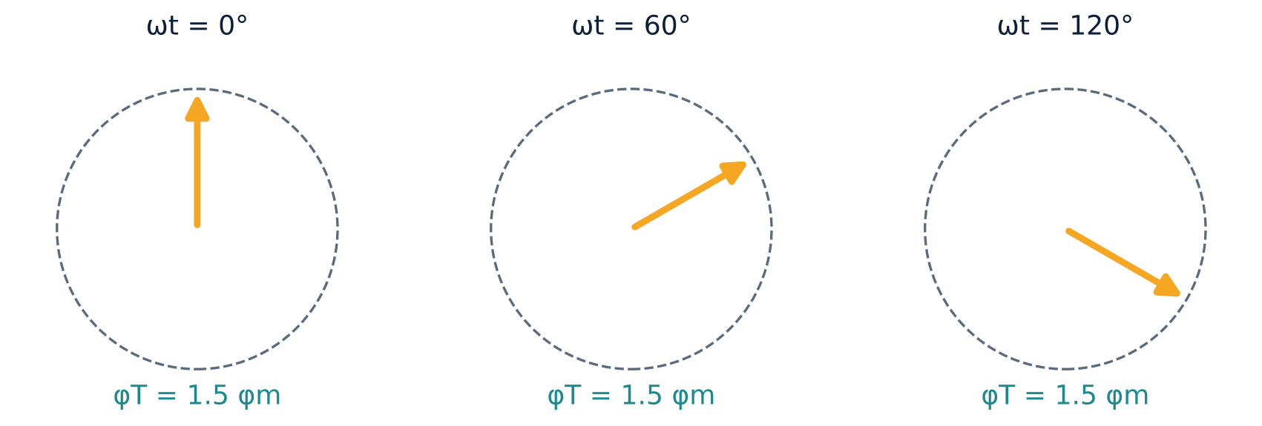
Resultant flux at successive instants
U2
At ωt = 0: φR = 0, φY = −0.866φm, φB = +0.866φm → φT = 1.5φm.
At 60°: resultant has turned 60°, magnitude still 1.5φm.
At 120°: turned 120°.
After 360° it completes one revolution (for 2 poles).
Notes:
The resultant flux has a constant magnitude of one point five times the maximum flux of one phase, and it rotates.

Slide 5
Synchronous speed
U2
Ns = 120 f / P
φT = 1.5 φm
rpm
constant amplitude
f = supply frequency (Hz), P = number of poles.
4 poles, 50 Hz: Ns = 1500 rpm; 2 poles: 3000 rpm; 6 poles: 1000 rpm; 8 poles: 750 rpm.
Direction reverses if any two supply leads are interchanged (phase sequence reversed).
Notes:
The speed of the rotating field is called the synchronous speed.

Slide 6
Synchronous speeds at 50 Hz
U2
Poles P | 2 | 4 | 6 | 8 | 10
Ns (rpm) | 3000 | 1500 | 1000 | 750 | 600
Ns = 120 f / P is independent of the load.
Notes:
More poles means lower speed for the same supply frequency.

Slide 7
Why it matters
U2
The rotating field replaces the mechanical motion of a magnet.
A conductor in this field sees relative motion and has an EMF induced.
No slip rings or commutator are needed on the stator.
Makes the three-phase induction motor self-starting.
Notes:
Single phase supply only produces a pulsating field with no starting torque, which is why three-phase motors are self-starting.

Slide 8
Key takeaways
U2
Three coils 120° apart + three-phase supply → rotating field
Resultant magnitude = 1.5 φm, speed Ns = 120f/P
Interchanging two leads reverses rotation
The rotating field makes the induction motor self-starting
Notes:
To summarise this topic. Three coils 120° apart + three-phase supply → rotating field. Resultant magnitude = 1.5 φm, speed Ns = 120f/P. Interchanging two leads reverses rotation. The rotating field makes the induction motor self-starting.

Slide 9
Practice questions
U2
Q1. Show that the resultant of three fluxes is 1.5φm at ωt = 60°.
Q2. Find the synchronous speed of a 6-pole, 50 Hz motor.
Q3. How do you reverse the direction of an induction motor?
Q4. Why is a single-phase stator winding not self-starting?
Notes:
Attempt these on your own, then check your working against your notes and textbook. Show that the resultant of three fluxes is 1.5φm at ωt = 60°. Find the synchronous speed of a 6-pole, 50 Hz motor. How do you reverse the direction of an induction motor? Why is a single-phase stator winding not self-starting?

