Slide 1

UNIT 3 · 9 hours
Half-Wave Rectifier
Diodes, Transistors and their Applications
Basic Electrical and Electronics Engineering (EEE103)
Dr. Mitesh Astik · Dept. of Electrical and Electronics Engineering
NMAM Institute of Technology, Nitte · 2025-26
Notes:
Welcome. In this session we study "Half-Wave Rectifier", part of Unit 3 (Diodes, Transistors and their Applications) of Basic Electrical and Electronics Engineering.

Slide 2
Learning objectives
U3
Explain the operation of the half-wave rectifier
Derive Vdc, Idc, Irms, ripple factor and efficiency
State the peak inverse voltage
Solve numericals
Syllabus context
Semiconductor diode, diode equivalent circuits, half-wave rectifier, full-wave bridge rectifier. Zener diode and its use in voltage regulation.
Notes:
By the end of this topic you should be able to do the following. Explain the operation of the half-wave rectifier. Derive Vdc, Idc, Irms, ripple factor and efficiency. State the peak inverse voltage. Solve numericals.

Slide 3
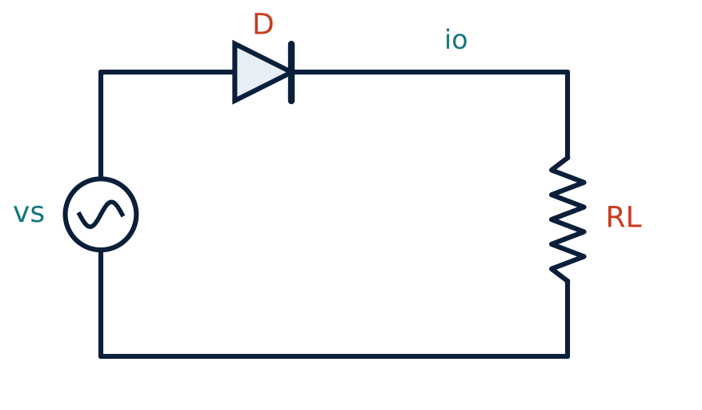
Circuit and operation
U3
Single diode D in series with load RL.
Positive half-cycle: D forward biased, current flows through RL.
Negative half-cycle: D reverse biased, no current.
Output is a pulsating DC with only positive half-cycles.
Notes:
The half wave rectifier allows one half of the AC voltage signal and blocks the other half.

Slide 4
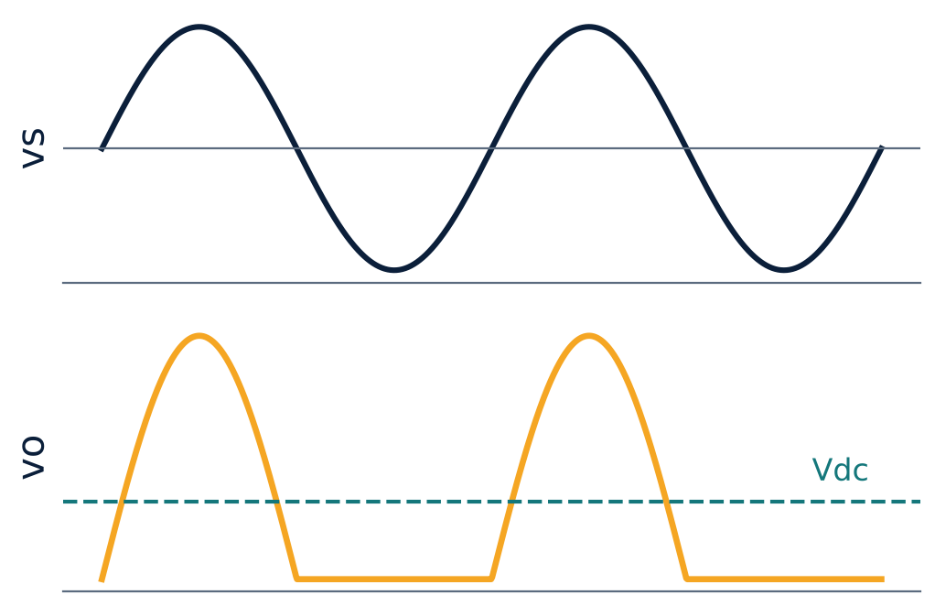
Input and output waveforms
U3
vo = Vm sin θ for 0 < θ < π, zero otherwise.
Output frequency equals input frequency.
Dashed line: average (DC) value Vdc = Vm/π.
Notes:
The output contains a DC component plus harmonics (ripple).

Slide 5
Performance equations (Rf = diode resistance)
U3
Im = Vm / (Rf + RL)
Idc = Im / π
peak current
average current
Irms = Im / 2
Vdc = Idc RL = Im RL / π
RMS current
DC output voltage
Notes:
These follow from averaging and R M S over one full cycle with zero output for the negative half.

Slide 6
Efficiency, ripple and PIV
U3
η = Pdc/Pac = 40.6 %
γ = √((Irms/Idc)² − 1) = 1.21
PIV = Vm
maximum (Rf = 0)
ripple factor
peak inverse voltage
Pdc = Idc² RL; Pac = Irms² (Rf + RL).
Ripple factor 1.21 means ripple exceeds the DC value: poor DC quality.
Transformer utilisation factor is only 0.287.
Notes:
Only forty point six percent of the A C input power is converted to D C.

Slide 7
Numerical: half-wave rectifier
U3
Problem Secondary voltage 20 V RMS, 50 Hz, RL = 100 Ω, diode ideal (Rf = 0). Find peak, DC and RMS current, power and efficiency.
Vm = 20√2 = 28.28 V; Im = 28.28/100 = 0.283 A
Idc = Im/π = 90.0 mA; Irms = Im/2 = 141.4 mA
Pdc = Idc² RL = 0.81 W; Pac = Irms² RL = 2.0 W
η = 0.81/2.0
Answer: Idc = 90 mA, η ≈ 40.5 %
Notes:
The result agrees with the theoretical maximum of forty point six percent.

Slide 8
Applications and limitations
U3
Used in: low-power circuits, simple battery chargers, AM demodulation, peak detectors.
Drawbacks: high ripple, low efficiency, DC component saturates the transformer core.
Improvement: add a filter capacitor, or use a full-wave rectifier.
Notes:
Half wave rectifiers are simple but waste half of the input waveform.

Slide 9
Key takeaways
U3
Conducts only during positive half-cycles
Vdc = Vm/π, Idc = Im/π, Irms = Im/2
η max = 40.6 %, ripple factor = 1.21
PIV = Vm
Notes:
To summarise this topic. Conducts only during positive half-cycles. Vdc = Vm/π, Idc = Im/π, Irms = Im/2. η max = 40.6 %, ripple factor = 1.21. PIV = Vm.

Slide 10
Practice questions
U3
Q1. Derive Idc and Irms for a half-wave rectifier.
Q2. Vm = 50 V, RL = 1 kΩ, Rf = 0. Find Vdc and Irms.
Q3. Why is the ripple factor high for a half-wave rectifier?
Q4. What is the PIV rating needed for 230 V RMS input?
Notes:
Attempt these on your own, then check your working against your notes and textbook. Derive Idc and Irms for a half-wave rectifier. Vm = 50 V, RL = 1 kΩ, Rf = 0. Find Vdc and Irms. Why is the ripple factor high for a half-wave rectifier? What is the PIV rating needed for 230 V RMS input?

