Slide 1

UNIT 3 · 9 hours
Full-Wave Bridge Rectifier
Diodes, Transistors and their Applications
Basic Electrical and Electronics Engineering (EEE103)
Dr. Mitesh Astik · Dept. of Electrical and Electronics Engineering
NMAM Institute of Technology, Nitte · 2025-26
Notes:
Welcome. In this session we study "Full-Wave Bridge Rectifier", part of Unit 3 (Diodes, Transistors and their Applications) of Basic Electrical and Electronics Engineering.

Slide 2
Learning objectives
U3
Explain the operation of a bridge rectifier
Derive and use Vdc, Idc, Irms, ripple factor and efficiency
Compare half-wave, centre-tap and bridge rectifiers
Solve numericals
Syllabus context
Semiconductor diode, diode equivalent circuits, half-wave rectifier, full-wave bridge rectifier. Zener diode and its use in voltage regulation.
Notes:
By the end of this topic you should be able to do the following. Explain the operation of a bridge rectifier. Derive and use Vdc, Idc, Irms, ripple factor and efficiency. Compare half-wave, centre-tap and bridge rectifiers. Solve numericals.

Slide 3
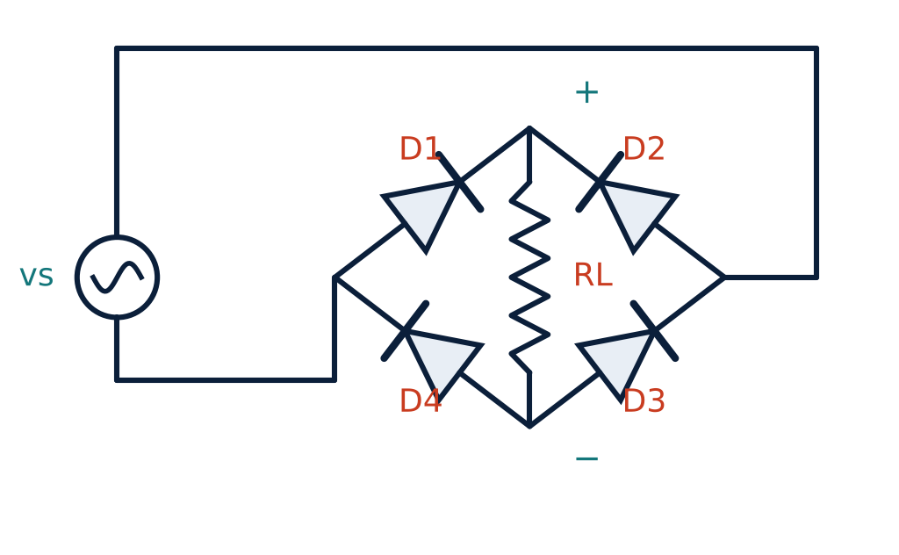
Bridge rectifier circuit
U3
Four diodes D1–D4 in a bridge.
Positive half-cycle (top terminal +): D2 and D4 conduct; current through RL top → bottom.
Negative half-cycle: D1 and D3 conduct; current through RL again top → bottom.
No centre-tapped transformer needed.
Notes:
Two diodes conduct in each half cycle. In both halves the direction of current through the load is the same, so the output is positive.

Slide 4
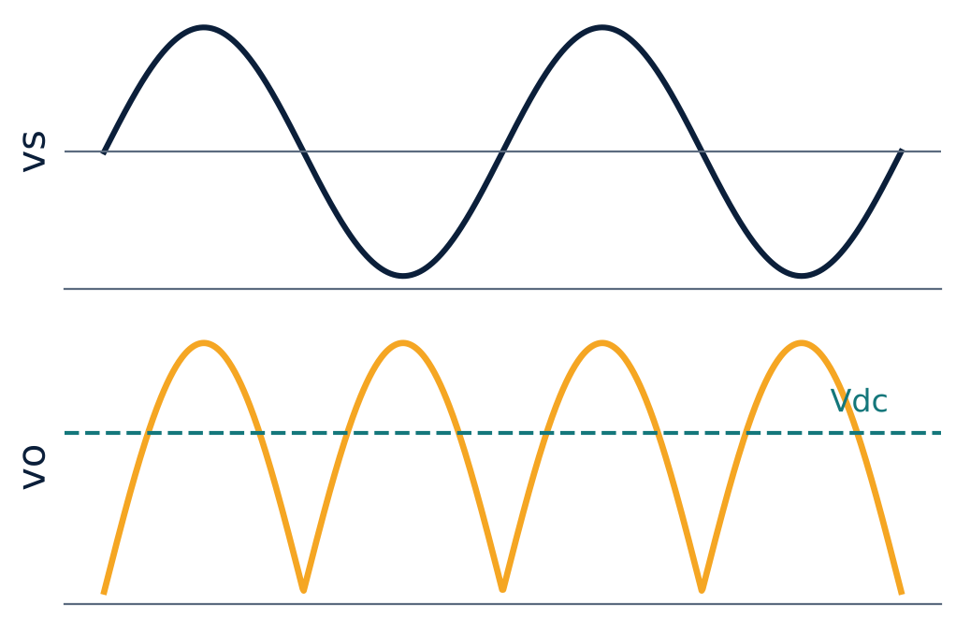
Input and output waveforms
U3
Both half-cycles reach the load.
vo = |Vm sin θ|; output frequency = 2 f.
Vdc = 2Vm/π (dashed line).
Notes:
The ripple is at twice the supply frequency, which makes filtering easier.

Slide 5
Performance equations
U3
Im = Vm / (2Rf + RL)
Idc = 2 Im / π
two diodes in path
average current
Irms = Im / √2
Vdc = 2 Vm / π
RMS current
DC output (Rf = 0)
Notes:
Both half cycles contribute, so the D C values are twice those of the half wave rectifier.

Slide 6
Efficiency, ripple and PIV
U3
η = 81.2 %
γ = 0.482
PIV = Vm
maximum (Rf = 0)
ripple factor
each diode (bridge)
Centre-tap full-wave needs PIV = 2Vm and a centre-tapped transformer.
Bridge uses the transformer secondary fully: TUF ≈ 0.81 compared with 0.287 (half-wave).
Notes:
Efficiency is twice that of the half wave circuit.

Slide 7
Rectifier comparison
U3
Parameter | Half-wave | Centre-tap FW | Bridge FW
Diodes | 1 | 2 | 4
Vdc | Vm/π | 2Vm/π | 2Vm/π
Ripple factor | 1.21 | 0.482 | 0.482
Efficiency (max) | 40.6 % | 81.2 % | 81.2 %
PIV | Vm | 2Vm | Vm
Output frequency | f | 2f | 2f
Notes:
The bridge rectifier is the most widely used in power supplies.

Slide 8
Numerical: bridge rectifier
U3
Problem A bridge rectifier is fed from 240 V RMS, RL = 480 Ω, each diode Rf = 2 Ω. Find mean load current and power in each diode.
Vm = 240√2 = 339.4 V; Im = 339.4/(480 + 2 × 2) = 0.701 A
Idc = 2Im/π = 0.446 A
Each diode conducts on one half-cycle: I(rms, diode) = Im/2 = 0.351 A
Pdiode = (Im/2)² Rf = 0.351² × 2
Answer: Idc = 0.446 A, P(diode) ≈ 0.25 W
Notes:
Use the sum of two diode resistances plus the load resistance when finding the peak current.

Slide 9
Key takeaways
U3
Bridge: four diodes, two conduct in each half-cycle
Vdc = 2Vm/π, Idc = 2Im/π, ripple 0.482, η max 81.2 %
PIV = Vm for the bridge
No centre tap required
Notes:
To summarise this topic. Bridge: four diodes, two conduct in each half-cycle. Vdc = 2Vm/π, Idc = 2Im/π, ripple 0.482, η max 81.2 %. PIV = Vm for the bridge. No centre tap required.

Slide 10
Practice questions
U3
Q1. Explain the operation of a bridge rectifier with a diagram.
Q2. Compare half-wave and full-wave rectifiers.
Q3. A bridge circuit gives 12 V DC (Rf = 0). Find the RMS secondary voltage.
Q4. Why does the full-wave rectifier have lower ripple?
Notes:
Attempt these on your own, then check your working against your notes and textbook. Explain the operation of a bridge rectifier with a diagram. Compare half-wave and full-wave rectifiers. A bridge circuit gives 12 V DC (Rf = 0). Find the RMS secondary voltage. Why does the full-wave rectifier have lower ripple?

