Slide 1

UNIT 3 · 9 hours
Zener Diode as a Voltage Regulator
Diodes, Transistors and their Applications
Basic Electrical and Electronics Engineering (EEE103)
Dr. Mitesh Astik · Dept. of Electrical and Electronics Engineering
NMAM Institute of Technology, Nitte · 2025-26
Notes:
Welcome. In this session we study "Zener Diode as a Voltage Regulator", part of Unit 3 (Diodes, Transistors and their Applications) of Basic Electrical and Electronics Engineering.

Slide 2
Learning objectives
U3
Draw and explain the Zener shunt regulator
Distinguish line and load regulation
Design Rs for given limits
Solve numericals
Syllabus context
Semiconductor diode, diode equivalent circuits, half-wave rectifier, full-wave bridge rectifier. Zener diode and its use in voltage regulation.
Notes:
By the end of this topic you should be able to do the following. Draw and explain the Zener shunt regulator. Distinguish line and load regulation. Design Rs for given limits. Solve numericals.

Slide 3
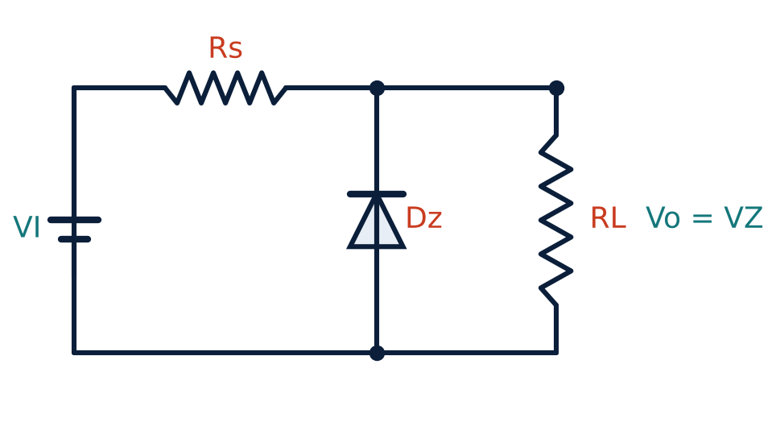
Zener shunt regulator
U3
Zener connected in reverse across the load RL.
Series resistor Rs limits current and drops the excess voltage.
Vo = VZ as long as the Zener stays in breakdown.
IS = IZ + IL; Rs = (VI − VZ)/IS.
Notes:
The voltage across the Zener remains steady at its breakdown voltage for all values of Zener current in the breakdown region.

Slide 4
Types of regulation
U3
Line regulation
Load regulation
Limits
Input voltage varies, RL fixed. Extra current flows through the Zener; Vo stays at VZ.
Input fixed, RL varies. Zener current changes to take up the difference; Vo stays at VZ.
Needs IZ ≥ IZmin always and IZ ≤ IZmax; so VImin and VImax and RL(min) are bounded.
Notes:
Regulation works only while the Zener stays in breakdown.

Slide 5
Design equations
U3
RS = (VI(min) − VZ)/(IZmin + IL(max))
IZ(max) = PZ / VZ
RS ≥ (VI(max) − VZ)/(IZmax + IL(min))
ensures Zener stays ON
power limit
protects the Zener
Choose VZ = VL (required output).
Power in Rs: PRS = IS² RS (choose a suitable wattage).
Notes:
The series resistor must be small enough to keep the Zener in breakdown at minimum input and large enough to protect it at maximum input.

Slide 6
Numerical 1 (from notes)
U3
Problem A 5 V supply from 12 V DC using a 5 V, 2 W Zener. Find the maximum Zener current and the minimum series resistance.
IZmax = PZ/VZ = 2/5 = 0.4 A
Rs(min) = (VI − VZ)/IZmax = (12 − 5)/0.4
Answer: IZmax = 0.4 A, Rs(min) = 17.5 Ω
Notes:
With no load all the current flows through the Zener, so this is the worst case.

Slide 7
Numerical 2: design a regulator
U3
Problem Design a 5 V regulator from 12 V for a 100 Ω load. Choose IZ = 10 mA at full load.
IL = 5/100 = 50 mA; IS = IZ + IL = 60 mA
Rs = (12 − 5)/0.060 = 116.7 Ω → choose 120 Ω
No load: IZ = 7/120 = 58 mA → PZ = 0.29 W: use a 0.5 W Zener
PRS = IS² Rs = 0.06² × 120 = 0.43 W: use a 1 W resistor
Answer: Rs ≈ 120 Ω, 5 V / 0.5 W Zener, 1 W resistor
Notes:
Always check the no load condition.

Slide 8
Limitations
U3
Poor efficiency: power is wasted in Rs and the Zener.
Output voltage fixed at VZ; limited load current.
Ripple not fully removed: dynamic resistance rz.
Better: IC regulators such as the 78XX series (Unit 5).
Notes:
For higher currents, series pass transistors or IC regulators are used.

Slide 9
Key takeaways
U3
Vo = VZ while the Zener is in breakdown
IS = IZ + IL, Rs = (VI − VZ)/IS
Line regulation: VI varies; load regulation: RL varies
Check the no-load and full-load limits
Notes:
To summarise this topic. Vo = VZ while the Zener is in breakdown. IS = IZ + IL, Rs = (VI − VZ)/IS. Line regulation: VI varies; load regulation: RL varies. Check the no-load and full-load limits.

Slide 10
Practice questions
U3
Q1. Explain with a circuit how a Zener regulates voltage.
Q2. A 12 V supply feeds a 6.2 V Zener, Rs = 100 Ω, RL = 200 Ω. Find IL, IS, IZ.
Q3. Find the Zener power if RL is removed.
Q4. Differentiate line regulation from load regulation.
Notes:
Attempt these on your own, then check your working against your notes and textbook. Explain with a circuit how a Zener regulates voltage. A 12 V supply feeds a 6.2 V Zener, Rs = 100 Ω, RL = 200 Ω. Find IL, IS, IZ. Find the Zener power if RL is removed. Differentiate line regulation from load regulation.

