Slide 1

UNIT 4 · 9 hours
BJT as a Switch
Transistors
Basic Electrical and Electronics Engineering (EEE103)
Dr. Mitesh Astik · Dept. of Electrical and Electronics Engineering
NMAM Institute of Technology, Nitte · 2025-26
Notes:
Welcome. In this session we study "BJT as a Switch", part of Unit 4 (Transistors) of Basic Electrical and Electronics Engineering.

Slide 2
Learning objectives
U4
Identify cut-off, active and saturation regions
Explain how a BJT acts as an open/closed switch
Design base resistance for saturation
Apply the switch to drive an LED/relay
Syllabus context
Construction and operation, BJT as a switch, working and characteristics of n-channel enhancement type MOSFET, common source amplifier, DC load line analysis, MOS inverter.
Notes:
By the end of this topic you should be able to do the following. Identify cut-off, active and saturation regions. Explain how a BJT acts as an open/closed switch. Design base resistance for saturation. Apply the switch to drive an LED/relay.

Slide 3
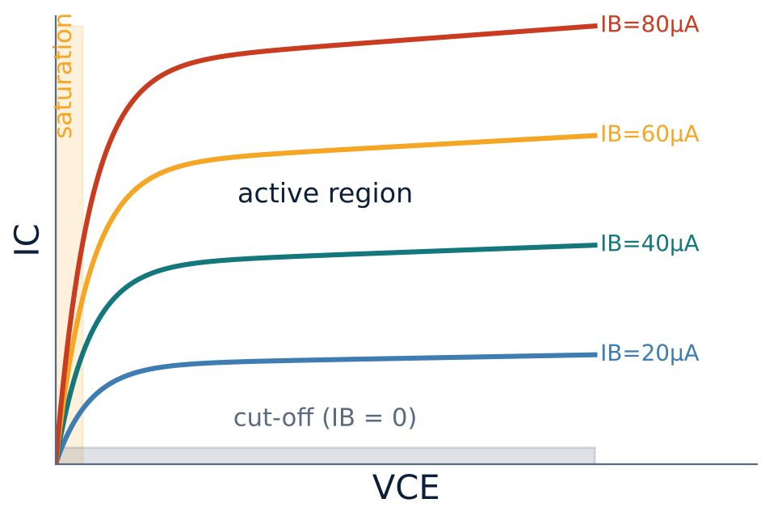
Output characteristics and regions
U4
Cut-off: IB = 0, IC ≈ 0 (junctions reverse biased).
Active: IC = β IB; used for amplification.
Saturation: both junctions forward biased; VCE(sat) ≈ 0.2 V.
Switch uses only cut-off and saturation.
Notes:
A BJT can be used as a switch when its operating point is moved between saturation and cut off.

Slide 4
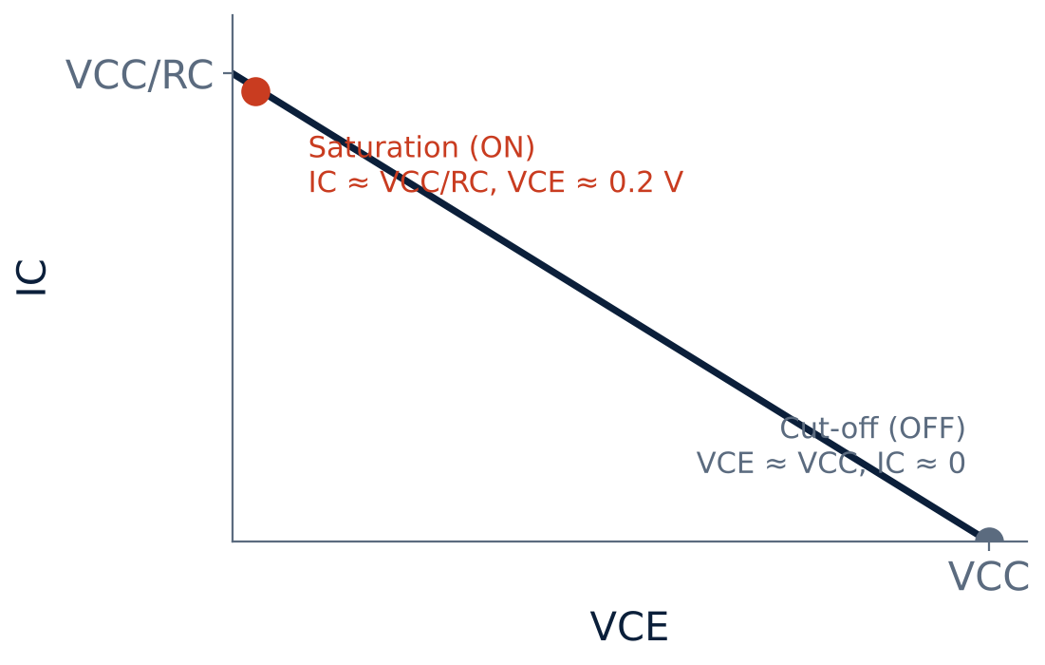
DC load line and the two switch states
U4
Load line: VCE = VCC − IC RC.
OFF: VCE ≈ VCC, IC ≈ 0 (open switch).
ON: IC ≈ VCC/RC, VCE ≈ 0.2 V (closed switch).
Notes:
The load line joins VCC on the horizontal axis to VCC over R C on the vertical axis.

Slide 5
OFF state versus ON state
U4
OFF: cut-off
ON: saturation
VBB (input) = 0 V, so IB = 0
Both junctions reverse biased
IC ≈ 0: open switch
VCE ≈ VCC; LED off
Input high; IB large enough
Both junctions forward biased
IC(sat) ≈ VCC/RC: closed switch
VCE(sat) ≈ 0.2 V; LED on
Notes:
When VBB is zero the base current is zero and the transistor is off, corresponding to an open switch.

Slide 6
Design for saturation
U4
IC(sat) ≈ (VCC − VCE(sat)) / RC
IB(min) = IC(sat) / β
RB = (Vin − VBE) / IB
load current
minimum base current
choose IB ≥ 2–5 × IB(min)
Notes:
Overdrive the base to guarantee saturation even when beta varies.

Slide 7
Numerical: transistor switch design
U4
Problem VCC = 10 V, RC = 1 kΩ, β = 100, Vin = 5 V (high). Find IC(sat), IB(min) and RB for IB = 2 × IB(min).
IC(sat) = (10 − 0.2)/1 kΩ = 9.8 mA
IB(min) = 9.8 mA/100 = 98 µA; IB = 196 µA
RB = (5 − 0.7)/196 µA
Answer: RB ≈ 22 kΩ
Notes:
A standard value of twenty two kilohms would be used.

Slide 8
LED switch application
U4
A 2 s square wave on the input: LED on for 1 s, off for 1 s.
Input low (0 V): transistor in cut-off, no collector current, LED off.
Input high: transistor saturates, collector current flows through the LED, LED on.
Other uses: relay/motor drivers, digital logic gates, inverters.
Notes:
A transistor used as a switch is the basis of digital logic circuits.

Slide 9
Key takeaways
U4
Switch uses cut-off (OFF) and saturation (ON)
ON: IC ≈ VCC/RC, VCE(sat) ≈ 0.2 V; OFF: IC ≈ 0, VCE ≈ VCC
Design IB ≥ IC(sat)/β with overdrive
Used in LED/relay drivers and digital logic
Notes:
To summarise this topic. Switch uses cut-off (OFF) and saturation (ON). ON: IC ≈ VCC/RC, VCE(sat) ≈ 0.2 V; OFF: IC ≈ 0, VCE ≈ VCC. Design IB ≥ IC(sat)/β with overdrive. Used in LED/relay drivers and digital logic.

Slide 10
Practice questions
U4
Q1. Explain the operation of a BJT as a switch with a diagram.
Q2. Find RB for VCC = 5 V, RC = 500 Ω, β = 50, Vin = 5 V, overdrive 2.
Q3. State the conditions for cut-off and saturation.
Q4. Why must the transistor not be left in the active region when used as a switch?
Notes:
Attempt these on your own, then check your working against your notes and textbook. Explain the operation of a BJT as a switch with a diagram. Find RB for VCC = 5 V, RC = 500 Ω, β = 50, Vin = 5 V, overdrive 2. State the conditions for cut-off and saturation. Why must the transistor not be left in the active region when used as a switch?

