Slide 1

UNIT 4 · 9 hours
n-Channel Enhancement MOSFET: Working and Characteristics
Transistors
Basic Electrical and Electronics Engineering (EEE103)
Dr. Mitesh Astik · Dept. of Electrical and Electronics Engineering
NMAM Institute of Technology, Nitte · 2025-26
Notes:
Welcome. In this session we study "n-Channel Enhancement MOSFET: Working and Characteristics", part of Unit 4 (Transistors) of Basic Electrical and Electronics Engineering.

Slide 2
Learning objectives
U4
Describe the structure of the n-channel enhancement MOSFET
Explain channel formation and the threshold voltage
Explain pinch-off and saturation
Interpret drain and transfer characteristics
Syllabus context
Construction and operation, BJT as a switch, working and characteristics of n-channel enhancement type MOSFET, common source amplifier, DC load line analysis, MOS inverter.
Notes:
By the end of this topic you should be able to do the following. Describe the structure of the n-channel enhancement MOSFET. Explain channel formation and the threshold voltage. Explain pinch-off and saturation. Interpret drain and transfer characteristics.

Slide 3
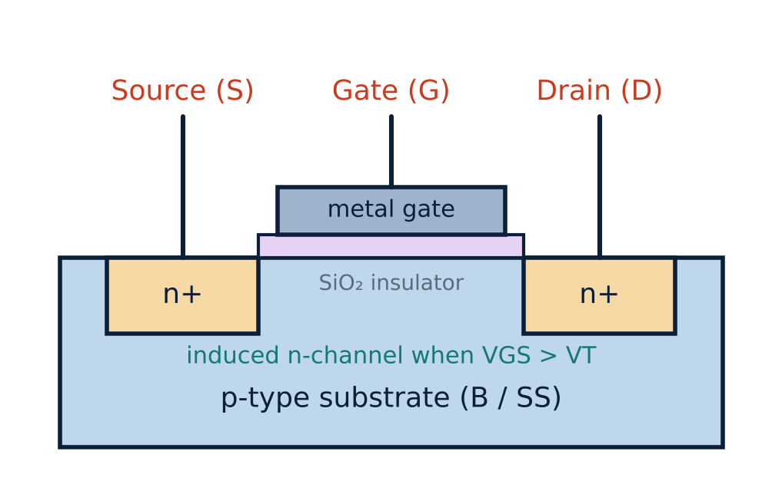
Structure
U4
p-type substrate (body) with two n+ regions: source and drain.
Gate: metal over a thin SiO₂ insulator: no gate current.
Four terminals: G, D, S and substrate (SS).
No channel exists at VGS = 0: 'enhancement' type.
Notes:
There is no direct electrical connection between the gate and the channel.

Slide 4
Operation
U4
1
2
3
4
VGS = 0
VGS > VT
More VGS
VDS rises
No channel; the two n+ regions are separated by the p-substrate: ID = 0.
Positive gate repels holes and attracts electrons to the surface: an n-channel forms.
More carriers; channel conductivity and ID rise.
Channel narrows near the drain (pinch-off); ID saturates.
Pinch-off at VDS(sat) = VGS − VT; typical VT ≈ 1–3 V.
Notes:
The level of V G S that causes a significant increase in drain current is the threshold voltage V T.

Slide 5
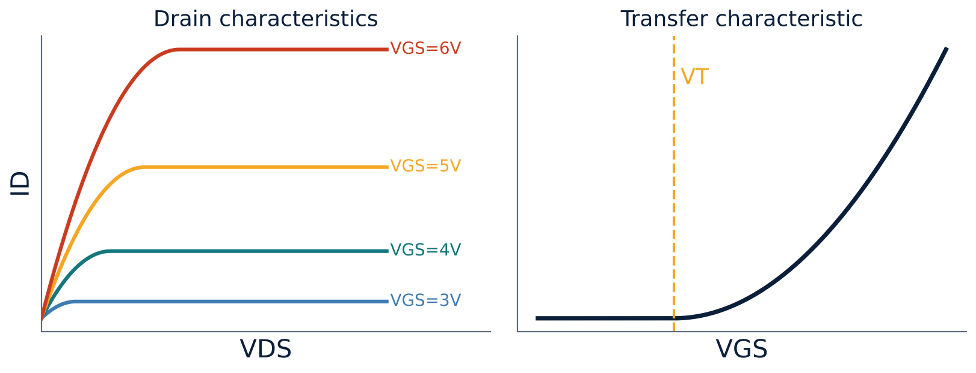
Drain and transfer characteristics
U4
Cut-off: VGS < VT, ID = 0.
Ohmic (triode): VDS < VGS − VT: ID = k[2(VGS − VT)VDS − VDS²].
Saturation: VDS ≥ VGS − VT: ID = k (VGS − VT)².
k ≈ 0.278 mA/V² in the notes' example.
Notes:
On both characteristics, the drain current increases as V G S increases.

Slide 6
Regions of operation
U4
Region | Condition | ID | Use
Cut-off | VGS < VT | 0 | Switch OFF
Triode / ohmic | VGS > VT, VDS < VGS − VT | k[2(VGS−VT)VDS − VDS²] | Switch ON, resistor
Saturation | VGS > VT, VDS ≥ VGS − VT | k(VGS − VT)² | Amplifier
Notes:
Careful: the saturation region of a MOSFET is the constant current region, not the same as the BJT saturation.

Slide 7
Numerical: drain current
U4
Problem n-channel enhancement MOSFET, k = 0.278 mA/V², VT = 2 V, VGS = 6 V. Check the region and find ID if VDS = 8 V.
VGS − VT = 4 V; VDS = 8 V ≥ 4 V → saturation
ID = k (VGS − VT)² = 0.278 × 4²
Answer: ID = 4.45 mA
Notes:
If VDS were 2 V the transistor would be in the ohmic region and the other expression would be used.

Slide 8
MOSFET versus BJT
U4
MOSFET
BJT
Voltage controlled (VGS)
Very high input resistance
Unipolar (one carrier)
Small area; dominant in ICs
Current controlled (IB)
Moderate input resistance
Bipolar (two carriers)
Higher gm for same current
Notes:
The MOSFET is the basic building block of VLSI circuits and microprocessors.

Slide 9
Key takeaways
U4
Gate insulated by SiO₂: no gate current
Channel forms for VGS > VT
Saturation: ID = k(VGS − VT)², VDS(sat) = VGS − VT
Voltage-controlled device with very high input impedance
Notes:
To summarise this topic. Gate insulated by SiO₂: no gate current. Channel forms for VGS > VT. Saturation: ID = k(VGS − VT)², VDS(sat) = VGS − VT. Voltage-controlled device with very high input impedance.

Slide 10
Practice questions
U4
Q1. Explain channel formation in an n-channel enhancement MOSFET.
Q2. k = 0.5 mA/V², VT = 1.5 V, VGS = 4 V in saturation. Find ID.
Q3. Define threshold voltage and pinch-off.
Q4. Why is it called enhancement type?
Notes:
Attempt these on your own, then check your working against your notes and textbook. Explain channel formation in an n-channel enhancement MOSFET. k = 0.5 mA/V², VT = 1.5 V, VGS = 4 V in saturation. Find ID. Define threshold voltage and pinch-off. Why is it called enhancement type?

