Slide 1

UNIT 4 · 9 hours
MOS Inverter and CMOS
Transistors
Basic Electrical and Electronics Engineering (EEE103)
Dr. Mitesh Astik · Dept. of Electrical and Electronics Engineering
NMAM Institute of Technology, Nitte · 2025-26
Notes:
Welcome. In this session we study "MOS Inverter and CMOS", part of Unit 4 (Transistors) of Basic Electrical and Electronics Engineering.

Slide 2
Learning objectives
U4
Explain the operation of an NMOS inverter with a resistive load
Explain the CMOS inverter with PMOS and NMOS
Draw the voltage transfer characteristic
State advantages of CMOS
Syllabus context
Construction and operation, BJT as a switch, working and characteristics of n-channel enhancement type MOSFET, common source amplifier, DC load line analysis, MOS inverter.
Notes:
By the end of this topic you should be able to do the following. Explain the operation of an NMOS inverter with a resistive load. Explain the CMOS inverter with PMOS and NMOS. Draw the voltage transfer characteristic. State advantages of CMOS.

Slide 3
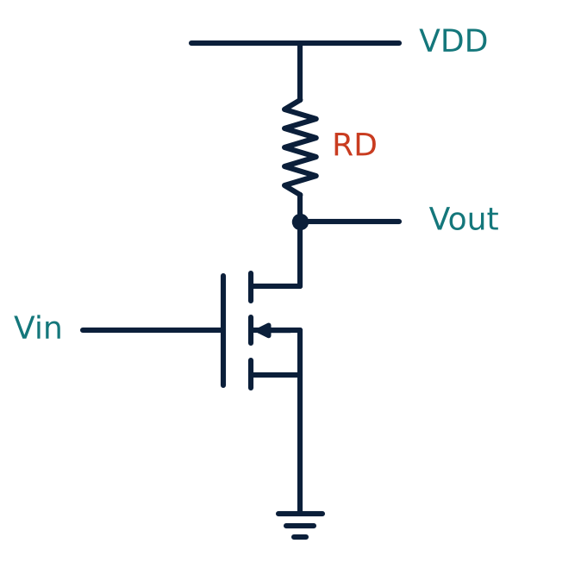
NMOS inverter (resistive load)
U4
Input at the gate, output at the drain; RD to VDD.
Vin low (< VT): MOSFET off, Vout = VDD = logic 1.
Vin high: MOSFET on, large current; Vout ≈ 0 = logic 0.
Logic NOT function.
Notes:
The MOS inverter converts a logic one into a logic zero and vice versa.

Slide 4
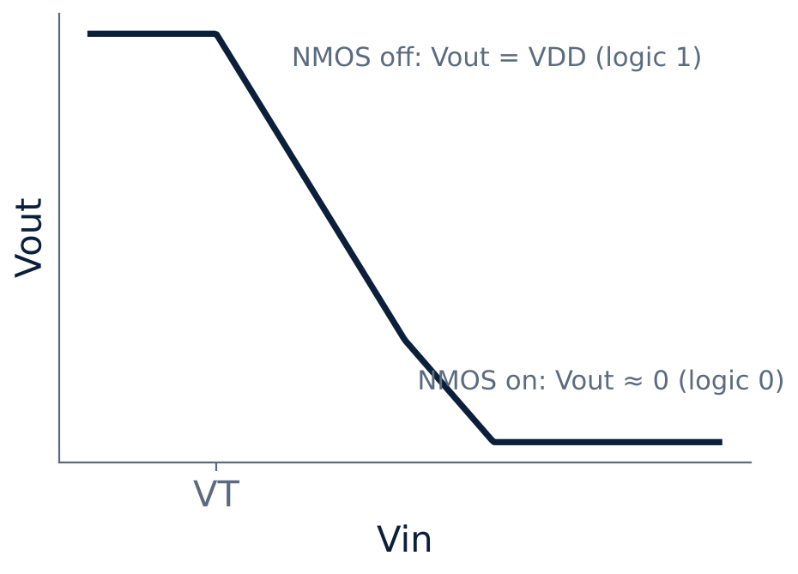
Voltage transfer characteristic
U4
Flat at VDD until Vin reaches VT.
Sharp transition region (high gain).
Low output level for Vin above transition.
Noise margins set by the transition voltages.
Notes:
The sharper the transition, the better the noise immunity of the logic family.

Slide 5
CMOS inverter
U4
Structure
Vin = 5 V (1)
Vin = 0 V (0)
A p-channel and an n-channel enhancement MOSFET on one substrate; gates joined as the input; drains joined as the output.
NMOS: VGS = 5 V, ON (low resistance). PMOS: VGS = 0 V, OFF. Output pulled to 0 V.
PMOS: VGS = −5 V, ON. NMOS: VGS = 0 V, OFF. Output pulled to 5 V.
Notes:
Hence the CMOS circuit acts as an inverter.

Slide 6
Truth table and device states (CMOS)
U4
Vin | NMOS | PMOS | Vout
0 V (logic 0) | OFF | ON | 5 V (logic 1)
5 V (logic 1) | ON | OFF | 0 V (logic 0)
One transistor is always OFF, so there is no DC path from VDD to ground.
Notes:
Only one transistor conducts at a time.

Slide 7
NMOS resistive load versus CMOS
U4
NMOS with RD
CMOS
One transistor + large resistor
Static power dissipated when output is low
Large area for resistor
Asymmetric rise/fall
Complementary pair
Almost zero static power
Full logic swing 0 to VDD
Basis of modern digital ICs
Notes:
CMOS dominates because its static power is nearly zero.

Slide 8
Key takeaways
U4
MOS inverter implements logic NOT
Resistive-load NMOS: Vin high → Vout low
CMOS: PMOS + NMOS, only one ON at a time
Very low static power; full-swing output
Notes:
To summarise this topic. MOS inverter implements logic NOT. Resistive-load NMOS: Vin high → Vout low. CMOS: PMOS + NMOS, only one ON at a time. Very low static power; full-swing output.

Slide 9
Practice questions
U4
Q1. Explain the working of a CMOS inverter.
Q2. Draw the VTC of an NMOS inverter.
Q3. Why does CMOS have almost zero static power?
Q4. State the output for Vin = 0 V in a 5 V CMOS inverter.
Notes:
Attempt these on your own, then check your working against your notes and textbook. Explain the working of a CMOS inverter. Draw the VTC of an NMOS inverter. Why does CMOS have almost zero static power? State the output for Vin = 0 V in a 5 V CMOS inverter.

