Slide 1

UNIT 5 · 9 hours
Integrator and Differentiator
Op-Amp and Linear IC Applications
Basic Electrical and Electronics Engineering (EEE103)
Dr. Mitesh Astik · Dept. of Electrical and Electronics Engineering
NMAM Institute of Technology, Nitte · 2025-26
Notes:
Welcome. In this session we study "Integrator and Differentiator", part of Unit 5 (Op-Amp and Linear IC Applications) of Basic Electrical and Electronics Engineering.

Slide 2
Learning objectives
U5
Draw and derive the op-amp integrator
Draw and derive the op-amp differentiator
Predict output waveforms for step, square and ramp inputs
Solve numericals
Syllabus context
Introduction, op-amp specifications, differential and common-mode operation, op-amp applications: inverting/non-inverting amplifier, summing, integrator, differentiator, comparator, 555 timer IC in astable mode, 78XX series IC voltage regulators.
Notes:
By the end of this topic you should be able to do the following. Draw and derive the op-amp integrator. Draw and derive the op-amp differentiator. Predict output waveforms for step, square and ramp inputs. Solve numericals.

Slide 3
Integrator: derivation
U5
1
2
3
4
Circuit
Current
Capacitor
Result
Input through R to the − node; capacitor C as feedback.
iR = vi/R (virtual ground); the same current charges C.
Q = C(0 − vo) = ∫ i dt.
vo = −(1/RC) ∫ vi dt.
Output is the (negative) time integral of the input. RC = time constant.
Notes:
The output voltage is the integral of the input voltage, scaled by one over R C.

Slide 4
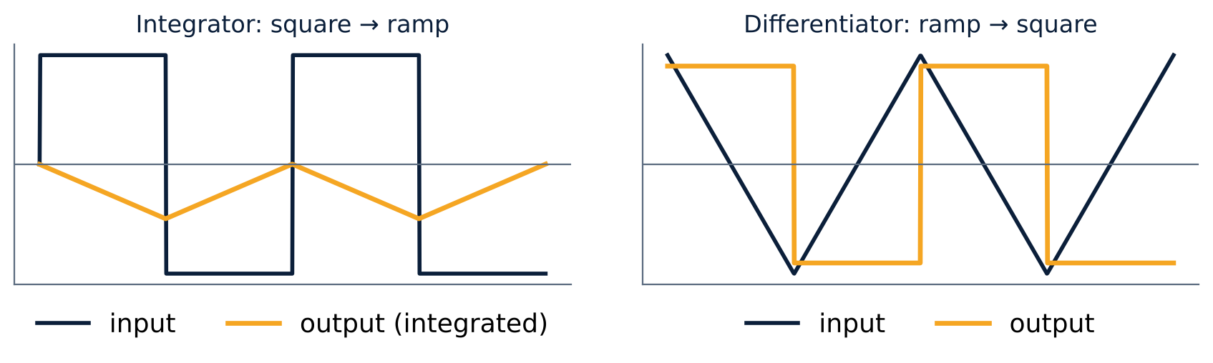
Waveforms
U5
Integrator: square wave → triangular wave.
DC input → ramp until saturation.
Differentiator: triangular input → square output.
Sine in → cosine out (90° shift).
Notes:
Integrator and differentiator are used for wave shaping.

Slide 5
Differentiator: derivation
U5
1
2
3
4
Circuit
Charge
Feedback
Result
Capacitor C at the input; resistor Rf as feedback.
q = C vi, so i = C dvi/dt.
The same i flows through R: i = (0 − vo)/R.
vo = −RC dvi/dt.
Practical circuits add a small series resistor and a feedback capacitor to limit high-frequency noise gain.
Notes:
The output is proportional to the rate of change of the input.

Slide 6
Integrator versus differentiator
U5
Integrator
Differentiator
C in the feedback path
vo = −(1/RC)∫vi dt
Acts as a low-pass filter
Used in ramp generators, ADCs, analog computers
C at the input, R in feedback
vo = −RC dvi/dt
Acts as a high-pass filter
Used in wave shaping, edge detection; noise-sensitive
Notes:
The differentiator amplifies high frequency noise so it must be used with care.

Slide 7
Numerical: integrator
U5
Problem R = 10 kΩ, C = 0.1 µF. A constant input of 1 V is applied at t = 0. Find vo at t = 5 ms.
RC = 10 kΩ × 0.1 µF = 1 ms
vo = −(1/RC) vi t = −(1 V/1 ms) × 5 ms
Answer: vo = −5 V
Notes:
The output ramps at minus one volt per millisecond until it saturates near the supply.

Slide 8
Numerical: differentiator
U5
Problem R = 10 kΩ, C = 0.1 µF. The input is a ramp of 1 V/ms. Find vo.
dvi/dt = 1 V/ms = 1000 V/s
vo = −RC dvi/dt = −(1 ms)(1000 V/s)
Answer: vo = −1 V (constant)
Notes:
A ramp differentiates to a constant.

Slide 9
Key takeaways
U5
Integrator: vo = −(1/RC)∫vi dt
Differentiator: vo = −RC dvi/dt
Square → triangle (integrator); triangle → square (differentiator)
Differentiator is noise-sensitive
Notes:
To summarise this topic. Integrator: vo = −(1/RC)∫vi dt. Differentiator: vo = −RC dvi/dt. Square → triangle (integrator); triangle → square (differentiator). Differentiator is noise-sensitive.

Slide 10
Practice questions
U5
Q1. Derive the output of an op-amp integrator.
Q2. R = 1 kΩ, C = 1 µF, square wave ±1 V, 500 Hz: find triangular peak-to-peak output.
Q3. Draw the output of a differentiator for a triangular input.
Q4. Why is a practical differentiator modified?
Notes:
Attempt these on your own, then check your working against your notes and textbook. Derive the output of an op-amp integrator. R = 1 kΩ, C = 1 µF, square wave ±1 V, 500 Hz: find triangular peak-to-peak output. Draw the output of a differentiator for a triangular input. Why is a practical differentiator modified?

