Slide 1

UNIT 5 · 9 hours
78XX Series IC Voltage Regulators
Op-Amp and Linear IC Applications
Basic Electrical and Electronics Engineering (EEE103)
Dr. Mitesh Astik · Dept. of Electrical and Electronics Engineering
NMAM Institute of Technology, Nitte · 2025-26
Notes:
Welcome. In this session we study "78XX Series IC Voltage Regulators", part of Unit 5 (Op-Amp and Linear IC Applications) of Basic Electrical and Electronics Engineering.

Slide 2
Learning objectives
U5
Explain the need for a regulated DC supply
Describe the 78XX three-terminal fixed regulators
Draw the standard connection with capacitors
Compute regulator power dissipation
Syllabus context
Introduction, op-amp specifications, differential and common-mode operation, op-amp applications: inverting/non-inverting amplifier, summing, integrator, differentiator, comparator, 555 timer IC in astable mode, 78XX series IC voltage regulators.
Notes:
By the end of this topic you should be able to do the following. Explain the need for a regulated DC supply. Describe the 78XX three-terminal fixed regulators. Draw the standard connection with capacitors. Compute regulator power dissipation.

Slide 3
Why IC regulators?
U5
A rectifier + filter gives DC that varies with mains and load.
A voltage regulator keeps VO constant against input, load and temperature variation.
IC regulators are simple three-terminal devices with built-in protection.
Better than a Zener regulator: higher current, lower output resistance.
Notes:
Electronic circuits need a stable DC voltage regardless of load current, temperature and supply variations.

Slide 4
The 78XX family
U5
Device | Output | Max current
7805 | +5 V | 1 A
7806 | +6 V | 1 A
7809 | +9 V | 1 A
7812 | +12 V | 1 A
7815 | +15 V | 1 A
79XX | negative voltages (7905 = −5 V) | 1 A
The last two digits give the output voltage; the 78 prefix means positive fixed regulator.
Notes:
The 78XX series are positive fixed voltage regulators.

Slide 5
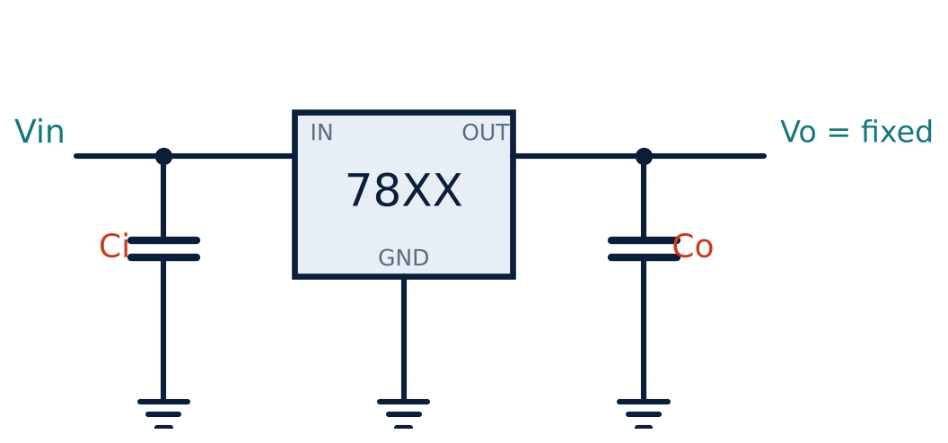
Standard connection
U5
Three terminals: IN, GND (common), OUT.
Input capacitor Ci (≈ 0.33 µF): cancels lead inductance, stabilises.
Output capacitor Co (≈ 0.1 µF): improves transient response.
Vin must exceed Vout by the dropout (≈ 2 V): e.g. ≥ 7 V for the 7805.
Notes:
The capacitors should be placed close to the regulator.

Slide 6
Features
U5
Fixed output
Built-in protection
Heat sinking
Accuracy about ±4 %; line regulation ≈ 0.01 %/V.
Thermal shutdown, short-circuit current limiting, safe-area protection.
Power dissipated = (Vin − Vout) × IL; use a heat sink above ≈ 1 W.
Notes:
The regulator can supply up to one ampere with an adequate heat sink.

Slide 7
Numerical: dissipation of a 7805
U5
Problem A 7805 is fed from 12 V and supplies 0.5 A. Find the power dissipated and the output power.
Voltage across regulator = 12 − 5 = 7 V
Pdiss = 7 V × 0.5 A = 3.5 W
Pout = 5 V × 0.5 A = 2.5 W; efficiency ≈ 2.5/(12 × 0.5) = 42 %
Answer: Pdiss = 3.5 W: needs a heat sink
Notes:
Linear regulators waste the excess voltage as heat, so keep the input only slightly above the dropout voltage.

Slide 8
Applications
U5
Power supplies for logic ICs (7805 for 5 V TTL/CMOS).
On-board regulation in microcontroller boards.
Adjustable output using a resistor from GND to ground (boost).
Current source: with a fixed resistor, I = Vreg/R.
Notes:
Complete power supply chain: transformer → rectifier → filter → 78XX → load.

Slide 9
Key takeaways
U5
78XX: positive 3-terminal fixed regulators; 7805 = +5 V
Need Vin ≥ Vout + ≈ 2 V
Ci and Co improve stability
Pdiss = (Vin − Vout) IL
Notes:
To summarise this topic. 78XX: positive 3-terminal fixed regulators; 7805 = +5 V. Need Vin ≥ Vout + ≈ 2 V. Ci and Co improve stability. Pdiss = (Vin − Vout) IL.

Slide 10
Practice questions
U5
Q1. Draw the connection of a 7812 and explain the capacitors.
Q2. A 7809 with Vin = 15 V supplies 0.4 A. Find Pdiss.
Q3. What are the built-in protections of a 78XX regulator?
Q4. What does 7912 denote?
Notes:
Attempt these on your own, then check your working against your notes and textbook. Draw the connection of a 7812 and explain the capacitors. A 7809 with Vin = 15 V supplies 0.4 A. Find Pdiss. What are the built-in protections of a 78XX regulator? What does 7912 denote?

