Slide 1

LABORATORY · Lab · 26 hours
Experiment 1: Step Response of a Second-Order System
Control Systems Laboratory (22EEG53)
Control Systems (22EEG53)
Dr. Mitesh Astik · Dept. of Electrical and Electronics Engineering
NMAM Institute of Technology, Nitte · 2025-26
Notes:
Welcome. In this session we study "Experiment 1: Step Response of a Second-Order System", part of Laboratory (Control Systems Laboratory (22EEG53)) of Control Systems.

Slide 2
Learning objectives
LAB
Obtain the step response for ζ = 0, underdamped, critically damped and overdamped cases
Observe the effect of ζ on overshoot and oscillation
Verify the response with the theoretical expressions
Syllabus context
Laboratory component of 22EEG53 Control Systems (0:0:2 hours per week). CIE: record and observation 25, viva-voce 5, lab test 20 marks.
Notes:
By the end of this topic you should be able to do the following. Obtain the step response for ζ = 0, underdamped, critically damped and overdamped cases. Observe the effect of ζ on overshoot and oscillation. Verify the response with the theoretical expressions.

Slide 3
Aim and requirements
LAB
Aim: to obtain the step response of a typical second-order system for undamped, underdamped, overdamped and critically damped cases using MATLAB/Simulink.
Software: MATLAB with the Control System Toolbox (Simulink where required).
Hardware: Personal computer.
System: G(s) = ωn²/(s² + 2ζωn s + ωn²), ωn = 5 rad/s.
Notes:
In this experiment we study how the damping ratio decides the shape of the step response.

Slide 4
Theory: damping cases
LAB
ζ | Poles | Response
0 | ±jωn | Undamped: sustained oscillation
0 < ζ < 1 | −ζωn ± jωd | Underdamped: overshoot, decaying oscillation
1 | −ωn (double) | Critically damped: fastest, no overshoot
> 1 | Real, distinct | Overdamped: slow, no overshoot
Notes:
ωd = ωn√(1 − ζ²) is the damped natural frequency.

Slide 5
Procedure
LAB
1
2
3
4
Define
Create TF
Simulate
Record
Enter ωn and the set of ζ values.
Use tf(wn^2, [1 2*zeta*wn wn^2]).
Use step(sys, t) on a common time axis.
Read Mp, tp, ts for the underdamped case; save plots.
Simulink alternative: Step → Transfer Fcn → Scope.
Notes:
For the Simulink version, use a step source, a transfer function block and a scope for each ζ.

Slide 6
MATLAB program
LAB
wn = 5; zeta = [0 0.3 0.7 1 2];
t = 0:0.01:6; hold on
for k = 1:length(zeta)
sys = tf(wn^2, [1 2*zeta(k)*wn wn^2]);
y = step(sys, t); plot(t, y, 'LineWidth', 1.5)
end
grid on; xlabel('Time (s)'); ylabel('c(t)')
legend('\zeta=0','0.3','0.7','1','2')
title('Step response of a second-order system')

Slide 7
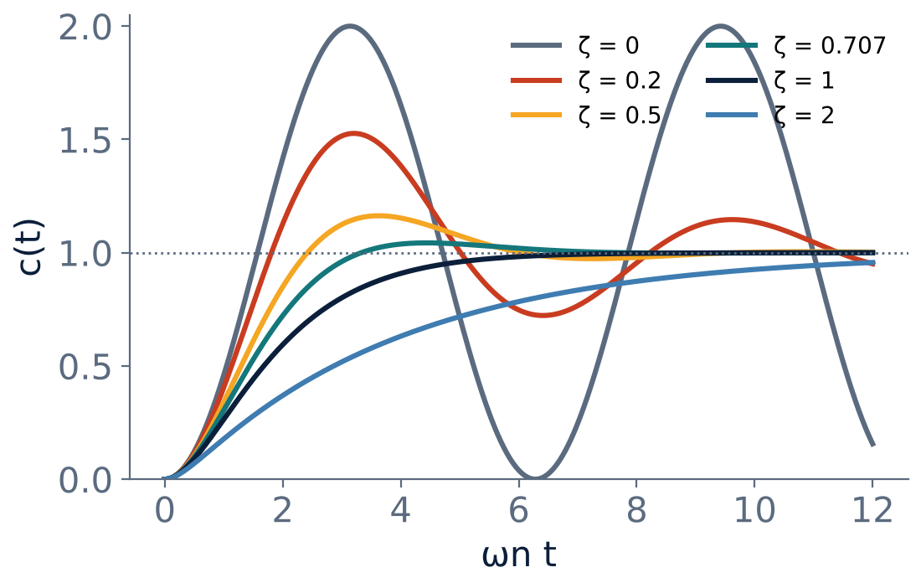
Expected results
LAB
ζ = 0: oscillates between 0 and 2.
ζ = 0.3: Mp ≈ 37 %.
ζ = 0.7: Mp ≈ 4.6 %.
ζ = 1: no overshoot, fastest.
ζ = 2: slow.
Notes:
Compare with the theoretical values. Use ωn t as the time axis in the normalised plot.

Slide 8
Observation table
LAB
ζ | Type | Mp (%) measured | Mp (%) theory | ts (s)
0 | Undamped | 100 | 100 | ∞
0.3 | Under |  | 37.2
0.7 | Under |  | 4.6
1 | Critical | 0 | 0
2 | Over | 0 | 0
Notes:
Fill in the measured values from the plots and compare with the formula Mp = exp(−πζ/√(1−ζ²)).

Slide 9
Key takeaways
LAB
ζ controls overshoot: small ζ → large overshoot
ζ = 1 is the fastest response without overshoot
MATLAB step() gives responses for all four cases
Measured values agree with theory
Notes:
To summarise this topic. ζ controls overshoot: small ζ → large overshoot. ζ = 1 is the fastest response without overshoot. MATLAB step() gives responses for all four cases. Measured values agree with theory.

Slide 10
Practice questions
LAB
Q1. What happens to the poles as ζ increases from 0 to 2?
Q2. Why does the ζ = 0 response not settle?
Q3. Write the MATLAB commands to get the step response.
Q4. For ωn = 5 and ζ = 0.5, find tp and Mp.
Notes:
Attempt these on your own, then check your working against your notes and textbook. What happens to the poles as ζ increases from 0 to 2? Why does the ζ = 0 response not settle? Write the MATLAB commands to get the step response. For ωn = 5 and ζ = 0.5, find tp and Mp.

