Slide 1

LABORATORY · Lab · 26 hours
Experiment 2: Effect of Addition of Poles and Zeros on Stability
Control Systems Laboratory (22EEG53)
Control Systems (22EEG53)
Dr. Mitesh Astik · Dept. of Electrical and Electronics Engineering
NMAM Institute of Technology, Nitte · 2025-26
Notes:
Welcome. In this session we study "Experiment 2: Effect of Addition of Poles and Zeros on Stability", part of Laboratory (Control Systems Laboratory (22EEG53)) of Control Systems.

Slide 2
Learning objectives
LAB
Observe how an added open-loop pole or zero changes the root locus
Observe the effect on the step response
Relate the result to stability and relative stability
Syllabus context
Laboratory component of 22EEG53 Control Systems (0:0:2 hours per week). CIE: record and observation 25, viva-voce 5, lab test 20 marks.
Notes:
By the end of this topic you should be able to do the following. Observe how an added open-loop pole or zero changes the root locus. Observe the effect on the step response. Relate the result to stability and relative stability.

Slide 3
Aim and requirements
LAB
Aim: to study the effect of adding poles and zeros to a system on its stability using MATLAB.
Software: MATLAB with the Control System Toolbox (Simulink where required).
Hardware: Personal computer.
Base system: G(s) = K/[s(s + 2)] with unity feedback.
Notes:
We add a pole or a zero to the open loop and see how the closed loop behaviour changes.

Slide 4
Theory
LAB
Adding a pole
Adding a zero
Closed-loop effect
Bends the locus to the right: reduces stability, lower damping, may cause instability at high gain.
Bends the locus to the left: increases stability and damping; adds overshoot via derivative-like action.
Poles ⇒ slower response; zeros ⇒ faster response with more overshoot.
Notes:
Compare the locus with and without extra pole or zero.

Slide 5
Procedure
LAB
1
2
3
4
Base system
Add pole
Add zero
Compare
Plot root locus and step response of G = 1/(s(s+2)).
Multiply by 1/(s + p): e.g. p = 4.
Multiply by (s + z): e.g. z = 4.
Plot loci and closed-loop steps; note stability limits.
Observe the K for which the poles cross the jω axis.
Notes:
Use rlocus and step(feedback(...)) commands.

Slide 6
MATLAB program
LAB
G = tf(1, [1 2 0]); % base
G1 = tf(1, conv([1 2 0],[1 4])); % extra pole at -4
G2 = tf([1 4], [1 2 0]); % extra zero at -4
subplot(2,3,1), rlocus(G), title('base')
subplot(2,3,2), rlocus(G1), title('+ pole')
subplot(2,3,3), rlocus(G2), title('+ zero')
subplot(2,1,2), hold on
step(feedback(G,1)), step(feedback(G1,1)), step(feedback(G2,1))
legend('base','+pole','+zero'); grid on

Slide 7
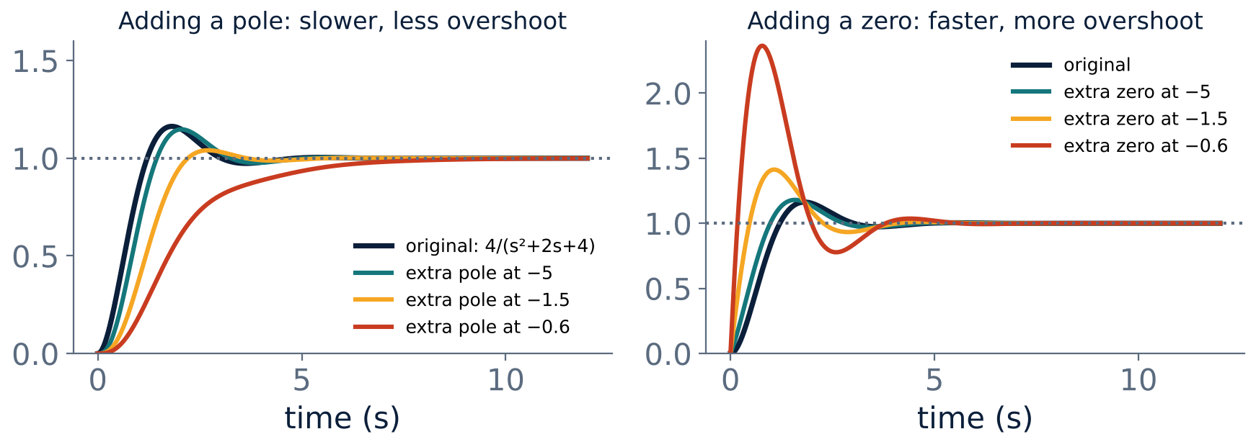
Expected step responses
LAB
Left: extra pole slows the response. Right: extra zero speeds it up and increases overshoot.
Notes:
These graphs use the example 4/(s²+2s+4) with a pole or zero added.

Slide 8
Observation table
LAB
Case | Locus bends | Stability limit (K) | Overshoot | Settling time
Base K/[s(s+2)] | Vertical | Stable for all K
+ pole at −4 | Right | Finite K
+ zero at −4 | Left | Stable for all K
Notes:
Record the gain at which the closed loop poles cross the imaginary axis.

Slide 9
Key takeaways
LAB
Adding a pole moves the locus right: less stable
Adding a zero moves the locus left: more stable
Poles slow the response; zeros speed it and increase overshoot
MATLAB rlocus and step show both effects
Notes:
To summarise this topic. Adding a pole moves the locus right: less stable. Adding a zero moves the locus left: more stable. Poles slow the response; zeros speed it and increase overshoot. MATLAB rlocus and step show both effects.

Slide 10
Practice questions
LAB
Q1. How does adding a pole change the stability of K/[s(s+2)]?
Q2. Which compensator adds a zero to the loop?
Q3. Write the MATLAB commands used.
Q4. Why does a zero increase overshoot?
Notes:
Attempt these on your own, then check your working against your notes and textbook. How does adding a pole change the stability of K/[s(s+2)]? Which compensator adds a zero to the loop? Write the MATLAB commands used. Why does a zero increase overshoot?

