Slide 1

LABORATORY · Lab · 26 hours
Experiment 4: Characteristics of Synchro Transmitter and Receiver Pair
Control Systems Laboratory (22EEG53)
Control Systems (22EEG53)
Dr. Mitesh Astik · Dept. of Electrical and Electronics Engineering
NMAM Institute of Technology, Nitte · 2025-26
Notes:
Welcome. In this session we study "Experiment 4: Characteristics of Synchro Transmitter and Receiver Pair", part of Laboratory (Control Systems Laboratory (22EEG53)) of Control Systems.

Slide 2
Learning objectives
LAB
Study the construction and principle of a synchro pair
Plot the receiver rotor angle versus transmitter angle
Plot the error voltage versus angular displacement
Understand its use as an error detector
Syllabus context
Laboratory component of 22EEG53 Control Systems (0:0:2 hours per week). CIE: record and observation 25, viva-voce 5, lab test 20 marks.
Notes:
By the end of this topic you should be able to do the following. Study the construction and principle of a synchro pair. Plot the receiver rotor angle versus transmitter angle. Plot the error voltage versus angular displacement. Understand its use as an error detector.

Slide 3
Aim and apparatus
LAB
Aim: to study the characteristics of a synchro transmitter and receiver pair.
Apparatus: synchro transmitter (CX) and control transformer/receiver (CT) trainer kit, AC supply, angular scales, voltmeter, connecting leads.
Use: error detector in position control systems.
Notes:
A synchro pair converts angular displacement into an electrical signal.

Slide 4
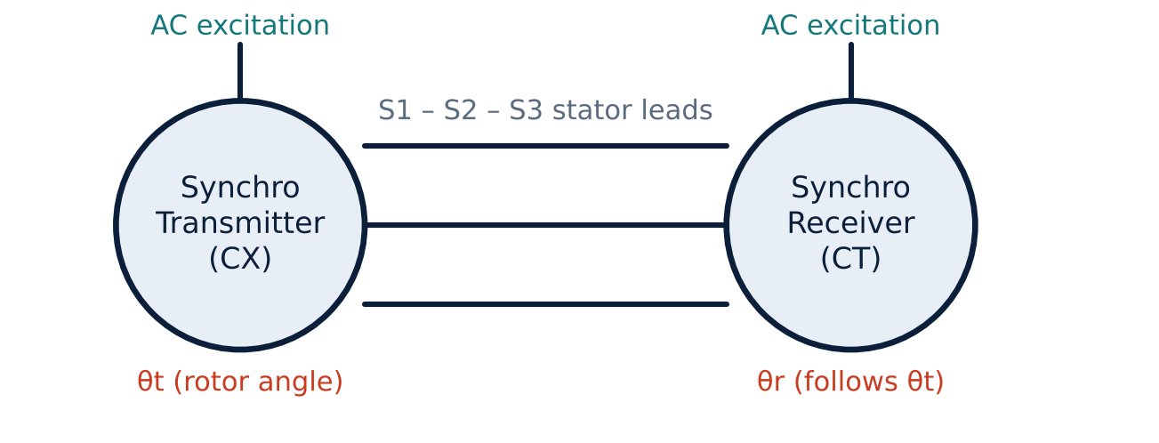
Synchro pair
LAB
Connection of synchro pair
Transmitter rotor excited from AC supply.
Three stator windings S1, S2, S3 at 120°.
Stator leads interconnected to the receiver.
Receiver output ∝ sin(θt − θr).
Notes:
The voltages induced in the stator depend on the rotor angle.

Slide 5
Theory
LAB
Synchro transmitter (CX)
Control transformer (CT)
Error detector
Single-phase rotor, three-phase stator. Stator voltages ∝ V cos(θ − 120°k).
Rotor output voltage ∝ sin(θt − θr): the error signal, used with an amplifier.
For small error e ≈ θt − θr: Ve = Ks (θt − θr), Ks in V/rad.
Notes:
The zero error position corresponds to alignment of rotors; rotor sense determines polarity.

Slide 6
Procedure
LAB
1
2
3
4
Connections
Set zero
Vary θt
Record
Connect S1–S1, S2–S2, S3–S3 of CX and CT; excite rotors from the same AC supply (as per kit).
Align both pointers to 0°.
Rotate the transmitter in steps of 10° (0°–360°).
Note receiver angle θr or error voltage Ve for each step; plot graphs.
Safety: keep the supply off while making connections.
Notes:
Use the manufacturer's connection diagram of the kit.

Slide 7
Observation table
LAB
θt (deg) | θr (deg) | Error θt − θr | Error voltage Ve (V)
0
30
60
90
120
... | ... | ... | ...
Notes:
Plot θr versus θt and Ve versus (θt − θr).

Slide 8
Expected results
LAB
θr follows θt closely: straight line at 45° (θr = θt).
Error voltage is sinusoidal in the error angle: zero at 0° and 180°, maximum at 90°.
Near zero error the relation is nearly linear: sensitivity Ks.
Small residual error arises from friction and loading.
Notes:
The linear region around the null is used in closed loop control.

Slide 9
Key takeaways
LAB
Synchro pair transmits angular position electrically
CT output ∝ sin(θt − θr): error signal
Linear near the null; used as error detector
Plot θr vs θt and Ve vs error angle
Notes:
To summarise this topic. Synchro pair transmits angular position electrically. CT output ∝ sin(θt − θr): error signal. Linear near the null; used as error detector. Plot θr vs θt and Ve vs error angle.

Slide 10
Practice questions
LAB
Q1. Explain the construction of a synchro transmitter.
Q2. Why is the CT output zero when the rotors are aligned?
Q3. Define synchro sensitivity.
Q4. Name two applications of synchros.
Notes:
Attempt these on your own, then check your working against your notes and textbook. Explain the construction of a synchro transmitter. Why is the CT output zero when the rotors are aligned? Define synchro sensitivity. Name two applications of synchros.

