Slide 1

LABORATORY · Lab · 26 hours
Experiment 5: Root Locus, Breakaway and Imaginary-Axis Crossover
Control Systems Laboratory (22EEG53)
Control Systems (22EEG53)
Dr. Mitesh Astik · Dept. of Electrical and Electronics Engineering
NMAM Institute of Technology, Nitte · 2025-26
Notes:
Welcome. In this session we study "Experiment 5: Root Locus, Breakaway and Imaginary-Axis Crossover", part of Laboratory (Control Systems Laboratory (22EEG53)) of Control Systems.

Slide 2
Learning objectives
LAB
Plot the root locus of a given transfer function
Verify the breakaway point analytically and in MATLAB
Find the imaginary-axis crossing and the marginal gain
Relate the gain to damping
Syllabus context
Laboratory component of 22EEG53 Control Systems (0:0:2 hours per week). CIE: record and observation 25, viva-voce 5, lab test 20 marks.
Notes:
By the end of this topic you should be able to do the following. Plot the root locus of a given transfer function. Verify the breakaway point analytically and in MATLAB. Find the imaginary-axis crossing and the marginal gain. Relate the gain to damping.

Slide 3
Aim and requirements
LAB
Aim: to draw the root locus for a given transfer function and verify the breakaway point and imaginary-axis crossover point using MATLAB.
Software: MATLAB with the Control System Toolbox (Simulink where required).
Hardware: Personal computer.
System: G(s)H(s) = K/[s(s + 1)(s + 2)].
Notes:
We verify the hand calculation of the root locus rules using MATLAB.

Slide 4
Hand calculations
LAB
Asymptotes 60°, 180°, 300°
Breakaway: 3s² + 6s + 2 = 0
Routh: K = 6
centroid σA = −1
s = −0.423 (on locus)
jω crossing at ±j1.414
Notes:
These are the expected results.

Slide 5
Procedure
LAB
1
2
3
4
Define G
Plot
Breakaway
Crossover
G = tf(1, [1 3 2 0]).
rlocus(G); sgrid or zeta lines.
Click on the locus or compute roots of d/ds of the characteristic polynomial.
rlocfind or margin: K at the jω-axis intersection.
Check with Routh: marginal gain K = 6.
Notes:
Use data tips on the plot to read K at selected points.

Slide 6
MATLAB program
LAB
G = tf(1, [1 3 2 0]);
rlocus(G); sgrid; grid on
% breakaway: roots of dK/ds = 0, K = -s(s+1)(s+2)
p = conv([1 0], conv([1 1], [1 2]));
ds = roots(polyder(p)) % -0.4226, -1.5774
K_b = -polyval(p, ds(1)) % gain at breakaway = 0.385
% imaginary axis crossing
[Gm, ~, wpc] = margin(G) % Gm = 6, wpc = 1.414
K_marginal = Gm

Slide 7
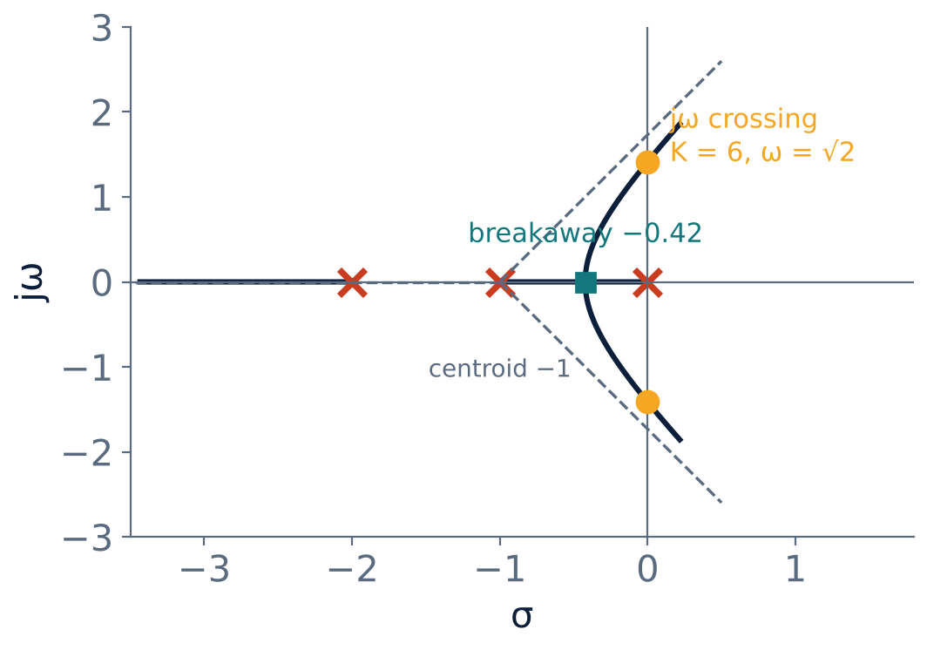
Expected root locus
LAB
Breakaway at −0.423 (K = 0.385).
Crossing at ±j1.414 for K = 6.
Asymptotes at ±60°, 180°.
Notes:
Compare with your MATLAB figure.

Slide 8
Observation table
LAB
Quantity | Hand calculation | MATLAB
Breakaway point | −0.423
Gain at breakaway | 0.385
Imaginary-axis crossing | ±j1.414
Marginal gain K | 6
Notes:
The two should agree within reading accuracy.

Slide 9
Key takeaways
LAB
rlocus plots the locus; sgrid shows ζ and ωn lines
Breakaway: dK/ds = 0 → −0.423
Marginal stability at K = 6, ω = 1.414 rad/s
MATLAB results agree with Routh and the rules
Notes:
To summarise this topic. rlocus plots the locus; sgrid shows ζ and ωn lines. Breakaway: dK/ds = 0 → −0.423. Marginal stability at K = 6, ω = 1.414 rad/s. MATLAB results agree with Routh and the rules.

Slide 10
Practice questions
LAB
Q1. List the steps to sketch the locus of K/[s(s+1)(s+2)].
Q2. Write the MATLAB commands for the locus.
Q3. Find K for ζ = 0.5 using rlocfind.
Q4. What happens for K > 6?
Notes:
Attempt these on your own, then check your working against your notes and textbook. List the steps to sketch the locus of K/[s(s+1)(s+2)]. Write the MATLAB commands for the locus. Find K for ζ = 0.5 using rlocfind. What happens for K > 6?

