Slide 1

LABORATORY · Lab · 26 hours
Experiment 7: Design of a PID Controller Using Tuning Methods
Control Systems Laboratory (22EEG53)
Control Systems (22EEG53)
Dr. Mitesh Astik · Dept. of Electrical and Electronics Engineering
NMAM Institute of Technology, Nitte · 2025-26
Notes:
Welcome. In this session we study "Experiment 7: Design of a PID Controller Using Tuning Methods", part of Laboratory (Control Systems Laboratory (22EEG53)) of Control Systems.

Slide 2
Learning objectives
LAB
Design a PID controller using Ziegler–Nichols tuning
Simulate the closed-loop step response
Compare P, PI and PID responses
Fine-tune the gains
Syllabus context
Laboratory component of 22EEG53 Control Systems (0:0:2 hours per week). CIE: record and observation 25, viva-voce 5, lab test 20 marks.
Notes:
By the end of this topic you should be able to do the following. Design a PID controller using Ziegler–Nichols tuning. Simulate the closed-loop step response. Compare P, PI and PID responses. Fine-tune the gains.

Slide 3
Aim and requirements
LAB
Aim: to design a PID controller using tuning methods in MATLAB.
Software: MATLAB with the Control System Toolbox (Simulink where required).
Hardware: Personal computer.
Plant: G(s) = 1/[s(s + 1)(s + 2)]; Kcr = 6, ωcr = 1.414 rad/s, Pcr = 4.44 s.
Notes:
The Ziegler Nichols ultimate gain method is used.

Slide 4
Ziegler–Nichols settings
LAB
Controller | Kp | Ti | Td
P | 0.5 Kcr | ∞ | 0
PI | 0.45 Kcr | Pcr/1.2 | 0
PID | 0.6 Kcr | 0.5 Pcr | 0.125 Pcr
PID values here: Kp = 3.6, Ti = 2.22 s, Td = 0.555 s.
Notes:
Obtain Kcr and Pcr from the root locus or Routh array.

Slide 5
Procedure
LAB
1
2
3
4
5
Find Kcr
Compute settings
Build controller
Simulate
Fine-tune
Use margin(G) or Routh: K = 6 gives sustained oscillation.
step(feedback(C*G, 1)); compare with P, PI.
Adjust to reduce overshoot.
Apply the ZN table.
C = pid(Kp, Ki, Kd).
Notes:
ZN gives a starting point; typical overshoot is 25 to 60 percent and needs fine tuning.

Slide 6
MATLAB program
LAB
G = tf(1, conv([1 0], conv([1 1], [1 2])));
[Gm, ~, wcr] = margin(G); Kcr = Gm; Pcr = 2*pi/wcr;
Kp = 0.6*Kcr; Ti = 0.5*Pcr; Td = 0.125*Pcr;
C_pid = pid(Kp, Kp/Ti, Kp*Td);
C_pi = pid(0.45*Kcr, 0.45*Kcr/(Pcr/1.2));
C_p = pid(0.5*Kcr);
t = 0:0.05:40; hold on
step(feedback(C_p*G,1), t), step(feedback(C_pi*G,1), t), step(feedback(C_pid*G,1), t)
legend('P','PI','PID'); grid on

Slide 7
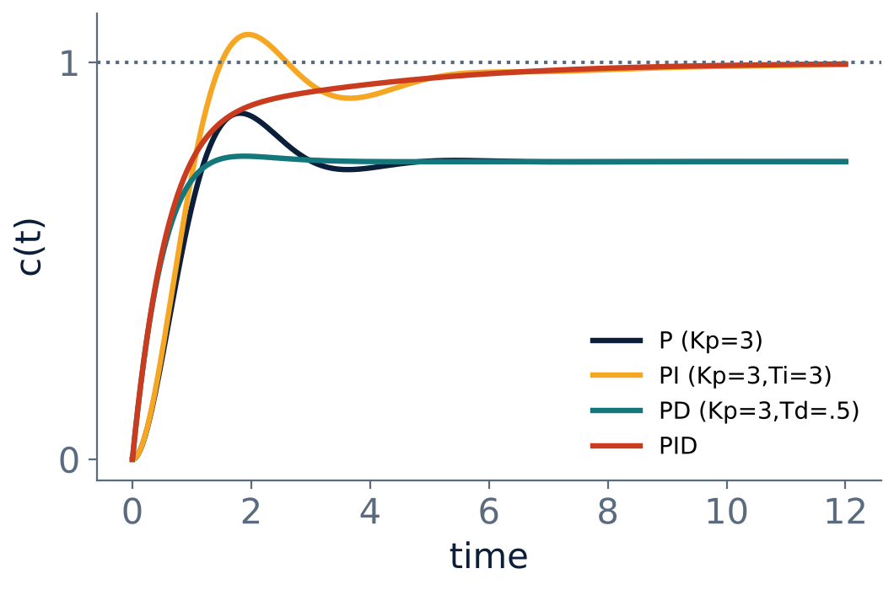
Typical responses (illustration)
LAB
PID gives lowest steady-state error with acceptable overshoot.
P alone leaves error for type-0 plants.
Fine-tune Kd to damp oscillation.
Notes:
The illustration uses a different plant, but the trends are the same.

Slide 8
Observation table
LAB
Controller | Kp | Ki | Kd | Mp (%) | ts (s) | ess
P
PI
PID | 3.6 | 1.62 | 2.0
Notes:
Record Mp, ts and ess from stepinfo.

Slide 9
Key takeaways
LAB
Find Kcr and Pcr, then use ZN formulas
PID: Kp = 0.6Kcr, Ti = 0.5Pcr, Td = 0.125Pcr
I removes the steady-state error; D adds damping
Fine-tune after ZN to reduce overshoot
Notes:
To summarise this topic. Find Kcr and Pcr, then use ZN formulas. PID: Kp = 0.6Kcr, Ti = 0.5Pcr, Td = 0.125Pcr. I removes the steady-state error; D adds damping. Fine-tune after ZN to reduce overshoot.

Slide 10
Practice questions
LAB
Q1. List the ZN settings for P, PI and PID.
Q2. Find Kcr and Pcr for K/[s(s+2)(s+4)].
Q3. Effect of Kd on overshoot?
Q4. Write the MATLAB command to create a PID controller.
Notes:
Attempt these on your own, then check your working against your notes and textbook. List the ZN settings for P, PI and PID. Find Kcr and Pcr for K/[s(s+2)(s+4)]. Effect of Kd on overshoot? Write the MATLAB command to create a PID controller.

