Slide 1

UNIT 1 · 8 hours
Signal Flow Graphs and Mason's Gain Formula
Introduction and Mathematical Modelling of Physical Systems
Control Systems (22EEG53)
Dr. Mitesh Astik · Dept. of Electrical and Electronics Engineering
NMAM Institute of Technology, Nitte · 2025-26
Notes:
Welcome. In this session we study "Signal Flow Graphs and Mason's Gain Formula", part of Unit 1 (Introduction and Mathematical Modelling of Physical Systems) of Control Systems.

Slide 2
Learning objectives
U1
Define the terms of a signal flow graph
Draw an SFG from equations or a block diagram
Identify forward paths, loops and non-touching loops
Apply Mason's gain formula
Syllabus context
Introduction and mathematical modelling of physical systems: open loop and closed loop systems, examples, control system components. Transfer function of physical systems: mechanical systems (translational and rotational), electrical systems, analogous systems, block diagram reduction techniques, signal flow graphs.
Notes:
By the end of this topic you should be able to do the following. Define the terms of a signal flow graph. Draw an SFG from equations or a block diagram. Identify forward paths, loops and non-touching loops. Apply Mason's gain formula.

Slide 3
Signal flow graph (SFG) terminology
U1
Node and branch
Path and forward path
Loop
Node = variable; branch = directed line with a gain (transmittance). Input node (source), output node (sink), mixed node.
A path follows branch directions without repeating a node. Forward path: from input to output.
A closed path that returns to the same node; loop gain = product of branch gains. Non-touching loops share no node.
Notes:
An SFG is a graphical representation of a set of linear algebraic equations.

Slide 4
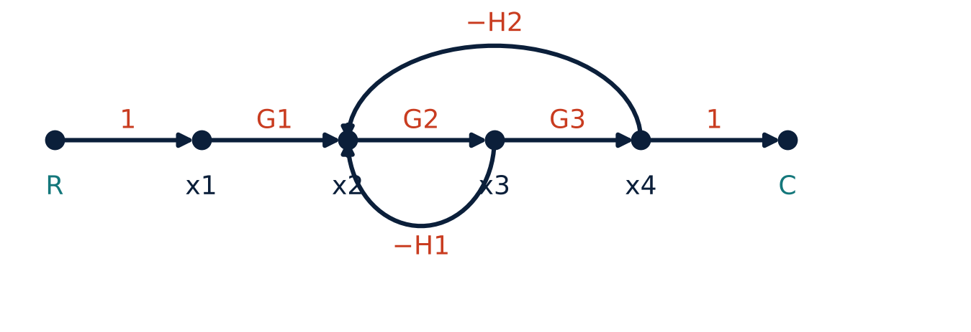
Example SFG
U1
Nodes: R, x1, x2, x3, x4, C.
Forward path: R→x1→x2→x3→x4→C.
Loop L1: x2→x3→x2 with gain −G2H1.
Loop L2: x2→x3→x4→x2 with gain −G2G3H2.
Notes:
Both loops pass through x2 and x3, so they touch each other.

Slide 5
Mason's gain formula
U1
T = C/R = Σ Pk Δk / Δ
Δ = 1 − ΣLi + ΣLiLj − ΣLiLjLk + …
Δk
overall gain
graph determinant
Δ with all loops touching path k removed
Pk = gain of the k-th forward path.
Li = loop gains; LiLj = products of gains of non-touching pairs, etc.
Notes:
Mason's formula gives the overall gain in a single step without graph reduction.

Slide 6
Applying Mason's formula to the example
U1
Problem Find C/R for the SFG with forward gain 1·G1·G2·G3·1 and loops −G2H1 and −G2G3H2.
P1 = G1 G2 G3
L1 = −G2H1, L2 = −G2G3H2 (touching)
Δ = 1 − (L1 + L2) = 1 + G2H1 + G2G3H2
Δ1 = 1 (no loop is disjoint from P1)
Answer: C/R = G1G2G3 / (1 + G2H1 + G2G3H2)
Notes:
No pair of loops is non touching, so there is no second order term.

Slide 7
Numerical: with non-touching loops
U1
Problem Loop gains L1 = −0.2, L2 = −0.5, L3 = −0.1; only L1 and L3 are non-touching. One forward path P1 = 5 touches all loops. Find T.
Σ Li = −0.8
Σ LiLj (non-touching) = L1L3 = (−0.2)(−0.1) = 0.02
Δ = 1 − (−0.8) + 0.02 = 1.82; Δ1 = 1
T = P1 Δ1/Δ = 5/1.82
Answer: T = 2.75
Notes:
Non touching loops contribute positive product terms to the determinant.

Slide 8
Block diagram to SFG
U1
1
2
3
4
Nodes
Branches
Summing points
Apply Mason
Draw a node for every signal (input, output, each summing/take-off point output).
Each block becomes a branch with the block's gain.
Branch gains ±1 into the summing node.
Find paths, loops, non-touching loops and evaluate.
Remember: negative feedback appears as a loop with negative gain.
Notes:
SFG and block diagram reduction give the same answer, but Mason's formula is quicker for complex systems.

Slide 9
Key takeaways
U1
SFG: nodes (variables) and directed branches (gains)
Mason: T = ΣPkΔk/Δ
Δ = 1 − ΣL + ΣLiLj (non-touching) − …
Δk excludes loops touching the k-th forward path
Notes:
To summarise this topic. SFG: nodes (variables) and directed branches (gains). Mason: T = ΣPkΔk/Δ. Δ = 1 − ΣL + ΣLiLj (non-touching) − …. Δk excludes loops touching the k-th forward path.

Slide 10
Practice questions
U1
Q1. Define forward path, loop and non-touching loops.
Q2. Write Mason's gain formula and explain each term.
Q3. Find T for P1 = 2, loops −1 and −0.5 (touching).
Q4. Convert a unity-feedback block diagram into an SFG.
Notes:
Attempt these on your own, then check your working against your notes and textbook. Define forward path, loop and non-touching loops. Write Mason's gain formula and explain each term. Find T for P1 = 2, loops −1 and −0.5 (touching). Convert a unity-feedback block diagram into an SFG.

