Slide 1

UNIT 2 · 8 hours
Standard Test Signals
Time Domain Analysis of Control Systems
Control Systems (22EEG53)
Dr. Mitesh Astik · Dept. of Electrical and Electronics Engineering
NMAM Institute of Technology, Nitte · 2025-26
Notes:
Welcome. In this session we study "Standard Test Signals", part of Unit 2 (Time Domain Analysis of Control Systems) of Control Systems.

Slide 2
Learning objectives
U2
Define step, ramp, parabolic, impulse and sinusoidal test signals
Write their Laplace transforms
Explain why standard signals are used
Relate the signals to each other and to the transient and steady-state response
Syllabus context
Time domain analysis of control systems: standard test signals, time response of zero, first and second order systems, time domain specifications, type of systems, static error constants and steady-state error, generalized error series.
Notes:
By the end of this topic you should be able to do the following. Define step, ramp, parabolic, impulse and sinusoidal test signals. Write their Laplace transforms. Explain why standard signals are used. Relate the signals to each other and to the transient and steady-state response.

Slide 3
Why standard test signals?
U2
Actual inputs are often unknown or random.
A few simple signals let us compare systems on an equal basis.
They represent common real inputs: sudden change (step), constant velocity (ramp), constant acceleration (parabola), shock (impulse).
System response to these signals indicates behaviour for other inputs (for LTI systems).
Notes:
Specifications of performance are given in terms of the response to standard test signals.

Slide 4
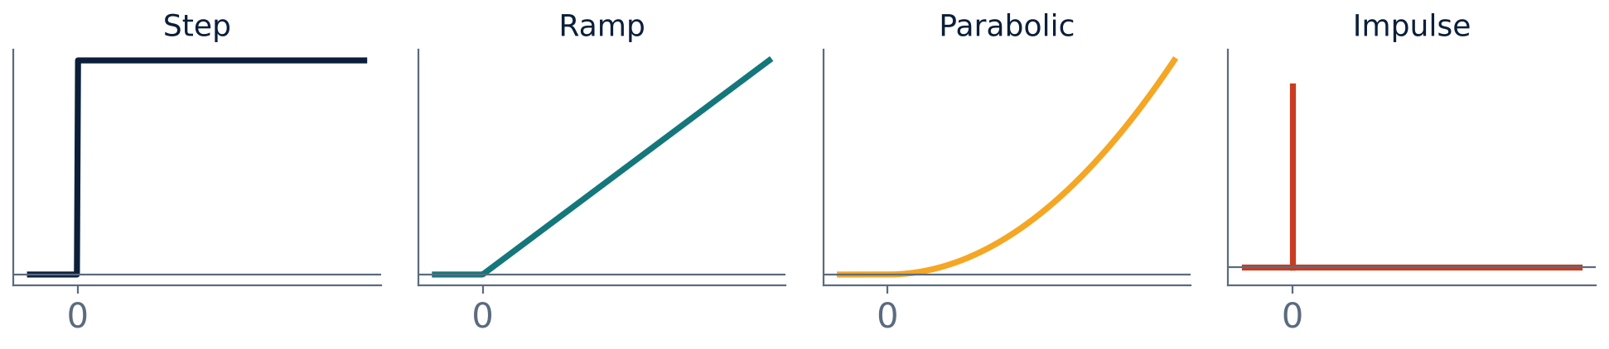
The four common signals
U2
Step, ramp, parabolic and impulse inputs
Notes:
Each is the integral of the next simpler one.

Slide 5
Definitions and Laplace transforms
U2
Signal | r(t) for t ≥ 0 | R(s)
Unit impulse δ(t) | ∞ at t = 0, area 1 | 1
Unit step u(t) | 1 | 1/s
Unit ramp | t | 1/s²
Unit parabola | t²/2 | 1/s³
Sinusoid | A sin ωt | Aω/(s² + ω²)
Notes:
Notice the pattern: step is the integral of impulse, ramp of step, parabola of ramp.

Slide 6
Physical meaning
U2
Step
Ramp
Parabola / impulse
Sudden change: switching on a supply, a change in set-point, setting a thermostat. Tests transient behaviour and steady-state accuracy.
Constant velocity input: tracking a moving target at constant speed. Tests velocity error.
Constant acceleration input; and a sudden shock or disturbance. The impulse response is the transfer function in the time domain: g(t) = L⁻¹{G(s)}.
Notes:
Choose the test signal closest to the real input.

Slide 7
Transient and steady-state response
U2
Total response: c(t) = c_tr(t) + c_ss(t).
Transient: part that dies out as t → ∞; shows speed and oscillation of response.
Steady state: part remaining as t → ∞; shows accuracy.
Absolute stability: required: the transient must decay.
Specifications are set for both: e.g. overshoot and settling time (transient), error (steady state).
Notes:
A good system has a fast, well damped transient and a small steady state error.

Slide 8
Key takeaways
U2
Standard signals: impulse, step, ramp, parabola (and sinusoid)
Laplace transforms: 1, 1/s, 1/s², 1/s³
Each signal is the integral of the previous one
Response = transient + steady state
Notes:
To summarise this topic. Standard signals: impulse, step, ramp, parabola (and sinusoid). Laplace transforms: 1, 1/s, 1/s², 1/s³. Each signal is the integral of the previous one. Response = transient + steady state.

Slide 9
Practice questions
U2
Q1. Write the Laplace transforms of unit step, ramp and parabola.
Q2. Why are standard test signals used?
Q3. Define transient and steady-state response.
Q4. Which test signal is used to find the velocity error?
Notes:
Attempt these on your own, then check your working against your notes and textbook. Write the Laplace transforms of unit step, ramp and parabola. Why are standard test signals used? Define transient and steady-state response. Which test signal is used to find the velocity error?

