Slide 1

UNIT 2 · 8 hours
Time Response of Zero and First Order Systems
Time Domain Analysis of Control Systems
Control Systems (22EEG53)
Dr. Mitesh Astik · Dept. of Electrical and Electronics Engineering
NMAM Institute of Technology, Nitte · 2025-26
Notes:
Welcome. In this session we study "Time Response of Zero and First Order Systems", part of Unit 2 (Time Domain Analysis of Control Systems) of Control Systems.

Slide 2
Learning objectives
U2
Describe a zero-order system
Derive the step, ramp and impulse response of a first-order system
Use the time constant to find rise time and settling time
Solve numericals on first-order systems
Syllabus context
Time domain analysis of control systems: standard test signals, time response of zero, first and second order systems, time domain specifications, type of systems, static error constants and steady-state error, generalized error series.
Notes:
By the end of this topic you should be able to do the following. Describe a zero-order system. Derive the step, ramp and impulse response of a first-order system. Use the time constant to find rise time and settling time. Solve numericals on first-order systems.

Slide 3
Zero-order system
U2
Transfer function G(s) = K (a pure gain).
Output follows the input instantly: c(t) = K r(t).
Example: a potentiometer (output voltage ∝ wiper position), ideal amplifier.
No dynamics: no transient, no poles.
Notes:
A zero order system has no energy storing elements.

Slide 4
First-order system
U2
G(s) = C/R = 1/(1 + sT)
Step: c(t) = 1 − e^(−t/T)
standard form
R = 1/s
Impulse: c(t) = (1/T) e^(−t/T)
Ramp: c(t) = t − T + T e^(−t/T)
R = 1
R = 1/s²
T = time constant (s); single pole at s = −1/T.
Examples: RC circuit (T = RC), thermometer, tank level.
Notes:
Take inverse Laplace transforms using partial fractions.

Slide 5
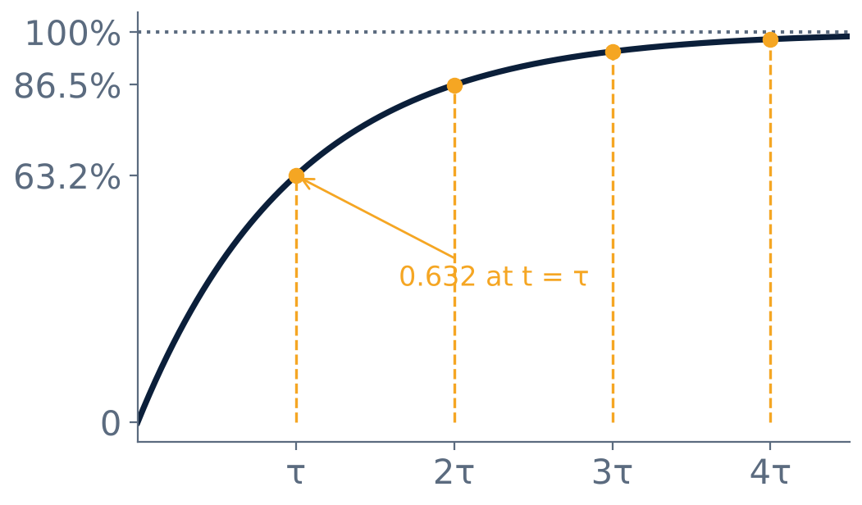
Unit step response
U2
At t = T: 63.2 % of final value.
2T: 86.5 %; 3T: 95 %; 4T: 98.2 %.
Initial slope = 1/T: would reach final value in T if it continued.
No overshoot: no oscillation.
Notes:
The time constant is the time to reach sixty three point two percent of the final value.

Slide 6
First-order step response specifications
U2
Specification | Definition | Value
Time constant T | Time to reach 63.2 % | T
Delay time td | Time to reach 50 % | 0.693 T
Rise time tr | 10 % to 90 % | 2.2 T
Settling time ts (2 %) | Stay within ±2 % | 4 T
Settling time ts (5 %) | Stay within ±5 % | 3 T
Notes:
The smaller the time constant the faster the response.

Slide 7
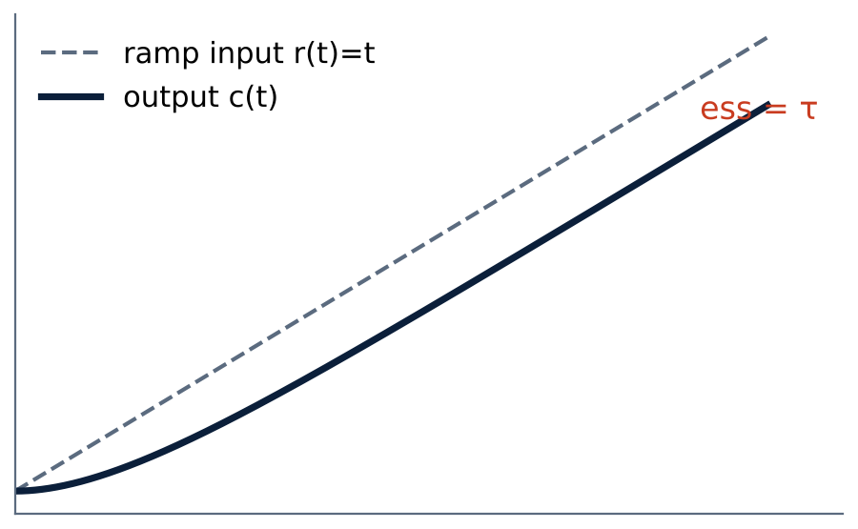
Ramp response and steady-state error
U2
c(t) = t − T + T e^(−t/T).
Output follows the ramp with a constant lag.
Steady-state error ess = T for a unit ramp.
Error = r − c = T(1 − e^(−t/T)) → T.
Notes:
A first order system follows a ramp with a constant error equal to its time constant.

Slide 8
Numerical: time constant
U2
Problem A system has G(s) = 2/(0.5s + 1). Find DC gain, time constant, rise time, 2 % settling time and final value for a unit step.
Standard form K/(1 + sT): K = 2, T = 0.5 s
tr = 2.2T = 1.1 s; ts(2 %) = 4T = 2 s
Final value = K × 1 = 2
c(t) = 2 (1 − e^(−2t))
Answer: K = 2, T = 0.5 s, tr = 1.1 s, ts = 2 s, c(∞) = 2
Notes:
The DC gain K scales the final value, not the speed.

Slide 9
Numerical: closed-loop first order
U2
Problem A unity-feedback system has G(s) = 10/s. Find the closed-loop time constant and settling time.
C/R = G/(1 + G) = (10/s)/(1 + 10/s) = 10/(s + 10) = 1/(0.1 s + 1)
T = 0.1 s
ts(2 %) = 4T
Answer: T = 0.1 s, ts = 0.4 s
Notes:
Increasing the loop gain makes the system faster.

Slide 10
Key takeaways
U2
Zero order: c = K r (instantaneous)
First order: G = 1/(1 + sT); step response 1 − e^(−t/T)
tr = 2.2T, td = 0.69T, ts = 4T (2 %)
Ramp: steady-state error = T
Notes:
To summarise this topic. Zero order: c = K r (instantaneous). First order: G = 1/(1 + sT); step response 1 − e^(−t/T). tr = 2.2T, td = 0.69T, ts = 4T (2 %). Ramp: steady-state error = T.

Slide 11
Practice questions
U2
Q1. Derive the unit step response of a first-order system.
Q2. T = 0.2 s: find tr, ts and the response at t = 0.4 s.
Q3. G(s) = 5/s with unity feedback: find T and ts.
Q4. Why is there no overshoot in a first-order system?
Notes:
Attempt these on your own, then check your working against your notes and textbook. Derive the unit step response of a first-order system. T = 0.2 s: find tr, ts and the response at t = 0.4 s. G(s) = 5/s with unity feedback: find T and ts. Why is there no overshoot in a first-order system?

