Slide 1

UNIT 2 · 8 hours
Time Response of Second-Order Systems
Time Domain Analysis of Control Systems
Control Systems (22EEG53)
Dr. Mitesh Astik · Dept. of Electrical and Electronics Engineering
NMAM Institute of Technology, Nitte · 2025-26
Notes:
Welcome. In this session we study "Time Response of Second-Order Systems", part of Unit 2 (Time Domain Analysis of Control Systems) of Control Systems.

Slide 2
Learning objectives
U2
Write the standard second-order transfer function
Classify the response: undamped, underdamped, critically damped, overdamped
Write and sketch the step response in each case
Find ωn and ζ from a given transfer function
Syllabus context
Time domain analysis of control systems: standard test signals, time response of zero, first and second order systems, time domain specifications, type of systems, static error constants and steady-state error, generalized error series.
Notes:
By the end of this topic you should be able to do the following. Write the standard second-order transfer function. Classify the response: undamped, underdamped, critically damped, overdamped. Write and sketch the step response in each case. Find ωn and ζ from a given transfer function.

Slide 3
Standard second-order system
U2
C/R = ωn² / (s² + 2ζωn s + ωn²)
s = −ζωn ± ωn √(ζ² − 1)
standard form
closed-loop poles
ωn = undamped natural frequency (rad/s); ζ = damping ratio.
Servo example: G = K/[s(s + a)] with unity feedback: ωn = √K and ζ = a/(2√K).
Unit step input: R(s) = 1/s.
Notes:
The behaviour of every second order system depends on just these two parameters.

Slide 4
Four damping cases
U2
ζ | Poles | Type | Step response
0 | ±jωn | Undamped | Sustained oscillation, 1 − cos ωn t
0 < ζ < 1 | −ζωn ± jωd | Underdamped | Decaying oscillation with overshoot
1 | −ωn (double) | Critically damped | Fastest without overshoot
> 1 | Two real negative | Overdamped | Slow, no overshoot
Notes:
ωd = ωn√(1 − ζ²) is the damped natural frequency.

Slide 5
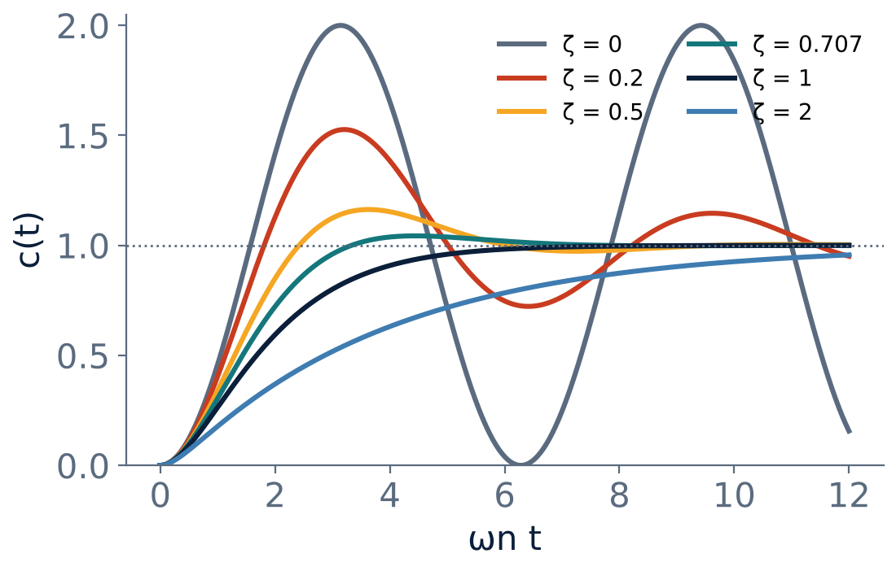
Step responses for different ζ
U2
ζ = 0: undamped, never settles.
Small ζ: large overshoot, many oscillations.
ζ ≈ 0.7: fast, small overshoot (≈ 4 %).
ζ = 1: critically damped.
ζ > 1: sluggish.
Notes:
ζ around zero point four to zero point eight is the usual design range.

Slide 6
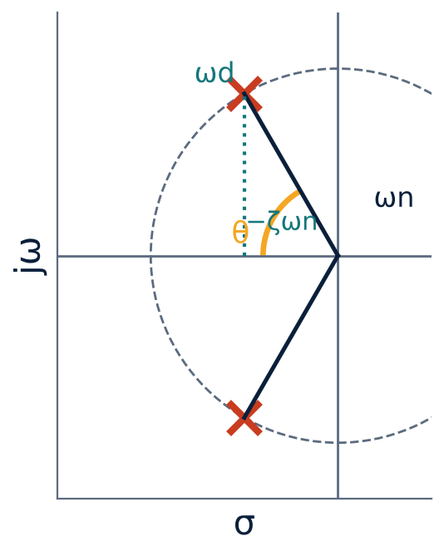
Pole location and ζ
U2
Poles at distance ωn from the origin.
cos θ = ζ where θ is measured from the negative real axis.
Real part −ζωn gives decay rate; imaginary part ωd gives oscillation.
Constant ζ ⇒ radial line; constant ωn ⇒ circle.
Notes:
The pole location gives a direct picture of the response.

Slide 7
Underdamped step response
U2
c(t) = 1 − [e^(−ζωn t)/√(1−ζ²)] sin(ωd t + φ)
φ = cos⁻¹ ζ
Critical: c(t) = 1 − (1 + ωn t) e^(−ωn t)
0 < ζ < 1
phase angle
ζ = 1
Notes:
The exponential envelope decays with time constant one over zeta omega n.

Slide 8
Numerical: classify the response
U2
Problem Find ωn, ζ and the type for (a) 25/(s²+6s+25), (b) 4/(s²+4s+4), (c) 9/(s²+9s+9).
(a) ωn = 5, 2ζωn = 6 ⇒ ζ = 0.6: underdamped
(b) ωn = 2, 2ζωn = 4 ⇒ ζ = 1: critically damped (double pole at −2)
(c) ωn = 3, 2ζωn = 9 ⇒ ζ = 1.5: overdamped (poles −1.15, −7.85)
Answer: (a) ζ = 0.6 (b) ζ = 1 (c) ζ = 1.5
Notes:
Compare the denominator with s squared plus two zeta omega n s plus omega n squared.

Slide 9
Numerical: servo gain and damping
U2
Problem A unity-feedback system has G(s) = K/[s(s+4)]. Find K for ζ = 0.6 and the resulting ωn.
Characteristic equation: s² + 4s + K = 0 ⇒ ωn² = K, 2ζωn = 4
ωn = 4/(2 × 0.6) = 3.33 rad/s
K = ωn² = 11.1
Answer: K = 11.1, ωn = 3.33 rad/s
Notes:
Increasing K increases ωn and lowers ζ.

Slide 10
Key takeaways
U2
Standard form ωn²/(s² + 2ζωn s + ωn²)
ζ = 0, 0<ζ<1, ζ = 1, ζ > 1: undamped, under, critical, overdamped
ωd = ωn√(1 − ζ²); cos θ = ζ
For G = K/[s(s+a)]: ωn = √K, ζ = a/(2√K)
Notes:
To summarise this topic. Standard form ωn²/(s² + 2ζωn s + ωn²). ζ = 0, 0<ζ<1, ζ = 1, ζ > 1: undamped, under, critical, overdamped. ωd = ωn√(1 − ζ²); cos θ = ζ. For G = K/[s(s+a)]: ωn = √K, ζ = a/(2√K).

Slide 11
Practice questions
U2
Q1. Write the step response for 0 < ζ < 1 and sketch it.
Q2. Find ωn and ζ for 16/(s² + 4s + 16).
Q3. G = K/[s(s + 2)]: find K for critical damping.
Q4. Locate the poles for ζ = 0.5, ωn = 10.
Notes:
Attempt these on your own, then check your working against your notes and textbook. Write the step response for 0 < ζ < 1 and sketch it. Find ωn and ζ for 16/(s² + 4s + 16). G = K/[s(s + 2)]: find K for critical damping. Locate the poles for ζ = 0.5, ωn = 10.

