Slide 1

UNIT 2 · 8 hours
Time Domain Specifications
Time Domain Analysis of Control Systems
Control Systems (22EEG53)
Dr. Mitesh Astik · Dept. of Electrical and Electronics Engineering
NMAM Institute of Technology, Nitte · 2025-26
Notes:
Welcome. In this session we study "Time Domain Specifications", part of Unit 2 (Time Domain Analysis of Control Systems) of Control Systems.

Slide 2
Learning objectives
U2
Define delay, rise, peak, settling times and peak overshoot
Derive the formulas for an underdamped second-order system
Compute specifications from ωn and ζ
Choose ωn and ζ to meet given specifications
Syllabus context
Time domain analysis of control systems: standard test signals, time response of zero, first and second order systems, time domain specifications, type of systems, static error constants and steady-state error, generalized error series.
Notes:
By the end of this topic you should be able to do the following. Define delay, rise, peak, settling times and peak overshoot. Derive the formulas for an underdamped second-order system. Compute specifications from ωn and ζ. Choose ωn and ζ to meet given specifications.

Slide 3
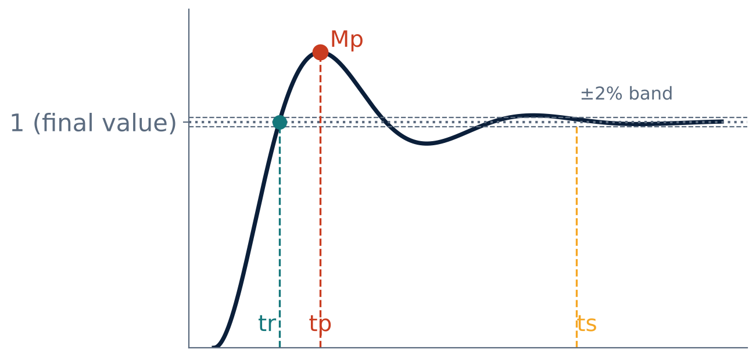
Transient specifications on the step response
U2
td: delay time (50 % of final value).
tr: rise time (0 → 100 % for underdamped).
tp: peak time.
Mp: maximum (peak) overshoot.
ts: settling time (±2 % or ±5 % band).
Notes:
These specifications describe the speed and the quality of the transient.

Slide 4
Formulas (underdamped, 0 < ζ < 1)
U2
tr = (π − φ)/ωd
tp = π/ωd
φ = cos⁻¹ζ
ωd = ωn√(1−ζ²)
Mp = e^(−πζ/√(1−ζ²)) × 100 %
ts = 4/(ζωn) (2 %)
overshoot
= 3/(ζωn) for 5 %
Notes:
Peak time follows by setting the derivative of the response to zero; overshoot by evaluating the response at tp.

Slide 5
Observations
U2
Mp depends only on ζ: smaller ζ → larger overshoot.
tr, tp, ts shrink as ωn increases for a given ζ.
ts depends on the real part ζωn of the poles: move poles left → faster settling.
Typical design range: ζ = 0.4–0.8 (Mp ≈ 25–1.5 %).
Percent overshoot table: ζ = 0.2 → 52.7 %; 0.4 → 25.4 %; 0.6 → 9.5 %; 0.8 → 1.5 %.
Notes:
The designer chooses pole locations to meet overshoot and settling time.

Slide 6
Numerical 1: compute specifications
U2
Problem A system has C/R = 25/(s² + 6s + 25). Find tr, tp, Mp and ts (2 %) for a unit step.
ωn = 5, ζ = 0.6; ωd = 5√(1 − 0.36) = 4 rad/s; φ = cos⁻¹0.6 = 0.927 rad
tr = (π − 0.927)/4 = 0.554 s; tp = π/4 = 0.785 s
Mp = exp(−π × 0.6/0.8) = e^(−2.356) = 9.48 %
ts = 4/(ζωn) = 4/3 = 1.33 s
Answer: tr = 0.554 s, tp = 0.785 s, Mp = 9.48 %, ts = 1.33 s
Notes:
Substitute carefully; keep the calculator in radians for the phase angle.

Slide 7
Numerical 2: design to specifications
U2
Problem Require Mp ≤ 10 % and ts ≤ 2 s (2 % band). Find the minimum ζ and ωn.
Mp ≤ 10 %: ζ ≥ ln(10)/√(π² + ln²(10)) = 2.303/3.895 = 0.591
ts = 4/(ζωn) ≤ 2 ⇒ ζωn ≥ 2
ωn ≥ 2/0.591 = 3.38 rad/s
Poles: −2 ± j2.73
Answer: ζ ≥ 0.59, ωn ≥ 3.38 rad/s
Notes:
The poles must lie to the left of minus two and inside the cone defined by zeta.

Slide 8
Numerical 3: servo
U2
Problem Unity-feedback servo G = K/[s(s+4)] with K = 11.1. Find ωn, ζ, Mp, ts.
s² + 4s + 11.1 = 0 ⇒ ωn = 3.33, ζ = 4/(2 × 3.33) = 0.6
Mp = 9.5 %
ts = 4/(0.6 × 3.33) = 2.0 s; ωd = 2.67; tr = (π − 0.927)/2.67 = 0.83 s
Answer: ζ = 0.6, Mp = 9.5 %, ts = 2 s, tr = 0.83 s
Notes:
This meets the design in the previous example.

Slide 9
Key takeaways
U2
tr = (π − φ)/ωd, tp = π/ωd
Mp = exp(−πζ/√(1 − ζ²)); depends only on ζ
ts = 4/(ζωn) (2 %) or 3/(ζωn) (5 %)
Design: choose ζ for overshoot, ωn for speed
Notes:
To summarise this topic. tr = (π − φ)/ωd, tp = π/ωd. Mp = exp(−πζ/√(1 − ζ²)); depends only on ζ. ts = 4/(ζωn) (2 %) or 3/(ζωn) (5 %). Design: choose ζ for overshoot, ωn for speed.

Slide 10
Practice questions
U2
Q1. Derive the expressions for tp and Mp.
Q2. ωn = 10, ζ = 0.5: find tr, tp, Mp, ts.
Q3. Find ζ for Mp = 20 %.
Q4. Explain the effect of ωn on ts for fixed ζ.
Notes:
Attempt these on your own, then check your working against your notes and textbook. Derive the expressions for tp and Mp. ωn = 10, ζ = 0.5: find tr, tp, Mp, ts. Find ζ for Mp = 20 %. Explain the effect of ωn on ts for fixed ζ.

