Slide 1

UNIT 3 · 7 hours
Bode Plot: Construction
Frequency Domain Analysis
Control Systems (22EEG53)
Dr. Mitesh Astik · Dept. of Electrical and Electronics Engineering
NMAM Institute of Technology, Nitte · 2025-26
Notes:
Welcome. In this session we study "Bode Plot: Construction", part of Unit 3 (Frequency Domain Analysis) of Control Systems.

Slide 2
Learning objectives
U3
Explain the Bode plot and decibel scale
Plot the asymptotic magnitude and phase of standard factors
Construct the Bode plot of a given G(s)
Determine the slope and corner frequencies
Syllabus context
Frequency domain analysis: frequency domain specifications peak resonance, resonant frequency, bandwidth and cut-off rate; correlation between time and frequency responses for second-order systems; Bode plot, gain margin and phase margin.
Notes:
By the end of this topic you should be able to do the following. Explain the Bode plot and decibel scale. Plot the asymptotic magnitude and phase of standard factors. Construct the Bode plot of a given G(s). Determine the slope and corner frequencies.

Slide 3
What is a Bode plot?
U3
Two plots: magnitude 20 log|G(jω)| in dB and phase ∠G(jω) in degrees, both against log ω.
Log scale turns products into sums: each factor of G(s) adds straight-line segments.
Octave and decade: frequency ratio 2 and 10; −20 dB/dec = −6 dB/octave.
Uses: stability margins, bandwidth, compensator design.
Notes:
The Bode plot is the most widely used frequency response plot.

Slide 4
Standard factors
U3
Factor | Magnitude | Phase
Constant K | 20 log K (flat) | 0° (K > 0)
Integrator 1/(jω)ⁿ | −20n dB/dec through 0 dB at ω = 1 | −90n°
Differentiator (jω) | +20 dB/dec | +90°
Simple lag 1/(1 + jωT) | 0 dB then −20 dB/dec after corner 1/T | 0° → −90° (−45° at 1/T)
Simple lead (1 + jωT) | 0 dB then +20 dB/dec after 1/T | 0° → +90°
Quadratic lag | −40 dB/dec after ωn; peak near ωn | 0° → −180°
Notes:
The error of the straight line approximation is at most three dB at the corner of a first order factor.

Slide 5
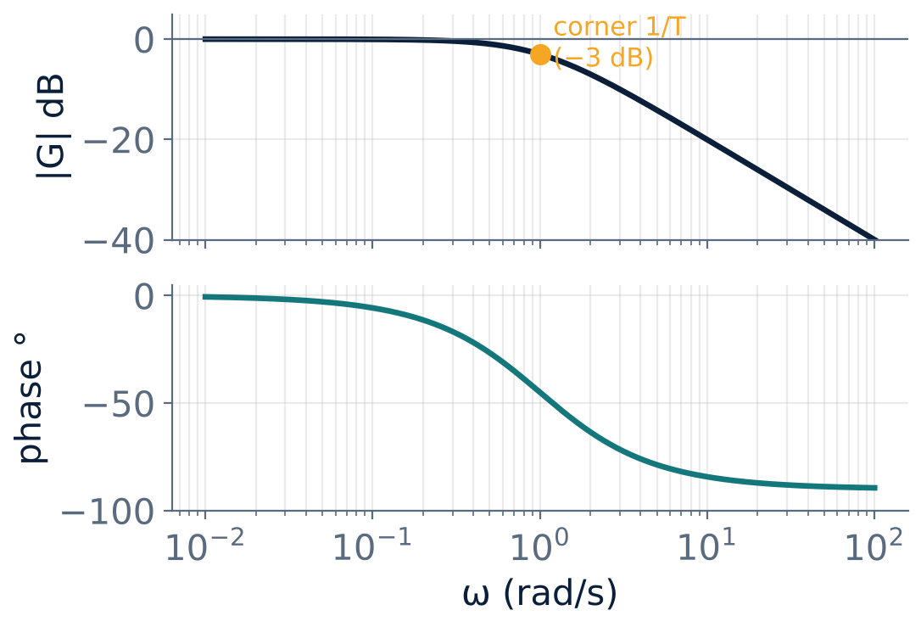
First-order lag: 1/(1 + jωT)
U3
Corner frequency ωc = 1/T.
Below ωc: 0 dB; above: −20 dB/dec.
At ωc exact magnitude = −3 dB, phase = −45°.
Phase goes 0° → −90°.
Notes:
At the corner frequency the actual curve is three dB below the asymptotes.

Slide 6
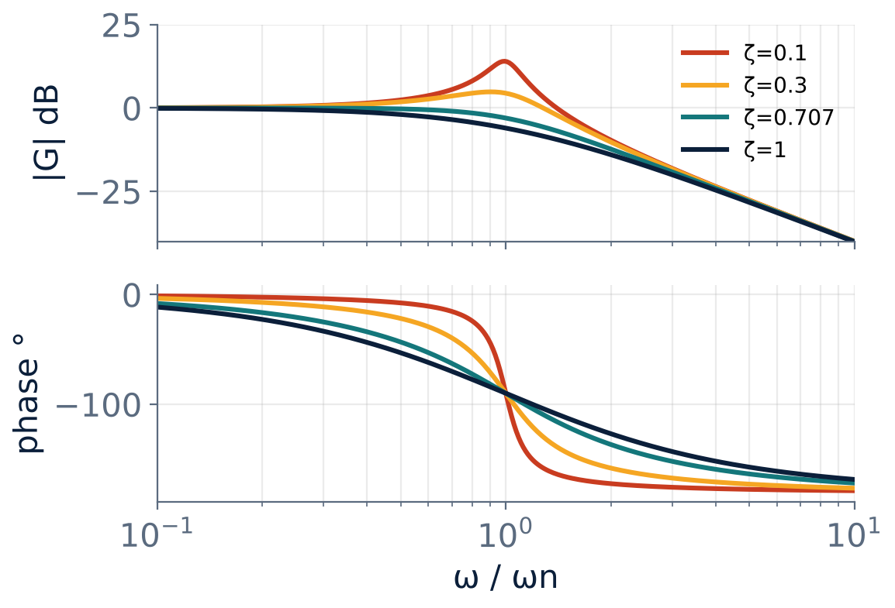
Second-order lag with damping
U3
Corner at ωn: slope changes by −40 dB/dec.
Peak near ωn for ζ < 0.707: Mr dB.
Phase from 0° to −180°, passing −90° at ωn.
Smaller ζ → sharper resonance and phase change.
Notes:
The straight line approximation must be corrected by the resonance peak for low zeta.

Slide 7
Construction procedure
U3
1
2
3
4
5
Standard form
Corner frequencies
Initial slope
Change slope
Phase
Write G(jω) in time-constant form with K as gain.
−20N dB/dec at low ω (N = type), through 20 log K at ω = 1.
At each corner: poles −20 dB/dec, zeros +20 dB/dec (−40 for quadratic poles).
Add the phase of each factor point by point.
List all 1/T values; arrange in increasing order.
Initial magnitude at ω = 1 rad/s is 20 log K for a type 1 system.
Notes:
Mark ω on a semilog sheet and draw asymptotes first, then refine.

Slide 8
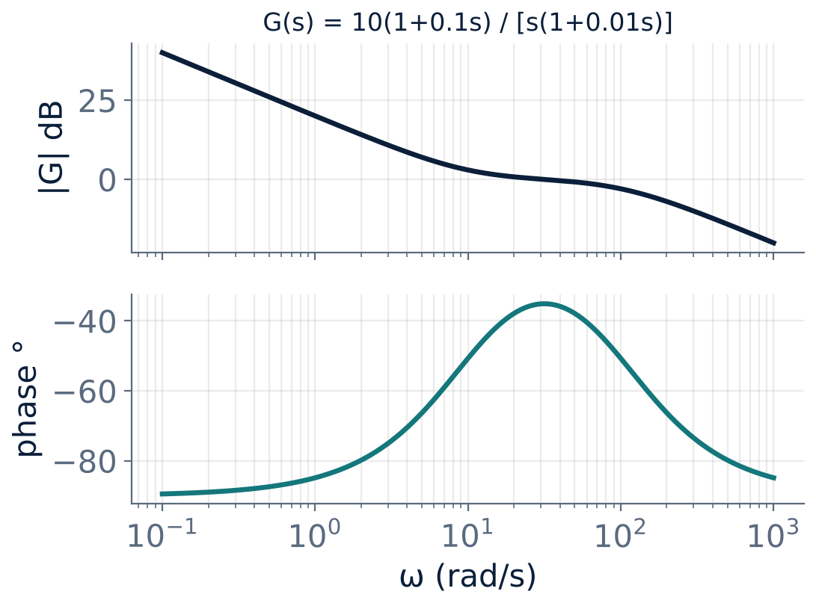
Example: G = 10(1 + 0.1s) / [s(1 + 0.01s)]
U3
Type 1, K = 10: starts at −20 dB/dec; 0 dB at ω = 10 (20 log 10 = 20 dB at ω = 1).
Zero at ω = 10: slope → 0 dB/dec.
Pole at ω = 100: slope → −20 dB/dec.
Phase: −90° → ≈ −35° → −90°.
Notes:
Follow the five steps: factors, corners, initial slope, slope changes, phase.

Slide 9
Numerical: asymptotic magnitude
U3
Problem G(s) = 100/[s(1 + 0.1s)]. Find the corner frequency, slopes and the gain crossover frequency.
Type 1, K = 100: at ω = 1, 20 log 100 = 40 dB with slope −20 dB/dec
Corner at ω = 1/0.1 = 10 rad/s: magnitude there = 40 − 20 log 10 = 20 dB; slope → −40 dB/dec
0 dB reached: 20 dB at 10 needs 20/40 = 0.5 decade more → ω ≈ 10 × 10^0.5
Answer: Gain crossover ≈ 31.6 rad/s (exact ≈ 31.5)
Notes:
Use the slope and the number of decades to reach zero dB.

Slide 10
Key takeaways
U3
Bode: 20 log|G| (dB) and phase vs log ω
Factor slopes: ±20 dB/dec per pole/zero, integrator −20
Corner frequency = 1/T; at corner −3 dB, −45°
Initial slope = −20 × type
Notes:
To summarise this topic. Bode: 20 log|G| (dB) and phase vs log ω. Factor slopes: ±20 dB/dec per pole/zero, integrator −20. Corner frequency = 1/T; at corner −3 dB, −45°. Initial slope = −20 × type.

Slide 11
Practice questions
U3
Q1. Draw the asymptotic Bode magnitude plot of G = 20/[(1 + 0.5s)(1 + 0.05s)].
Q2. State the slope contributions of poles and zeros.
Q3. Find the phase at ω = 1/T for 1/(1 + sT).
Q4. Construct the Bode plot for G = 10/[s(s + 10)].
Notes:
Attempt these on your own, then check your working against your notes and textbook. Draw the asymptotic Bode magnitude plot of G = 20/[(1 + 0.5s)(1 + 0.05s)]. State the slope contributions of poles and zeros. Find the phase at ω = 1/T for 1/(1 + sT). Construct the Bode plot for G = 10/[s(s + 10)].

