Slide 1

UNIT 3 · 7 hours
Gain Margin and Phase Margin
Frequency Domain Analysis
Control Systems (22EEG53)
Dr. Mitesh Astik · Dept. of Electrical and Electronics Engineering
NMAM Institute of Technology, Nitte · 2025-26
Notes:
Welcome. In this session we study "Gain Margin and Phase Margin", part of Unit 3 (Frequency Domain Analysis) of Control Systems.

Slide 2
Learning objectives
U3
Define gain and phase crossover frequencies
Define gain margin and phase margin
Determine margins from a Bode plot and analytically
Assess stability from margins
Syllabus context
Frequency domain analysis: frequency domain specifications peak resonance, resonant frequency, bandwidth and cut-off rate; correlation between time and frequency responses for second-order systems; Bode plot, gain margin and phase margin.
Notes:
By the end of this topic you should be able to do the following. Define gain and phase crossover frequencies. Define gain margin and phase margin. Determine margins from a Bode plot and analytically. Assess stability from margins.

Slide 3
Definitions
U3
Gain crossover ωgc
Phase crossover ωpc
GM and PM
Frequency at which |G(jω)H(jω)| = 1 (0 dB).
Frequency at which ∠GH = −180°.
PM = 180° + ∠GH(jωgc). GM = −20 log|GH(jωpc)| (dB), or 1/|GH(jωpc)|.
Stable closed loop (minimum phase): both GM and PM positive.
Notes:
Gain margin is the additional gain that would bring the system to the verge of instability. Phase margin is the additional phase lag at gain crossover that would do so.

Slide 4
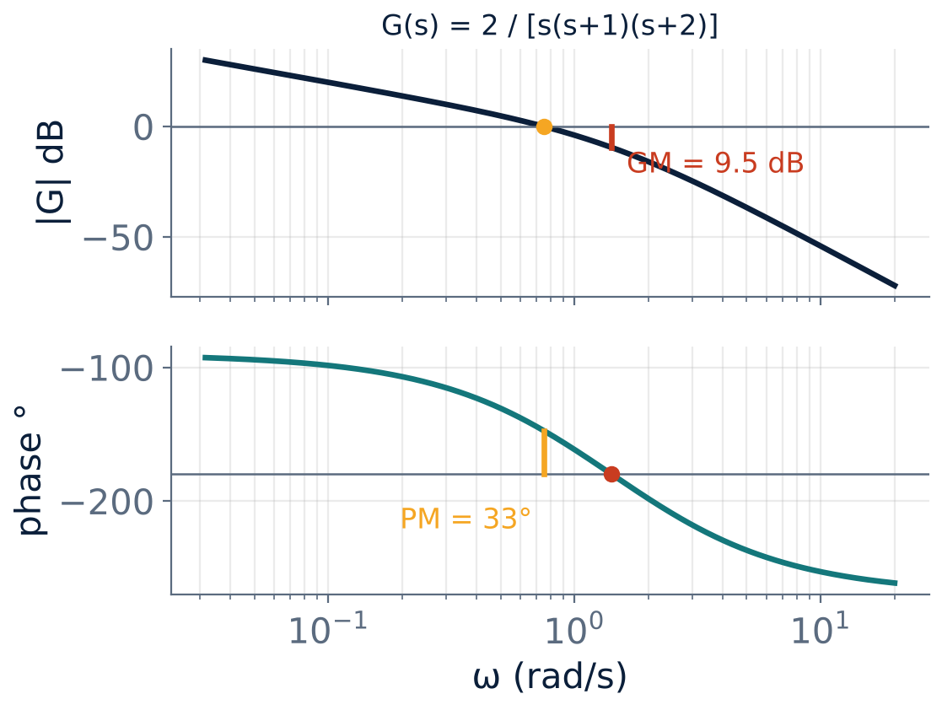
Margins on the Bode plot
U3
G(s) = 2/[s(s+1)(s+2)].
ωgc = 0.75 rad/s: PM = 32.7°.
ωpc = 1.41 rad/s: GM = 9.5 dB.
Both positive ⇒ stable.
Notes:
Read PM at the point where the magnitude crosses 0 dB, and GM at the point where the phase crosses minus one eighty degrees.

Slide 5
Interpretation
U3
Condition | Meaning
GM > 0 dB and PM > 0° | Stable
GM = 0 dB and PM = 0° | Marginally stable (sustained oscillation)
GM < 0 dB or PM < 0° | Unstable
Good design | GM ≥ 6 dB (≥ 2×); PM = 30°–60°
Large PM | Well damped; small overshoot
Notes:
A system that is conditionally stable needs more careful analysis.

Slide 6
Numerical: margins analytically
U3
Problem G(s)H(s) = K/[s(s+1)(s+2)] with K = 2. Find ωpc, GM, ωgc and PM.
Phase = −90° − tan⁻¹ω − tan⁻¹(ω/2) = −180° ⇒ ω² = 2 ⇒ ωpc = 1.414 rad/s
|G(j1.414)| = 2/(1.414 × √3 × √6) = 2/6 = 1/3 ⇒ GM = 20 log 3 = 9.54 dB
|G| = 1 at ωgc = 0.748 rad/s; phase = −90 − 36.8 − 20.5 = −147.3°
PM = 180 − 147.3
Answer: GM = 9.54 dB, PM = 32.7°
Notes:
The gain can be increased three times (to K = 6) before instability.

Slide 7
Using the margins in design
U3
Gain K shifts the magnitude curve up/down without changing the phase: PM and GM change.
To get the required PM: find ω where phase = −180° + PM and set |G| = 1 there to fix K.
Phase margin ≈ 100 ζ links to the transient overshoot.
Compensators (Unit 5) reshape the Bode plot to meet GM and PM.
Notes:
Margins are the safety allowance against model errors and parameter drift.

Slide 8
Key takeaways
U3
ωgc: |GH| = 1; ωpc: ∠GH = −180°
PM = 180° + ∠GH(ωgc); GM = −20 log|GH(ωpc)|
Stable if GM > 0 dB and PM > 0°
Typical design: GM ≥ 6 dB, PM 30–60°
Notes:
To summarise this topic. ωgc: |GH| = 1; ωpc: ∠GH = −180°. PM = 180° + ∠GH(ωgc); GM = −20 log|GH(ωpc)|. Stable if GM > 0 dB and PM > 0°. Typical design: GM ≥ 6 dB, PM 30–60°.

Slide 9
Practice questions
U3
Q1. Define GM and PM and state the stability conditions.
Q2. For K/[s(s+1)(s+2)] find K for marginal stability.
Q3. Find PM for G = 10/[s(s+2)].
Q4. Explain how changing K changes the margins.
Notes:
Attempt these on your own, then check your working against your notes and textbook. Define GM and PM and state the stability conditions. For K/[s(s+1)(s+2)] find K for marginal stability. Find PM for G = 10/[s(s+2)]. Explain how changing K changes the margins.

