Slide 1

UNIT 4 · 8 hours
Rules for Construction of the Root Locus
Stability of Systems
Control Systems (22EEG53)
Dr. Mitesh Astik · Dept. of Electrical and Electronics Engineering
NMAM Institute of Technology, Nitte · 2025-26
Notes:
Welcome. In this session we study "Rules for Construction of the Root Locus", part of Unit 4 (Stability of Systems) of Control Systems.

Slide 2
Learning objectives
U4
Apply the rules for plotting a root locus
Find asymptotes, centroid, breakaway points and angle of departure
Find the jω-axis crossing using Routh
Sketch the root locus for a third-order system
Syllabus context
Stability of systems: characteristic equation, location of roots, absolute and relative stability, Routh–Hurwitz criterion (necessary and sufficient conditions), root locus concept, rules for construction of root locus.
Notes:
By the end of this topic you should be able to do the following. Apply the rules for plotting a root locus. Find asymptotes, centroid, breakaway points and angle of departure. Find the jω-axis crossing using Routh. Sketch the root locus for a third-order system.

Slide 3
Rules (1–5)
U4
Rule | Statement
1 Symmetry | Locus is symmetric about the real axis.
2 Start/end | Branches start at open-loop poles (K = 0) and end at zeros (K = ∞), or at infinity.
3 Number of branches | Equals max(P, Z), P = poles, Z = zeros.
4 Real axis | A point is on the locus if the number of poles + zeros to its right is odd.
5 Asymptotes | N = P − Z asymptotes; angles (2q + 1)180°/(P − Z); centroid σA = (Σpoles − Σzeros)/(P − Z).
Notes:
Apply the rules in order to build the sketch.

Slide 4
Rules (6–8)
U4
Rule | Statement
6 Breakaway / break-in | Solve dK/ds = 0 with K = −1/G1H1(s); valid roots lie on the locus.
7 jω-axis crossing | Use Routh's array (K and ω at the marginal row) or put s = jω in 1 + GH = 0.
8 Angle of departure / arrival | φd = 180° − Σ(angles from other poles) + Σ(angles from zeros) at a complex pole.
9 Gain at a point | K = Π|distances to poles| / Π|distances to zeros|.
Notes:
Rules six to eight give the points that fix the shape.

Slide 5
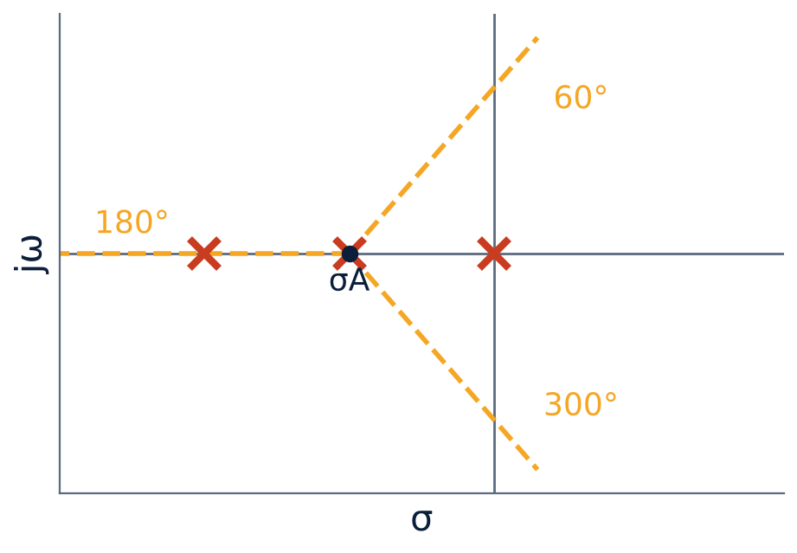
Asymptotes: K/[s(s+1)(s+2)]
U4
P = 3, Z = 0: three asymptotes.
Angles: 60°, 180°, 300°.
Centroid σA = (0 − 1 − 2)/3 = −1.
Real-axis locus: 0 to −1 and −2 to −∞.
Notes:
For large K the branches follow the asymptotes.

Slide 6
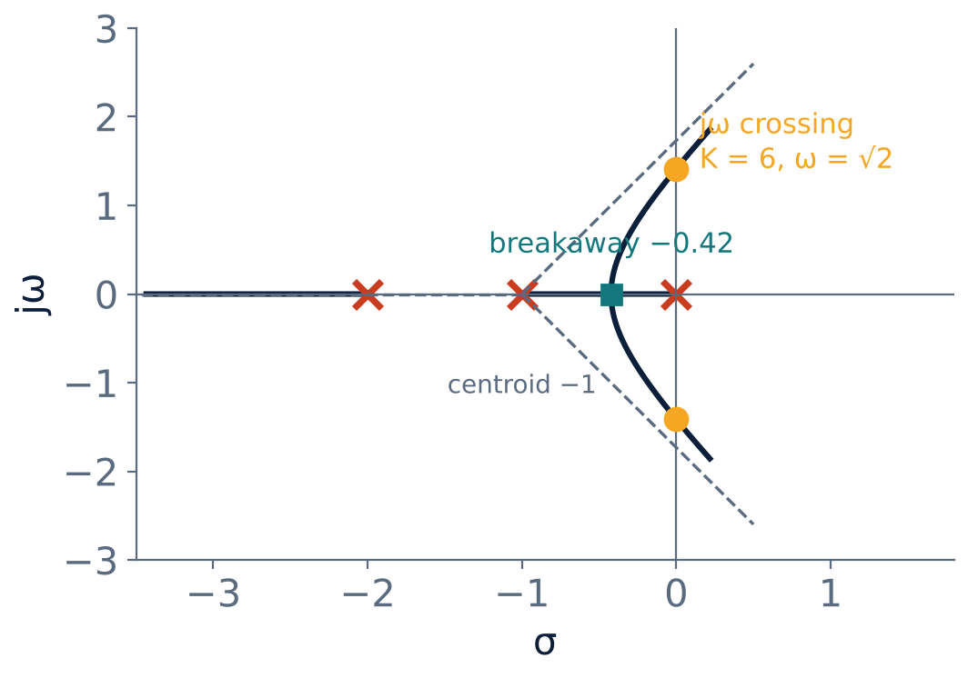
Completed root locus
U4
Breakaway: K = −s(s+1)(s+2); dK/ds = 0 ⇒ 3s² + 6s + 2 = 0 ⇒ s = −0.423 (on locus), −1.577 (not).
jω crossing: Routh gives K = 6, ω = √2.
K > 6: two roots in the RHP: unstable.
Gain at breakaway: K = 0.385.
Notes:
Compare with the Routh result: the marginal gain is six.

Slide 7
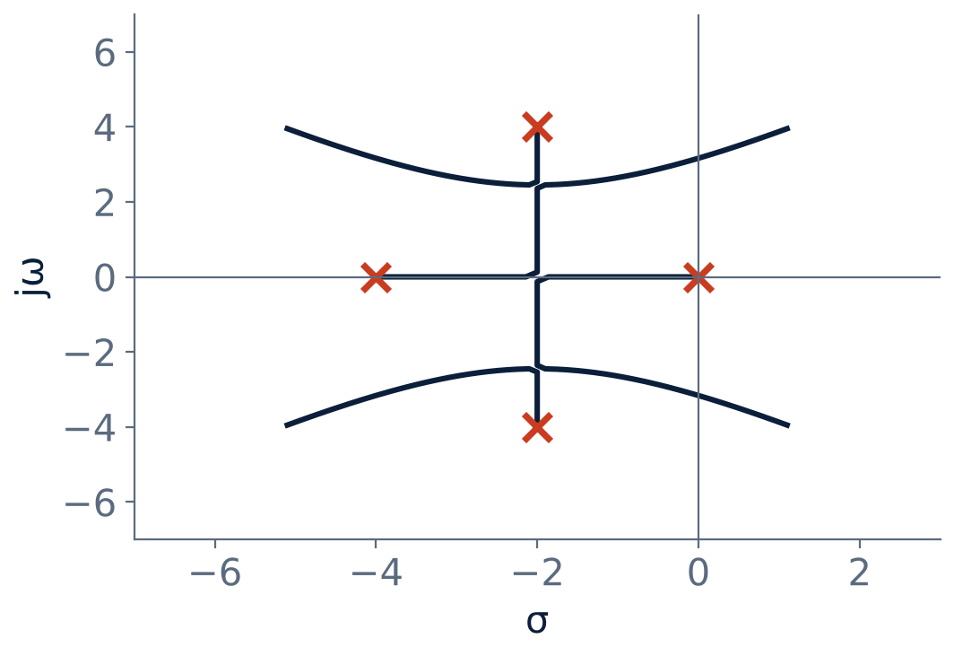
Fourth-order example: K/[s(s+4)(s²+4s+20)]
U4
Poles: 0, −4, −2 ± j4.
Asymptotes: 45°, 135°, 225°, 315°; σA = −2.
Breakaway: −2 and −2 ± j2.45.
Angle of departure at −2 + j4: 180° − (116.6° + 63.4° + 90°) = −90°.
jω crossing: K = 260, ω = 3.16.
Notes:
This is a classic example showing complex break away points.

Slide 8
Numerical: the jω crossing
U4
Problem Characteristic equation s³ + 3s² + 2s + K = 0. Find K and ω at the imaginary-axis crossing.
Routh: s¹ element (6 − K)/3 = 0 ⇒ K = 6
Auxiliary equation from the s² row: 3s² + K = 0 ⇒ 3s² + 6 = 0
s = ± j√2
Answer: K = 6, ω = 1.414 rad/s
Notes:
For gains above six, the closed loop poles enter the right half plane.

Slide 9
Key takeaways
U4
Branches start at poles, end at zeros/infinity; symmetric about the real axis
Asymptotes: angles (2q+1)180°/(P−Z), centroid = (Σp − Σz)/(P−Z)
Breakaway: dK/ds = 0; jω crossing: Routh
Angle of departure from a complex pole: 180° − Σφp + Σφz
Notes:
To summarise this topic. Branches start at poles, end at zeros/infinity; symmetric about the real axis. Asymptotes: angles (2q+1)180°/(P−Z), centroid = (Σp − Σz)/(P−Z). Breakaway: dK/ds = 0; jω crossing: Routh. Angle of departure from a complex pole: 180° − Σφp + Σφz.

Slide 10
Practice questions
U4
Q1. Sketch the root locus of K/[s(s+3)(s+6)] and find the marginal K.
Q2. Find asymptote angles and centroid for K(s+1)/[s(s+2)(s+4)].
Q3. Find the breakaway point of K/[s(s+4)].
Q4. State the rule for real-axis segments.
Notes:
Attempt these on your own, then check your working against your notes and textbook. Sketch the root locus of K/[s(s+3)(s+6)] and find the marginal K. Find asymptote angles and centroid for K(s+1)/[s(s+2)(s+4)]. Find the breakaway point of K/[s(s+4)]. State the rule for real-axis segments.

