Slide 1

UNIT 5 · 8 hours
State-Space Model Using the Physical Variable Approach (SISO)
Compensators, Controllers and State-Space Analysis
Control Systems (22EEG53)
Dr. Mitesh Astik · Dept. of Electrical and Electronics Engineering
NMAM Institute of Technology, Nitte · 2025-26
Notes:
Welcome. In this session we study "State-Space Model Using the Physical Variable Approach (SISO)", part of Unit 5 (Compensators, Controllers and State-Space Analysis) of Control Systems.

Slide 2
Learning objectives
U5
Choose physical variables as state variables
Derive state-space models of RLC and mass–spring–damper systems
Write the A, B, C, D matrices
Check using the transfer function
Syllabus context
Introduction to state variable analysis: modelling of physical systems using the state-space approach, advantages of state space over the transfer function approach, state-space model using the physical variable approach for SISO systems.
Notes:
By the end of this topic you should be able to do the following. Choose physical variables as state variables. Derive state-space models of RLC and mass–spring–damper systems. Write the A, B, C, D matrices. Check using the transfer function.

Slide 3
Physical variable approach
U5
1
2
3
4
Identify storage
Choose states
Write laws
Matrix form
Find independent energy-storing elements (L, C, M, K, J).
Inductor current, capacitor voltage; mass position and velocity; etc.
KVL/KCL or Newton's law for each storage element: first-order equations.
Collect into ẋ = Ax + Bu, y = Cx.
Number of states = number of independent energy storage elements.
Notes:
Physical variables have a clear meaning and can be measured.

Slide 4
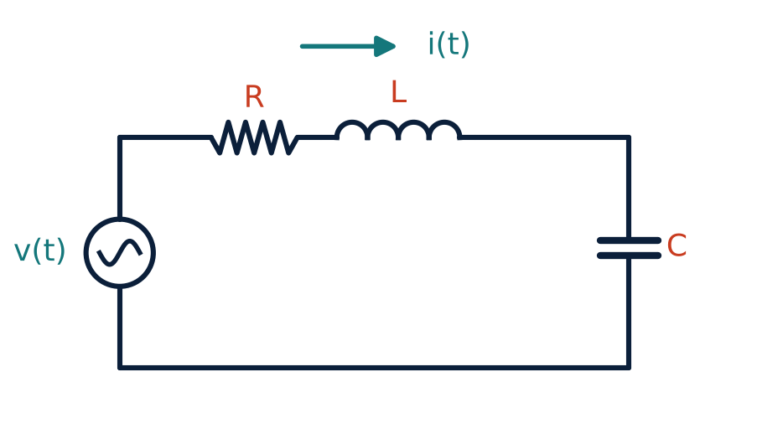
Series RLC circuit
U5
States: x1 = i (inductor current), x2 = vc (capacitor voltage).
L di/dt = u − R i − vc.
C dvc/dt = i.
Output y = vc.
Notes:
Choose the inductor current and capacitor voltage as states because they store energy.

Slide 5
RLC state model
U5
Problem Write the state model for R = 3 Ω, L = 1 H, C = 0.5 F (input u = source voltage, output vc). Verify with the transfer function.
ẋ1 = −(R/L)x1 − (1/L)x2 + (1/L)u = −3x1 − x2 + u
ẋ2 = (1/C)x1 = 2x1
A = [−3 −1; 2 0], B = [1; 0], C = [0 1], D = 0
det(sI − A) = s² + 3s + 2; G = C(sI − A)⁻¹B = 2/(s² + 3s + 2)
Answer: Eigenvalues −1, −2; G(s) = 2/(s² + 3s + 2)
Notes:
This equals Vc over V equals one over L C s squared plus R C s plus one.

Slide 6
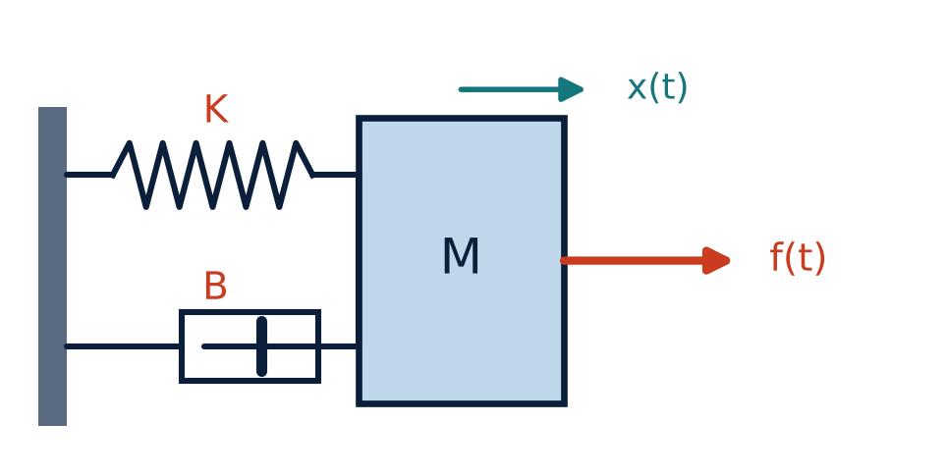
Mass–spring–damper
U5
States: x1 = x (position), x2 = ẋ (velocity).
ẋ1 = x2
ẋ2 = −(K/M)x1 − (B/M)x2 + (1/M)f
Output y = x1.
Notes:
Position and velocity describe the energy stored in the spring and in the mass.

Slide 7
Mass–spring–damper state model
U5
Problem M = 1 kg, B = 3 N·s/m, K = 2 N/m. Write A, B, C and check the poles.
A = [0 1; −K/M −B/M] = [0 1; −2 −3]
B = [0; 1/M] = [0; 1], C = [1 0], D = 0
det(sI − A) = s² + 3s + 2 ⇒ eigenvalues −1, −2
G(s) = 1/(s² + 3s + 2) — same as Unit 1
Answer: A = [0 1; −2 −3], B = [0; 1], C = [1 0]
Notes:
The eigenvalues of A equal the poles of the transfer function.

Slide 8
Remarks
U5
State-space model is not unique: a different state choice gives a different (similar) A.
Phase variable form can be derived directly from the transfer function.
Physical variables preferred when the internal quantities are of interest or must be measured.
MATLAB: sys = ss(A, B, C, D); step(sys), eig(A), tf(sys).
Notes:
Different choices of states represent the same input output behaviour.

Slide 9
Key takeaways
U5
Choose physical energy-storage variables as states
RLC: x = [i, vc]; mass-spring: x = [position, velocity]
ẋ = Ax + Bu, y = Cx; poles = eig(A)
Verify with G(s) = C(sI − A)⁻¹B
Notes:
To summarise this topic. Choose physical energy-storage variables as states. RLC: x = [i, vc]; mass-spring: x = [position, velocity]. ẋ = Ax + Bu, y = Cx; poles = eig(A). Verify with G(s) = C(sI − A)⁻¹B.

Slide 10
Practice questions
U5
Q1. Derive the state model of a series RLC circuit.
Q2. Write A, B, C for M = 2, B = 4, K = 8.
Q3. Find the eigenvalues of A = [0 1; −6 −5].
Q4. Convert the state model to a transfer function.
Notes:
Attempt these on your own, then check your working against your notes and textbook. Derive the state model of a series RLC circuit. Write A, B, C for M = 2, B = 4, K = 8. Find the eigenvalues of A = [0 1; −6 −5]. Convert the state model to a transfer function.

