Slide 1
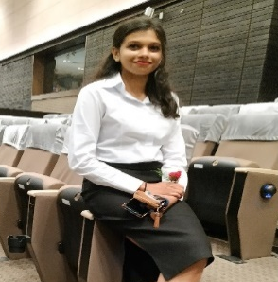

SENIOR FULL STACK ENGINEER
SRUTHI SANTHOSH
Experience Summary
Industry 4.0 Services[Mindtree]:
Hands on experience in JAVA application with SQL storage services.
Hands on experience in creation of core IoT application services communicating to Azure IoT Hub for device provisioning and device management using JAVA services, and azure storage accounts i.e. blob storage, table storage, file storage, queue storage.
Hands on Azure DevOps- Kubernetes , App Service container instances ,Static web app.
Involved in creating UI using React –for building device, user, tenant management
Involved in various technical discussions and project architecture understanding workshop.
Enterprise Search & Decision Moments – Mindtree’s Data Platform framework
Worked end to end implementation using react and python , also deployed services in AKS and client side in apache. Worked on implementing SOLR tool which is a key word-based search tool. Also contributed in integrating semantic search in one of the project.
Worked 3 months on creating Editor UI using angular for dynamic HTML element editing/styling .
Professional Summary:
I have a 2.7 years of professional experience with
hands on experience in java spring boot, python
React and cloud technologies. Hands on experience on IoT device management, device provisioning and device twin using Azure IoT hub
Hands on experience in Azure services like Azure Kubernetes services, Azure container instances, Azure storage services, Azure SQL, Azure IoT hub, Azure CLI, Azure DevOps and Azure app service.
Education:
B.Tech in computer science and engineering (2015-19)
Experience:
2years 7 months .
Tech Stack :
Client-side – React , Angular
Server-side- Java spring Boot , Python fast-API
Database - SQL , Mysql , Mongodb

Slide 2
Worked on to create a visualization of data comprehended from an excel using Angular and java Spring boot.
Created separate integrable user Authorization, Authentication , Accounting Service/Application.
Worked on Azure files shares, blob storage to upload large files in chunks by only using JS framework (Angular).
The application is deployed in Azure Kubernetes services.

