Slide 1

OCE: 5571, Naval Architecture Final Presentation
Automating Mono-Hull Hydrostatics Calculations Using MATLAB
Spring 2021
Daniel Wilkinson
Mohammad Barooni
Shitij Vishwakarma

Slide 2
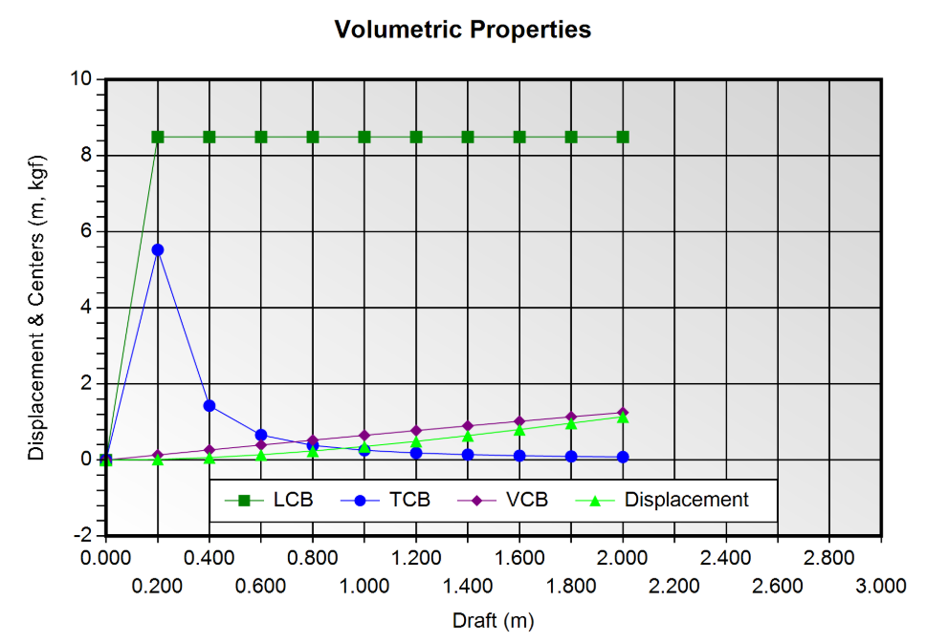
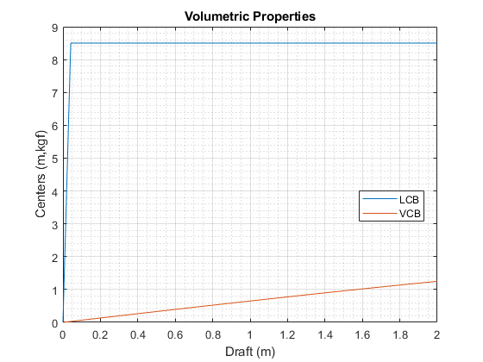
Results Overview
ORCA 3D Results
MATLAB Results
LCB | 0.000 | 8.497 | 8.500 | 8.500 | 8.500 | 8.500 | 8.500 | 8.500 | 8.500 | 8.500 | 8.500
 | 0.000 | 8.498 | 8.497 | 8.497 | 8.497 | 8.497 | 8.498 | 8.498 | 8.498 | 8.498 | 8.498
VCB | 0.000 | 0.133 | 0.264 | 0.394 | 0.523 | 0.650 | 0.775 | 0.898 | 1.018 | 1.136 | 1.250
 | 0.000 | 0.133 | 0.264 | 0.394 | 0.523 | 0.650 | 0.775 | 0.898 | 1.018 | 1.136 | 1.250

Slide 3
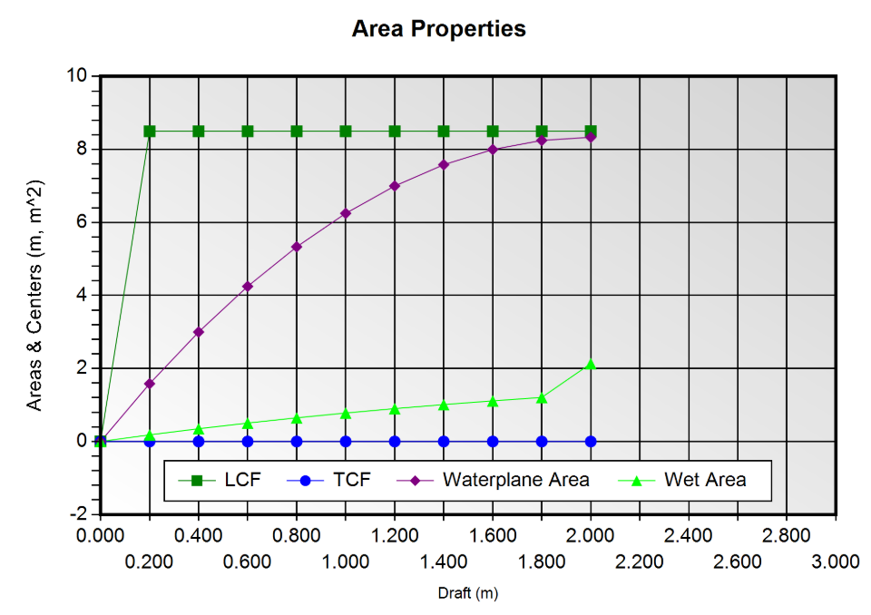
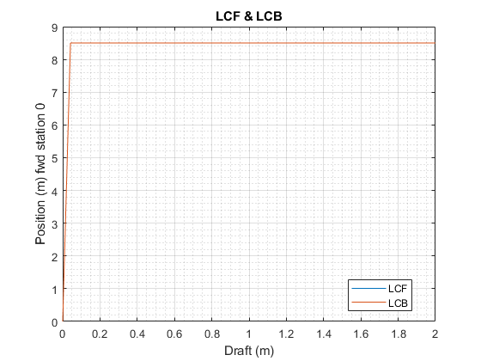
ORCA 3D Results
MATLAB Results
LCF | 8.500 | 8.500 | 8.500 | 8.500 | 8.500 | 8.500 | 8.500 | 8.500 | 8.500 | 8.500 | 8.500
 | 0.000 | 8.498 | 8.498 | 8.498 | 8.498 | 8.498 | 8.498 | 8.498 | 8.498 | 8.498 | 8.499

Slide 4
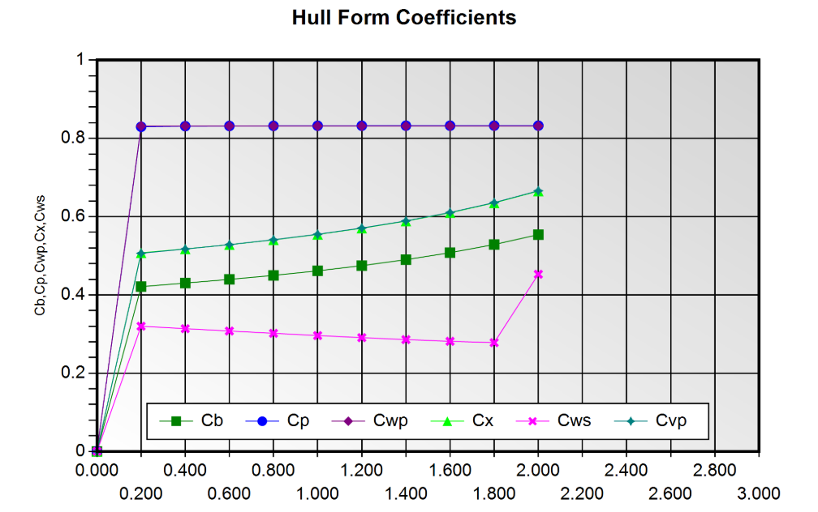
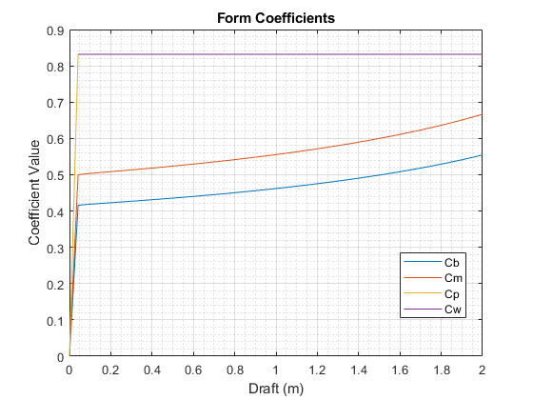
ORCA 3D Results
MATLAB Results
Cb | 0.000 | 0.423 | 0.431 | 0.440 | 0.450 | 0.462 | 0.475 | 0.490 | 0.508 | 0.529 | 0.554
 | 0.000 | 0.423 | 0.431 | 0.440 | 0.450 | 0.474 | 0.475 | 0.490 | 0.508 | 0.529 | 0.554
Cm | 0.000 | 0.508 | 0.518 | 0.529 | 0.542 | 0.555 | 0.571 | 0.590 | 0.611 | 0.636 | 0.667
 | 0.000 | 0.508 | 0.518 | 0.528 | 0.541 | 0.555 | 0.570 | 0.589 | 0.610 | 0.635 | 0.665
Cw | 0.832 | 0.832 | 0.832 | 0.832 | 0.832 | 0.832 | 0.832 | 0.832 | 0.832 | 0.832 | 0.832
 | 0.000 | 0.832 | 0.832 | 0.832 | 0.832 | 0.853 | 0.832 | 0.832 | 0.832 | 0.832 | 0.832
Cp | 0.000 | 0.831 | 0.832 | 0.832 | 0.832 | 0.832 | 0.832 | 0.832 | 0.832 | 0.832 | 0.832
 | 0.000 | 0.832 | 0.833 | 0.833 | 0.833 | 0.854 | 0.833 | 0.833 | 0.833 | 0.833 | 0.833

Slide 5
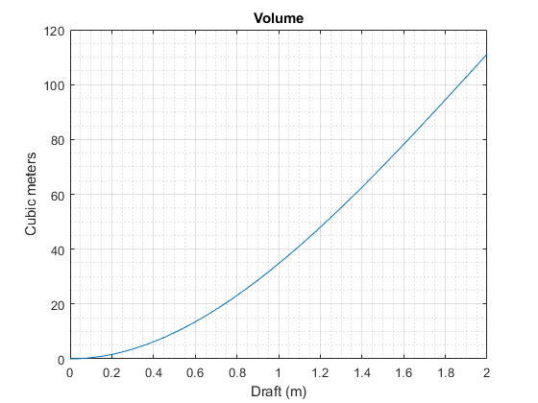
Other Results Summary
Volume vs Draft
Vol. Disp. | 0.00 | 1.65 | 6.38 | 13.83 | 23.68 | 35.58 | 49.19 | 64.17 | 80.17 | 96.85 | 113.89
 | 0.00 | 1.65 | 6.38 | 13.84 | 23.70 | 35.60 | 49.22 | 64.21 | 80.21 | 96.91 | 113.94

Slide 6
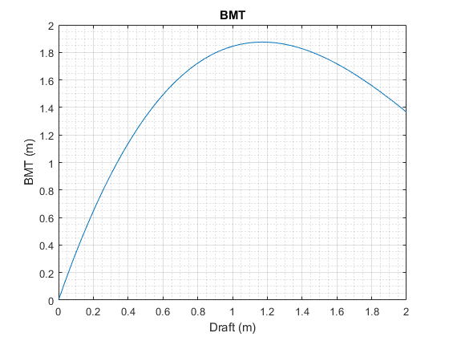
BMT
BMT | 0.000 | 0.647 | 1.139 | 1.492 | 1.722 | 1.845 | 1.875 | 1.827 | 1.717 | 1.559 | 1.366
 | 0.000 | 0.647 | 1.138 | 1.492 | 1.722 | 1.843 | 1.875 | 1.827 | 1.716 | 1.559 | 1.366

Slide 7
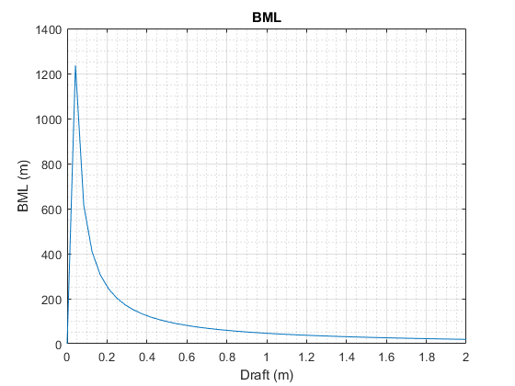
BML
BML | 0.00 | 252.03 | 124.20 | 81.09 | 59.43 | 46.36 | 37.56 | 31.19 | 26.34 | 22.48 | 19.31
 | 0.00 | 253.28 | 124.18 | 81.08 | 59.43 | 46.35 | 37.55 | 31.19 | 26.33 | 22.48 | 19.32

Slide 8
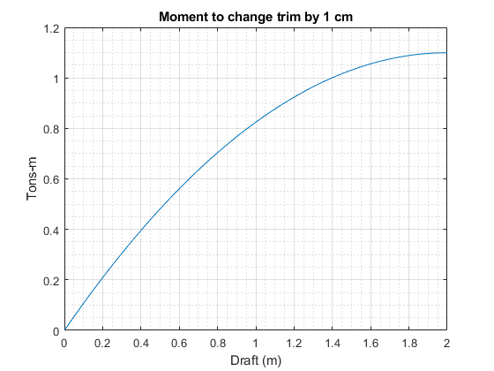
Tons per cm immersion
MCTC
TPC | 0.000 | 0.162 | 0.308 | 0.436 | 0.547 | 0.641 | 0.718 | 0.777 | 0.820 | 0.846 | 0.854
 | 0.000 | 0.162 | 0.307 | 0.436 | 0.547 | 0.640 | 0.717 | 0.777 | 0.820 | 0.845 | 0.854
MCTC | 0.000 | 0.209 | 0.396 | 0.561 | 0.704 | 0.825 | 0.924 | 1.001 | 1.056 | 1.089 | 1.100
 | 0.000 | 0.209 | 0.396 | 0.561 | 0.704 | 0.846 | 0.924 | 1.001 | 1.056 | 1.089 | 1.101

Slide 9
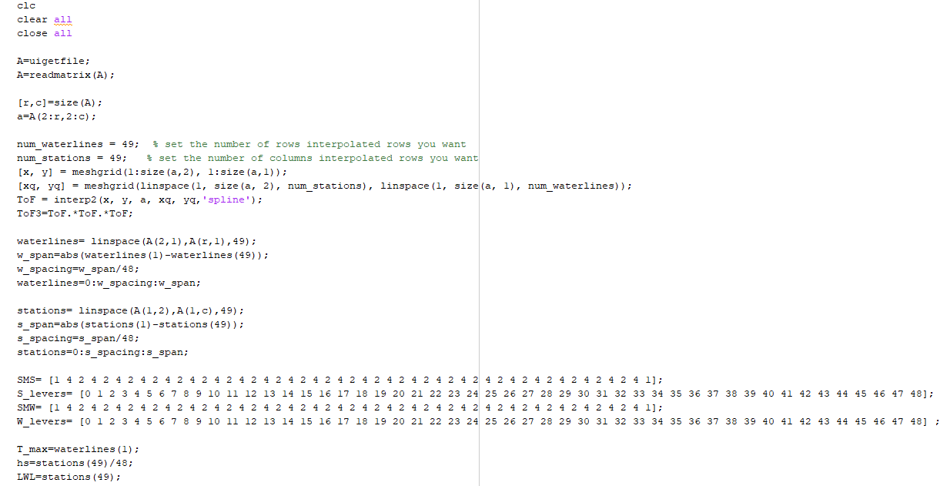
MATLAB Code Walkthrough

Slide 10
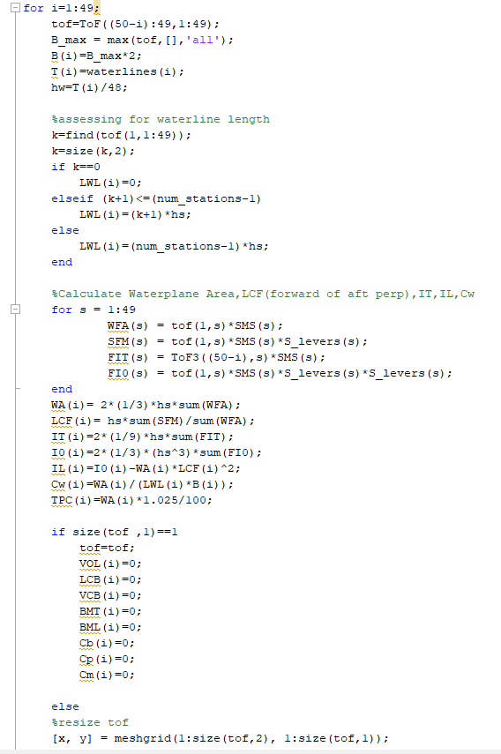

Slide 11
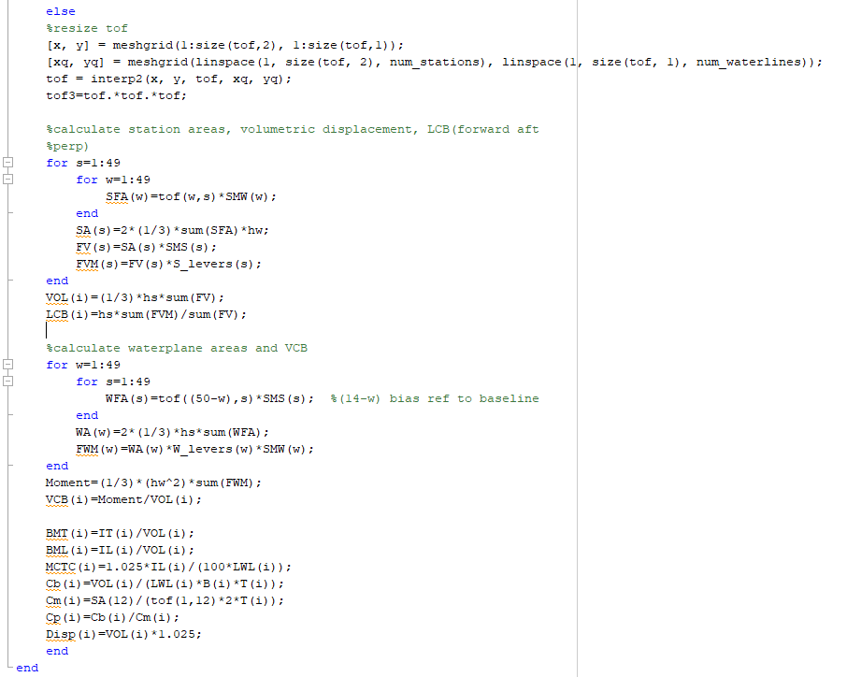

Slide 12
Thank you, for your attention.

