Slide 1
SMS
School Management System
Shitij Singh
Multi-Programming Developer

Slide 2
☺
Index
Introduction
Motivation
System Development
Conclusions
Shitij Singh

Slide 3
Introduction
A School Management System is a large database system which can be used for managing school's daily work.
It is configurable and can be configured to meet most individual school's needs.
It is a multi-user system and can be used by thousands of users at same time.
General speaking, it is platform running on a Local Area Network (LAN).
Shitij Singh

Slide 4
☺
Motivation
Introduction
Motivation
System Development
Conclusions
Shitij Singh

Slide 5
Motivation (1)
Every School is working on a developed strategy which aims the development of scalable structures in all the high schools of their respective countries.
Most of the high schools are already equipped with necessary hardware and network structures .
Open issue:
  Managing the information electronically.
Solution:
  School Management System
Shitij Singh

Slide 6
Motivation (2)
Goals:
  managing information on students,
  employees,
  teaching processes
  etc...
Initiative of a Professional High School .
Shitij Singh

Slide 7
System Development
Introduction
Motivation
System Development
Conclusions
Shitij Singh

Slide 8
System Development
☺
System Development
Analysis and Definition
Design
  Data Model
  Software Model
Implementation
Shitij Singh

Slide 9
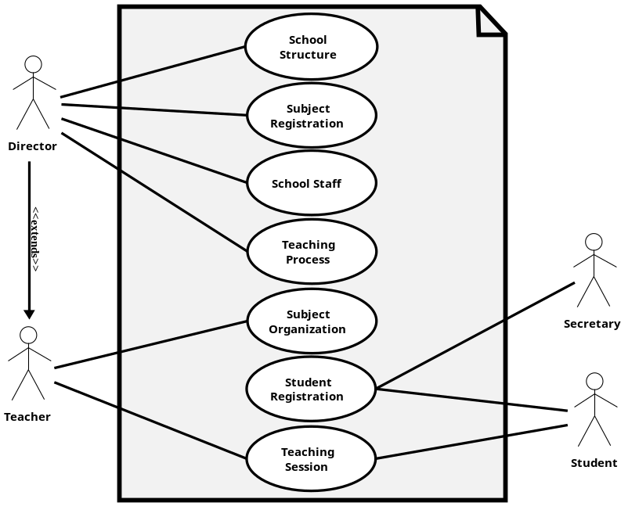
Analysis & Definition
The requirements specification document was created.
Existing documents were a good reference.
Shitij Singh

Slide 10
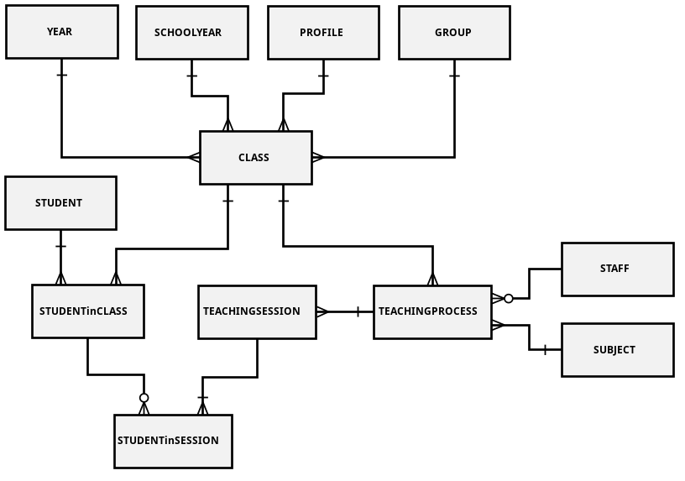
Design (Data Model)
We made decisions regarding how best to take the system in the real world and model it in a database.
A well-designed database takes time and effort to conceive, build and refine.
Shitij Singh

Slide 11
Design (Software Model)
Object-Oriented Modeling technique.
Designed in order to define a good ORM.
The model better describes interactions and relationships between objects representing real life entities.
Shitij Singh

Slide 12
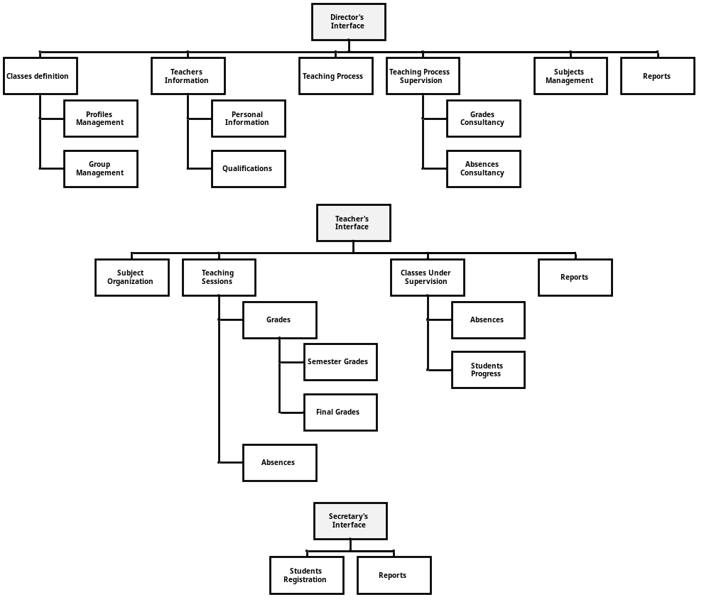
Implementation
3 levels of users with different rights upon the data/information that can be stored, retrieved or modified:
  Director
  Teachers
  Secretary
  Parents
Shitij Singh

Slide 13
☺
Conclusions
Introduction
Motivation
System Development
Conclusions
Shitij Singh

Slide 14
Technologies
Java 8
Spring / Spring Boot
Spring Securities
PostgreSQL
Tomcat 8
Hibernate
Shitij Singh

Slide 15
Conclusions
The need of managing the information electronically is growing rapidly in all important areas.
School Management Systems are being identified as an appropriate method for managing information in schools.
SMS was built based on real life situations in high school, taking into consideration all possible situations and functionalities of the daily work in these schools.
This system maybe considered as a good first step in implementing performing electronic based information management in schools.
Shitij Singh

Slide 16
Screen Shots

Slide 17
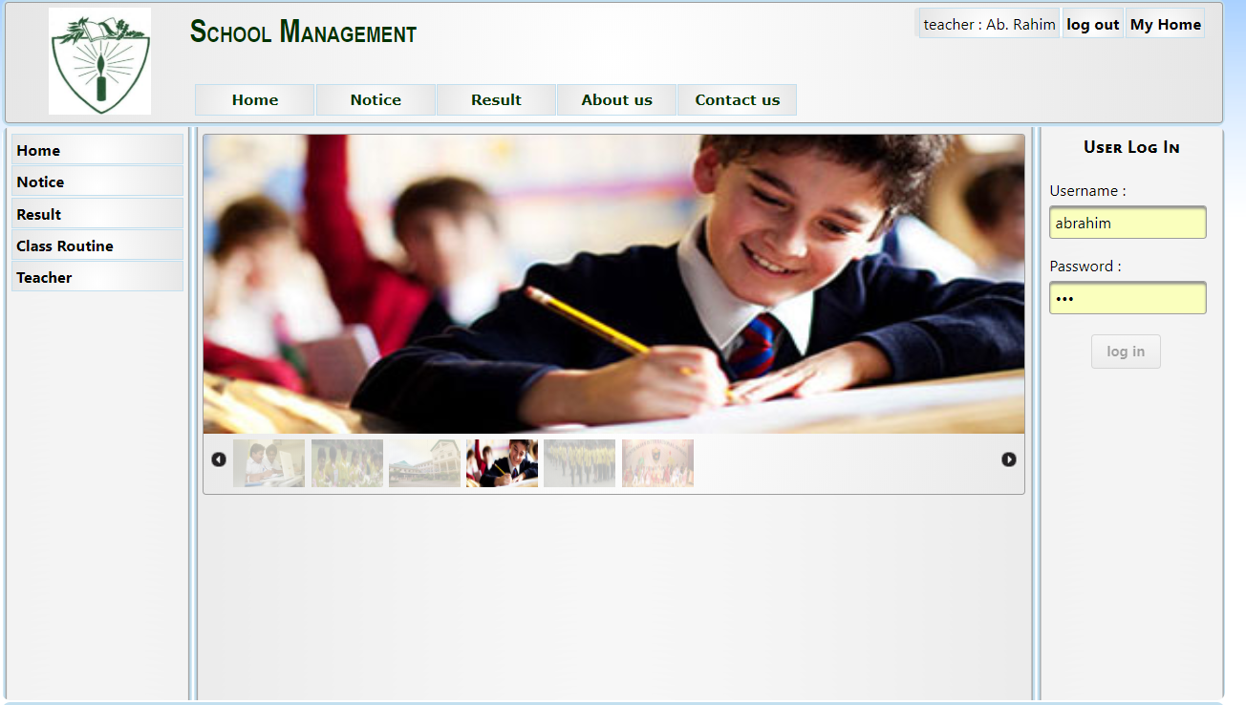
Home Page
Mihal Brumbulli

Slide 18
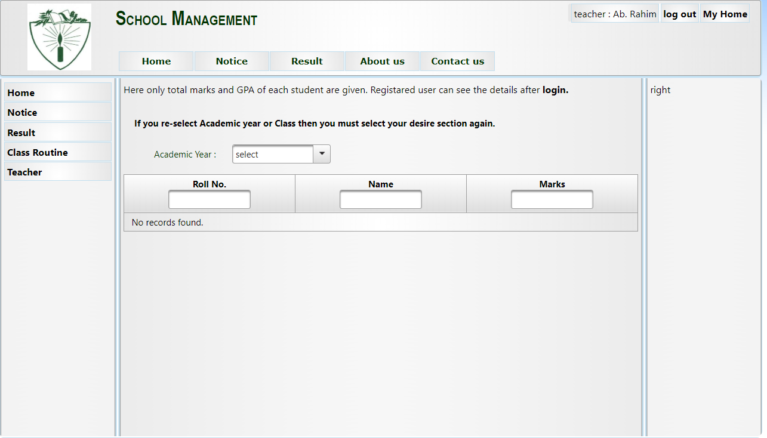
Result
Shitij Singh

Slide 19
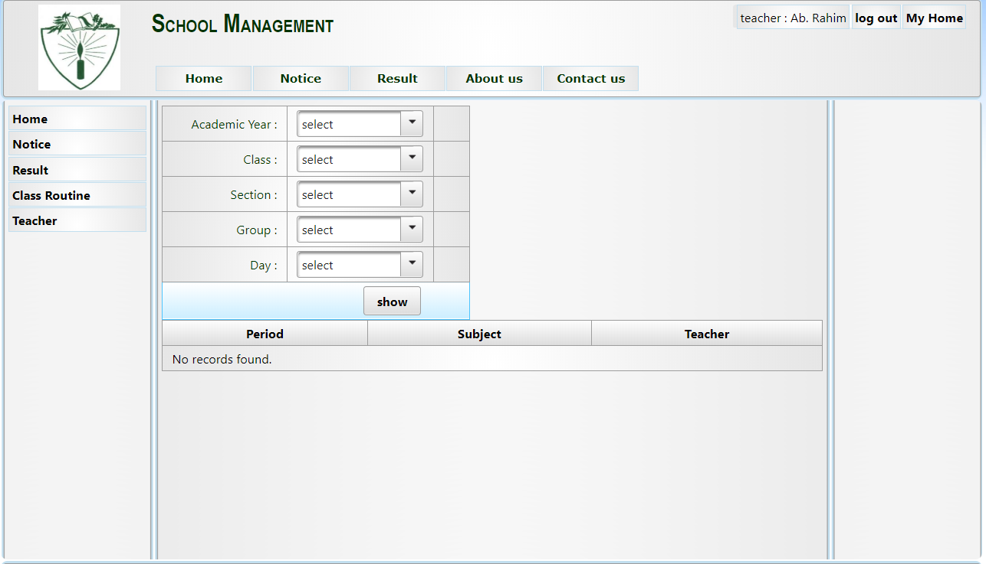
Class Routine
Shitij SIngh

Slide 20
Benefits of our Technologies
Java based systems are the most secured systems in the world.
Securities that we provide will be of OWASP standards.
Hack proof systems.
Multithreaded.
Can be accessed from anywhere in the world.
Staging of Roles.
Shitij SIngh

Slide 21
Thank You!
☺

