Slide 1


STUDENT PERFORMANCE FACTORS
LIBRARIES USED:
Pandas
Numpy
Seaborn
Matplotlib.pyplot
LabelEncoder from sklearn.preprocessing
Axes3D from mpl_toolkits
Norm from scipy.stats
cross_val_score, Kfoldfrom from sklearn.model_selection
LinearRegression, Ridge, Lasso sklearn.linear_model
RandomForestRegressor, GradientBoostingRegressor from sklearn.ensemble
r2_score, mean_squared_error from sklearn.svm
BY: SHITIZ KUMAR GUPTA
ROLL NO: A013
Github

Slide 2
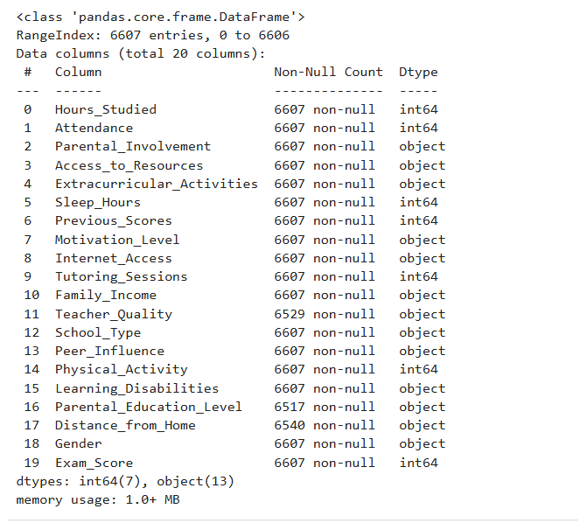
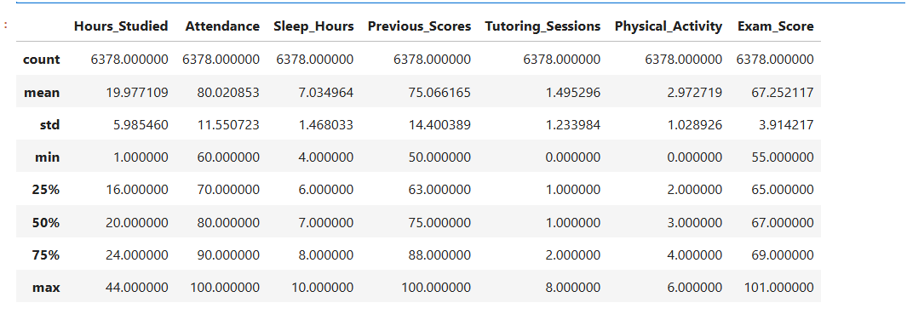
INTRODUCTION
This dataset provides a comprehensive overview of various factors affecting student performance in exams. It includes information on study habits, attendance, parental involvement, and other aspects influencing academic success.

Slide 3

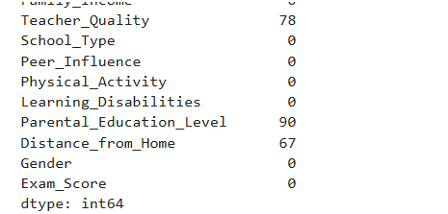

DATA CLEANSING
BEFORE DATA CLEANING
AFTER DATA CLEANING
Removed the null values and duplicates since the values were too low to affect the data frame.

Slide 4
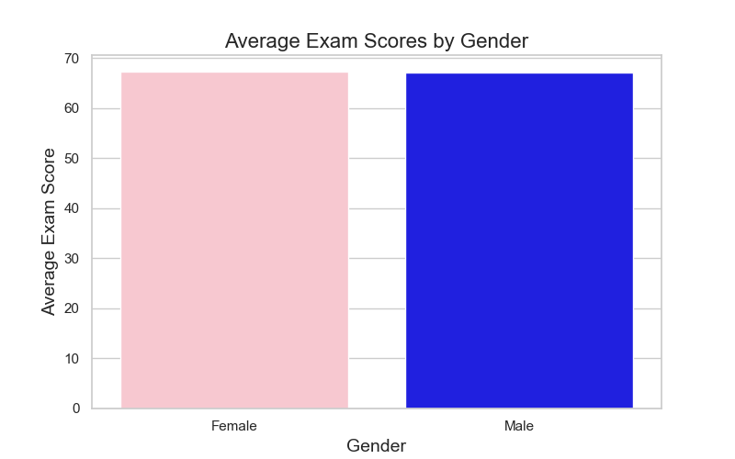
HYPOTHESIS TESTING
H₀ : Male and Female have equal Exam scores
H1: Male and Female do not have equal Exam scores
Using Z-test to test the mean score of two independent attributes: Male and Female.
Level of significance = 5%
Decision Criteria: Rejecting H₀ , if alpha > p-value
Conclusion:

Slide 5
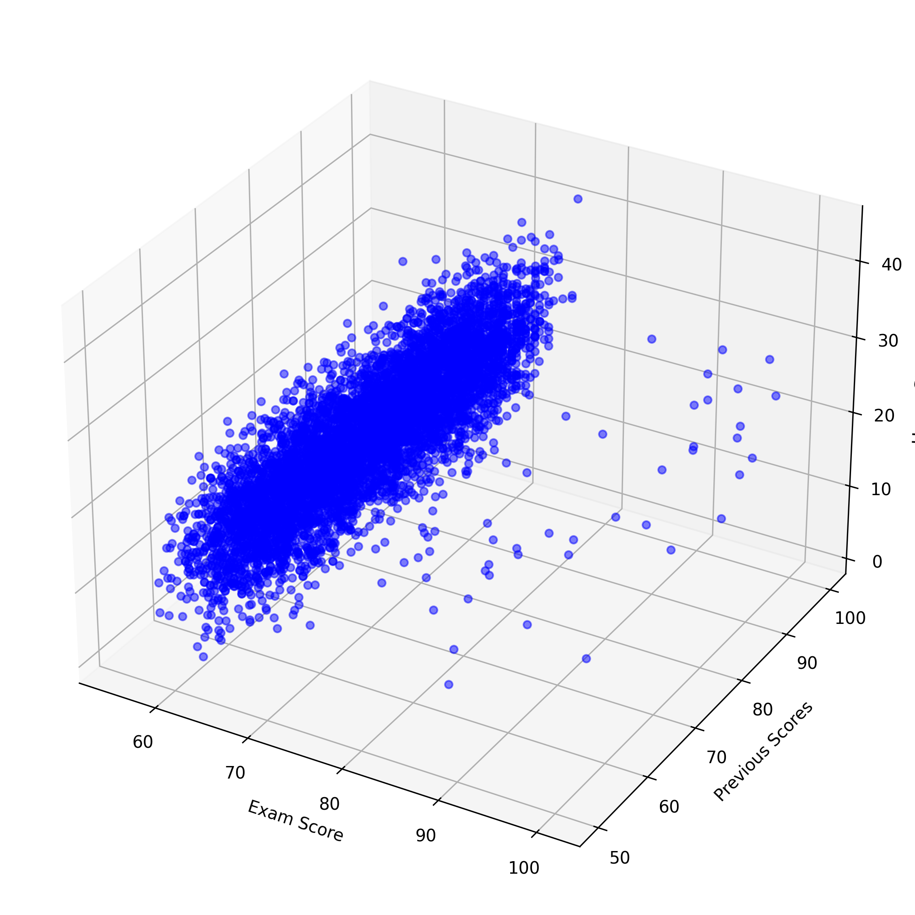
DATA VISUALIZATION
This 3D scatter plot provides a visual comparison between "Exam Score," "Previous Scores," and "Hours Studied.“
The plot shows a dense cluster of points along a diagonal plane, suggesting that students who have high previous scores and dedicate more hours to studying tend to achieve higher exam scores. This clustering indicates a positive correlation between consistent study habits and improved performance.
Some points deviate from the main cluster, indicating outliers. For instance, students with lower hours studied but still achieving high exam scores suggest other influential factors.

Slide 6
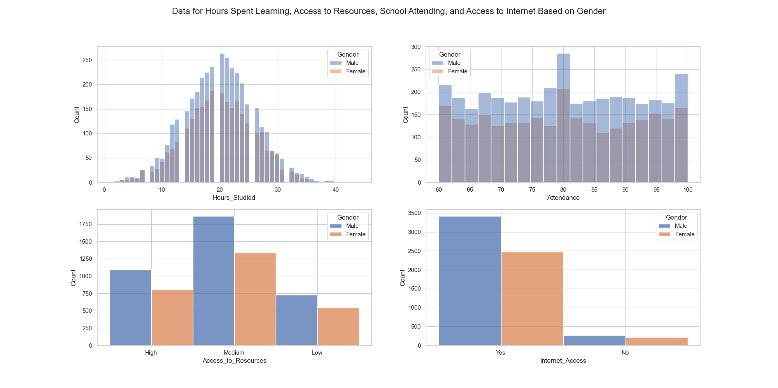
DATA VISUALIZATION
Males generally spending more time studying than females.
It shows that males have higher access to "High" and "Medium" resources compared to females, who are more concentrated in the "Low" access category.
The attendance plot shows that attendance rates are higher for males than females across the full range of attendance percentages. The internet access plot indicates that more males have access to the internet compared to females.

Slide 7
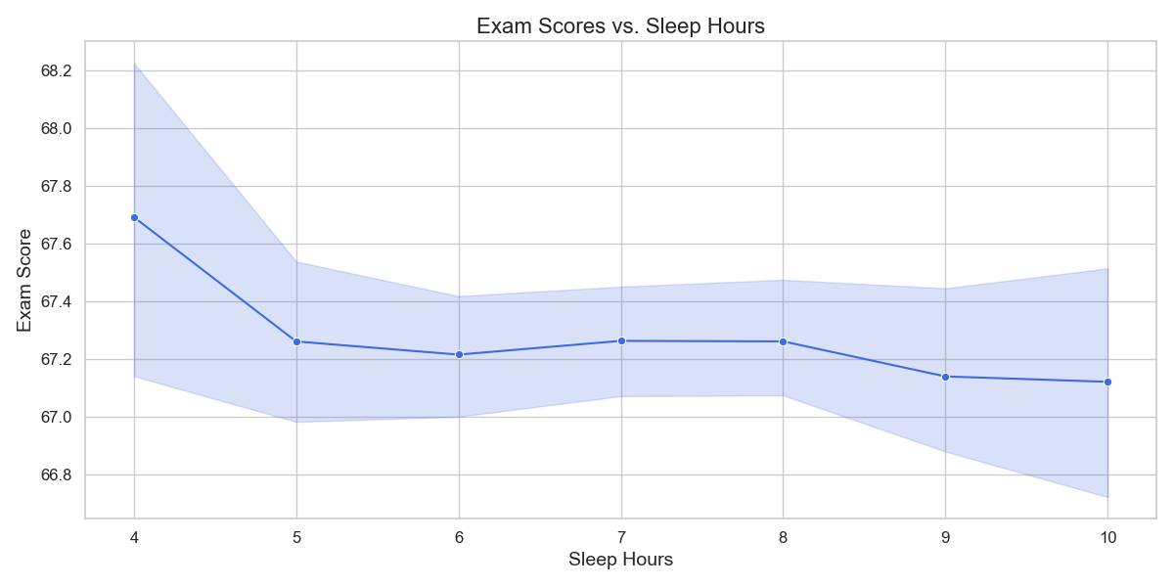
DATA VISUALIZATION
There's a slight initial decline in scores as sleep hours increase from 4 to 5 hours, after which the scores stabilize around 67.2 before gradually declining again.
Between 6 and 8 hours of sleep, exam scores show minimal variation, suggesting that moderate sleep does not significantly impact performance in this range. This may indicate an optimal range for maintaining consistent performance.
The shaded area represents the confidence interval or variability in exam scores across different sleep hours. This variability is more pronounced with fewer and more hours of sleep, possibly indicating inconsistent performance due to either lack or excess of sleep

Slide 8
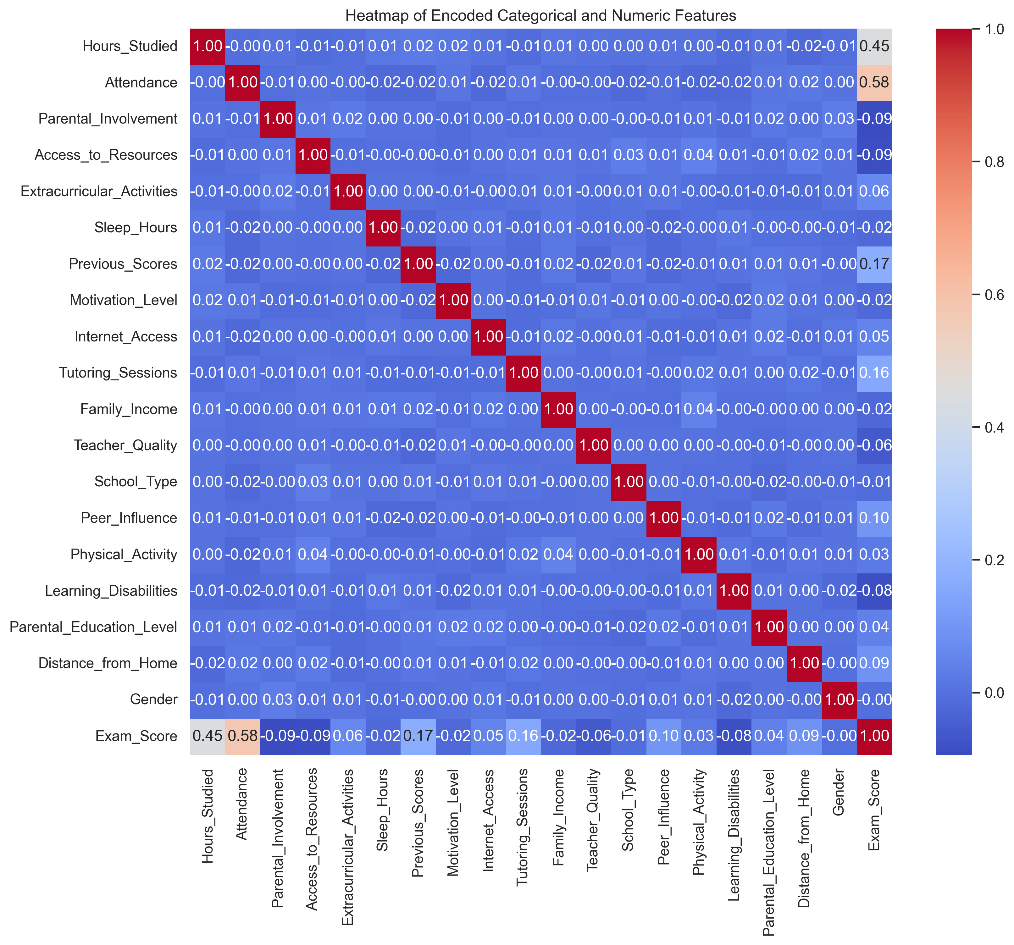
HEATMAP : CORRELATION ANALYSIS
Attendance shows the highest positive correlation (0.58) with exam scores, suggesting that regular class attendance is the most important factor for academic performance.
Hours studied also has a notable positive correlation (0.45) with exam scores, indicating that study time is the second most significant factor.
Previous scores have a moderate positive correlation (0.17) with exam scores
Limited Impact of Demographic Factors: Interestingly, factors like gender, distance from home, and parental education level show very weak correlations (near 0) with exam scores, suggesting that these demographic factors may not significantly influence academic performance.
Notable Weak or Negative Correlations: Parental involvement and access to resources show slight negative correlations (-0.09) with exam scores.

Slide 9
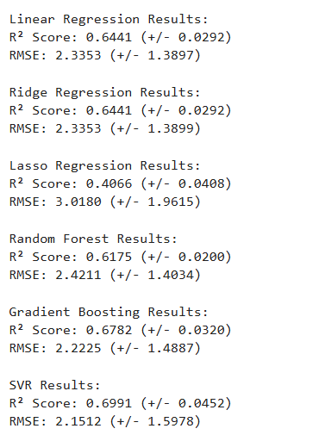
FITTING A MODEL TO PREDICT SCORE
Best Performing Model: SVR (Support Vector Regression)
Highest R² score: 0.6991
Lowest RMSE: 2.1512
However, it also has relatively high variability (±0.0452 for R², ±1.5978 for RMSE)
Close Second: Gradient Boosting
R² score: 0.6782
RMSE: 2.2225
More stable than SVR based on the standard deviations

Slide 10
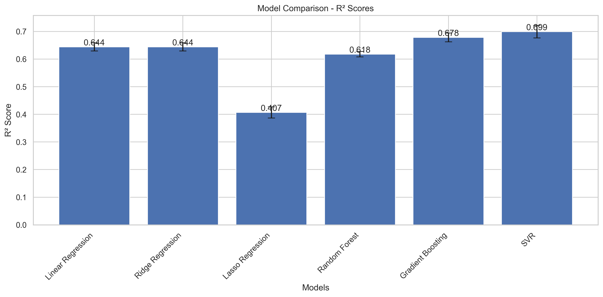

Slide 11
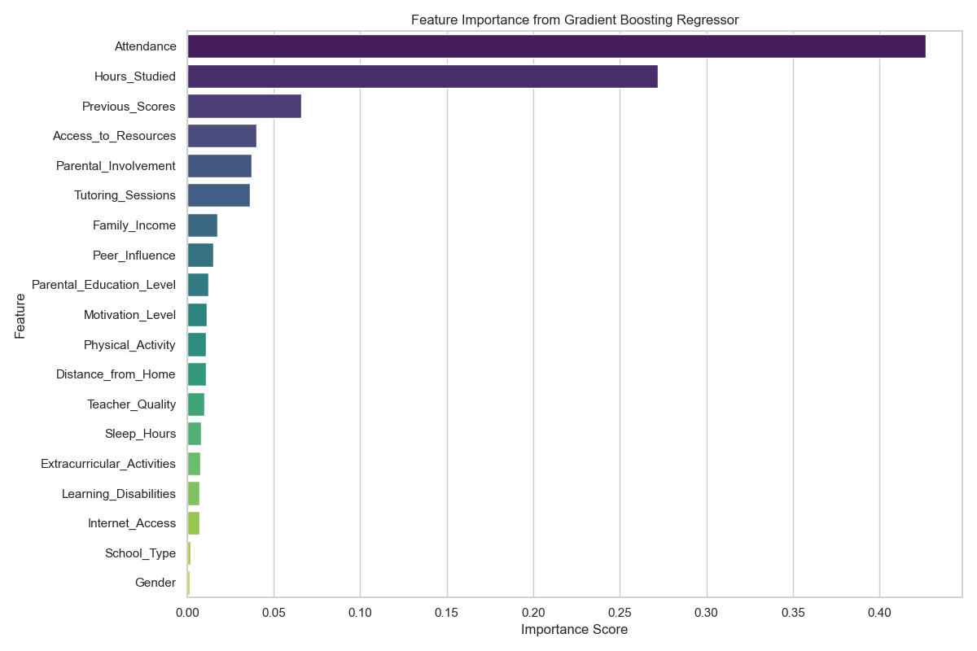

Slide 12
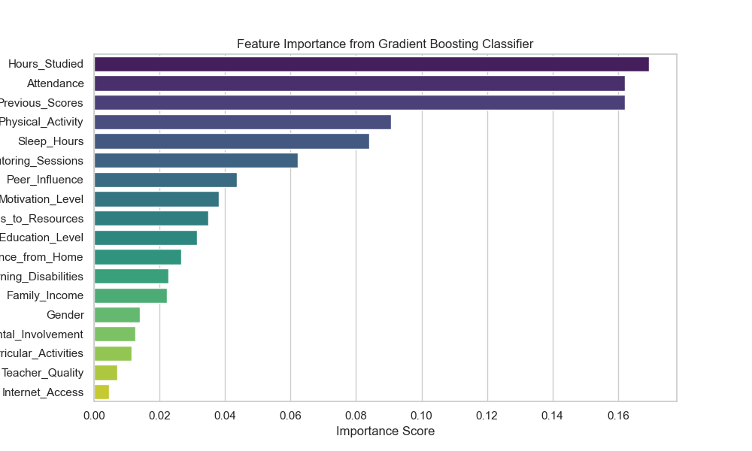
GRADIENT BOOSTING
Gradient Boosting builds a strong predictive model by iteratively adding weak learners (typically decision trees) that focus on correcting the mistakes of previous learners. Each new tree tries to predict the residual errors (the difference between predicted and actual values) from the combined previous trees, gradually improving the overall prediction accuracy.

Slide 13
CONCLUSION
Correlation Between Study Hours and Exam Scores: There appears to be a relationship between hours studied and exam scores, suggesting that increased study time may positively impact performance. This could inform recommendations for time management.
Impact of Parental Involvement and Education Level: Parental involvement and education levels may be influential factors in student performance, highlighting the value of parental support in academic success.
Access to Resources and Extracurricular Activities: Access to educational resources and participation in extracurricular activities likely correlate with better scores, suggesting the importance of well-rounded support systems in schools.
Influence of Health and Well-being: Data on sleep hours and physical activity indicate that students who maintain healthier lifestyles tend to perform better, underscoring the need for balanced routines.
Socioeconomic Factors and School Type: Socioeconomic background and school type also appear to impact student outcomes, emphasizing the need for equity in educational opportunities and resources.

Slide 14


