Slide 1


IL2225 Project
Project Group 20
Jinye Gong,
Shitong Guo, shitongg@kth.se
Weiyi Lyu
January 16, 2026

Slide 2
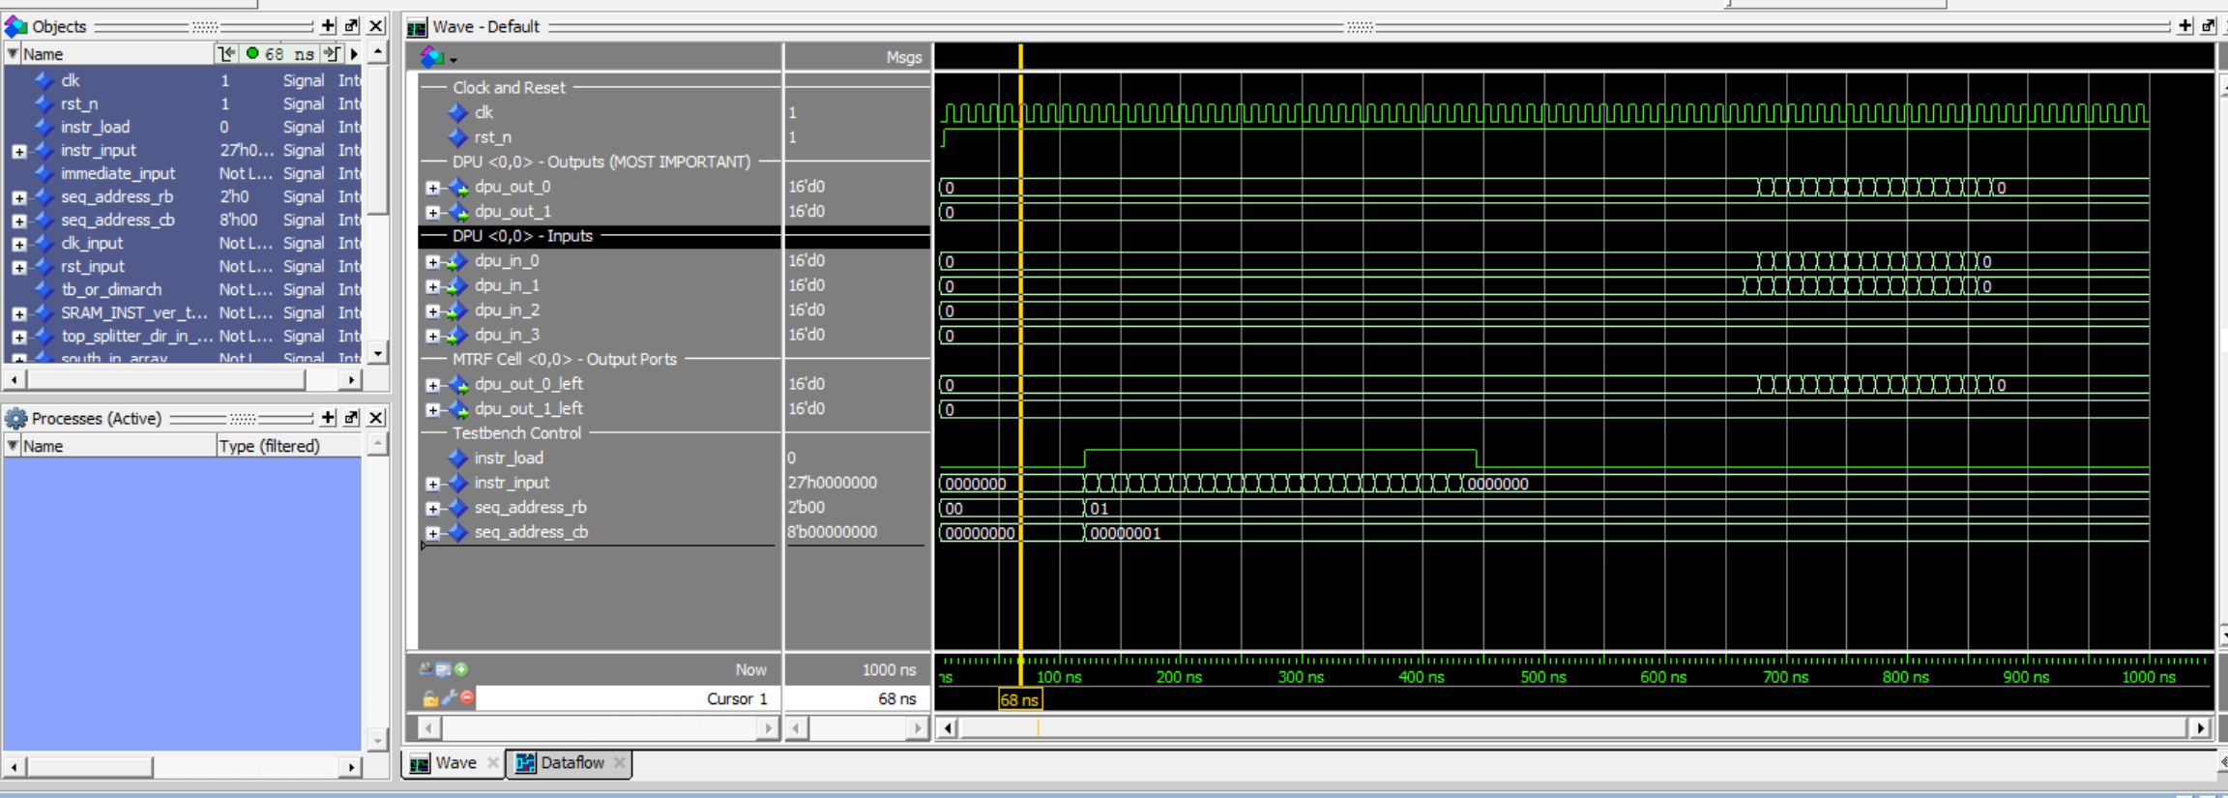
TASK 1 – Simulation of RTL design

Slide 3
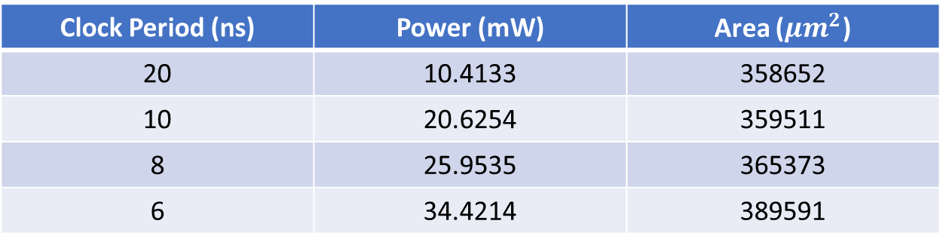
TASK 2 – Flat logic synthesis
Clock Period (ns) | Power (mW) | Area ($μm^{2}$)
20 | 10.4133 | 358652
10 | 20.6254 | 359511
8 | 25.9535 | 365373
6 | 34.4214 | 389591

Slide 4
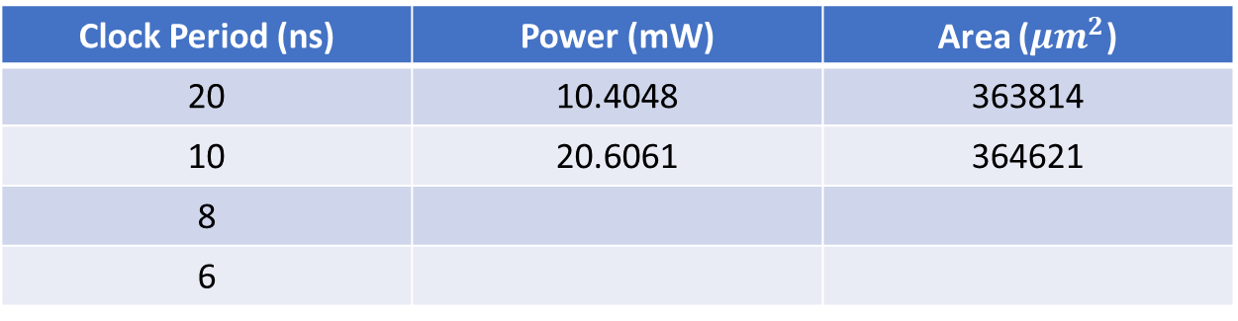
TASK 3 – Bottom-Up logic synthesis
Clock Period (ns) | Power (mW) | Area ($μm^{2}$)
20 | 10.4048 | 363814
10 | 20.6061 | 364621
8
6

Slide 5
Task 4 - Flat Physical synthesis

Slide 6
Task 5 - Floorplaning

Slide 7
Task 6 - Hierarchical Physical synthesis

Slide 8
THANK YOU!

