Slide 1



Logistic Regression
2021 DGIST MBIS Lab.
2021. 03. 03.
M.S candidate
JaeGeun Park

Slide 2
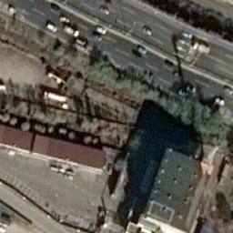

Input data
…
256 pixels
16 cuts
…
16 x 16 images
256 pixels
16 cuts
For each images
If segmented image have more than 128 white pixels
It have label [1] it means building
Else
It have label [0] It means ground

Slide 3
Input data
Image
Label
We change(16, 16, 3) array’s value
to one scalar value. It’s mean of (16, 16, 3)
[1]
576,000
pairs
………………
Scalar
Label
[128.432]
[1]
So we have many scalar and label pairs
576,000
pairs
………………

Slide 4
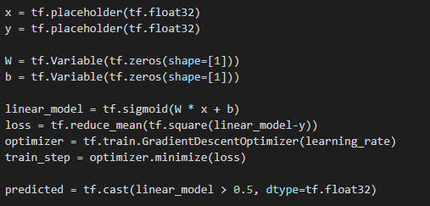
Logistic Regression Model
Model is simple Logistic Regression Model
Linear_model have sigmoid function because we need 0 to 1 output
We have to minimize distance between linear_model and y
Use GradientDescent for optimizer
If linear_model is smaller than 0.5, predicted = 0
Else predicted = 1

Slide 5
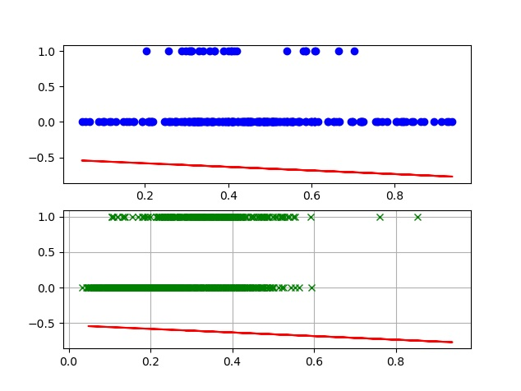
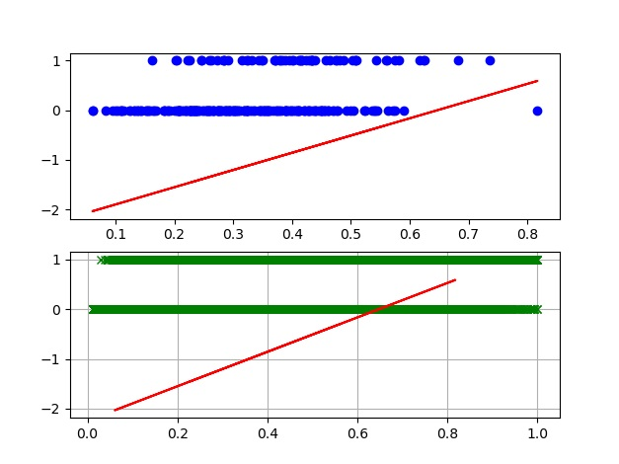
Problem # 1
Train with 768 pairs
Train with 576,000 pairs
It have different Outcome with same input
It’s not gonna work when using k-means clustering, SVM, or else
Because image’s feature is not good.
I think It’s not good idea that using mean value in image
Either It’s not work with using max value in image

Slide 6
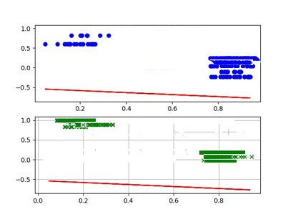
Problem # 1
If we have good feature, than we can use many other ways to find patterns
like using k-means or SVM also we can use Logistic Regression
Important Thing is we have to find good feature.

Slide 7
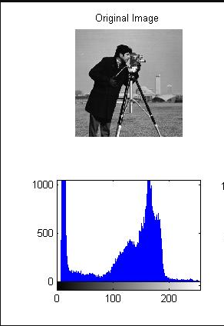
Problem # 1
w1 | w2 | w3
w4 | w5 | w6
w7 | w8 | w9
I want to know filter that make image to good feature
Train filter W with 16x16 images will work
Before that, I’ll check histogram between building images and ground image
If Histogram looks similar, mean value in image is not good for training

Slide 8
Problem # 2
Dataset is 576,000, but building label [1] is only 152,371
This unbalance of label[1] and label[0] is not good for training
I think we need preprocessing

Slide 9
Thank You

