Slide 1
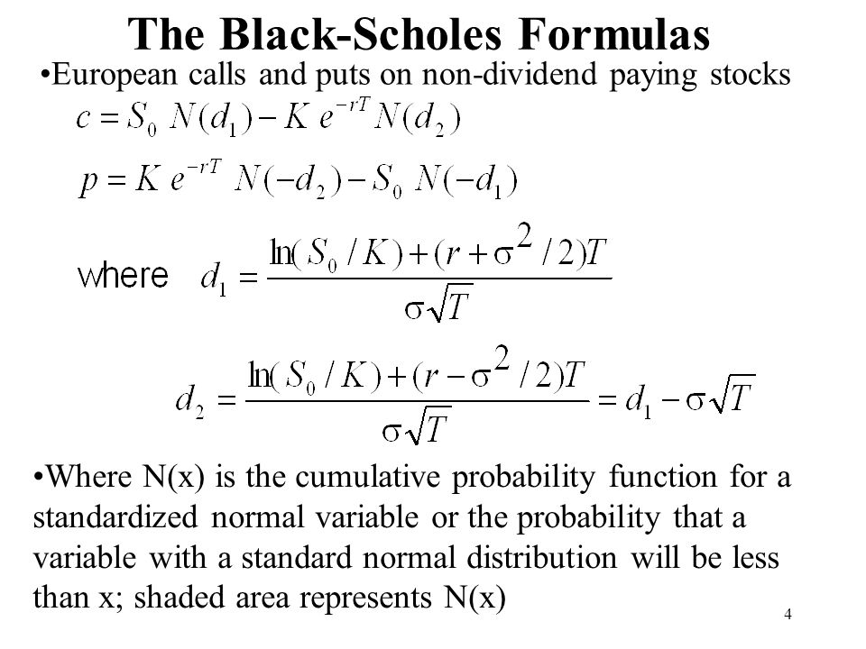
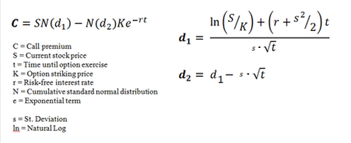

Option Value, C = Expected Value of the Stock you will receive, SN(d₁)
Minus
Expected value of the Strike to pay N(d₂)K, present valued e^{-rt}.

Slide 2
If we are in the money, and the option expires tomorrow:
N(x) => 1
C = S – K
If we are out of the money, and the option expires tomorrow:
N(x) => 0
C = 0 - 0

Slide 3
Why are d1 and d2 different?
Expected Value = payoff x probability
K is fixed. If the option is ITM, we pay K on exercise day, so its EV is present value of K times prob.
But S is just the stock price today. If we ultimately exercise, the stock value we receive can be anything.

Slide 4
We know S, K, t
We can guesstimate r
But we don’t know σ
We imply it back from the market price of the option, thus getting the market’s view of forward looking volatility.

Slide 5
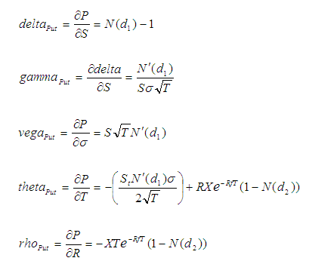
Δ | Change of premium with respect to underlying. “hedge ratio”
Γ | Change of delta with respect to underlying.
ν | Change of premium with respect to volatility.
θ | Change of premium with respect to time. “time decay” , “cost of carry”
ρ | Change of premium with respect to interest rates.
Chain Rule dy/dx = dy/du . du/dx
N(x) & N’(x) are the CDF & PDF of the normal distribution.
d ln(x) = 1/x
d e^{x} = e^{x}

Slide 6
Delta : rate of change of option price w.r.t. underlying asset
e.g. we operate in USD, but have an upcoming receipt of £1M in a mth.
Currently GBPUSD is 1.30, so a 1c drop would result in loss of $10,000
1mth 1.23 Put GBUS042019 has a delta of

