Slide 1
Presented to:
Md. Moshahidul Islam
Show and tell consultant limited
Project consultant IDB-BISEW

Slide 2
Welcome to Library Management System
Maintains Your Library Smartly

Slide 3
Overview of desktop Application
To manage the details of Student
To manage the details of Book
To manage the issue book
To manage the return book
update and delete

Slide 4
Using technologies:
Net Beans ide 8.2 version
Java Development kit 1.8
MySQL database
Core java and java swing with GUI environment.

Slide 5
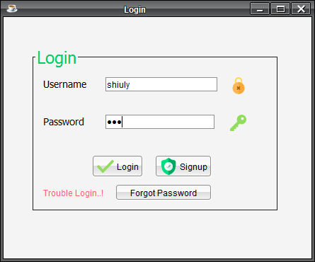
Design part of desktop app

Slide 6
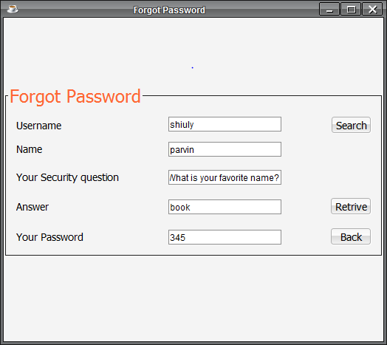

Slide 7
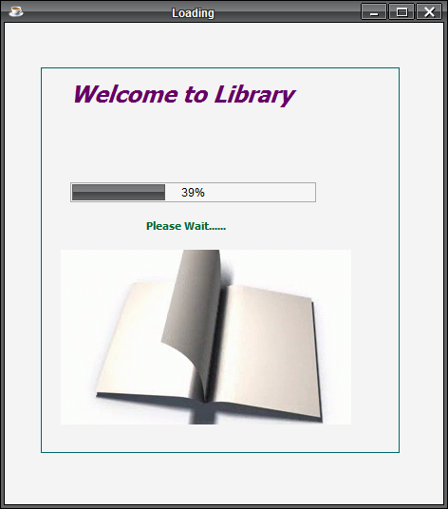

Slide 8
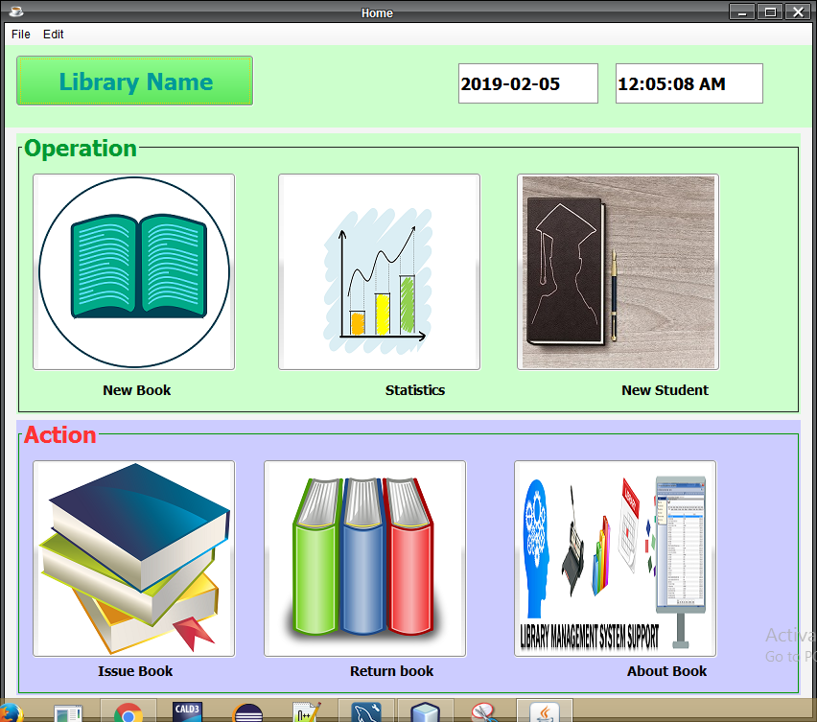

Slide 9
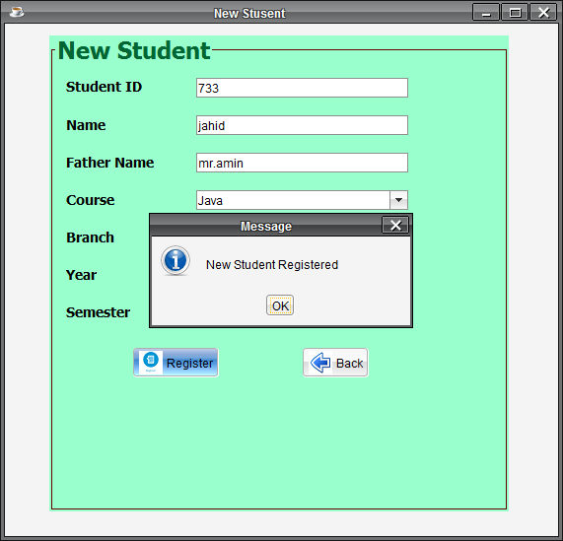

Slide 10
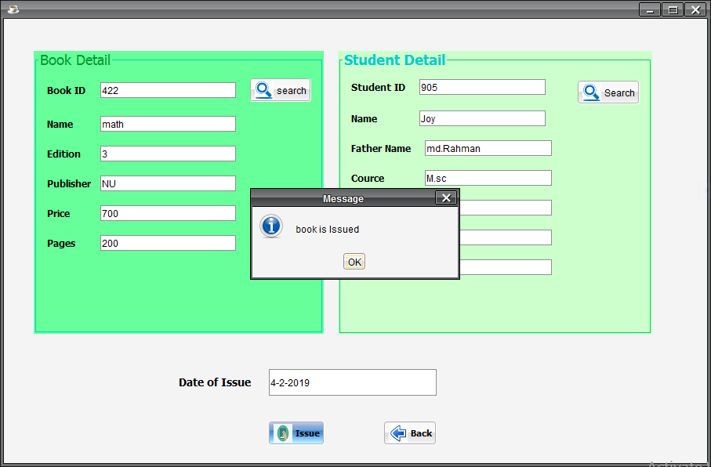

Slide 11
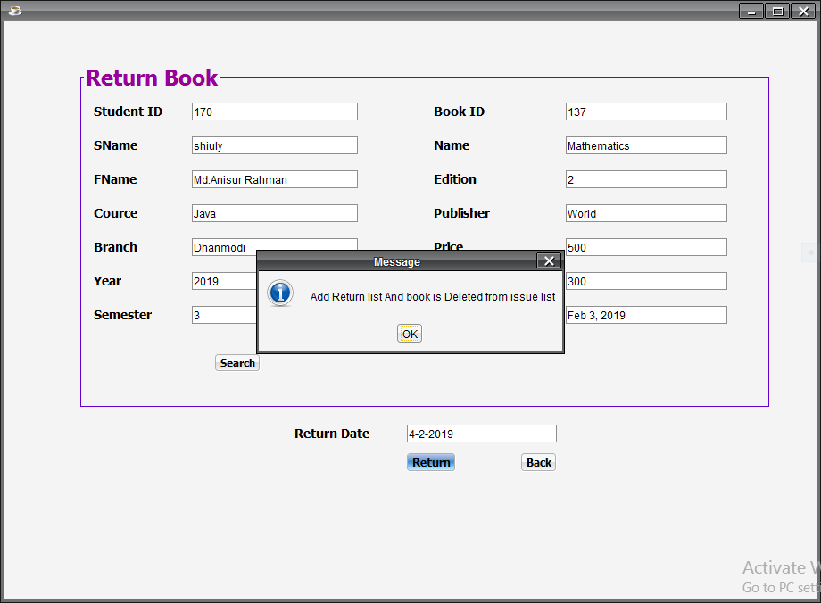

Slide 12
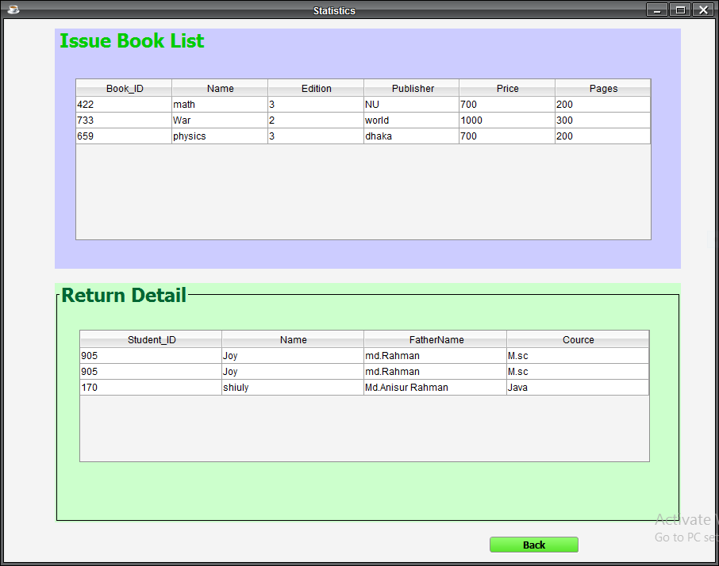

Slide 13
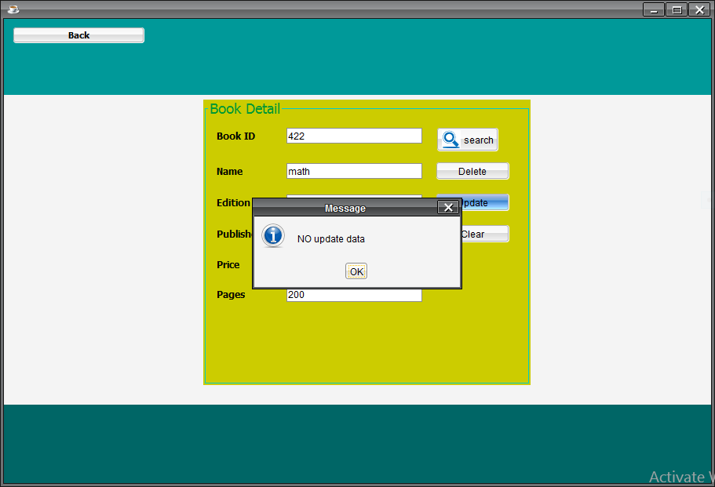

Slide 14
Limitation and Scope of future Work
Data are executed only off line
System is only for offline
Single small work capacity
Scope
Upgrade to online database
Enhance work capacity

