Slide 1

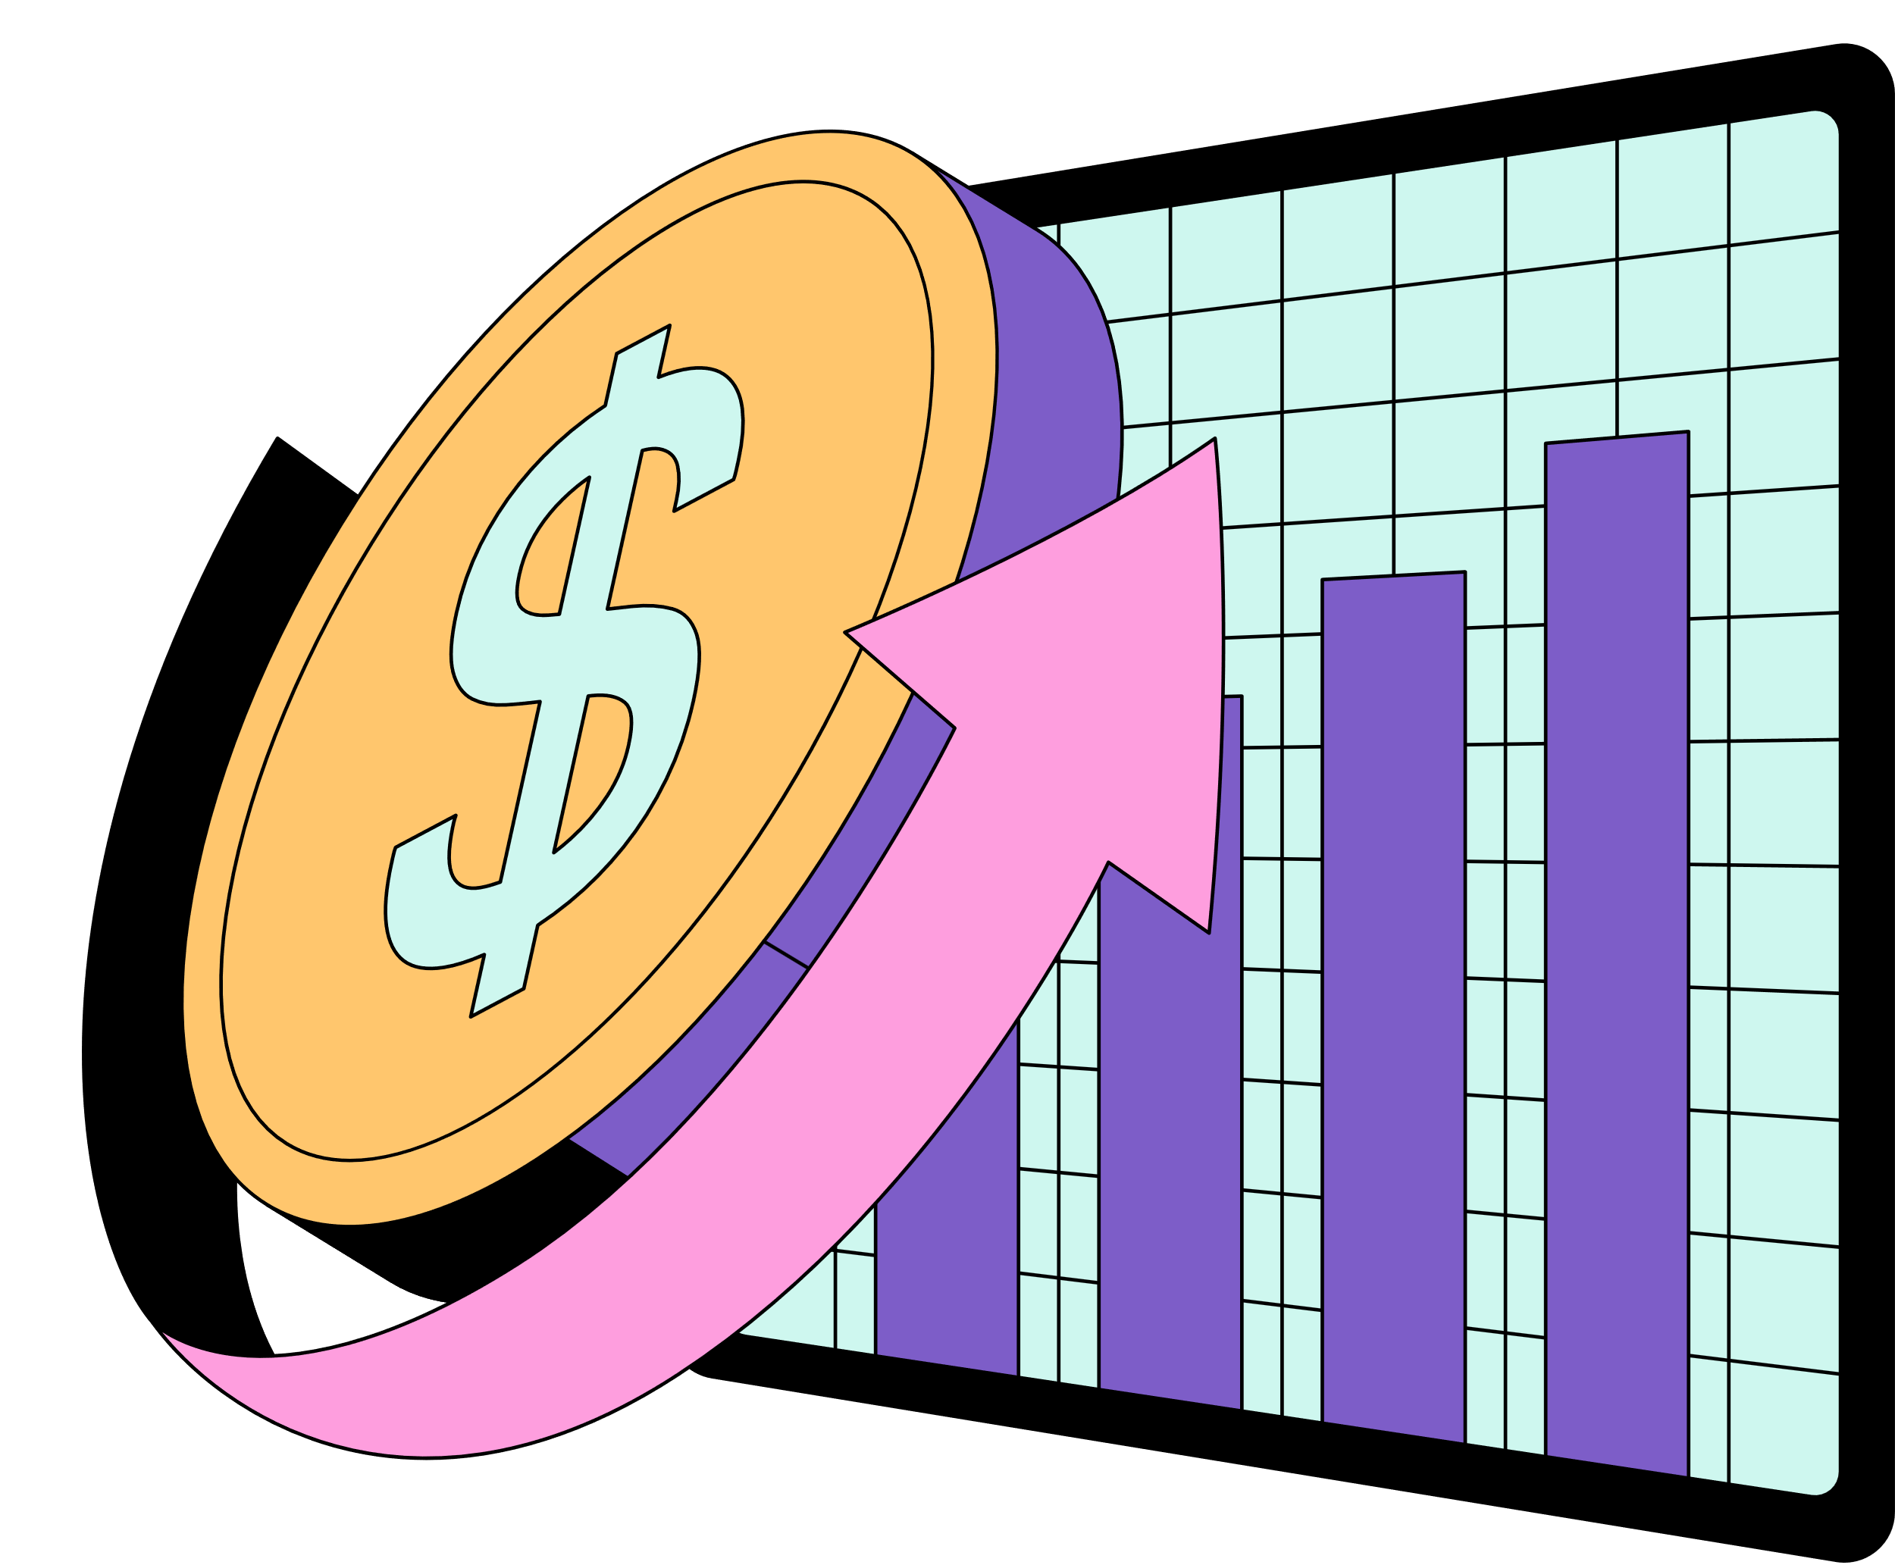
AI-Driven Stock Market Debate System
Industry Project--Etherwise
Guided By:
Prof.Diptee Ghusse
Group Members:
Shivshankar Ghyar - 202201040031
Shrushty Dhamange - 202201070016
Tejas Gophane -202201040063

Slide 2
AI-Driven Stock Market Debate System
GITHUB LINK
https://github.com/shiv-1540/AIStockMarketDebate1.git
DATASET LINK
https://www.kaggle.com/datasets/luisandresgarcia/stock-market-prediction

Slide 3


Problem Statement
Traders struggle to make informed decisions due to overwhelming and fast-changing market data.
Current AI tools lack multi-perspective analysis, often leading to biased or incomplete stock recommendations.

Slide 4
Problem Statement
The AI solution will have five inputs: market type, risk level, and timeframe.
The outputs will be the top three stock picks for the week with justifications, entry price, stop loss, and target price for each pick, along with a reasoning breakdown.
The system will consist of multiple AI agents, each with a specific role, debating to provide a comprehensive analysis. Additionally, the AI solution will be integrated into a web application for easier access and interaction. The output will be generated in Python.

Slide 5

Literature Survey
[1] Multi-Agent Systems: A Survey
Multi-Agent Systems (MASs) are used to solve complex problems by breaking them into smaller tasks, which are handled by independent agents. This survey explains what MASs are, how they work, where they’re used, and the main issues involved—serving as a useful guide for both researchers and professionals.
https://ieeexplore.ieee.org/stamp/stamp.jsp?tp=&arnumber=8352646
[2] Prediction of Stock Market Using Artificial Intelligence Application
This explores how AI-powered apps collect and analyze data to forecast stock movements, and discusses their current use, future potential, and impact on financial research. It highlights how AI simplifies complex market behavior and plays a growing role in shaping investment strategies.
https://ieeexplore.ieee.org/document/10952368

Slide 6
Literature Survey
AI System (Type) Purpose & Strengths Challenges
Expert-level fundamental reasoning Convincing narratives supporting its recommendation; broad coverage (can value any listed company)​
DBOT (Academic)
“Damodaran Bot
Single-perspective (one expert’s style)
ProPicks AI (InvestingPro)
a data-driven selection of “winners”)​
1. Past-dependent (regime changes could hurt performance)
2. Little transparency (users don’t see “why” each stock is picked)

Slide 7
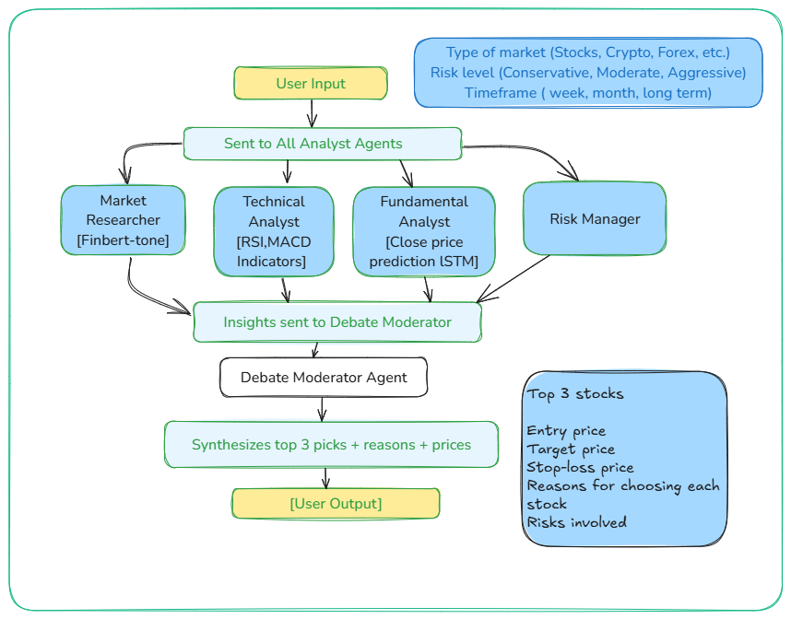

Solution Approach

Slide 8

Expected Outcome
Final Deliverables:
A live system that generates stock recommendations.
Clear buy/hold/sell signals with entry/target/stop-loss prices.
A dashboard for users to interact with the AI and view recommendations.
Business Impact:
Faster decision-making for traders.
Reduced emotional bias in stock selection.
Data-driven insights for better long-term investments.

Slide 9

THANK YOU !!

Slide 10
Suggestions & Improvements
Accuracy: Are there any other indicators or factors we should consider?
User Experience: How should we design the interface for traders?
Model Choice: Should we fine-tune a smaller model or stick with larger models for better accuracy?
Future Features: Is real-time market alerting or portfolio tracking valuable?

Slide 11
Feasibility & Future Scope
Feasibility:
Technically feasible using available AI models via OpenRouter and Python-based multi-agent frameworks.
Financially viable with free APIs, open-source tools, and scalable infrastructure.
Concept proven by existing academic prototypes and initial commercial applications.
Scope:
Builds a real-time, AI-powered stock recommendation system.
Uses five specialized agents for research, analysis, risk management, and decision-making.
Can be extended to support multiple markets (stocks, crypto, forex) and integrated with trading platforms.

Slide 12
Relevance & Innovation
Relevance:
Addresses the real-world problem of information overload in stock trading.
Helps traders make well-informed decisions by combining expert-like reasoning and real-time data analysis.
Aligns with current trends in AI-driven finance and personalized investment tools.
Innovation:
Uses a multi-agent debate system instead of a single AI model, simulating a panel of financial experts.
Integrates diverse perspectives—technical, fundamental, news-based, and risk-focused—for balanced stock recommendations.
Offers transparent, explainable AI decisions rather than black-box predictions.

