Slide 1

Campus-Sink
MITAOE SUPER-30 PHASE 3 PROJECT
Guided By:
Anuradha Pawar
Jayesh Raut Sir
Team Seascape
Dhiraj Rathod
Shivshankar Ghyar
Shravani Sakore
Diksha Tiwari

Slide 2
Problem Statement
In the current academic environment, institutions face multiple challenges in managing and coordinating student workloads, faculty tasks, and administrative responsibilities effectively.

Slide 3
Pain Points
Faculty/Admin Side
01 Lack of Dashboard View
>> cannot easily monitor deadlines,
submissions or allocated tasks from unified
platform
02 Coordinating with multiple departments
>> difficulty in collaboartion for
seminar/events
03 Limited Oversight
>> struggle to track performance or
engagement
Student Side
01 Lack of Centralized Communication
02 Overlapping Workload
>> multiple deadlines clashing and
increased stress
03 Manual Tracking
>> rely on informal methods
[whatsapp grps or CR]
04 Poor Feedback Mechanism
>> don’t get timely updates on their submissions, project reviews
05 Delayed Notification

Slide 4
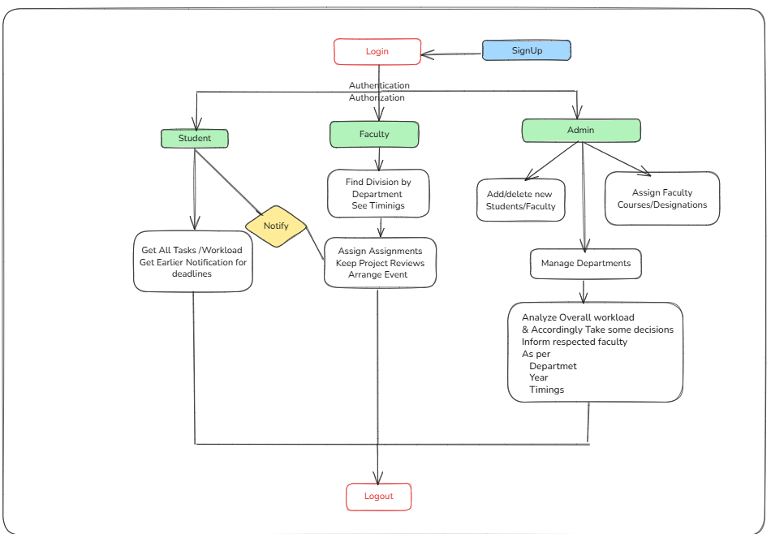
MindMap

Slide 5
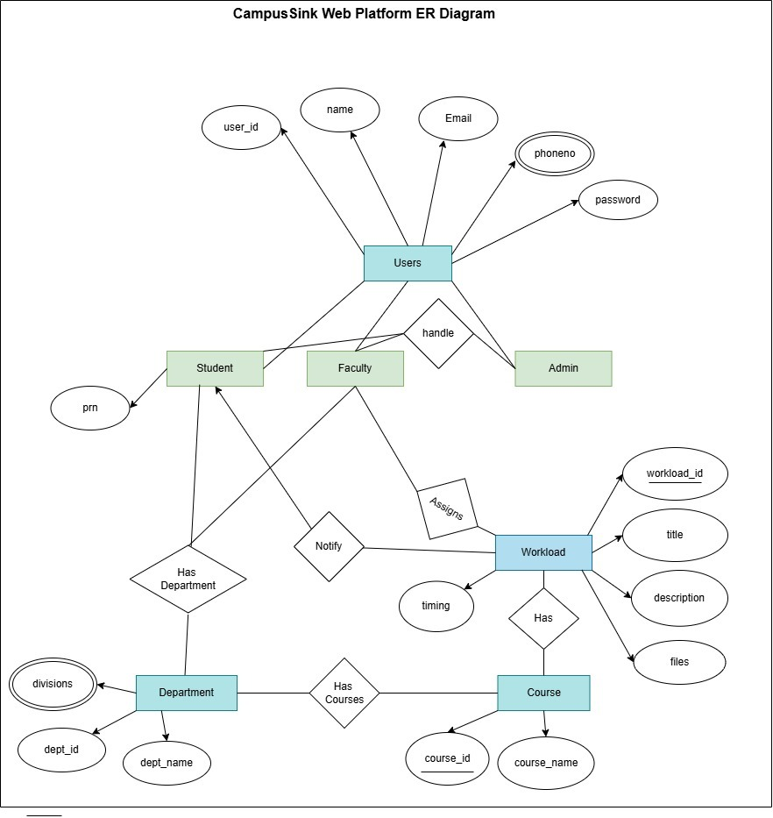
ERD

Slide 6
THANK YOU !!

