Slide 1



HackMe Tantrafiesta 2K22
Problem Statement – 2
Inter-linked platform for College and Tenders
Team Name
PUZZLE
Prashant Kumar
Shivansh Nagar
Vikash Rajput
College Name: IIIT Nagpur

Slide 2






Solution
Portal in the form of a user-friendly website integrated with a server for colleges and companies for efficient trading
Colleges can upload tender info, and track the entire process just through this portal on their dashboard.
Companies can easily apply for tender in single step process by filling a form.
After the given time duration colleges will get the best option and a sorted list of companies according to price, review, period of work and distance from institute and also notified by an auto generated e-mail.

Slide 3









Tech Stack
Front End
Back End
Website Host

Slide 4




Use Case 1
It will help the colleges get data about companies in the industry & come up with best option. Reduces time and efforts by linking colleges directly to companies.
Use Case 2
Easy for colleges to search for companies according to the requirements of the tender.
Use Case 3
This Website can be viewed as a business opportunity by companies.

Slide 5
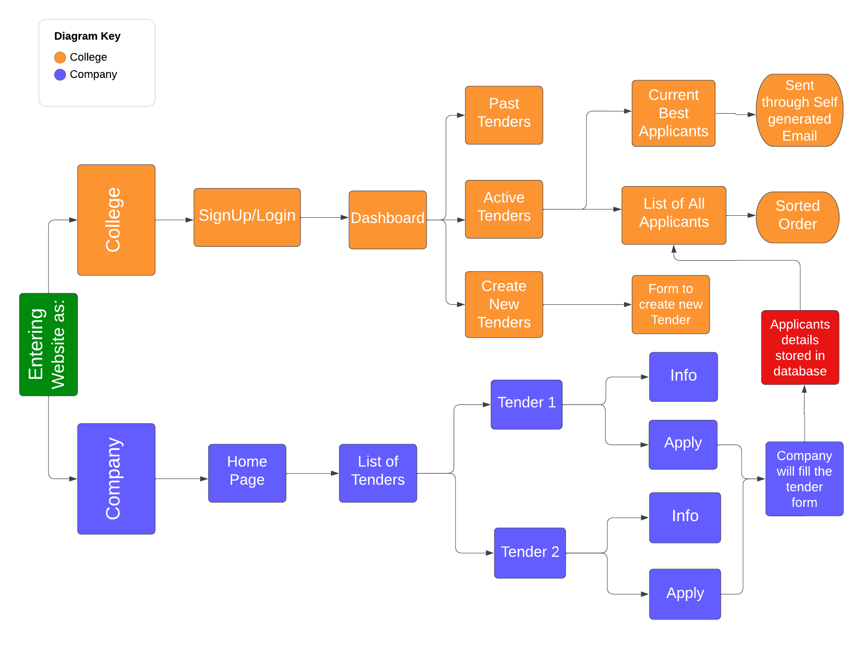
Working Model

