Slide 1
Warehouse robot coordination
A* search for a safe delivery wave
Fundamentals of AI
[Student Name] [Roll Number]
[Institution] [Faculty] [Submission Date]
1
Notes:
Present the objective in about 30 seconds. This is a single delivery wave with static shelves, built with explicit A* and space-time A*. Do not claim physical deployment. Student metadata must be replaced.

Slide 2
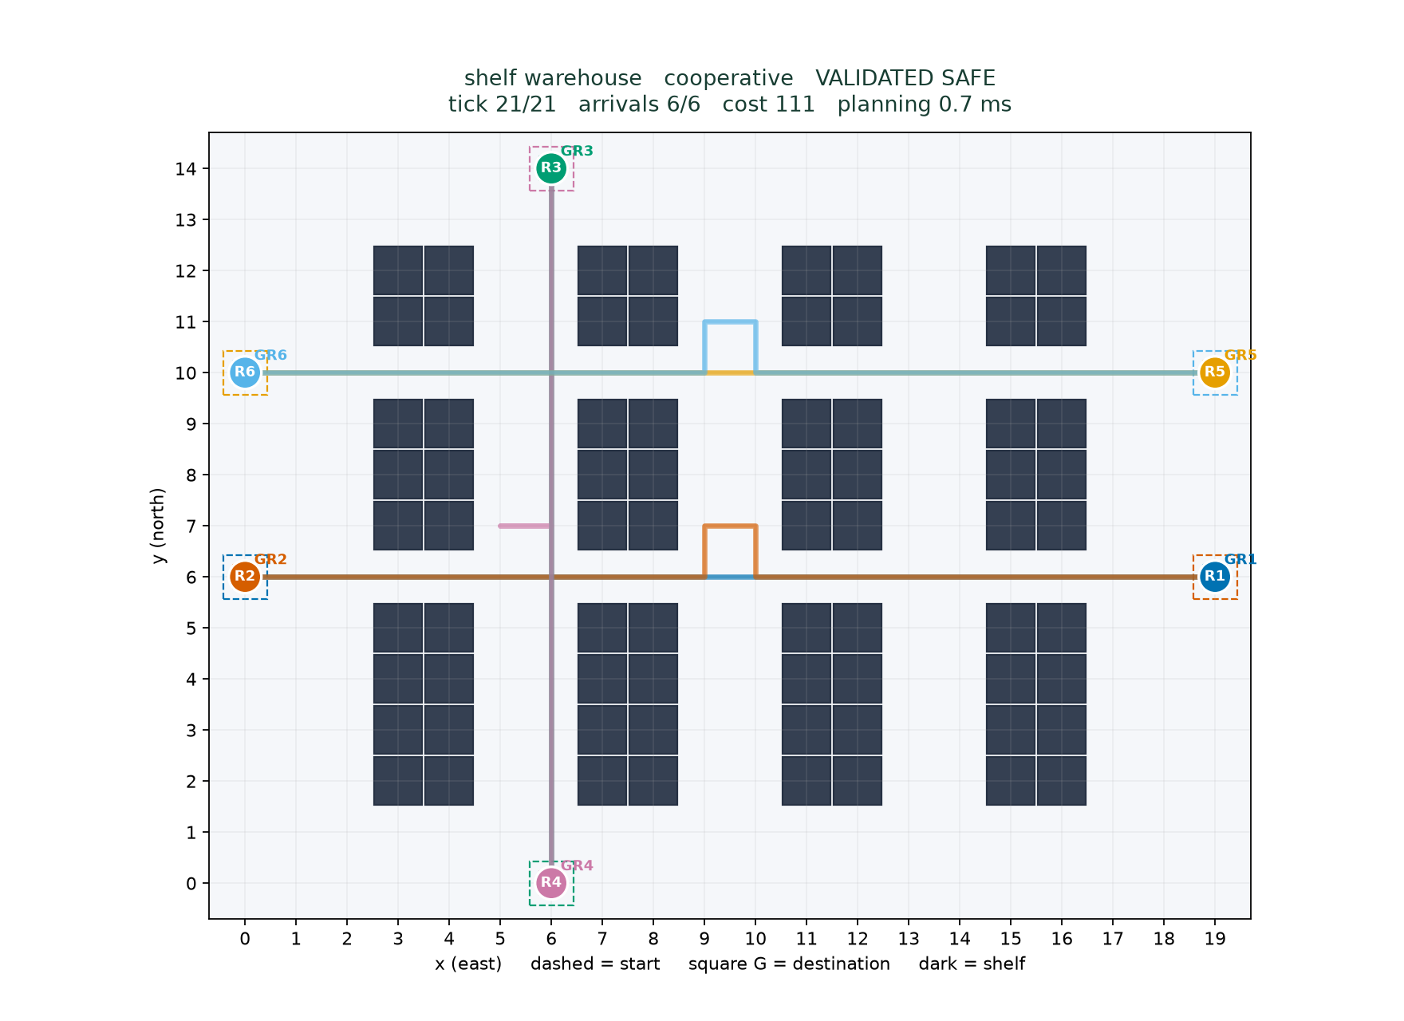
The warehouse problem
20 x 15 cells and six robots
Assigned starts and unique destinations
Crossing aisles connect shelf blocks
Safe completion is the primary objective
2
Notes:
Explain the six assigned loads, static shelf geometry and interacting routes. Primary aim is safe completion. Costs and finish times are performance measures, not globally optimized promises.

Slide 3
State actions and collision rules
Model | Rule
Coordinates | (x,y), east +x, north +y
Actions | N, S, E, W or wait, unit cost
Vertex conflict | Same cell at the same tick
Edge swap | Opposite traversal in one interval
Goals | Hold accepted terminal goals forever
Following | Allowed after another robot leaves
3
Notes:
Full state is all positions at a synchronous tick. Lower-level states add time. Following is permitted, vertex sharing and opposite-edge swaps are forbidden. Final goals persist indefinitely. A nonterminal goal visit can depart when holding is unsafe.

Slide 4
Spatial A* search
f(n) = g(n) + h(n)
Manhattan h = |x - goal_x| + |y - goal_y|
Cell toward (2,1) | g | h | f
(0,0) | 0 | 3 | 3
(1,0) | 1 | 2 | 3
(2,0) | 2 | 1 | 3
heapq frontier
Deterministic ties
Stale-entry check
h = 0 comparison
4
Notes:
Source [1]: [1] Hart, P. E., Nilsson, N. J., and Raphael, B. (1968). A Formal Basis for the Heuristic Determination of Minimum Cost Paths. IEEE Transactions on Systems Science and Cybernetics 4(2), 100-107. DOI 10.1109/TSSC.1968.300136. https://ieeexplore.ieee.org/document/4082128 Explain g as known cost, h as lower bound. Each orthogonal move reduces Manhattan by at most one. A zero heuristic gives Dijkstra through the same function. Shared _search uses heapq and skips stale entries. In the worked no-obstacle example root (0,0) to (2,1) has g=0,h=3,f=3. After east, g=1,h=2,f=3.

Slide 5
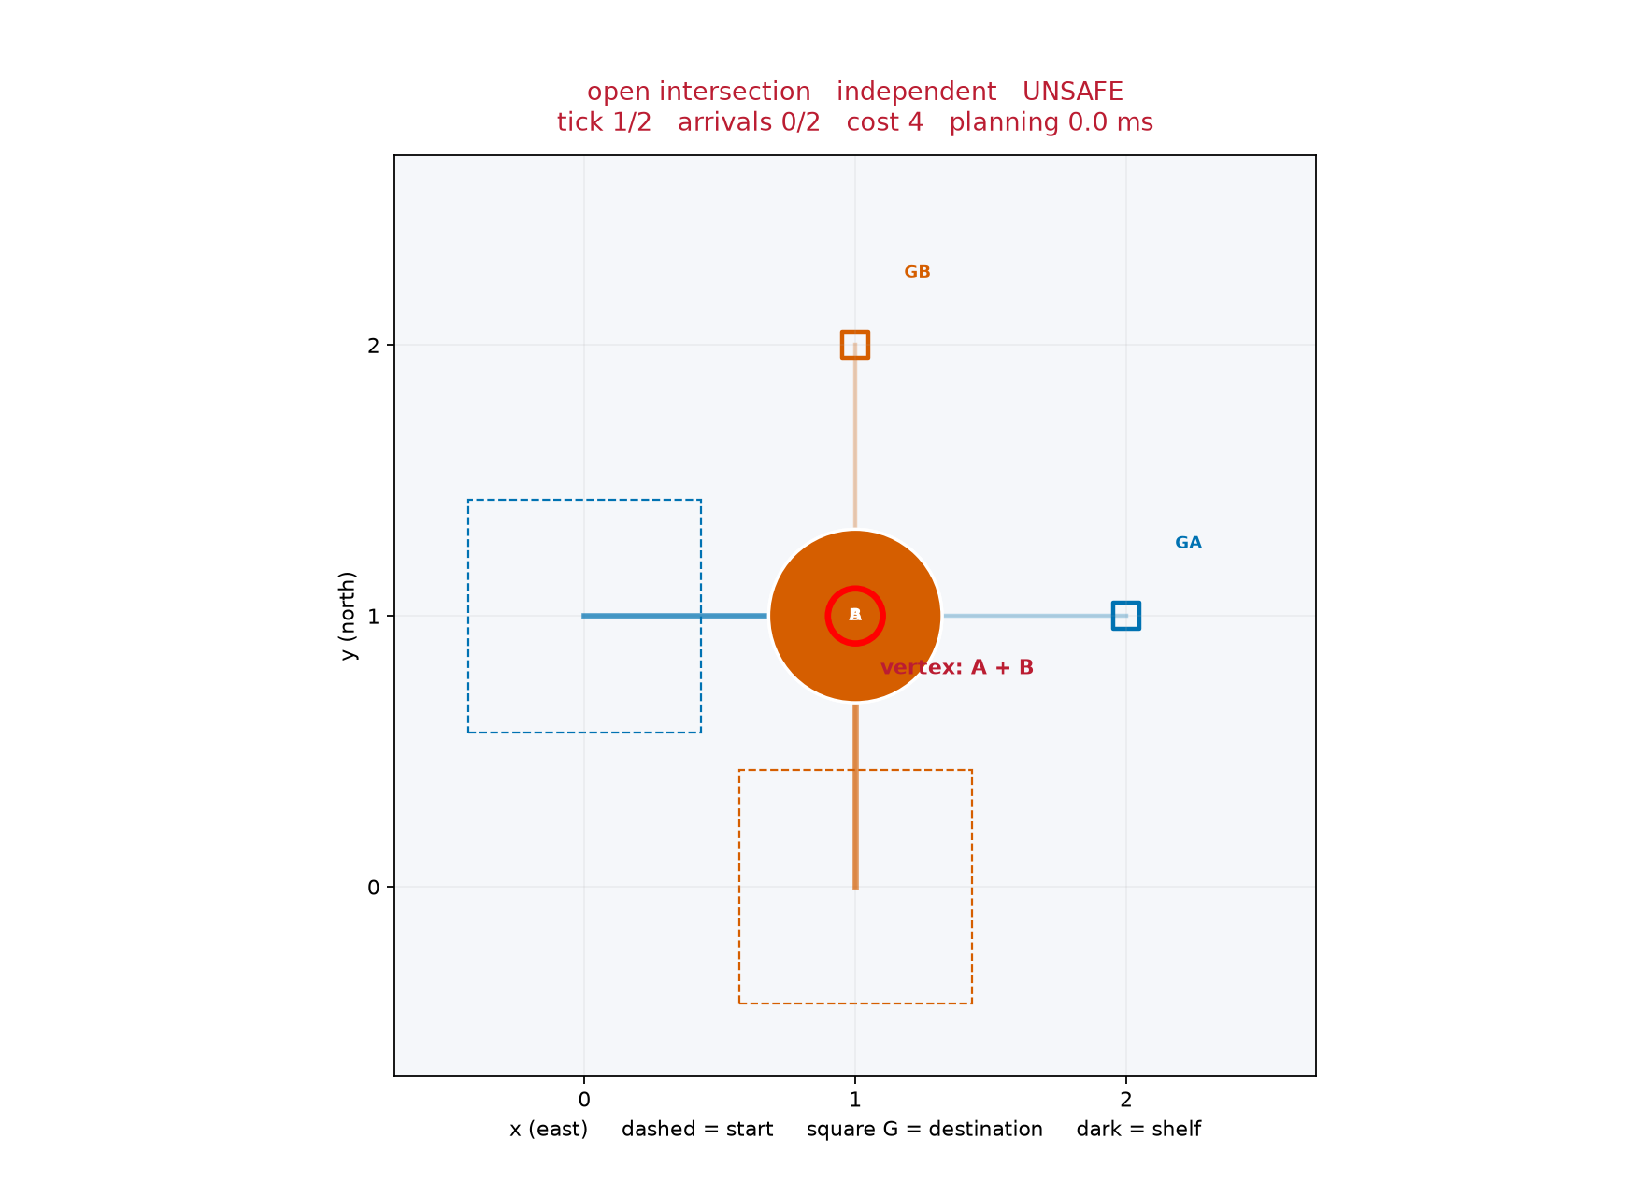
Independent routes can collide
Tick 1 shares the center
Both individual routes are shortest
Joint replay detects a vertex conflict
The saved plan is labeled UNSAFE
5
Notes:
Show actual intersection baseline at tick 1. Both robots independently choose length-two routes through (1,1), causing a real vertex conflict. The cost four is unsafe joint cost, not a feasible solution. Source: results/baseline_plan.json.

Slide 6
Space-time A* includes waiting
State (x,y,t)
Move or wait advances to t+1
Reservations constrain successors
Goal acceptance checks future occupancy
Tick | A | B
0 | (0, 1) | (1, 0)
1 | (1, 1) | (1, 0)
2 | (2, 1) | (1, 1)
3 | (2, 1) | (1, 2)
B waits one tick before the crossing
6
Notes:
Source [2]: [2] Silver, D. (2005). Cooperative Pathfinding. Proceedings of the AAAI Conference on Artificial Intelligence and Interactive Digital Entertainment 1(1), 117-122. DOI 10.1609/aiide.v1i1.18726. https://ojs.aaai.org/index.php/AIIDE/article/view/18726 Explain (x,y,t), a unit-cost wait successor and absolute horizon. The intersection is taken from results/worked_example.json, not hand-drawn hypothetical routes. Low-level search may reach a goal but must still check safe holding.

Slide 7
Reservation table semantics
Vertex (cell,t) includes tick zero
Edge (u,v,t) represents interval t to t+1
Reject the reserved reverse traversal (v,u,t)
Permanent goal reservations continue indefinitely
Future finite visits also prevent early terminal acceptance
7
Notes:
Walk through the dictionary/set design in reservations.py. last_visit summarizes the latest finite tick at a cell. can_hold requires no permanent use and last_visit < arrival. A goal free at the present tick may be unsafe later. Following remains legal when destination and reverse-edge tests pass.

Slide 8
Implementation and planning flow
Scenario validation and spatial preflight
Fresh reservation table for each priority attempt
Space-time A* commits one route at a time
Independent joint validator checks complete paths
Self-contained plan JSON feeds replay and export
8
Notes:
Files: models/grid, astar, reservations/cooperative, validation/io, simulation/visualization. Fixed order is lexicographic ID. Portfolio is descending distance, reverse, three seeded permutations, deduplicated. Horizon sequence 40,80, first valid selection. All failed effort counts.

Slide 9
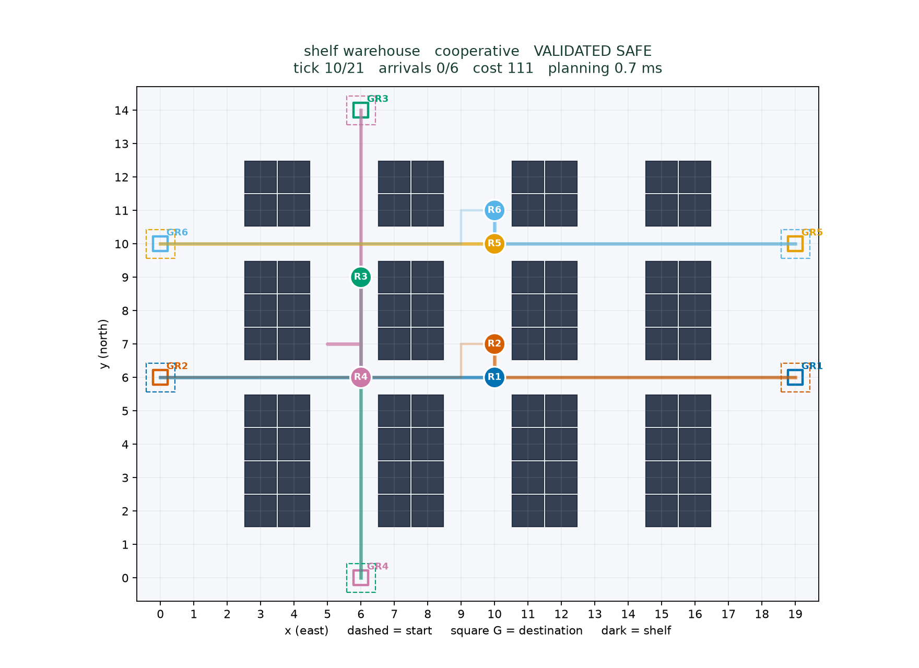
Simulation and live demo
Play/pause, Step and Reset
Playback speed and overlays
Cost 111, makespan 21
110 moves and 1 wait
Zero detected conflicts
9
Notes:
Run python -m warehouse_ai replay --plan results/default_plan.json. Point out paths, stable IDs, shelves and goal labels. Pause, step and reset, then change speed. A global tick reads all robot positions simultaneously. The headless GIF is a reliable fallback. Distinguish export verification from actual GUI checks in docs/QA.md.

Slide 10
Experiment design and fair comparison
Same 20 aggregate instances for all algorithms
Robot counts 2, 4, 6, 8 with five seeds each
Six separate diagnostic scenarios
Horizons 40 and 80, expansion cap 30,000
Rates use all cases, costs use valid cases
Timing includes failed attempts and excludes rendering
10
Notes:
Seeds are 11,22,33,44,55. Fixed shelf layout, uniform 2N distinct free endpoints, static connectivity checked but joint feasibility not guaranteed. There are 78 total runs. One perf_counter timing per solver and instance; means across seeds. Environment: 3.12.14, macOS-27.0.1-arm64-arm-64bit

Slide 11
Measured completion and planning time
Five seeds per robot count. Both coordinators safely complete 20/20 sampled cases.
11
Notes:
Raw data: results/runs.json and summary.json. Both coordinators 20/20 aggregate safe completion; independent 10/20. Five cases per count, no confidence intervals. Timing is machine-specific and includes all planning effort. Equal rates here do not establish equal general robustness.

Slide 12
Priority portfolios can increase travel cost
Robots | Fixed cost | Portfolio cost | Paired delta
2 | 24.6 | 24.6 | 0
4 | 44.6 | 44.6 | 0
6 | 75.4 | 77.8 | 2.4
8 | 114.2 | 114.2 | 0
Five common-success pairs per count
At six robots, higher mean cost accompanies a lower mean makespan
The solver returns the first valid priority attempt
12
Notes:
Report only same common-success samples. At six robots, five paired cases: portfolio cost 77.8 versus fixed 75.4, delta +2.4. Portfolio mean makespan is 19.8 versus 20.2. First valid order is not global optimization. Independent valid subsets differ and have no valid sample at eight, so no independent cost advantage claim.

Slide 13
Tests safety validation and failures
22 passed in 1.03s
50 seeded maps checked against an independent BFS oracle
Vertex, swap, following and permanent-goal tests
Order-sensitive retry and bounded impossible corridor
CLI, JSON reload, PNG and GIF export checks
13
Notes:
Do not confuse pytest item count with number of randomized maps. Each algorithmic safety case tests concrete assertions. Validator reads actual transitions and padded occupancy, not reservations. Horizon exhaustion is not an impossibility proof. Exact evidence: results/test_execution.txt. GUI verification scope is separately documented.

Slide 14
Limits and future work
Prioritized planning is incomplete and order-dependent
The coordinator does not globally optimize cost or makespan
Finite horizons and expansion limits can reject feasible cases
Static shelves, point robots and centralized offline planning
Future work: tiny-instance CBS and physical movement constraints
14
Notes:
Explain the bay-exit fixture: A first plugs center; B first exits and A arrives later. Bounded retries are not deadlock-proof. CBS is not implemented and no optimality claim is borrowed from it. Complexity expands from V cells to V(H+1) time states per low-level search.

Slide 15
Demonstrated findings and references
Default six-robot wave safely finishes in 21 ticks
Both coordinators solve all 20 aggregate samples safely
Independent validation protects every complete returned plan
Hart, Nilsson and Raphael (1968), DOI 10.1109/TSSC.1968.300136
Silver (2005), DOI 10.1609/aiide.v1i1.18726
Stern et al. (2019), arXiv:1906.08291
15
Notes:
Close in about 30 seconds. These findings are scoped to tested cases. The three references were checked against publisher/author metadata; not every full text was accessed. Full URLs and all authors are in docs/references.md. Total presentation target 8-10 minutes. AI-assisted implementation and preparation should be disclosed according to course policy.

