Slide 1
What is Appium?
Cross-platform, open-source, and supports native, hybrid, and web apps.
Works for both Android & iOS.
Run the same script on multiple platforms.
Appium supports multiple languages: Java, Python, C#, JavaScript, Ruby, PHP
No requirement to recompile or modify apps.
No licensing costs.
Strong community support and continuous updates.

Slide 2
Introduction to Appium Architecture
Appium follows a client-server architecture.
It is built on the WebDriver protocol for communication.
Uses JSON Wire Protocol for interaction with mobile devices.
Appium Server
Acts as a bridge between test scripts and mobile devices.
Built using Node.js.
Receives commands from the client, processes them, and sends them to mobile devices.
Appium Client
A test script written in Java, Python, C#, or other languages.

Slide 3
Prerequisites
JDK 17 or later (Ensure JAVA_HOME is set)
Android Studio (with SDK, ADB, and Emulator)
Node.js (LTS version) (Required for Appium Server)
Appium Server
Appium Inspector (for element identification)
Eclipse/IntelliJ/PyCharm/Visual Studio Code (for writing scripts)

Slide 4
Install & Setup Appium
Install Appium via NPM (Node.js Package Manager)
npm install -g appium
Appium –v
appium
Install Android SDK & Emulator
Android SDK
Android SDK Platform-Tools
Android Emulator
adb devices

Slide 5
Setup for real devices
Configure Real Android Device for Testing
Go to Settings → About Phone.
Tap Build Number 7 times to enable Developer Mode.
Navigate to Developer Options.
Enable USB Debugging.
Connect the device to your PC via USB.
adb devices

Slide 6
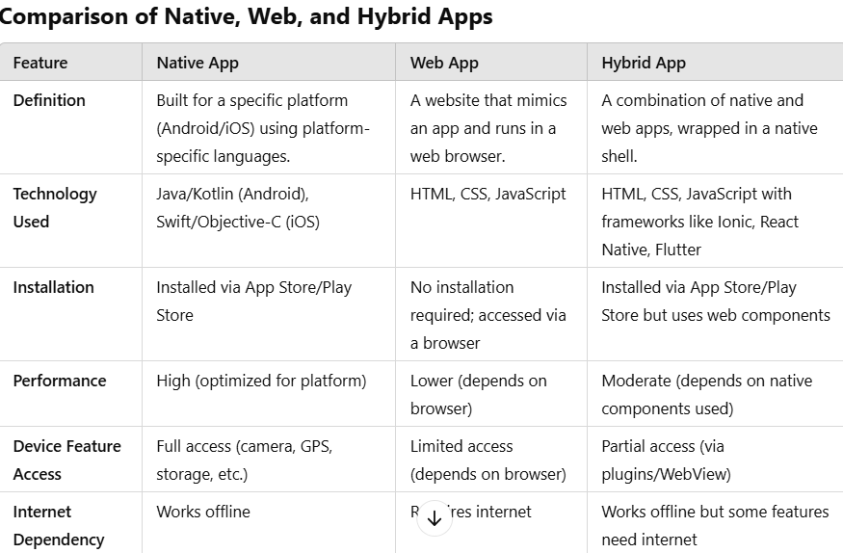

Slide 7
Examples:
Native Apps: WhatsApp, Instagram, Uber
Web Apps: Gmail Web, Google Docs, Flipkart Lite
Hybrid Apps: Instagram (partially hybrid), Uber, Twitter

