Slide 1
Python Discussions
Topic : Variables, Identifiers & Other beginner functions
Moderator : Shivasiddharth Narayanan Date : 11-Jan-2021

Slide 2
Building Blocks of Python Programming
Variables
Identifiers
Keywords
Functions
Classes and Objects
Modules
Constants

Slide 3
Variables & Identifiers
Variables
Variable/Variables are nothing but names given to the memory locations.
Variables can also be called as containers for storing data values.
Identifiers
Python Identifiers are user-defined names to represent a variable, function, class, module or any other object.
If you assign some name to a programmable entity in Python, then it is nothing but technically called an identifier.

Slide 4
Keywords
A Python keyword is a unique programming term intended to perform some action.
There are as many as 33 such keywords in Python, each serving a different purpose(might get changed/updated).
Together, they build the vocabulary of the Python language.
Since all of them are reserved, so you can’t use their names for defining variables, classes or functions.
The below command prints the list of all keywords in python:
help(‘keywords’)

Slide 5
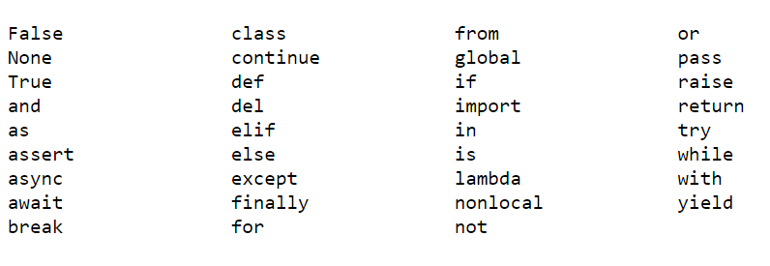
List of Keywords
Reference:
https://www.geeksforgeeks.org/keywords-python-set-1/ https://www.geeksforgeeks.org/keywords-python-set-2/

Slide 6
Example
In traditional C:
int ht; /**Declaration**/
ht = 5; /**Initialization**/
In python:
ht = 5
“”” Here, ‘ht’ is a variable to store numeric data.
Currently the value assigned to is 5.
The varying quantity(say, height) is identified via. the identifier “ht”

Slide 7
Important - Rules for creating Identifiers
The identifiers can be a combination of alphanumeric characters.
Case-sensitive.
Keywords cannot be used as identifiers.
Cant use digits to begin the identifier name. Either use an alphabet or an underscore(_).
Special characters (like ‘.’, ‘!’, ‘@’, ‘#’, ‘$’, ‘%’) cant be used.

Slide 8
Input/Print/Help
To read input from the user:
input()
-Always input shall be read as a string
-Explicit data-type conversions are required to change data-type
To print output to the user:
print()
In case of both above functions double-quotes will be considered as normal text and displayed on output screen.

Slide 9
Comments
Comments can be used to explain Python code.
Comments can be used to make the code more readable.
When you run a program you will not see any indication of the comment there.
Comments are in the source code for us to read, not for computers to execute.

Slide 10
Comments - Types
Types of Comments
Single-line comment | Multi-line comment
Example-1: #This is a single-line comment print("Single line commenting...!!") O/P: Single line commenting...!! Example-2: a=10 b=5 print(a+b)#This is an inline comment O/P: 15 | Example: #This is multi-line comment-1 #This is multi-line comment-2 #This is multi-line comment-3 a=100 b=5 print(a*b) O/P: 500
 | Also Doc-strings can be used. Example: “”” This is a doc-string method. Mainly used for documentation purposes. Can be used for multi-line comments too. “””

Slide 11
QA & Feedback

Slide 12
Thanks

