Slide 1
Python Discussions
Topic : Datatypes
Moderator : Shivasiddharth Narayanan Date : 13-Jan-2021

Slide 2
Datatypes
Numeric
int
float
complex
Text
string
Sequence
list
tuple
Boolean
Dictionary
Set

Slide 3
Numeric Datatypes
Datatype | Numeral type
int | Whole numbers
float | Decimal numbers
complex | Complex numbers

Slide 4
Arithmetic Operators
Arithmetic Operation | Operator | O/P
Addition | 3+2 | 5
Subtraction | 3-2 | 1
Multiplication | 3*2 | 6
Divison | 3/2 | --In py-2 : 1 --In py-3 : 1.5
Floor Divison | 3//2 | 1
Exponent | 3**2 | 3%2
Modulus(Remainder) | 3%2 | 1

Slide 5
Comparisons
Comparison Operation | Operator | O/P
Equal | 3 == 2 | Returns Boolean values “True” / “False”
Not Equal | 3 != 2
Greater than | 3 > 2
Less than | 3 < 2
Greater or Equal | 3 >= 2
Lesser or Equal | 3 <= 2

Slide 6
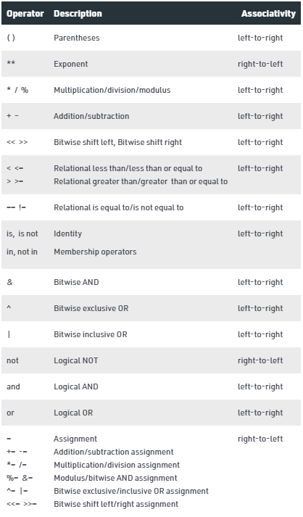
Py Operators Precedence & Associativity

Slide 7
String - Datatype
String datatype is for textual data in python
Textual data can be enclosed in single, double or triple quotes
Individual characters of string can be accessed using the index value
String Indexing in python starts from 0 till (n-1)
Syntax : str_value[start : end : step]
Step value is optional for indexing
len function – returns length of the string value
Syntax : len(<text_or_stringVariable>)

Slide 8
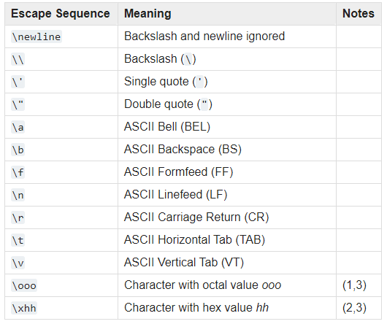
Escape Sequences
Escape sequences allows you to include
special characters in strings.
Add a backslash (\) before the
character you want to escape.
Full list of Escape Sequences in
python are as listed here.
Reference : http://www.asciitable.com/

Slide 9
list, set, tuples -Datatype
Syntax:
list – []
tuple – ()
set – {}
list, tuples – for sequential data
Slicing & Indexing operations are similar to strings
list – mutable ; tuples – Immutable
Use tuples only when there would be no changes to contained values
set – Unordered collection of values with no duplicates
Sets are mainly used for membership tests

Slide 10
Dictionary - Datatype
Syntax:
dictionary – {k:v}
Dictionary – To deal with key-value pairs
key – Unique Identifier
value – Data associated with the key
Similar to normal English dictionary
Can be looped through using items method

Slide 11
Empty Initialisations of Sequence Datatypes
empty_list=[]
empty_list=list()
empty_tuple=()
empty_tuple=tuple()
empty_set={} # This creates a DICTIONARY, not a set
empty_set=set()

Slide 12
Python Datatypes - Summary
Python Datatype | Mutable/Immutable | Ordered/Unordered
list | Mutable | Ordered
tuples | Immutable | Ordered
set | Mutable | Unordered
dictionary | Mutable | Unordered

Slide 13
QA & Feedback

Slide 14
Thanks

