Slide 1
Python Discussions
Topic : Introduction & Installation/Set-up
Moderator : Shivasiddharth Narayanan Date : 8-Jan-2021

Slide 2
Python - Programming Language
General Purpose Language :
Python could be used to develop different types of software.
History:
Developed by Guido Van Rossum in 90’s.
Named after his favourite TV series “Monty Python’s Flying Circus”.
Why Python ?
Beginner friendly.
Easy to learn (Especially for starters).

Slide 3
Python - Versions
Version | Release Date
1.0 | 1994 Jan
2.0 | 2000 Oct
3.0 | 2008 Dec
3.9(current) | 2020 Oct
Source:
https://www.python.org/downloads/

Slide 4
Python - Applications
Scripting
Testing
Web Development
Data Analysis/ Data Science
ML/AI
Gaming Development
Ethical Hacking
Apps Development…

Slide 5
Python – Technical Features
Supports OOPs
Dynamically & Strongly Typed
Indentation is mandatory
Automatic garbage collection
Can be easily integrated with other programming languages
Can work on different hardware platforms
An Interpreted Language (Partly Compiled)

Slide 6
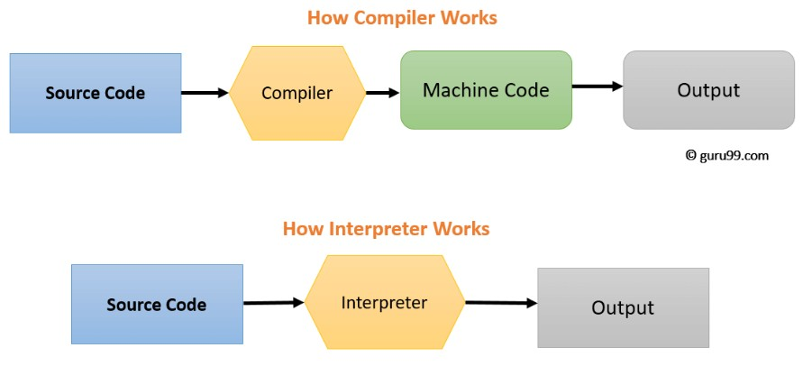
Python - Interpreter OR Compiler ?
Source:
https://www.guru99.com/difference-compiler-vs-interpreter.html

Slide 7
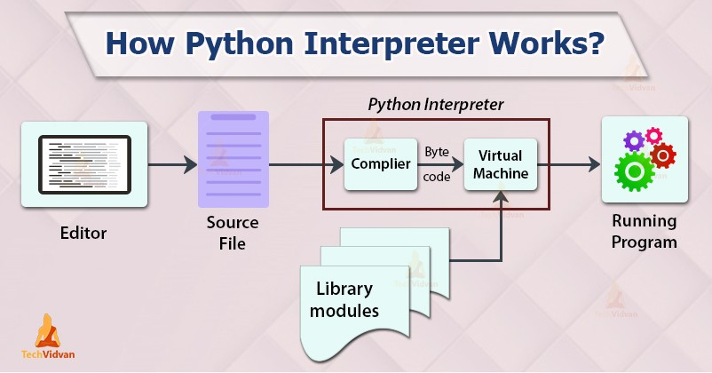
Python – How it runs ?
Source: https://techvidvan.com/tutorials/python-interpreter/ https://www.geeksforgeeks.org/python-compiled-or-interpreted/

Slide 8
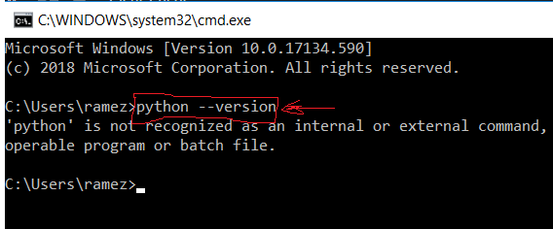
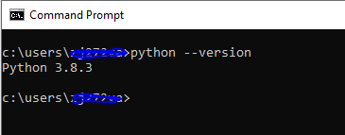
Python – Download & Installation
Check for the below command to not work in your cmd prompt:
Have python(latest stable version) installed from the below link:
https://www.python.org/downloads/
Check again for the below command to work in your cmd prompt:

Slide 9
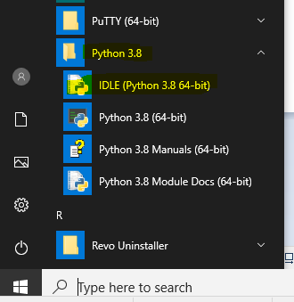
Python – Interactive/IDLE IDE Demo
IDLE gets installed by default during python installation.
Post py install in your system the Windows menu looks like the below:
Source:
https://www.youtube.com/watch?v=pfPCV7DXc5w

Slide 10
Python – IDEs for Development
IDLE (comes default with Python Installation)
PyCharm (most widely used)
Visual Studio Code (Microsoft Product, Recommended here @EY)
Anaconda (for Data-science enthusiasts)
Spyder (for Scientific Python Development)
Atom
Sublime-text
VIM….

Slide 11
Python – Anaconda Demo/Installation
Mainly a Data science platform
Can be installed on Windows following the below steps:
https://docs.anaconda.com/anaconda/install/windows/
Important Note-1 : Prior installation of python is optional
Important Note-2 : python & anaconda path variables don’t get mix-up
Installing Anaconda also installs:
A python distribution
A package manager called conda
Numpy
Scipy
Jupyter notebook(Highly interactive IDE rendered on our web-browser)

Slide 12
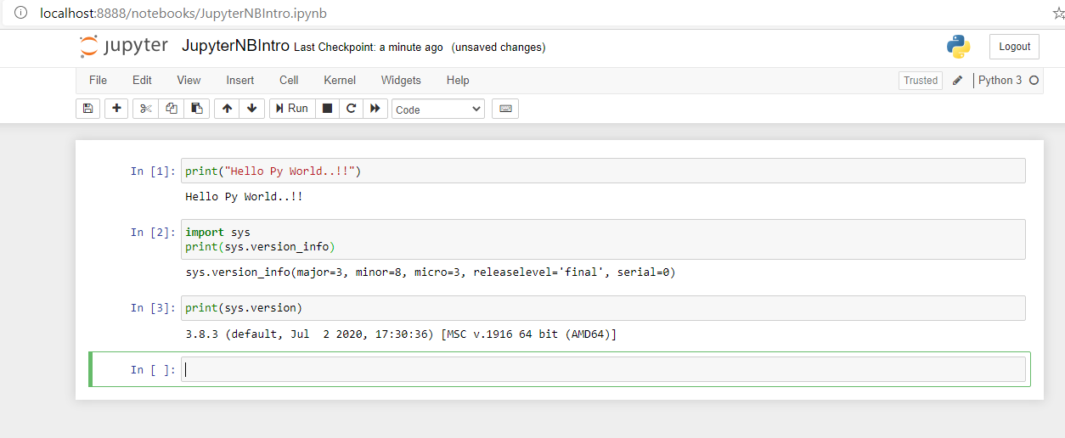
Jupyter Notebook – GUI Demo

Slide 13
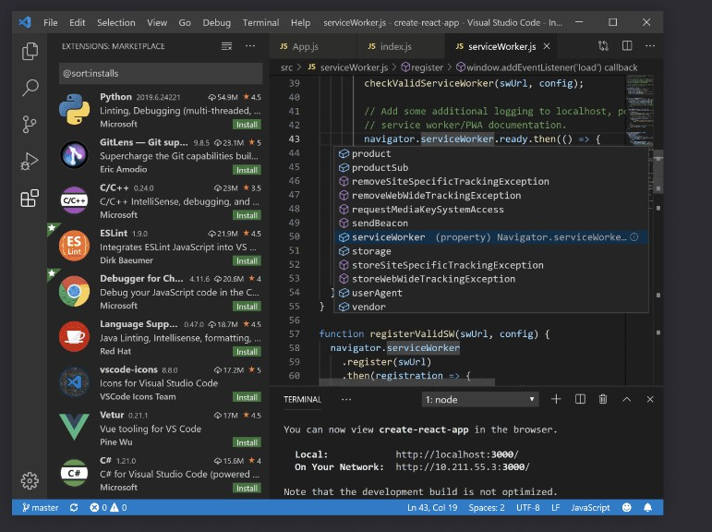
Python – VS Code Setup/Installation
Post python installation VS Code IDE can be downloaded/installed from the below link:
https://code.visualstudio.com/
A hassle-free straight forward installation process

Slide 14
QA & Feedback

Slide 15
Thanks

