Slide 1

Shri Guru Gobind Singhji Institute of Engineering and Technology (An Autonomous institute of Govt. of Maharashtra)
Intelligent Video Surveillance System (Campus surveillance)
PRESENTED BY:
SHREYASH DESHMUKH (A-67)
SHIVPRASAD RATHOD(A-72)
RAJKUMAR KUMBHARGAVE(A-75)
Project Guide :
Dr. Sushma G. Kejgir

Slide 2
PROBLEM STATEMENT
To design and implement an intelligent and efficient surveillance system that utilizes Image processing, Machine learning analysis techniques to enhance security and monitoring capabilities.

Slide 3
CONTENTS
Introduction
Methodology
Software Tools and Technologies
Implementation
Results
Advantages and Disadvantages
Future Scope
Conclusion

Slide 4
INTRODUCTION
Develop a computational model to identify the moving objects by using background subtraction.
Detect the moving object in various scenarios.
Develop comparative result of efficiency for better object detection .
Develop an application for the smart surveillance system using object detection.

Slide 5
METHODOLOGY
Data collection
Data preprocessing
Model Training
User Interface
Deployment
Testing

Slide 6
FLOWCHART
Output
Input Video Sequences
Binary Image
Extract Frame
Moving Frame & Background Frame
Convert to Gray
Scale
Convert to HSV
Background
Subtraction

Slide 7
SOFTWARE TOOLS
Visual Studio Code
free, open-source source code editor
Supports wide range of languages
User friendly interface
Inbuild Terminal support
Deployed project using VS code
PyCharm Community
IDE specially designed for python development
Integrated python console
Virtual environment
Deployed and tested ML models

Slide 8


TECHNOLOGIES USED
HTML
Basic structuring of web page.
Tags and Attributes
Cross browser compatibity (HTML5)
Integration with css and js.
CSS
Cascading Style sheets
style and layout web pages
Inline, internal, external type selectors

Slide 9


JAVASCRIPT
Client side scripting language
To make pages dynamic and interactive
Used in almost all websites
Rich library and framework support
Bootstrap is a free front-end framework
Responsive website design
Pre-built components
Customizable
BOOTSTRAP

Slide 10


PYTHON
High level, Interpreted language
Wide range of applications including ML, AI, web etc
Rich library Support
Framework: Django, Flask
Libraries: Numpy, pandas, OpenCV, tensorflow etc
DJANGO
Back-end server side framework
MVT architecture
Rapid development, robust features
Apps, Urls, views, models, templates etc

Slide 11
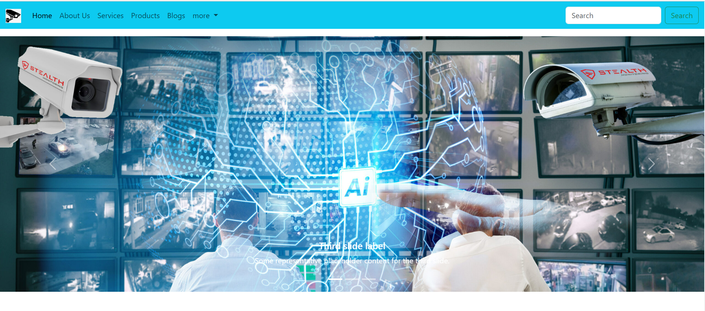
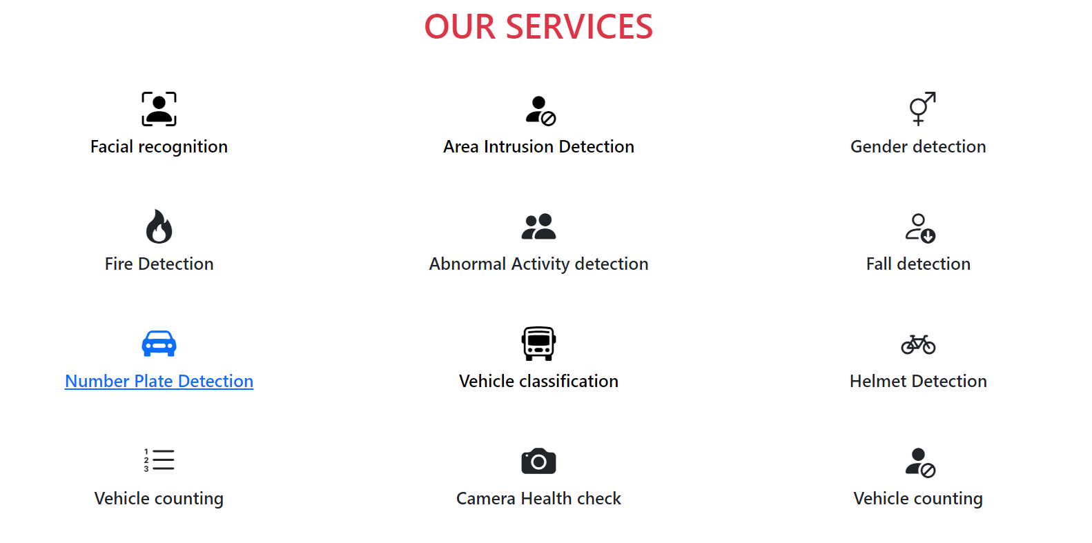
WEBSITE VIEW
Website includes sections – Home, about us, contact us, services, Blogs, Login and registration etc.
HOMEPAGE
SERVICES

Slide 12
IMPLEMENTATION AND RESULTS
SERVICES
Number Plate Detection
Fire Detection
Camera Disruption Detection
Vehicle Detection and Counting
Human Detection and Counting
Perimeter Breached Detection

Slide 13
Number Plate Detection
Read and resize image to the required size
Convert to gray scale
Smoothing effect
Perform edge detection
Find contours in the edged image
Mask the part other than the number plate

Slide 14
Camera Disruption
Open the camera
Read the first frame
Read the next frame
Compute the absolute difference between the frames
Compute the average intensity of the difference image
Check if the average intensity is above a threshold
Update the previous frame and continue the process

Slide 15
Fire Detection
Load the pre-trained fire detection model
Read a frame from the video capture
Perform fire detection on each frame
Draw rectangles around the detected fires

Slide 16
Benefits and Limitations
Benefits
Enhanced Situational Awareness:
Object Detection and Tracking:
Limitations
Computational Complexity:
Data Volume and Storage:

Slide 17
CONCLUSION
System aims to automate the field of surveillance by using computer vision and machine learning techniques
Provide variety of services by analyzing CCTV videos in real time
Project utilize Django framework for deployment of system
It empowers security personnel with real-time insights and automated analysis, reducing manual effort and response time

Slide 18
FUTURE SCOPE
Advanced algorithms implementation for increased accuracy of the system.
Integration with IOT devices.
Creating APIs
Cloud Based architecture.
More added services.

Slide 19
THANK YOU

