Slide 1

AD358
Product Demo - Team HackForFood

Slide 2







Why our product ?
Over 1,26,350 kms of road under consideration
approx. 8000 employees
Work on paper-work related
to road inspection
With our app, filling and submitting up an inspection form is just a few clicks away!
Gujarat witnesses approx 18k road accidents annually
The pothole detection app warns the civilian about a probable pothole beforehand
Govt invested 25,874 Cr. in road sector from 2014-2018
Our Portal’s BI tools provide an instant and efficient insights into data and help in making smart decisions in less time.

Slide 3
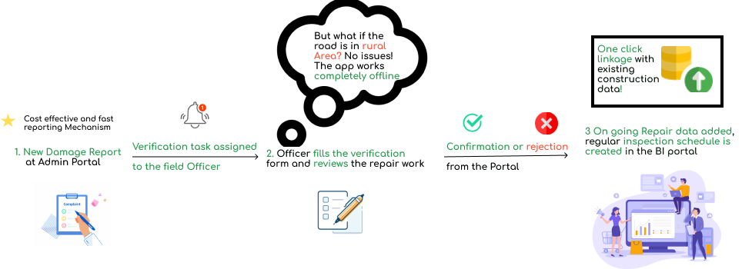
A flow graph illustration of our project

Slide 4
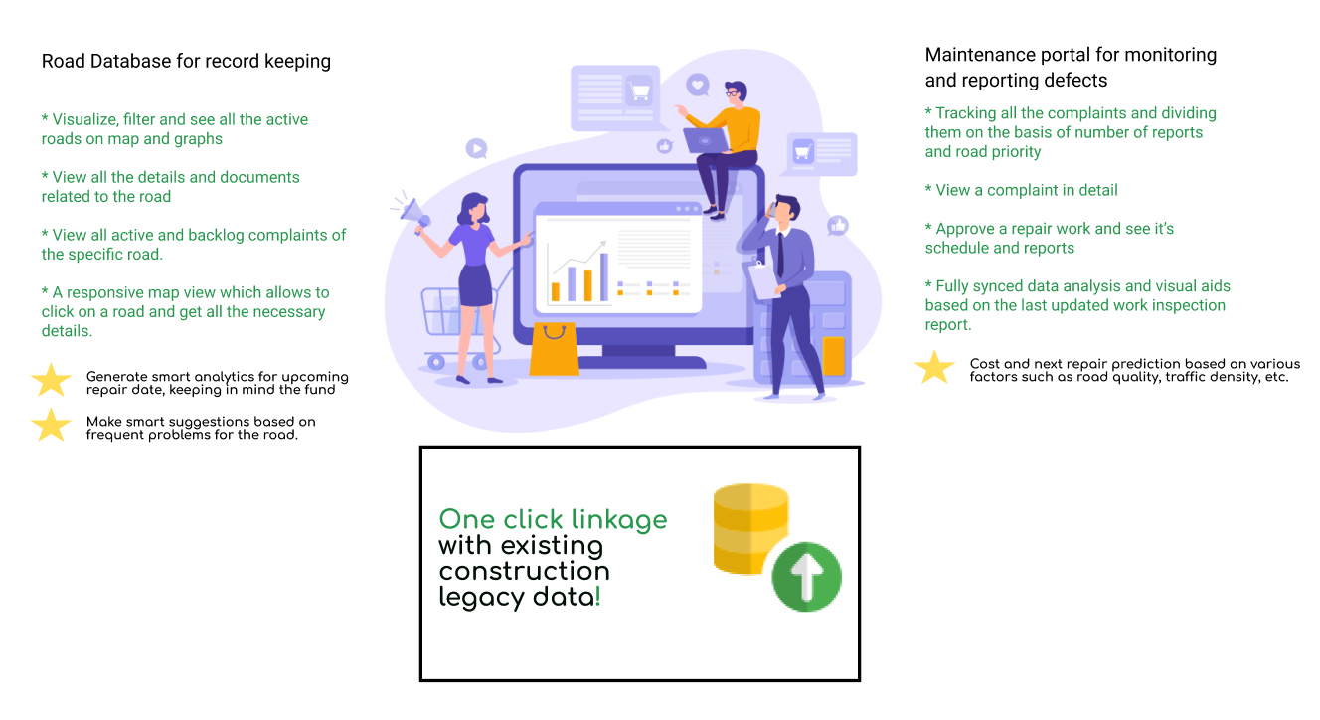
The Backbone: BI Portal

Slide 5
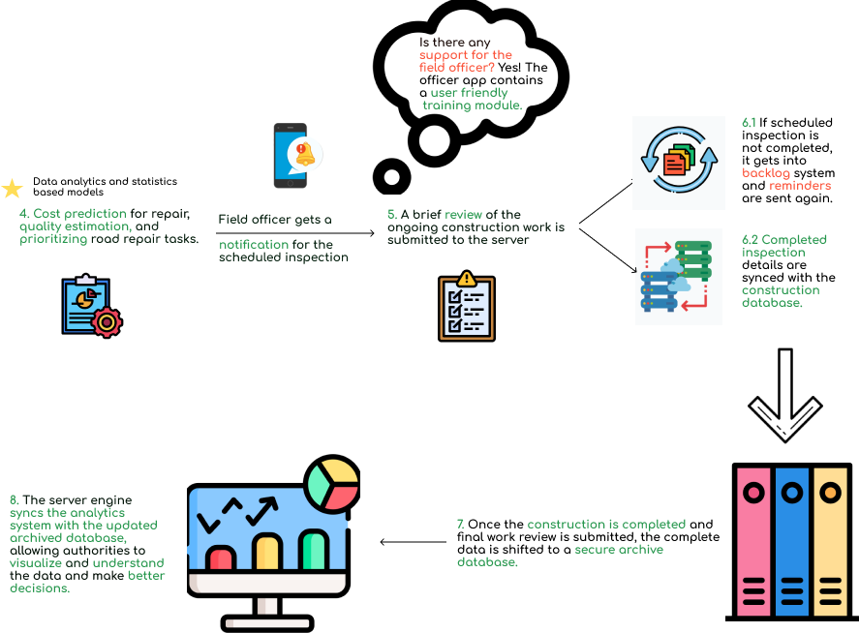
Illustration continued..

Slide 6
Demo
Classification Model

Slide 7


Demo - Inspector App (Offline)

Slide 8
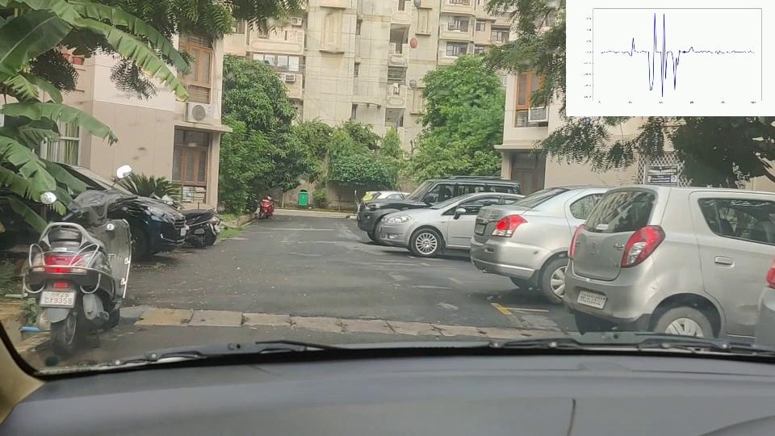
Demo - Civilian App (Driving)

Slide 9
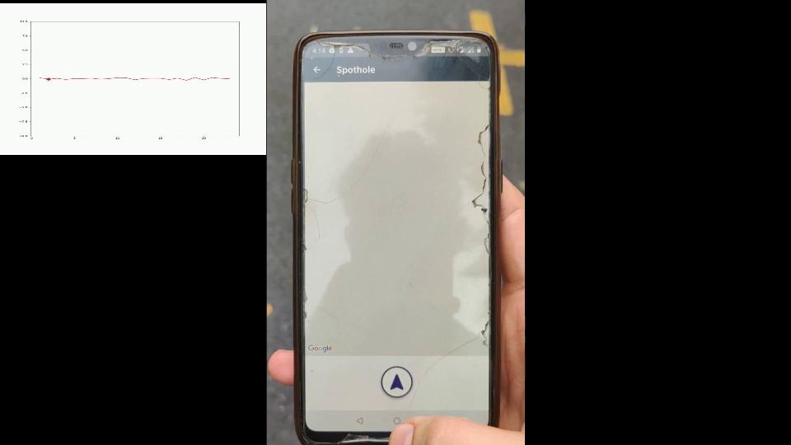
Demo - Civilian App (Walking)

Slide 10
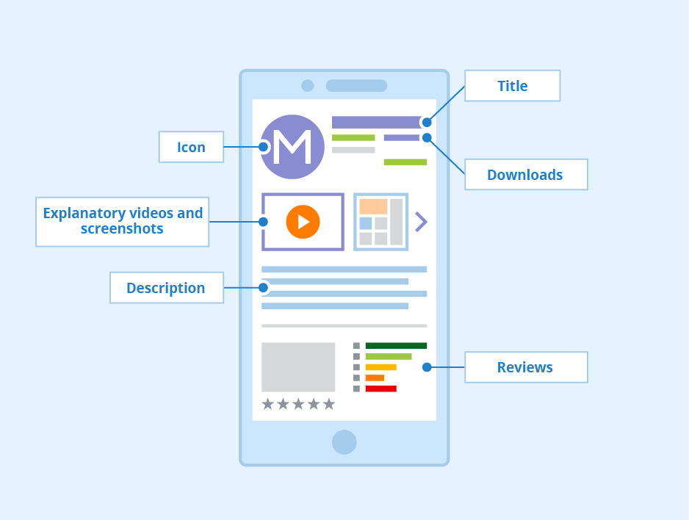


Highlights
Collect and verify complaint data quickly with mobile solutions
Get quick data insights for faster, smarter and effective decisions using data visualization
Keep your data organized with complete record keeping on a single consolidated portal

Slide 11
Thank You

