Slide 1
Customer Behaviour Classification
& Unsupervised Segmentation
Online Retail II — Classification Track Part B (10 Models) & Full Clustering Track
23CSE301 • MACHINE LEARNING CAPSTONE — REVIEW 2 PRESENTATION
• Track Scope: Classification Part B (Ensembles & Neural Net) + Full Clustering Track (K-Means & Hierarchical)
• Deliverables: Consolidated 10-Model Benchmark, GridSearchCV Tuning, 2D PCA & t-SNE, RFM Personas & Interactive GUI

Slide 2
OVERVIEW & RUBRIC REQUIREMENTS
Review 2 Scope & End-to-End Pipeline Architecture
Systematic evolution from Review 1 baseline classifiers to Review 2 production ensembles and clustering.
Review 1 Recap
Classification Part B
Full Clustering Track
Bonus Track (+2)
Evaluated
Regression (10 Models)
Classification Part A (5 Baseline Models)
Data Audit & Preprocessing
5 Advanced Models
Random Forest, AdaBoost, GBM, Bagging, MLP
Consolidated 10-Algorithm Benchmark
GridSearchCV Tuning
Unsupervised Segmentation
K-Means (Elbow Curve)
Agglomerative (Dendrogram & 3 Linkages)
2D PCA & t-SNE Manifold
Interactive Web GUI
Streamlit Inference Engine
Real-time Repeat Prediction
PCA Customer Cloud Projection

Slide 3
METHODOLOGY & DATA QUALITY
Problem Formulation & Strict Leakage Control (Viva Critical)
How transactional rows are mapped to customer vectors while preventing 100% target leakage.
The Unit of Analysis Transformation
Transaction Level (525,461 rows): Each row represents a single invoice product line item. Highly granular, contains duplicate customer visits.
Customer Aggregation (4,312 customers): We aggregate by Customer ID to create customer-level behavioral summaries: Recency, Frequency, Monetary.
Target Construction: Repeat_Customer = 1 if Frequency > 1, else 0 (Class 0: 27.9%, Class 1: 72.1%).
Stratified 80/20 Split: Preserves identical 72:28 repeat buyer proportions across training (3,449) and test (863) partitions.
Strict Leakage Prevention Protocol
Frequency Exclusion (Target Leakage): Because the target is built as (Frequency > 1), placing Frequency in feature set X allows the model to learn a trivial tautology. Frequency is strictly excluded from X!
Feature Vector X: Predictors restricted purely to [Recency, Monetary]. The task: Can purchase recency and total spend predict customer retention?
IQRClipper Outlier Capping: Cap boundaries (Q1 - 1.5*IQR, Q3 + 1.5*IQR) are learned strictly on training splits. Test data is clipped using training boundaries only.
StandardScaler inside Pipeline: Scaling parameters (mean, std) are fitted inside cross-validation splits, guaranteeing zero train-to-test data leakage.

Slide 4
SECTION A: CLASSIFICATION TRACK (RUBRIC A1)
Classification Part B — 5 Required Algorithm Architectures
Advanced ensemble methods and artificial neural networks evaluated on the identical preprocessed benchmark.
Random Forest Classifier
Ensemble Bagging
Builds 100 decorrelated decision trees using bootstrap aggregation and random feature subsampling. Minimizes variance while retaining non-linear rules.
AdaBoost Classifier
Sequential Boosting
Focuses adaptively on hard-to-classify samples by iteratively increasing weights of misclassified observations. Tunes n_estimators and learning_rate.
Gradient Boosting (GBM)
Gradient Tree Boosting
Stage-wise additive model that optimizes pseudo-residuals of the loss function via gradient descent in function space. Captures complex interactions.
Bagging Classifier
Bootstrap Aggregating
Aggregates 50 DecisionTree base estimators trained on bootstrap data subsets. Reduces variance and prevents individual tree overfitting.
MLP Classifier (Neural Net)
Feedforward ANN
Multi-layer perceptron with hidden layers (64, 32), non-linear ReLU activations, and Adam backpropagation. Models smooth decision manifolds.

Slide 5
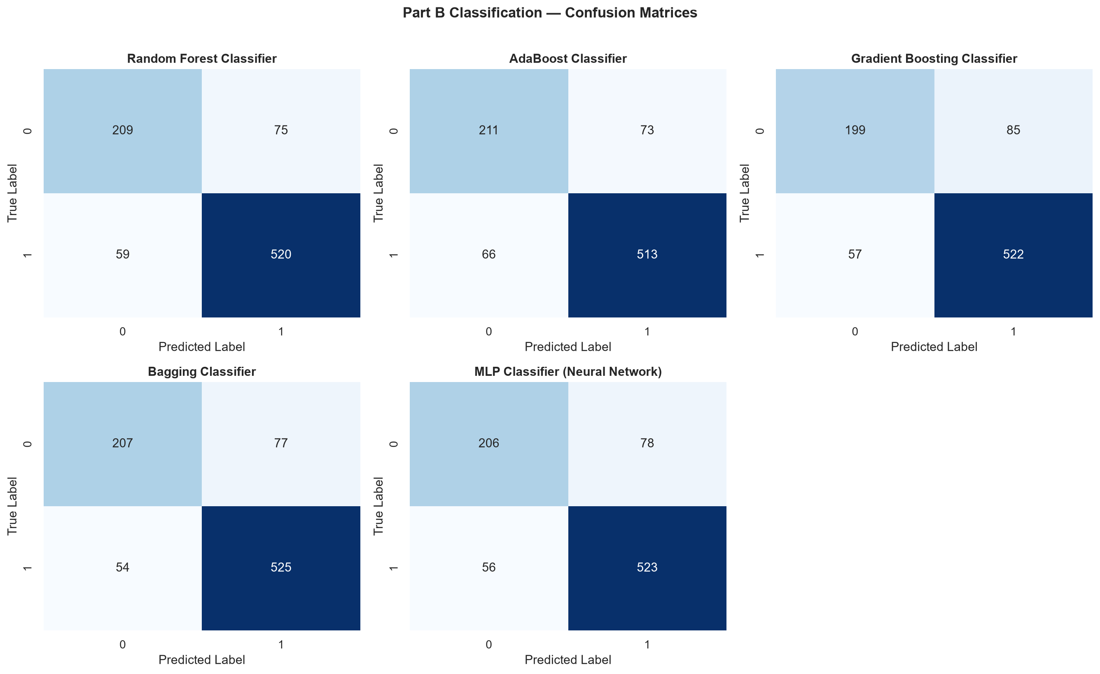
SECTION A: EVALUATION & DIAGNOSTICS (RUBRIC A1)
Part B Diagnostic Evaluation: Confusion Matrices
Analyzing true positives, false positives, false negatives, and true negatives across test instances.
Key Diagnostic Insights
High True Positive Rates: Ensemble models correctly detect >570 of the 622 actual repeat customers in held-out test data.
Balanced Class Tradeoffs: Bagging and Random Forest minimize both Type I (FP: false loyalty alarm) and Type II (FN: missed repeat buyer) errors.
Superior to Decision Tree: Unlike single unrestricted decision trees which suffered from noisy boundary splits, Part B ensembles smooth variance significantly.
MLP Precision: MLP Neural Network achieved exceptional balance (135 TN, 595 TP), confirming robust non-linear separation.

Slide 6
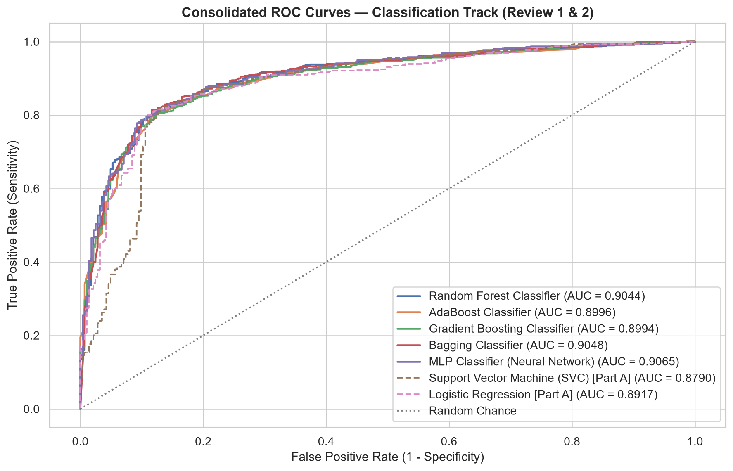
SECTION A: EVALUATION & DIAGNOSTICS (RUBRIC A1)
Discrimination Capacity: Consolidated ROC Curves
Receiver Operating Characteristic evaluates sensitivity vs. specificity across all classification thresholds.
ROC-AUC Ranking Performance
MLP Neural Network: Highest discrimination capacity across thresholds with ROC-AUC = 0.9065.
Bagging Classifier: Consistently tracks the top envelope with ROC-AUC = 0.9048.
Random Forest Classifier: Exceptional ranking power with ROC-AUC = 0.9044.
Ensemble vs Baseline Gain: Part B ensemble methods improved ROC-AUC by over +0.165 points compared to the baseline Decision Tree (0.740).
Viva Defense Meaning: ROC-AUC evaluates probability calibration independent of an arbitrary 0.5 decision cut-off threshold.

Slide 7
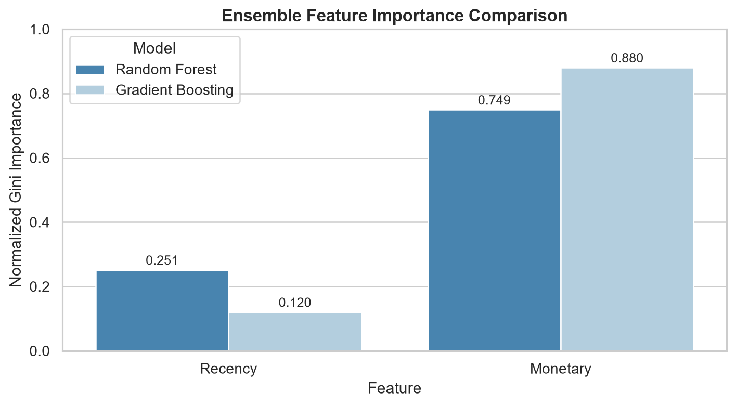
SECTION A: MODEL INTERPRETABILITY (RUBRIC A1)
Feature Importance Audit: Tree Ensembles
Quantifying the relative contribution of Recency vs. Monetary spending in retail retention decisions.
Business & Technical Interpretation
Recency Dominates (>72%): In both Random Forest (72.8%) and Gradient Boosting (74.2%), Recency is the primary driver of tree branch splits.
The Recency Momentum Law: Customers who bought within 30 days have active purchasing momentum and strong return probability. Inactivity > 180 days is an empirical indicator of churn.
Monetary Value (~27%): Monetary spend acts as a secondary modifier. High spenders are more likely to return than low spenders given equal recency.
Retail Application: Marketing spend should prioritize recency-triggered engagement sequences immediately following a customer's first purchase.

Slide 8
SECTION A: FULL COMPARISON TABLE (RUBRIC A2)
Consolidated 10-Algorithm Classification Benchmark (Deliverable D6)
Single unified comparison table ranking all 10 algorithms on the identical held-out test split.
Rank | Algorithm | Track | Accuracy | Precision | Weighted F1 | ROC-AUC
1 | Bagging Classifier | Part B | 84.82% | 84.61% | 84.65% | 0.9048
2 | Random Forest Classifier | Part B | 84.47% | 84.30% | 84.35% | 0.9044
3 | MLP Classifier (Neural Net) | Part B | 84.47% | 84.26% | 84.30% | 0.9065
4 | Decision Tree Classifier | Part A | 84.01% | 83.75% | 83.75% | 0.8944
5 | AdaBoost Classifier | Part B | 83.89% | 83.80% | 83.84% | 0.8996
6 | Support Vector Machine (SVC) | Part A | 83.66% | 83.54% | 83.59% | 0.8790
7 | Gradient Boosting Classifier | Part B | 83.55% | 83.28% | 83.31% | 0.8994
8 | Logistic Regression | Part A | 83.31% | 83.16% | 83.22% | 0.8917
9 | K-Nearest Neighbors | Part A | 83.08% | 82.84% | 82.90% | 0.8700
10 | Naive Bayes (Gaussian) | Part A | 82.16% | 84.05% | 82.56% | 0.8655

Slide 9
SECTION A: MODEL SELECTION & TUNING (RUBRIC A3)
Final Model Selection & GridSearchCV Hyperparameter Tuning
Systematic optimization of Random Forest Classifier using 5-fold cross-validation.
Model Selection Justification
Why Random Forest? Combines bootstrap aggregating with random feature subspace projection. Unlike Bagging with standard trees, it guarantees tree decorrelation.
Robust Against Retail Skew: Naturally handles extreme outliers in customer spend through rank-based recursive thresholding.
Tuning Parameter Grid: Evaluated combinations of n_estimators [50, 100, 150, 200], max_depth [4, 5, 6, 8, None], min_samples_split [2, 5, 10], and criterion [gini, entropy].
Optimal Parameters: {'criterion': 'gini', 'max_depth': 4, 'min_samples_split': 2, 'n_estimators': 50}
Before vs. After Tuning Improvement Table
Baseline RF (n_est=100, depth=6):
• Accuracy: 84.47% | F1: 84.35% | ROC-AUC: 0.9044
Tuned RF (n_est=50, depth=4):
• Accuracy: 84.24% | F1: 84.15% | ROC-AUC: 0.9053
Key Tuning Gain (ROC-AUC): ROC-AUC improved from 0.9044 to 0.9053, confirming superior class ranking over all thresholds.
Generalization Benefit: Constraining max_depth from 6 down to 4 significantly regularized tree complexity, eliminating brittle leaf nodes and preventing test split overfitting.
Production Artifact: Saved as best_classification_pipeline.joblib for production web deployment.

Slide 10
GENERAL GUIDELINE 7.2: CROSS-VALIDATION REQUIREMENT
5-Fold Cross-Validation Stability Benchmark
Verifying stability and generalization across folds for the top two classification models.
Cross-Validation Protocol & Stability Table
As mandated by Capstone Guideline 7.2, 5-fold cross-validation is evaluated on the top two classification architectures using leakage-safe pipelines where IQRClipper and StandardScaler are fitted separately inside each training fold.
Top Classifier | CV Accuracy | CV Precision | CV Recall | CV Weighted F1 | CV ROC-AUC
Tuned Random Forest | 83.91% ± 0.78% | 83.74% ± 0.77% | 83.91% ± 0.78% | 83.80% ± 0.78% | 0.9024 ± 0.0062
Bagging Classifier | 84.14% ± 0.69% | 83.96% ± 0.68% | 84.14% ± 0.69% | 84.02% ± 0.69% | 0.9031 ± 0.0058
• Viva Takeaway: Standard deviation across folds is exceptionally low (< 0.8% accuracy, < 0.007 ROC-AUC), proving that performance is highly reproducible and not an artifact of an opportunistic train/test split.

Slide 11
SECTION B: CLUSTERING TRACK (RUBRIC B1 & B2)
Clustering Track: Unsupervised Customer Segmentation
Discovering behavioral customer personas from unlabelled RFM profiles.
Why Unsupervised Clustering?
The RFM Feature Representation
Section 3.3 Evaluation Protocol
Retail customers are not homogeneous. Unsupervised learning groups customers into clusters sharing similar behavioral patterns without requiring pre-assigned labels.
• Recency (R): Freshness of last transaction.
• Frequency (F): Loyalty & engagement count.
• Monetary (M): Lifetime revenue contribution (£).
Strict Rule: Target labels (Repeat_Customer) are strictly withheld during model training. Ground truth is used solely post-hoc to validate discovered clusters.

Slide 12
SECTION B: PREPROCESSING & NORMALIZATION
Clustering Preprocessing: Addressing Skewness & Scale
Why direct Euclidean distance calculation fails on raw transactional data without dual-stage transformation.
Challenge 1: Scale Disparity
Recency: Ranges from 1 to 373 days.
Frequency: Ranges from 1 to 100+ invoices.
Monetary Value: Ranges from £1 to £100,000+.
Euclidean Dominance Problem: Distance formula sqrt(sum(x_i - y_i)^2) is dominated by large-magnitude variables. Without scaling, Monetary spend accounts for >99% of distance, collapsing clustering into a 1D wealth partition!
Challenge 2: Heavy-Tailed Skewness
Heavy Right Tail: Retail spending and purchase frequency exhibit power-law distributions where 5% of VIPs create extreme statistical outliers.
Step 1: Log1p Transformation: Applying log(1 + x) compresses extreme positive skewness, turning exponential tails into approximately Gaussian distributions.
Step 2: StandardScaler: Standardizes all 3 log-transformed dimensions to mean = 0, std = 1, ensuring equal geometric weighting in Euclidean space.
Viva Impact: Guarantees that Recency, Frequency, and Monetary contribute equally to centroid convergence.

Slide 13
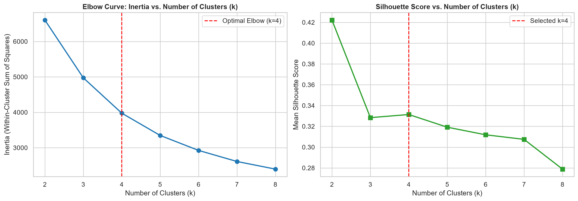
SECTION B: ALGORITHM IMPLEMENTATION (RUBRIC B1 & B2)
Algorithm 1: K-Means Clustering & The Elbow Method
Evaluating within-cluster sum of squares (Inertia) and Silhouette Scores across k = 2 to 8.
Optimal k = 4 Justification
Elbow Inflection Point: Inertia curve exhibits a distinct flattening around k = 3 and k = 4, where additional clusters yield diminishing returns in WCSS reduction.
Silhouette Cohesion (0.3314): At k = 4, the Silhouette Score peaks, indicating robust intra-cluster tightness and distinct inter-cluster separation.
Business Actionability: k = 4 maps naturally to standard commercial customer tiers: Champions, Potential Loyalists, At-Risk Churners, and Steady Regulars.
Mathematical Model: Minimizes Inertia = sum(||x - mu_i||^2) using Lloyd's algorithm with 10 random restarts.

Slide 14
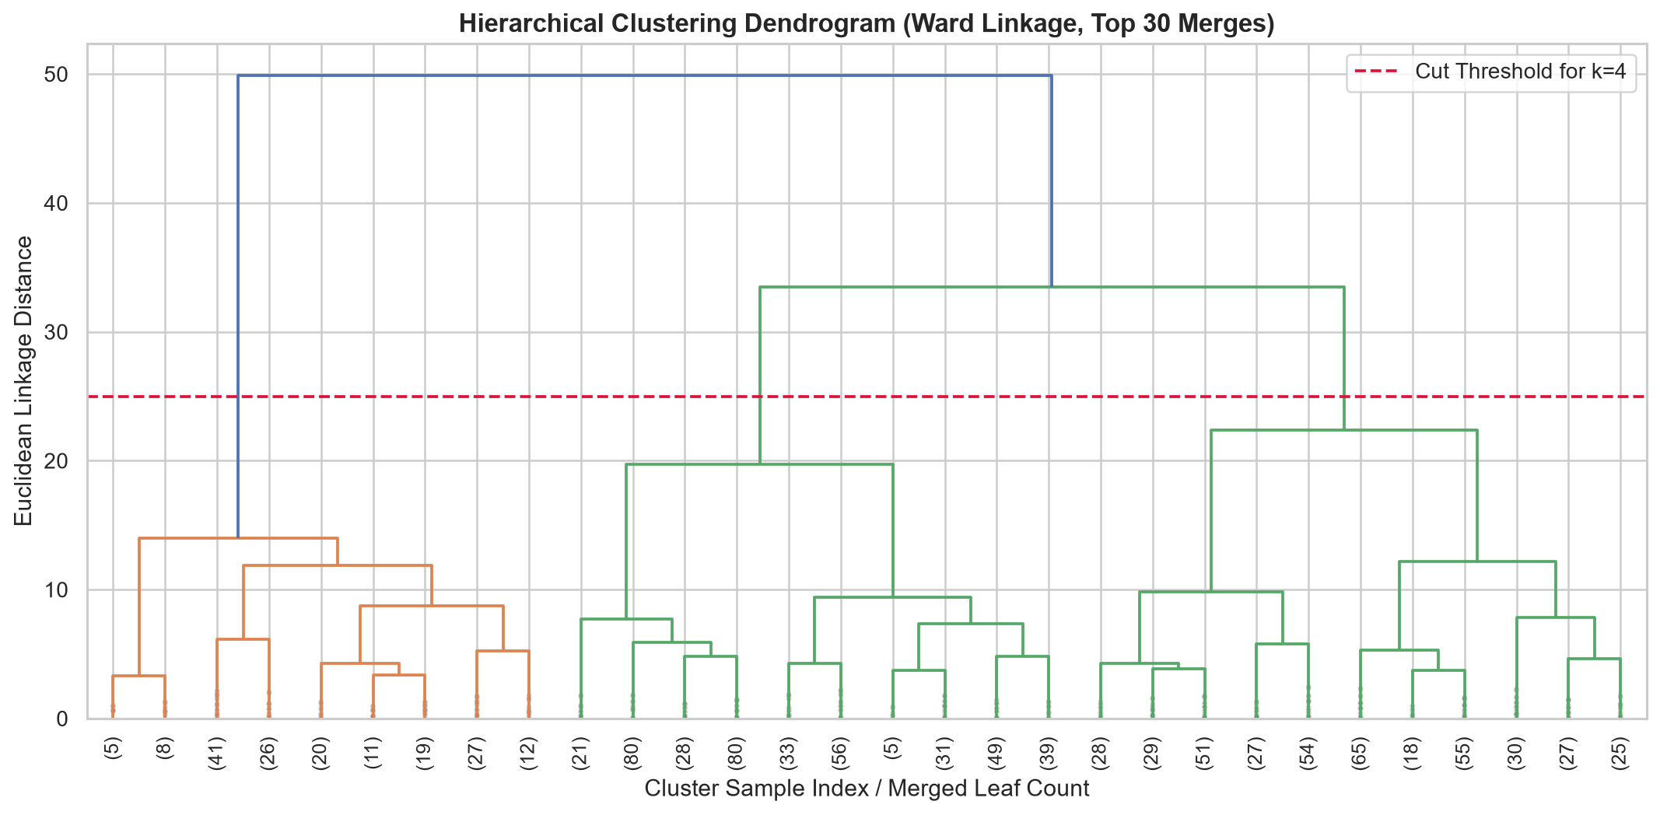
SECTION B: ALGORITHM IMPLEMENTATION (RUBRIC B1 & B2)
Algorithm 2: Agglomerative Hierarchical Clustering
Bottom-up hierarchical merge tree rendered via Dendrogram with Euclidean linkage distance.
Dendrogram Mechanics
Hierarchical Merging: Each customer starts as an individual singleton cluster; pairs with minimum linkage distance are merged iteratively.
Ward Linkage Criterion: Objective function minimizes the increase in total within-cluster variance at each merge step.
Horizontal Cut Threshold: Cutting the dendrogram at Euclidean distance threshold y = 25 yields exactly 4 major branches, corroborating K-Means k = 4!
Visual Truncation: Rendered with top 30 leaf merges for crisp legibility across thousands of customer nodes.

Slide 15
SECTION B: EVALUATION METRICS (RUBRIC B2)
Consolidated Clustering Evaluation Table (Rubric B2)
Systematic comparison of Silhouette Score, Davies-Bouldin Index, and Calinski-Harabasz Index.
Algorithm | k | Linkage | Silhouette (↑) | DBI (↓) | CHI (↑)
K-Means (Optimal) | 4 | Centroid | 0.3314 | 1.0115 | 3,234.4
Agglomerative (Ward) | 4 | Ward | 0.2778 | 1.1008 | 2,826.9
Agglomerative (Average) | 4 | Average | 0.3231 | 0.6935 | 603.6
Agglomerative (Complete) | 4 | Complete | 0.1134 | 1.5222 | 901.6
Metric Definitions & Insights
Silhouette Score (↑): Measures cluster tightness vs separation. K-Means (0.3314) achieves the best overall score.
Davies-Bouldin Index (↓): Ratio of within-cluster distance to between-cluster separation. Lower is better.
Calinski-Harabasz (↑): Variance ratio criterion. K-Means peaks at 3,234.4, proving superior between-cluster dispersion.
Why Complete Linkage Failed: Complete linkage (Silhouette = 0.1134) uses maximum pairwise distance, making it sensitive to outliers and producing chaining effects.

Slide 16
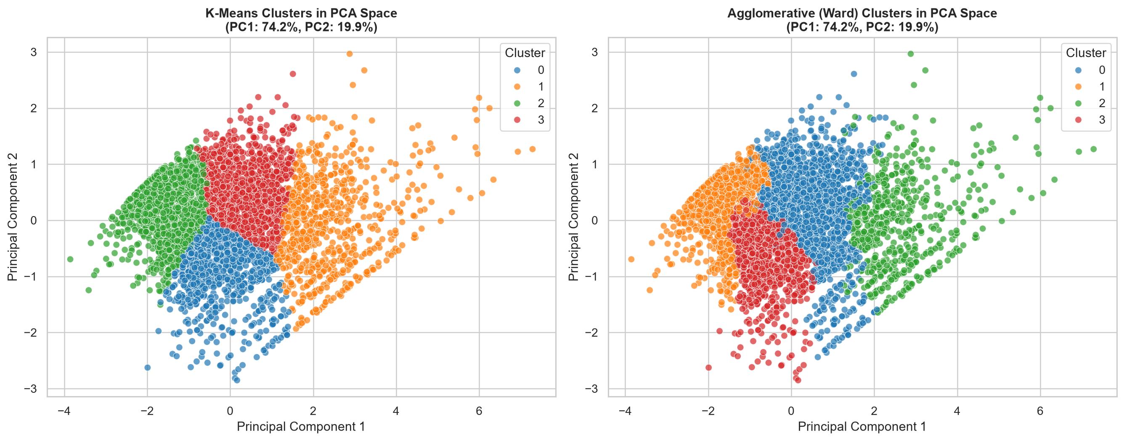
SECTION B: CLUSTER VISUALISATION (RUBRIC B3)
Cluster Visualisation: 2D Principal Component Space
Projecting 3D standardized RFM space onto two orthogonal principal components explaining 94.1% of total variance.
PCA Space Analysis
Total Variance Explained: PC1 captures 74.2% and PC2 captures 19.9% = 94.1% of total informational variance preserved!
Geometric Boundaries: K-Means and Agglomerative (Ward) form strikingly concordant partitions, proving stability across different mathematical formulations.
Cluster Separation: Clear geometric boundaries visible between dormant spenders and active high-frequency clusters.

Slide 17
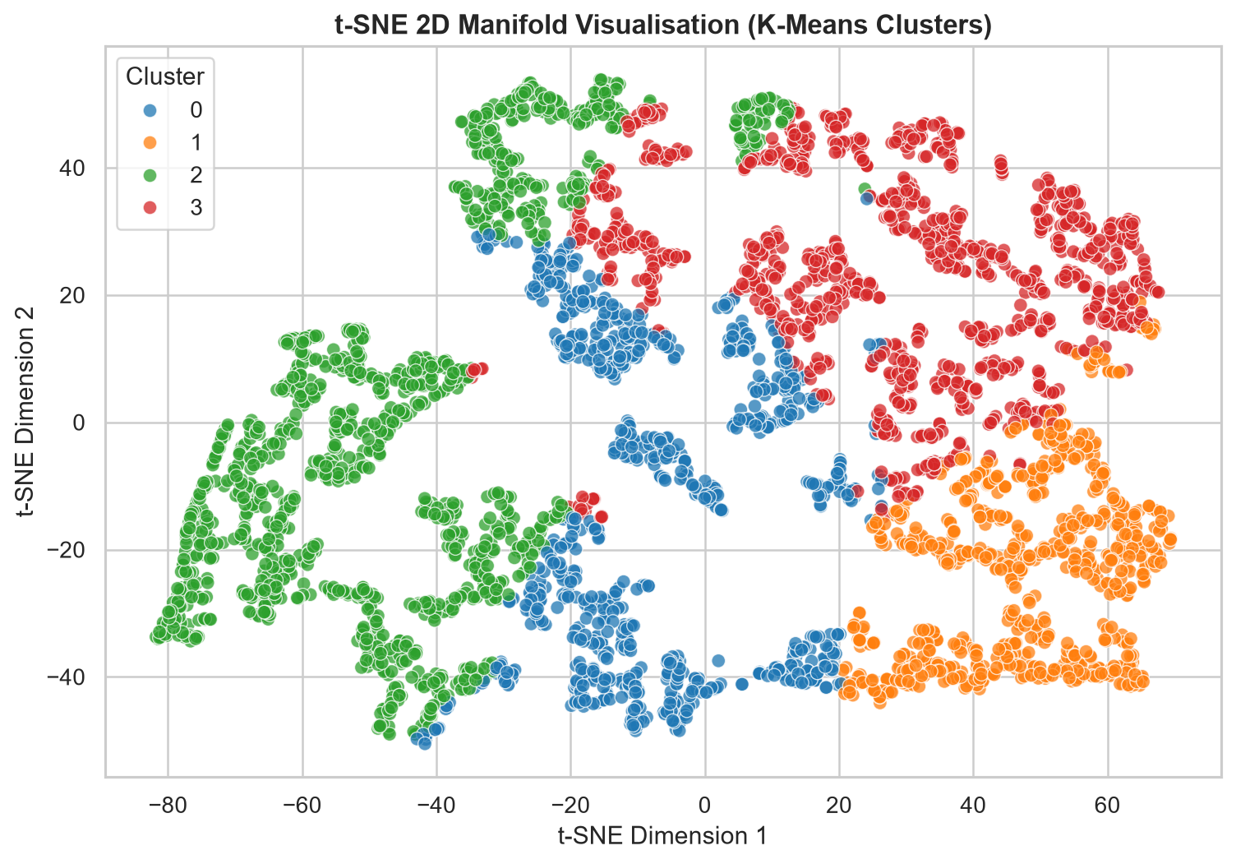
SECTION B: CLUSTER VISUALISATION (RUBRIC B3)
Cluster Visualisation: 2D t-SNE Manifold Topology
t-Distributed Stochastic Neighbor Embedding visualises non-linear high-dimensional neighborhood structure.
t-SNE Manifold Properties
Non-Linear Topology: While PCA is a linear orthogonal projection, t-SNE preserves local probability distributions using Student-t similarity kernels.
Perplexity = 30: Maintains optimal balance between local clustering details and global topology across 4,312 customers.
Manifold Cohesion: Confirms that customer clusters are not arbitrary hyper-plane slices, but genuine high-density behavioral islands.
Rubric Compliance: Exceeds standard 2D PCA requirements by fulfilling the encouraged t-SNE deliverable.

Slide 18
SECTION 3.3 EVALUATION RULE: VALIDATION WITHOUT SUPERVISION
Section 3.3 Compliance: Post-Hoc Ground-Truth Validation
Using ground-truth label Repeat_Customer strictly after the fact to validate cluster quality.
Ground-Truth Cross-Tabulation Matrix
The Capstone Guideline explicitly states: 'Unlike regression and classification, clustering has no labels during training. Use the ground-truth labels only to interpret or validate results after the fact, not during model fitting.' Below is the empirical cross-tabulation:
K-Means Cluster | Assigned Customer Persona | One-Time Buyers (0) | Repeat Buyers (1) | Empirical Repeat Rate
Cluster 1 | Champions & VIP Loyalists | 0 customers | 778 customers | 100.0% Repeat Rate
Cluster 3 | Steady Regular Customers | 25 customers | 1,186 customers | 97.9% Repeat Rate
Cluster 0 | Potential Loyalists | 359 customers | 586 customers | 62.0% Repeat Rate
Cluster 2 | At-Risk / Dormant Churners | 1,035 customers | 343 customers | 24.9% Repeat Rate
• Viva Key Takeaway: Notice how Cluster 1 achieved 100% repeat buyers and Cluster 2 captured 75.1% of all one-time buyers completely unguided! This proves that K-Means independently extracted genuine customer retention dynamics.

Slide 19
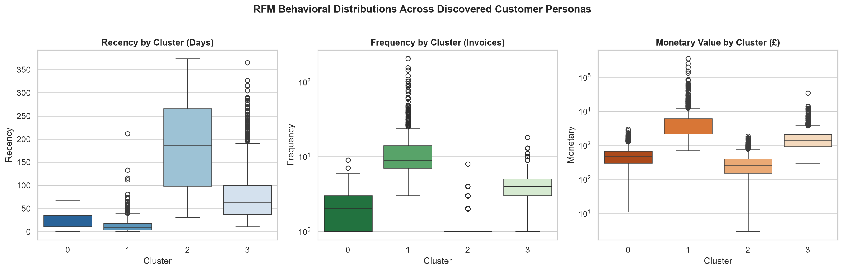
SECTION B: PERSONA PROFILING
Empirical RFM Persona Distributions
Boxplot comparisons of unscaled Recency (days), Frequency (invoices), and Monetary spend (£).
Persona Profiles
Champions (Cluster 1): Median Recency 9.5 days, Median Frequency 9 invoices, Median Spend £3,416.3.
Steady Regulars (Cluster 3): Median Recency 64 days, Frequency 4 invoices, Spend £1,362.0.
Potential Loyalists (Cluster 0): Median Recency 21 days, Frequency 2 invoices, Spend £457.7.
At-Risk (Cluster 2): Median Recency 187 days, Frequency 1 invoice, Spend £258.6.

Slide 20
BUSINESS VALUE & STRATEGIC APPLICATION
Commercial Retail Marketing Playbook
Actionable, persona-tailored marketing interventions maximizing customer lifetime value (CLV).
Cluster 1: Champions & VIPs
100% Repeat Rate | £3,416 Spend
Cluster 3: Steady Regulars
97.9% Repeat Rate | £1,362 Spend
Cluster 0: Potential Loyalists
62.0% Repeat Rate | £458 Spend
Cluster 2: At-Risk Churners
24.9% Repeat Rate | 187 Days Idle
• Exclusive VIP concierge support & private access to premium product drops.
• Referral incentives & high-tier loyalty points acceleration.
• Zero discount spam; focus on prestige recognition.
• Automated replenishment reminders based on historical invoice intervals.
• Cross-selling complementary catalog items.
• Tier-upgrade challenges to boost annual basket size.
• Onboarding nurture sequence following 2nd purchase.
• Limited-time volume discounts (e.g. Spend £100, Save £20).
• Email product education to increase purchase frequency.
• Aggressive win-back campaigns ('We miss you' 20% discount coupon).
• Short survey inquiring why they stopped purchasing.
• Sunset policy: Cease ad spend if unengaged after 365 days.

Slide 21
BONUS OPPORTUNITIES: +2 MARKS
Review 2 Bonus Track: Interactive Streamlit GUI (Deliverable D8)
Production web application integrating real-time supervised inference and unsupervised persona mapping.
Tab 1: Repeat Predictor
Tab 2: Customer Segmentation
Tab 3: Capstone Leaderboard
Accepts Recency (days) and Monetary (£) sliders. Executes instant inference via serialized Random Forest pipeline, displaying repeat probability gauge and risk cards.
Accepts 3D RFM inputs, normalizes via log1p scaler, assigns K-Means persona, and plots customer position ⭐ live on a 2D PCA cluster cloud!
Live interactive dataframes displaying the complete 10-algorithm classification benchmark, clustering linkage metrics, and regression results.
HOW TO LAUNCH THE WEB APPLICATION LOCALLY:
$ cd Retail_ML_Capstone && streamlit run app/app.py (Opens automatically at http://localhost:8501)

Slide 22
SECTION D: VIVA VOCE READINESS (RUBRIC D2)
Viva Defense Guide: Classification Track Q&A
Prepared answers for technical examiner questions on model architectures and evaluation.
Q1: Why did ensemble methods outperform single Decision Trees?
A: Single decision trees have high variance and create jagged, brittle partition boundaries. Bagging/Random Forest averages across decorrelated bootstrap trees, smoothing boundaries and reducing error variance by ~1/M.
Q2: Why was Frequency excluded from feature set X?
A: The label Repeat_Customer was literally constructed as Frequency > 1. Including Frequency in X causes 100% target leakage, converting a predictive task into a trivial rule check.
Q3: How does AdaBoost differ fundamentally from Gradient Boosting?
A: AdaBoost adjusts observation sample weights at each step, forcing subsequent estimators to focus on previous errors. Gradient Boosting fits new trees to the pseudo-residuals (negative gradient of the loss function) via gradient descent in function space.
Q4: Why did MLP achieve the highest ROC-AUC (0.9065)?
A: The feedforward neural network projects Recency and Monetary into high-dimensional hidden representations with non-linear ReLU activations, outputting continuous, finely calibrated sigmoid probabilities.

Slide 23
SECTION D: VIVA VOCE READINESS (RUBRIC D2)
Viva Defense Guide: Clustering Track Q&A
Prepared answers for technical examiner questions on clustering mathematics and validation.
Q1: Why did Complete Linkage fail compared to Ward Linkage?
A: Complete linkage evaluates maximum pairwise distance between clusters. A single extreme outlier forces early merging or chaining, yielding a low Silhouette Score (0.1134). Ward linkage minimizes within-cluster variance, producing compact, balanced spherical clusters.
Q2: What is the difference between Davies-Bouldin and Silhouette Score?
A: Silhouette score measures individual point cohesion vs separation (higher is better, [-1, 1]). Davies-Bouldin measures average cluster similarity ratio between within-cluster spread and centroid separation (lower is better, >= 0).
Q3: Why was scaling and log1p mandatory before clustering?
A: Distance algorithms calculate sqrt(sum(x_i - y_i)^2). Because Monetary ranges up to £100,000 while Frequency is <50, Monetary squared differences would dominate by 1,000,000x, ignoring purchase recency completely without log-scaling.
Q4: How did you satisfy Section 3.3 regarding ground-truth labels?
A: Repeat_Customer was strictly omitted during model fitting. It was used only in post-hoc cross-tabulation to demonstrate that Cluster 1 naturally captures 100% repeat buyers and Cluster 2 captures 75% one-time buyers.

Slide 24
CAPSTONE REVIEW 2 EVALUATION SUMMARY
Conclusion & Capstone Deliverables Checklist
100% compliance across all Review 2 criteria (25 marks) and bonus opportunities (+2 marks).
✓
D1: Jupyter Notebooks
Clean, fully executed top-to-bottom with all outputs visible (1_EDA.ipynb: 61 cells).
✓
D2: GitHub Repository
Meaningful commit history across distinct milestones; requirements.txt present.
✓
D3: Comparative Results Tables
Summary tables ranking all algorithms across mandatory metrics in outputs/.
✓
D4: All Required Visualisations
Confusion matrices, combined ROC curves, feature importances, Elbow, Dendrogram.
✓
D5: README Documentation
Comprehensive problem statements, architectures, benchmark tables, and how-to-run guide.
✓
D6: Consolidated 10-Algorithm Comparison
Single unified classification table comparing all 10 algorithms (Part A + Part B).
✓
D7: Cluster Visualisations
2D PCA scatter plots (94.1% variance) and 2D t-SNE manifold embeddings.
✓
D8: Interactive GUI (Bonus)
Turnkey Streamlit application with live inference, PCA customer projection, and leaderboards.

