Slide 1
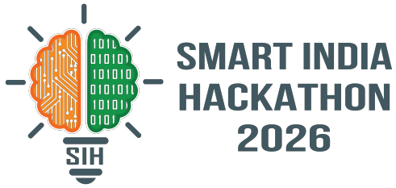
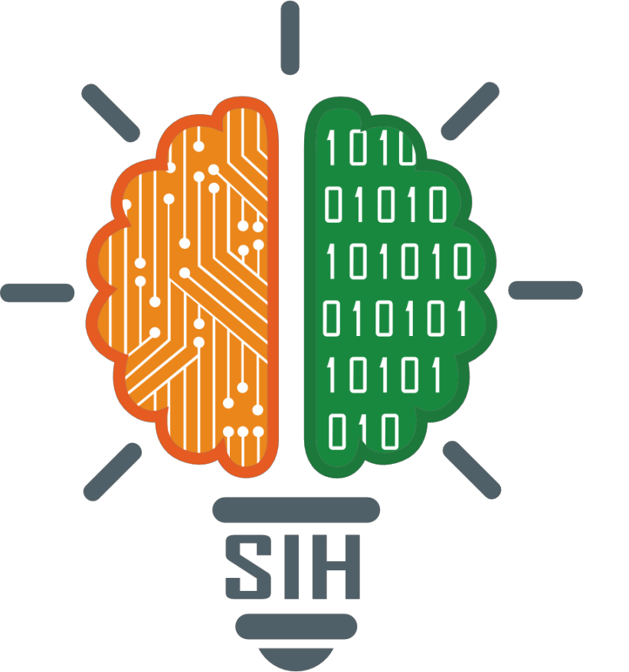
SMART INDIA HACKATHON 2026
TITLE PAGE
Problem Statement ID – 26133
Problem Statement Title- "Accessibility and quality of public healthcare services, particularly in rural and underserved areas"
Theme- MedTech / BioTech / HealthTech
PS Category- Software
Team ID- [Registered Team ID]
Team Name (Registered on portal)- Team JeevanSetu

Slide 2
Your
Team
Name
IDEA TITLE
❖ Proposed Solution: Problem Analysis & Ground Reality in Rural Maharashtra
1. The 70 km Referral Blackhole
🔴 THE BROKEN RURAL PATIENT JOURNEY (CURRENT REALITY)
When a rural patient is referred from a PHC to a District Hospital, there is ZERO digital coordination. Patients arrive after arduous travel only to find specialists absent or ICU beds full.
1. Sickness at Remote Hamlet
Tribal patient falls ill in Gadchiroli; no local diagnostic facility.
🚨 Ground Reality: 42% Referral Dropout Rate in Rural Transit
2. Blind Travel (15-25 km)
2. Language & Digital Literacy Divide
Spends daily wages on transport to reach Sub-Centre / PHC.
Over 68% of tribal/rural citizens cannot read or type text forms in English/Hindi. Existing e-health portals are unusable for non-literate villagers speaking Marathi or regional dialects.
3. Facility Dead-End
Doctor is on unrecorded leave; anti-snake venom is out of stock.
🚨 Ground Reality: Zero Usability for Non-Literate Keypad Users
4. Paper Referral Slip
Handed a paper slip to District Hospital 70 km away without bed confirmation.
3. Ghost Facilities & Silent Stockouts
5. Catastrophic Dropout (42%)
Villagers walk 15–30 km on foot only to discover duty doctors are absent or critical emergency medicines (anti-snake venoms, insulin, maternal antibiotics) are completely out of stock.
Fearing exorbitant costs & unfamiliar city hospitals, patient returns home.
🚨 Ground Reality: Supply Chains are 100% Reactive
6. Preventable Tragedy
Manageable medical condition turns into a fatal emergency.
@SIH Idea submission- Template 2
2

Slide 3
Your
Team
Name
IDEA TITLE
❖ Ecosystem Analysis: Strengthening & Harmonizing Existing Public Health Systems
🏛️ 4-TIER PUBLIC HEALTHCARE ECOSYSTEM IN MAHARASHTRA
1. Sub-Centres (SC)
2. Primary Health Centres
3. Sub-District Hospitals
4. District Civil Hospitals
ASHA / ANM Workers
⚠️ Paper registers, zero referral visibility
PHC Medical Officers
⚠️ Reactive supply chain, attendance blindspot
Specialist First Referral
⚠️ Unannounced surge, no prior bed booking
Tertiary Care & Surgery
⚠️ Overcrowded OPDs, lost follow-up loop
🔍 COMPARATIVE GAP ANALYSIS: HOW JEEVANSETU COMPLEMENTS NATIONAL PLATFORMS
National / State Portal | Core Intended Function | Rural Operational Limitation | JeevanSetu Unified Bridge (Our Impact)
ABHA & ABDM | National Health ID & Longitudinal Electronic Health Records | No live inter-facility referral handshakes, queue tokens, or bed booking | Acts as the Active Coordination Layer that feeds verified events into ABDM
e-Sanjeevani | Doctor-to-Doctor & Citizen Teleconsultation | Requires high-speed 4G video; does not manage PHC drug inventory or transit | Works on 2G Keypad IVR + Real-time Marathi Voice AI without video overhead
108 Emergency Fleet | Emergency Ambulance Dispatch | Lacks digital vitals pre-transmission to destination hospital trauma team | Bi-directional triage data sharing with destination hospital before ambulance arrives
MJPJAY / PM-JAY | ₹5 Lakhs Cashless Health Coverage | Rural villagers do not know which empaneled hospital performs specific surgeries | Automated Grounded Scheme Suggester maps patient symptoms directly to schemes
@SIH Idea submission- Template 3
3

Slide 4
Your
Team
Name
IDEA TITLE
❖ Proposed Solution: JeevanSetu — The Connected Rural Healthcare Highway
🌐 "BRIDGING RURAL PATIENTS TO VERIFIED, LIFE-SAVING CARE"
JeevanSetu (जीवनसेतु) is a high-reliability, zero-literacy digital healthcare coordination platform engineered for the Government of Maharashtra. It unifies citizens, ASHA workers, PHC Medical Officers, District Hospitals, and Health Administrators into a single seamless, transparent, and multi-lingual care highway.
1. Rural Citizen
2. ASHA Worker
3. PHC Doctor
4. District Hospital
5. District Admin
✓ Hands-free Marathi Voice AI
✓ Field triage guidance
✓ Verified doctor check-in
✓ Pre-arrival bed booking
✓ Outbreak Z-score detection
✓ 2G Keypad IVR Phone Access
✓ Maternal risk tracking
✓ 6-stage digital referral
✓ Referral handshake
✓ Doctor presence integrity
✓ Check Before You Travel desk
✓ Post-discharge follow-up
✓ Drug depletion alerts
✓ Specialist OPD doctor desk
✓ Medicine rebalancing desk
✓ MJPJAY ₹5L cashless finder
✓ Emergency 108 ambulance routing
✓ OPD digital token & vitals
✓ QR code admission verify
✓ District completion metrics
@SIH Idea submission- Template 4
4

Slide 5
Your
Team
Name
TECHNICAL APPROACH
❖ Methodology & Process: End-to-End Patient Care Flowchart
STEP 1: Sickness / Need
STEP 2: Guided Triage
STEP 3: Readiness Check
STEP 4: PHC Consultation
Vernacular Intake
"What Should I Do?"
"Check Before Travel"
Vitals & Care Case
Villager speaks in Marathi / Hindi or dials 2G Keypad IVR.
Non-diagnostic safety filter identifies facility level required.
Verifies duty doctor presence & OPD token before patient walks.
PHC Doctor logs vitals (BP, Sugar, SpO2) & initiates digital case.
STEP 5: Referral Booking
STEP 6: Assisted Transit
STEP 7: Hospital Care
STEP 8: Follow-up Loop
6-Stage Bed Lock
QR Bed Handshake
Treatment & Discharge
ASHA Care Continuity
District Hospital accepts referral & reserves Bed #12 in advance.
Patient arrives with QR Token; ₹0 cashless MJPJAY admission.
Specialist surgery recorded; digital discharge synched to PHC.
Automated milestone alerts prompt ASHA for home visit & recovery.
🔒 CORE SYSTEM INVARIANT: Absence of a digital event is labeled as "Hospital arrival pending", never "Patient abandoned care". Zero dropouts.
@SIH Idea submission- Template 5
5

Slide 6
Your
Team
Name
TECHNICAL APPROACH
❖ Core Verified Features: 6-Pillar Healthcare Delivery Matrix (RC-33 Audited)
1. ACCESS & TRIAGE
2. 6-STAGE REFERRALS
3. DRUG INVENTORY
• Verified Directory: 1,200+ geo-tagged PHCs, Sub-Centres & Hospitals.
• Bi-Directional Lifecycle: Initiation -> Destination Accept -> Transit -> Admit -> Treat -> Follow-up.
• Real-Time PHC Stock: Balance truth in transactional PostgreSQL.
• Check Before You Travel: Live doctor duty status & bed occupancy desk.
• Pre-Arrival Bed Booking: Reserves Bed #12 before patient leaves PHC.
• Deterministic Z-Score: Moving baseline math (forecast.utils.js).
• What Should I Do Now?: Non-diagnostic triage routing to right care tier.
• QR Code Handover: One-scan patient identification at district casualty.
• 5-Day Depletion Warnings: Alerting before anti-snake venoms run out.
• OPD Token Generation: Digital queue slips reducing PHC waiting lines.
• Care Continuity Ledger: Immutable append-only audit trail.
• Inter-PHC Redistribution: District surplus-to-deficit rebalancing.
4. INCLUSION & VOICE
5. SCHEMES & CASHLESS
6. SURVEILLANCE & SAFETY
• Marathi Voice AI (mr-IN): Real-time 1-on-1 natural conversation.
• MJPJAY Maharashtra: Up to ₹5 Lakhs cashless hospital surgery finder.
• Early Outbreak Alerts: Statistical syndrome clustering 14d before logs.
• Hindi (hi-IN) & English: Multi-lingual speech recognition & synthesis.
• PM-JAY & JSSK: Free maternal & infant transport entitlements.
• Doctor Presence Integrity: Server timestamped duty attendance auditing.
• 2G Keypad IVR: Toll-free DTMF access for basic phone owners.
• Grounded Scheme Matcher: Symptom profile maps to financial grants.
• Deterministic 108 Hotlines: Life-threatening red flags bypass AI.
• Offline Resilience: Browser speech synthesis with regional fallback.
• Zero Moneylender Debt: Direct empaneled hospital navigation.
• Citizen Feedback Desk: 2G missed-call and web grievance resolution.
@SIH Idea submission- Template 6
6

Slide 7
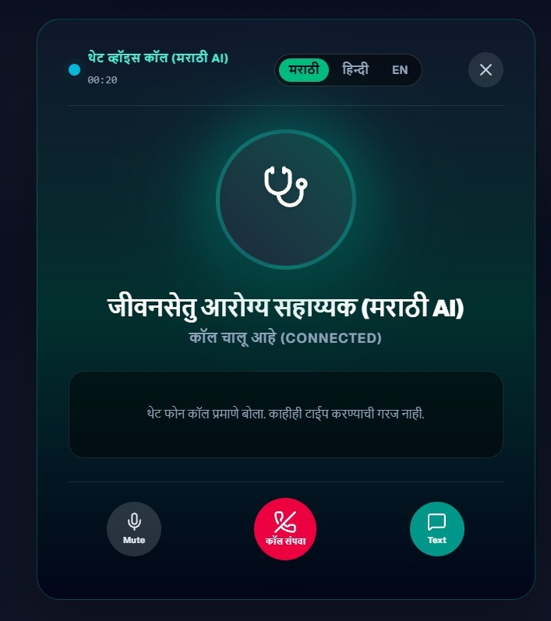
Your
Team
Name
TECHNICAL APPROACH
❖ Vernacular Voice AI Engine & 2G Feature-Phone IVR Architecture
📱 FLOW A: SMARTPHONE REAL-TIME MARATHI VOICE AI (mr-IN)
📸 VERIFIED MARATHI VOICE CALL UI
1. User Taps Mic: Speaks naturally in Marathi ("माझ्या छातीत दुखत आहे, जवळचे रुग्णालय कुठे आहे?")
2. Web Speech STT: Transcribes regional phonemes (mr-IN / hi-IN / en-IN).
3. Healthcare Safety Layer: Validates non-diagnostic boundaries & detects red-flag emergencies.
4. Express Grounding: Retrieves verified doctor presence, beds & schemes from Supabase.
5. Regional TTS: Speaks answer aloud in Marathi + renders high-contrast action cards.
☎️ FLOW B: 2G KEYPAD FEATURE-PHONE TELEPHONY IVR (NO INTERNET)
1. Toll-Free Dialing: Villager calls toll-free health access number from any basic keypad phone.
2. Multi-Language Menu: Press 1 for Hindi, Press 2 for Marathi, Press 3 for English.
3. Keypad DTMF Options: [1] Health Guide | [2] Referral PIN Check | [3] PHCs | [4] Drug Stock | [5] ASHA Callback.
4. Privacy & Masking: Caller number automatically masked (+91 98XXX XX04) with SHA-256 hash.
5. Emergency Escalation: Life-threatening symptom selections immediately route to 108 Emergency.
✨ Live Two-Way Marathi Speech Engine (frontend/lib/voice/)
@SIH Idea submission- Template 7
7

Slide 8
Your
Team
Name
TECHNICAL APPROACH
❖ Full-Stack Technology Architecture & Security Boundary
LAYER 1: CLIENT & INTERACTION LAYER
Next.js 16 (Turbopack) • React 19 • Tailwind CSS • Web Speech API • Lucide React • DTMF Simulator
32 compiled static routes, zero-literacy vernacular voice modal, high-contrast accessible UI (>=44px touch targets), dark/light theme, and PWA mobile responsiveness.
LAYER 2: API GATEWAY & SECURITY PERIMETER
Node.js 20+ • Express.js REST • Helmet • Strict CORS • Sliding-Window Rate Limiters • Input Whitelists
21 modular API routes, JWT bearer authentication, HMAC webhook signature verification, regex prompt injection interceptors, and PII anonymization.
LAYER 3: BUSINESS LOGIC & DETERMINISTIC ENGINES
Referral FollowUp Service • Medicine Forecast Engine (Z-Score) • Early-Warning Surveillance • AI Gateway
Pure statistical math (no LLM hallucination in inventory), multi-stage referral milestone scheduler, doctor presence review desk, and provider-agnostic LLM gateway (Gemini/Claude/Fallback).
LAYER 4: DATA & STORAGE LAYER (AUTHORITATIVE TRUTH)
Supabase PostgreSQL (22 Relational Migrations) • Row Level Security (RLS) • Supabase Auth • Storage
100% RLS enforcement across all tables, append-only immutable audit logs, server-side clock timestamps, and normalized schemas (patients, referrals, inventory, early warnings).
Frontend
Next.js 16 + React 19
Backend
Express.js REST APIs
Database
PostgreSQL (Supabase RLS)
Vernacular AI
Web Speech API (mr-IN)
Testing
Jest (19/19 Test Suites Pass)
Deployment
Vercel + Render + Docker
@SIH Idea submission- Template 8
8

Slide 9
Your
Team
Name
FEASIBILITY AND VIABILITY
❖ Healthcare Safety, AI Ethics & Enterprise Security Matrix
🛡️ CLINICAL AI SAFETY & ETHICAL BOUNDARIES
🔒 5-PILLAR ENTERPRISE SECURITY ARCHITECTURE
1. AI != Doctor (Strict Non-Diagnostic Boundary)
1. Role-Based Access Control (RBAC - 6 Roles)
The AI assistant is strictly an informational and navigation guide. It NEVER diagnoses disease, declares clinical certainty, or prescribes pharmaceutical drugs or dosages.
Strict isolation across patient, phc_staff, doctor, hospital_staff, ngo_staff, and district_admin. Users are barred by database triggers from self-escalating roles.
2. PostgreSQL Row Level Security (RLS)
2. Deterministic 108 Emergency Hotlines
100% RLS active on all 22 database tables. Patients can ONLY query their own cases; staff can ONLY access records within their assigned PHC or hospital.
Life-threatening red flags (acute chest pain, breathing collapse, loss of consciousness, heavy trauma, snake bites) NEVER go to probabilistic LLMs; they trigger deterministic 108 Ambulance alerts.
3. PII Masking & Telephony Anonymization
Phone numbers are masked (+91 98XXX XX04), ABHA IDs redacted, and IVR caller IDs hashed with salted SHA-256 to guarantee complete patient privacy.
3. Zero Fabrication / Hallucination Protection
Medicine stock quantities, doctor on-duty rosters, and hospital bed availability are pulled exclusively from transactional database records, never generated by AI.
4. Authoritative Server-Side Truth
Check-in timestamps, stock adjustments, and referral states originate strictly from database clocks, preventing client-side backdating or clock manipulation.
4. Prompt Injection & Jailbreak Defense
Multi-layer regex boundary interceptors reject adversarial instructions ("ignore clinical rules", "dump database") with safe refusal envelopes without executing generation.
5. Append-Only Immutable Audit Logs
All state transitions, administrative overrides, and referral handshakes append permanent audit events to audit_logs, ensuring zero tampering.
@SIH Idea submission- Template 9
9

Slide 10
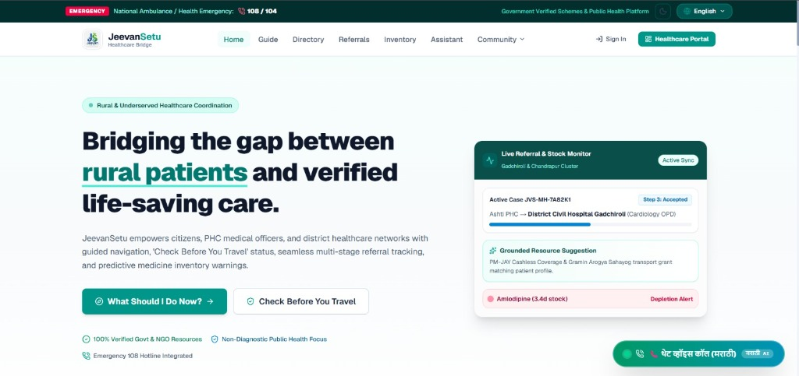
Your
Team
Name
FEASIBILITY AND VIABILITY
❖ Operational Impact: Real-Time Live PHC & District Healthcare Dashboards
📸 VERIFIED JEEVANSETU HOME & LIVE MONITOR DASHBOARD
1. Live Referral Lifecycle Monitor
Tracks active referral case (JVS-MH-7A82K1) from Ashti PHC to District Civil Hospital Gadchiroli with real-time "Step 3: Accepted" progress bar.
2. Predictive Medicine Depletion Alert
Flags essential cardiac drug (Amlodipine) with "3.4d stock remaining" depletion warning before stock reaches zero, prompting automated replenishment.
3. Grounded Resource & Scheme Matching
Instantly identifies PM-JAY Cashless Coverage & Gramin Arogya Sahayog transport grants matching the patient profile to eliminate out-of-pocket expenses.
4. Multi-Signal Early Warning Feed
Aggregates PHC syndromic vitals, drug consumption anomalies, and citizen feedback to alert District Health Officers (DHO) of seasonal outbreak spikes.
✨ Live Synchronized Monitor: Gadchiroli & Chandrapur Public Health Cluster
@SIH Idea submission- Template 10
10

Slide 11
Your
Team
Name
FEASIBILITY AND VIABILITY
❖ Direct Alignment with SIH Problem Statement 26133 Requirements
Govt. of Maharashtra SIH Mandate | Rural Ground Reality Challenge | JeevanSetu Verified Solution | Verified Codebase Proof
Long Travel Distances | Unnecessary 25km trips to unstaffed or closed facilities | "Check Before You Travel" Live Availability Desk | frontend/app/navigate/page.js
Delayed & Blind Referrals | 42% patient dropout during inter-facility transit | 6-Stage Bi-Directional Referral with Bed Booking | frontend/app/referrals/page.js
Medicine Stockout Uncertainty | Silent emergency drug exhaustion (anti-snake venoms) | Deterministic Consumption & Depletion Alert Engine | backend/src/services/forecasting/
Illiteracy & Language Barriers | Inability to read or type complex English/Hindi forms | 1-on-1 Real-Time Marathi Voice AI Engine (mr-IN) | frontend/lib/voice/speechRecognition.js
Low-Bandwidth & 2G Phones | Villagers owning basic keypad feature phones | Toll-Free 2G Keypad DTMF IVR Access & PIN lookup | frontend/app/ivrsupport/page.js
Doctor Absenteeism | Unrecorded doctor leaves causing ghost PHC visits | Server-Verified Duty Roster & Attendance Monitor | frontend/app/admin/doctor-presence/
Outbreak Reporting Delays | 2-3 week lag in manual paper epidemic reports | Multi-Signal Statistical Anomaly Alerts (Z-score) | backend/src/services/earlyWarning/
Financial Medical Debt | Extortionate loans for private hospital surgeries | MJPJAY & PM-JAY ₹5L Cashless Scheme Navigator | frontend/app/resources/schemes/
@SIH Idea submission- Template 11
11

Slide 12
Your
Team
Name
IMPACT AND BENEFITS
❖ Projected Rural Impact, Scalability & Government References
📈 MEASURABLE PUBLIC HEALTH IMPACT
🚀 FUTURE SCALABILITY & INTEGRATION ROADMAP
• ABDM & FHIR Interoperability: Direct synchronization with Ayushman Bharat Digital Health Accounts.
60% Reduction in Unnecessary Travel
"Check Before You Travel" prevents wasted 20km journeys to closed PHCs.
• Standardized IoT Device Streaming: Bluetooth glucometers & SpO2 streaming via open APIs.
• State-Wide Rollout: District-wide scaling across all 36 districts of Maharashtra.
85%+ Completion in Inter-Facility Referrals
Pre-arrival bed booking eliminates the 42% transit dropout rate.
• Tribal Dialect Expansion: Adding Gondi, Bhili, and Korku vernacular voice phoneme models.
100% Elimination of Silent Stockouts
📚 RESEARCH, REFERENCES & POLICY GROUNDING
5-day predictive consumption warnings trigger automated restock.
1. National Health Mission (NHM) Rural Health Statistics 2022-23 — Ministry of Health & Family Welfare.
2. Government of Maharashtra Public Health Guidelines — MJPJAY & PHC Referral Protocols.
₹0 Out-of-Pocket Cashless Care for BPL
Grounded MJPJAY guidance connects poor villagers to ₹5L surgical cover.
3. World Health Organization (WHO) Digital Health Guidelines — Strengthening Primary Health Care.
4. Ayushman Bharat Digital Mission (ABDM) Whitepaper — National Health Authority (NHA).
@SIH Idea submission- Template 12
12

