Slide 1

BUG BOUNTY PROGRAM

Slide 2
INDEX
Sr.No | Chapters
01 | Introduction
02 | History of bug bounty program
03 | Bug bounty hunting platforms
04 | Types of bug bounty program
05 | What should you learn technically
06 | Benefits of bug bounty program
07 | Bug bounty program working process
08 | References

Slide 3

01
Introduction

Slide 4

Introduction
Bug bounty is a method for finding flaws and vulnerabilities in web applications; application vendors reward bounties, and so the bug bounty hunter can earn money in the process of doing so. Application vendors pay hackers to detect and identify vulnerabilities in their software, web applications, and mobile applications. Whether it's a small or a large organization, internal security teams require an external audit from other real-world hackers to test their applications for them. That is the reason they approach vulnerability coordination platforms to provide them with private contractors, also known as Bug Bounty Hunters, to assist them in this regard.

Slide 5

02
History Of Bug Bounty Program

Slide 6
History of Bug Bounty Program
In 1995, Netscape took the initiative to offer a cash reward for non-employees to report bugs. They launched a brand-new cybersecurity concept, now known as a bug bounty. Matt Horner, Netscape’s Vice President of marketing, explained at the time: “By rewarding users for quickly identifying and reporting bugs back to us, this program will encourage an extensive, open review of Netscape Navigator 2.0 and will help us to continue to create products of the highest quality.”
As Netscape’s bug bounty methodology did not catch on to other vendors, the security company IDefense, began an initiative in 2002. Their vulnerability contributor program offered researchers cash rewards of up to $400 for reporting vulnerabilities in software to them.

Slide 7

03
Bug Bounty Hunting Platforms

Slide 8

Bug Bounty Hunting Platforms
 | PLATFORMS | DESCRIPTION
01 | HackerOne | This is a web-based platform that connects organizations with ethical hackers to test for cybersecurity vulnerabilities and bugs.
02 | Bugcrowd | This is a crowdsourced cybersecurity platform that connects hackers and researchers with organizations to help organizations identify and fix vulnerabilities.
03 | Cobalt | Cobalt's Penetration Testing as a Service (PTaaS) platform converts broken pentest models into a data-driven vulnerability co-ordination engine
04 | Synack | This is a vulnerability intelligence platform that automates the discovery of exploitable vulnerabilities for reconnaissance and turns them over to the company's freelance hackers to create vulnerability reports for clients.

Slide 9

04
TYPES OF BUG BOUNTY PROGRAM

Slide 10
Types of Bug Bounty Program
Public
A public bug bounty program is one that is open to anyone who wants to participate. This program may prohibit some researchers from participating based on the researcher's level and track record, but in general, anyone can participate in a public bounty program and this includes the scope, the rules of engagement, as well as the bounty guidelines. A public program is accessible by all researchers on the platform, and all bug bounty programs outside of the platforms are also considered bug bounty programs.

Slide 11
Types of Bug Bounty Program
Private
A private bug bounty program is one that is an invite-only program for selected researchers. This is a program that allows only a few researchers to participate and the researchers are invited based on their skill level and statistics. Private programs only select those researchers who are skilled in testing the kinds of applications that they have. The programs tend to go public after a certain amount of time but some of them may never go public at all. These programs provide access only to those researchers that have a strong track record of reporting good vulnerabilities, so to be invited to good programs, it is required to have a strong and positive record.

Slide 12
05
What Should You Learn Technically

Slide 13
What Should You Learn Technically
01
Web Application Security
05
Programming and Scripting
02
Network Security
06
Mobile Application Security
03
Operating system
07
Cloud Security
04
Bug Bounty Platforms and Tools
08
Report Writing and Communication

Slide 14
06
Benefits Of Bug Bounty Program

Slide 15
Benefits of Bug Bounty Program
Greatly reduces cost per vulnerability compared with other security solutions
Offer a cost-effective way to discovering vulnerabilities and triage risks that internal security teams may miss
01
04
Engage a diverse group of hackers by tapping into a broad array of talent
Contribute to a reputation for taking security seriously among hackers and the broader security community by being willing to invest in results
02
05
Allow you to stay on top of the always-evolving landscape of security threats due to the principles of bottom-up competition in the platforms that that fosters continuous improvement and perpetual learning
03
06
Provide continuous assurance that allows you to maintain the highest standard of security for critical assets

Slide 16

07
Bug Bounty Program Working Process

Slide 17
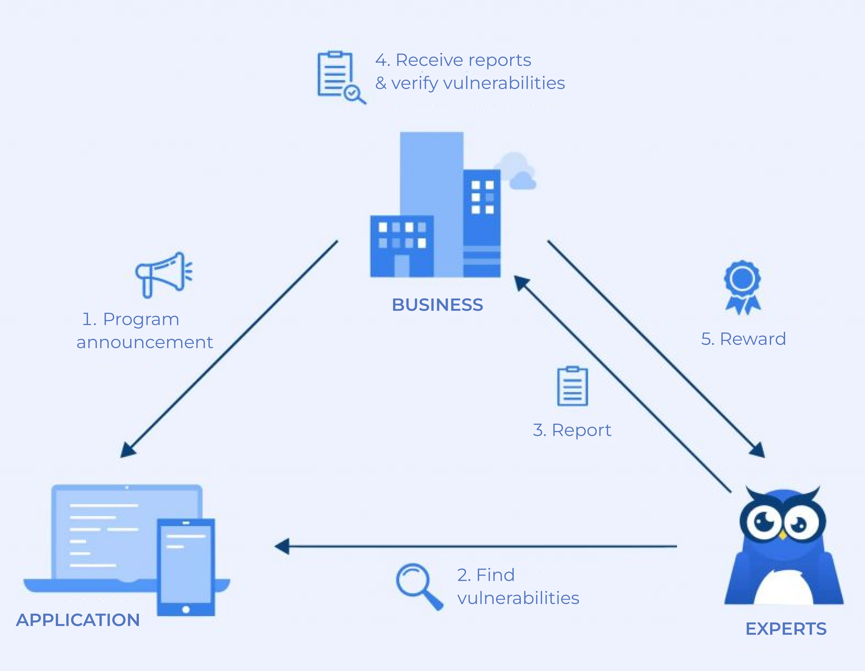
Bug bounty program working process

Slide 18

Reference
https://www.slideshare.net/null0x00/bug-bounty-1
https://www.slideserve.com/26545/the-importance-of-bug-bounty-training-in-cyber-security-pdf
https://www.slideshare.net/null0x00/bug-bounty-secrets
https://youtu.be/9ouro4tr7fq?si=dp1z5ghz5kqechmx

Slide 19

THANK YOU

