Slide 1
GROUP-30
TEAM MEMBERS:
1) Mohit Khosla
2) Danish Ahmed
3) Gaurav Rajkumar Savlani
4) Himanshu Kumar
5) Ashutosh Abhishek Toppo
6) Shiv Shankar Singh
GUIDED BY : Pradeep Tripathi sir
MENTOR NAME: Aniruddha Parte , Vaishnavi Bhoir

Slide 2
Problem Statement :
Build and automate machine learning model to predict used car Price on cloud.
Problem:
(Due to huge decline in availability semiconductors, geopolitical tensions, Huge waiting period the sales of new car is decreasing rapidly, however this has benefited the used car market but the problem is there are a lot of complex variables on which the used car price is decided)
Technologies Used:
AWS EMR, S3,LAMBDA
GITHUB
JENKINS
JUPYTER NOTEBOOK
PYTHON
STREAMLIT
Project Status : 65%

Slide 3
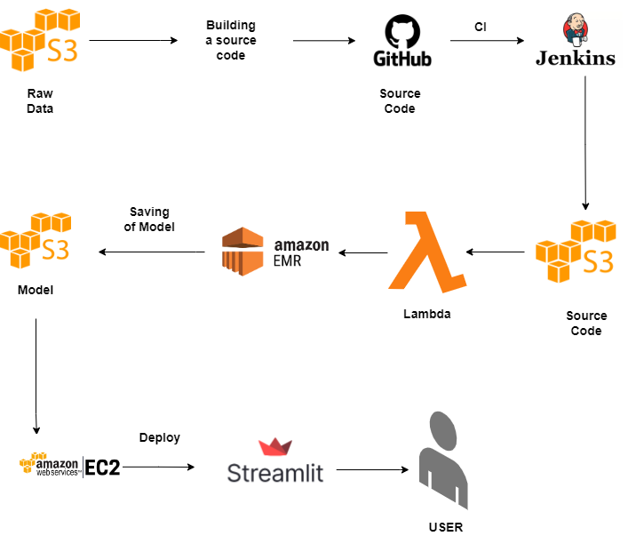
Project Architecture

