Slide 1


TRACK: STREAMING
STRUCTURED DATA STREAMING
SHIVJI KUMAR JHA
@ShivjiJha
in/shivjijha

Slide 2

About Me
Senior MTS at Nutanix
Platform Engineer
DBs, SOA, Infra, Streams
Love
Distributed data systems
Open-source software (OSS)
OSS Contributions
Apache Pulsar
MySQL

Slide 3
Contents
Why Schema?
How
Popular formats
What
Examples, Learnings

Slide 4
Why: Abstractions (historical perspective)

Slide 5

A Brief History…
Of Databases
1960: Flat Files
1960s: Hierarchical Databases
Need for structure
1980: SQL / Relational Databases
High-level language
Some more structure!
2004: NoSQL
Scale & Availability above all
No relational model, less structure
2010s: Distributed SQL
Well, no, we need structure*
Image source: https://commons.wikimedia.org/wiki/File:Human_evolution.svg

Slide 6
A Brief History…
Of Data Streams
Apache Kafka:
Built inside LinkedIn
2011: Kafka becomes open source
2012: Graduated from Apache incubator
Apache Pulsar
Built at Yahoo
2016: Contributed to Open source
2018: Top-level Apache project
Image source: https://commons.wikimedia.org/wiki/File:Human_evolution.svg

Slide 7
History tell us…
Evolution
OBJECTS
BYTES
BITS
PRIMITIVE TYPES
SQL -> NoSQL -> Distributed SQL
Relation database has strict schema
Streaming bytes -> Schema Registry
Both Kafka and Pulsar support schema registry now!
Its not ideal to stream bytes
Use schema wherever possible
Err on the side of having schema

Slide 8
What: Schema 101

Slide 9


Hello PubSub!
Produce Data
Consume Data

Slide 10
Hello PubSub!
Produce Data
Consume Data

Slide 11
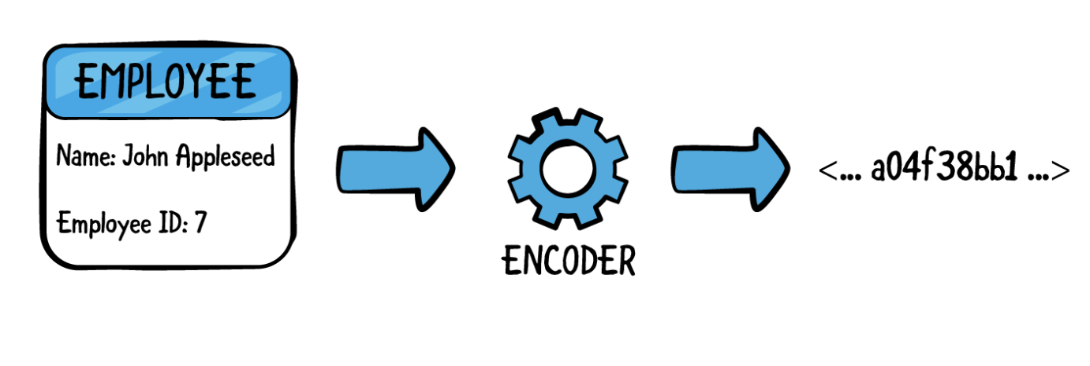

Computers only know bits…
Encoding data
Example: Write an employee record
Sending data to a computer
Local computer
Over network
Can't send as is.
Encode to bits
Also, serialization
Send
https://www.raywenderlich.com/books/swift-apprentice/v6.0/chapters/22-encoding-decoding-types

Slide 12
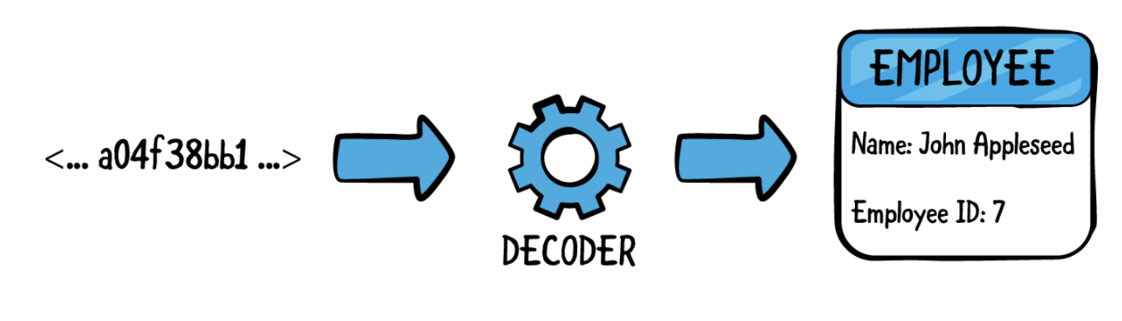
Computers only know bits…
Decoding data
Example: Read an employee record
Read data from a computer
Local computer
Over network
Turn bytes to employee rocrd
Decode to bits
Also, de-serialization
Use in program.
https://www.raywenderlich.com/books/swift-apprentice/v6.0/chapters/22-encoding-decoding-types

Slide 13


Encoder / decoder placements
Choice 1 : App
Produce Data
Consume Data

Slide 14
Encoder / decoder placements
Choice 2 : Producer/Consumer
Produce Data
Consume Data

Slide 15
Encoder / decoder placements
Choice 3 : Stream Platform
Produce Data
Consume Data

Slide 16
Abstraction vs Flexibility
Abstraction
Flexibility
Abstract out encode / decode to the stream platform
Lighter Individual apps
Single Responsibility Principle
Easy Evolution of schema
Versioning
Less bugs!
Keep encode / decode in (each) app
Flexibility of choice
Schema formats
Schema evolution is hard
Versioning
Upgrade Path?
More bugs?

Slide 17
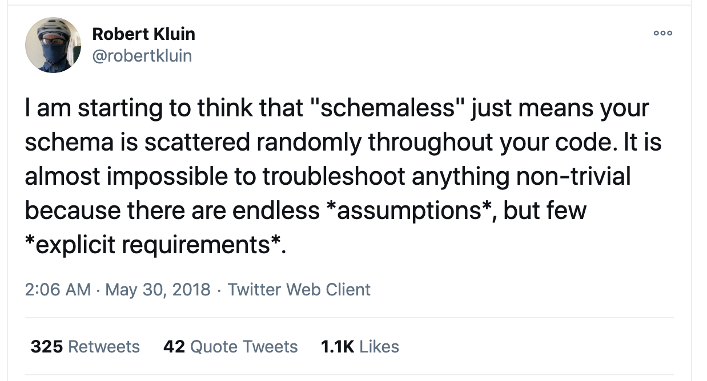
Flexibility? : Choose Wisely…

Slide 18
Flexibility? : Choose Wisely…
Flexibility is a good choice when:
Non-uniform data
Custom Fields
Non-uniform Types
Frequent schema migrations

Slide 19
How: Schema Representations

Slide 20
Schema : Choice 1
Use Native serialization of programming language
Examples:
Java serialization
Python’s pickle
Ruby’s Marshall
Good
Easy implementation
Bad
Locked with same programming language for producer and consumer
Difficult to Evolve schema versions
Upgrade Path?

Slide 21
Schema : Choice 2
Use same format as web APIs (REST?)
Examples:
JSON
XML
Good
Familiar implementation, share code!
Text, readable, easy to debug
Bad
Key Name in every message, too much data
Auto detected type, may go wrong…
New types? Nested types? Ship POJO library?
Document? Synchronize? Ignore new data?

Slide 22
Schema : Choice 3
Struct Schema : Avro, Thrift, Protocol Buffers
Good
Binary formats, less space
Matured over the years
Well documented
Libraries in multiple languages
Good support in stream ecosystem
Evolution with versioning
Bad
Extra learning curve

Slide 23
Case Study: Apache Pulsar Schema

Slide 24

Apache Pulsar 101
Apache Pulsar
Cloud-native,
Highlights
Modular Design
Distributed messaging and
Distributed streaming platform
Horizontally scalable
Low latency & high throughput
Multi-tenancy
Geo Replication
PRODUCER
CONSUMER

Slide 25
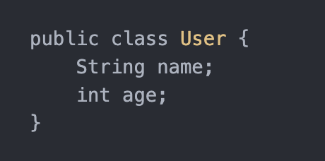
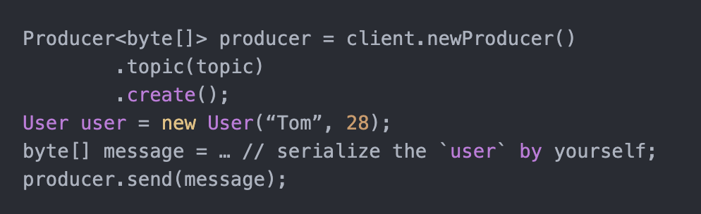
Pulsar schema : Byte Schema
Domain Object
Pulsar Producer : Sample Code

Slide 26
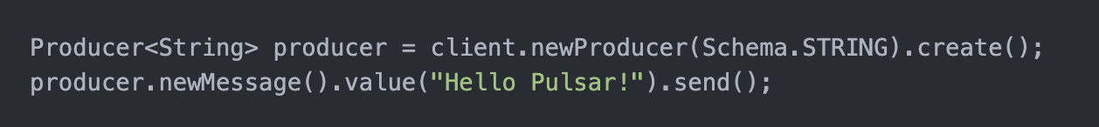
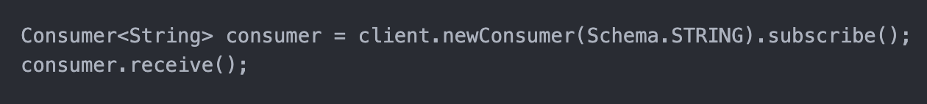
Pulsar schema : String Schema
Producer
Consumer

Slide 27
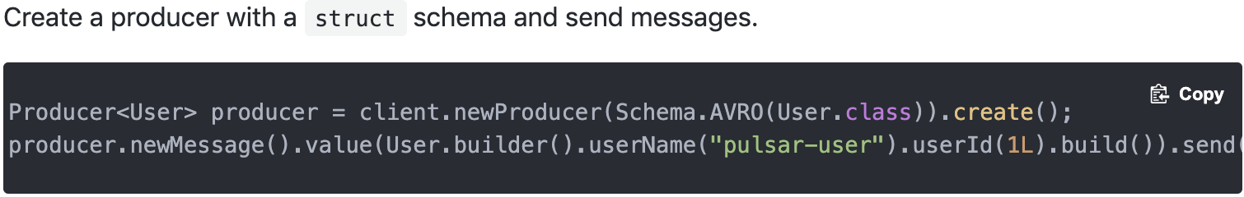
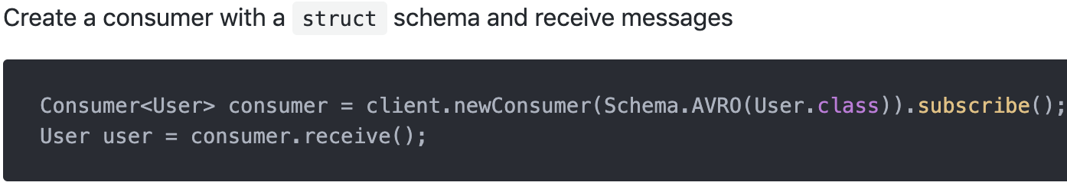
Pulsar schema : Avro Schema

Slide 28
Pulsar schema : Schema Registry
Topic to schemas mapping.
Stores accepted schemas for a topic.
Manages evolution with versioning.
Producer adds schema, if compatible.
Consumer fetches schema, given topic & message.
Schema => [name, payload, type, properties]

Slide 29
Schema Evolution
Manual
Check every schema before upgrade
Auto – updates
If new schema passes compatibility tests, producer uploads new version of schema.

Slide 30
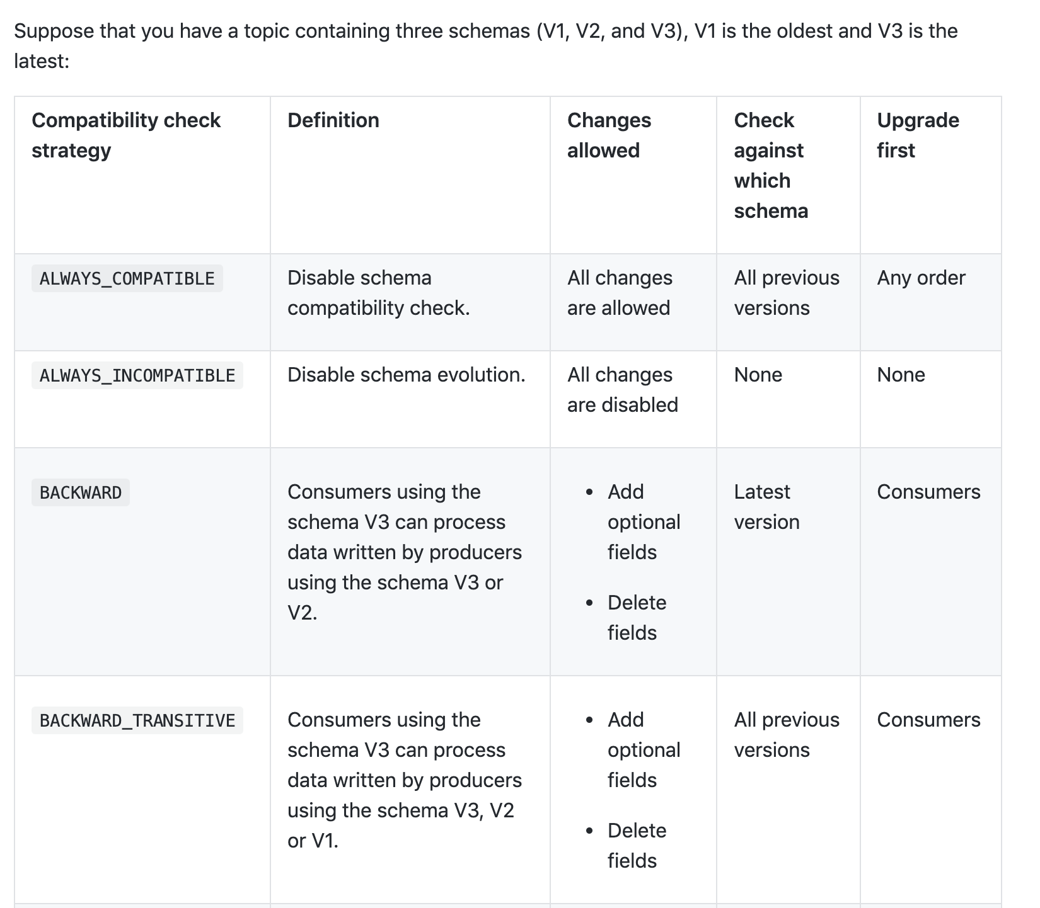
Schema : Compatibility modes

Slide 31
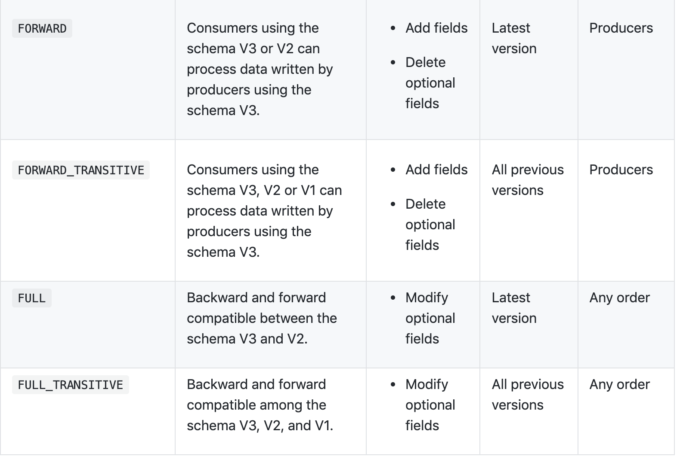
Schema : Compatibility modes

Slide 32
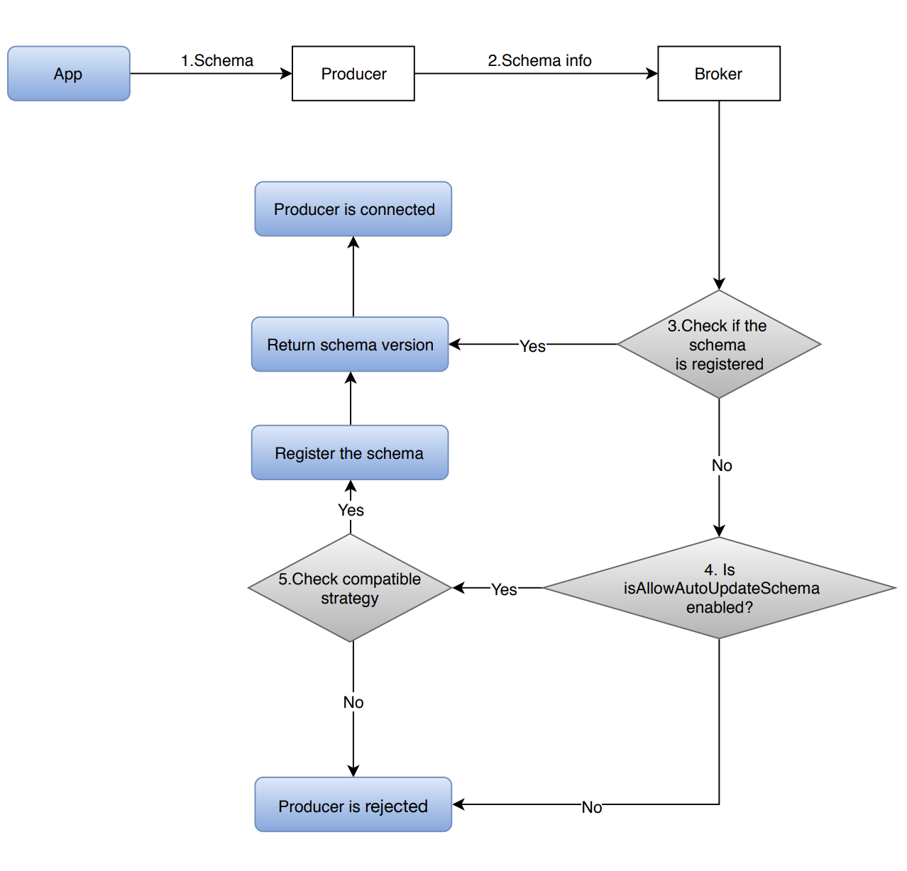
Schema Registry: Producer

Slide 33
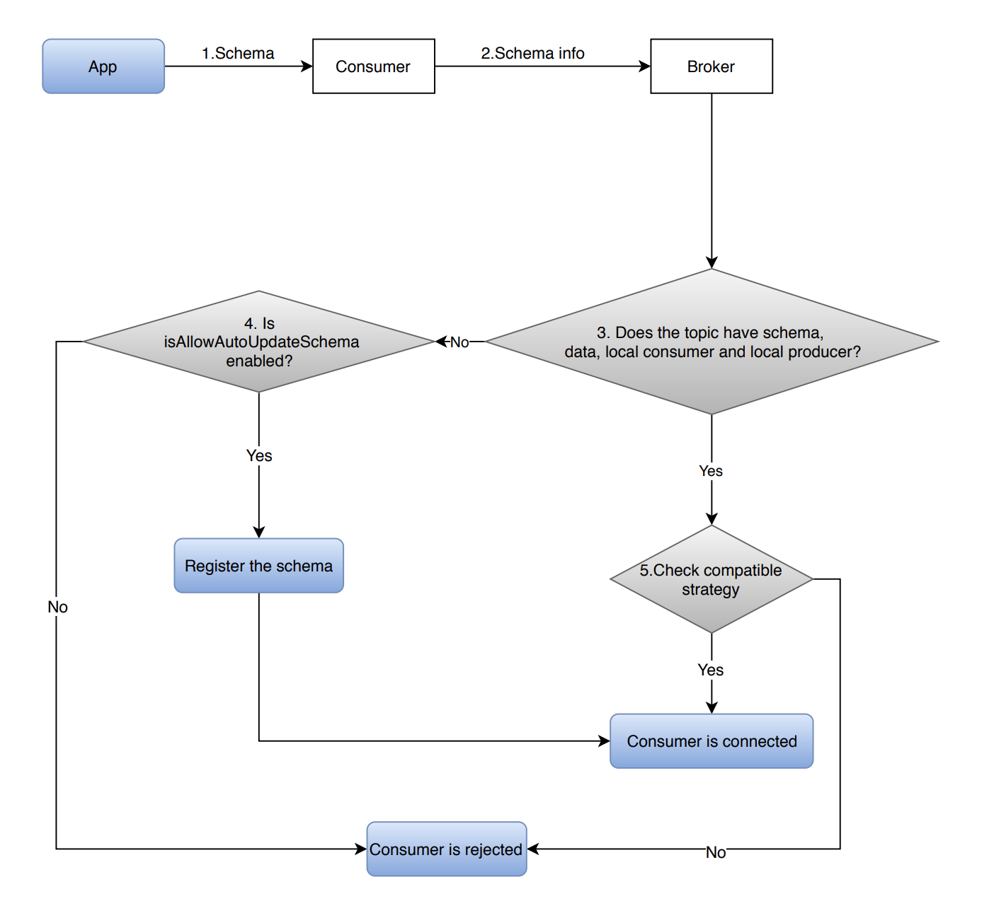
Schema Registry: Consumer

Slide 34
Pulsar schema : Schema Registry
AUTO_PRODUCE
AUTO_CONSUME
Validates whether the bytes sent is compatible
If not, rejects.
Produce<byte[]> pulsarProducer = client.newProducer (Schema.AUTO_PRODUCE()) … .create();
Validate whether bytes sent from topic is compatible with schemas on topic.
If not, rejects.
Consumer<GenericRecord> pulsarConsumer = client.newConsumer(Schema.AUTO_CONSUME()) … .subscribe();

Slide 35
Topic Schema Mapping
Topic : schema = 1:1 ?
What about relative ordering?
Opinion:
Model domain to topic
Domain may have multiple schema.
Example : User, accounts, subscription
Prefer relative ordering
Work with parallel evolution
User v1 -> User V2 -> User V3
Account v1 -> Account V2 -> Account V3
Subscription v1 -> Subscription V2 -> Subscription V3

Slide 36
Schema across pipeline
Pulsar IO
Source (Examples : Flink, Spark, Elasticsearch)
Pulsar
Sink (Examples : Flink, Spark, Elasticsearch)
Same schema across pipeline
Unless you decorate..
Unless different format for optimization
Type of query

Slide 37
Learnings

Slide 38
Learnings over the years
Struct schemas model domain objects well.
Binary representation is space efficient.
Use schemas management on apps, only if you need that extra flexibility.
Use schema registry by default.
Recommend Avro
Json schema – a bit too verbose
Proto awesome, not adopted well among sources / sinks.
Avro is adopted really well.
Decide and set compatibility / evolution rules. Worth it!

Slide 39
References
Pulsar docs: https://pulsar.apache.org/docs/en/schema-get-started/
Schema auto update strategy: https://pulsar.apache.org/docs/en/pulsar-admin/#set-schema-autoupdate-strategy
Schema Evolution in Avro, Thrift, Protobuff: https://martin.kleppmann.com/2012/12/05/schema-evolution-in-avro-protocol-buffers-thrift.html
Topic design per domain: https://www.confluent.io/blog/put-several-event-types-kafka-topic/
Schema Compatibility Design: https://docs.confluent.io/platform/current/schema-registry/avro.html#compatibility-types

Slide 40


THANK YOU
QUESTIONS?
@ShivjiJha
in/shivjijha/
shiv4289
ShivjiKumarJha

