Slide 1

Compiler Design Parser Project
Topic : JAVA DEFINING CLASS
Submitted By :
SHIV KUMAR (20234757047)
DEEPAK KUMAR (20234757011)
Submitted to:
Dr. Ankit Rajpal

Slide 2
Project Overview
This project presents a simple parser to java defining a class
with limited use cases and tokens supported. It's made for academic purposes and learning purposes.
The source file of yacc is defined in class.y The source file of lex is defined in class.l
What does the parser do?
The parser analyses the syntax of a java defining function entered by the user and tells whether the statement is a java defining function or not.
The parser works perfectly for all the ideal test cases of the following syntax :
public class hello {
public static void main(String[] args) {
int a = 10;
int b = 20;
int c = a + b;
}
}

Slide 3
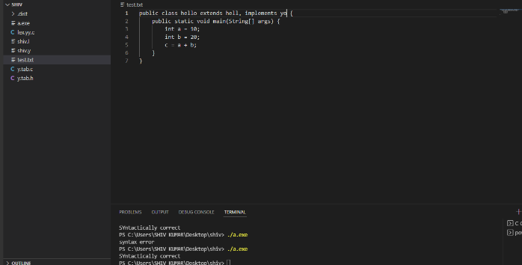
Commands to run code :
Windows
flex class.l
bison -yvd class.y
gcc lex.yy.c y.tab.c
a.exe
Linux
yacc -d –verbose class.y
lex class.l
gcc lex.yy.c y.tab.c
./a.out
Sample execution:

