Slide 1

AI
and machine learning
TOPIC
AIML
PRESENTED BY
Shiv Dixit
History and Evolution
Tracing the journey of intelligent machines — from a
wartime idea to the generative systems of today.
ROLL NUMBER
2401220100217
1950
2020s
ORIGINS
TODAY
Artificial Intelligence & Machine Learning

Slide 2
01
FOUNDATIONS
What is AI and ML?
Artificial Intelligence
Artificial Intelligence
The broad science of building machines that perform
tasks requiring human-like reasoning, perception, and
decision-making.
Machine Learning
Machine Learning
A subset of AI where systems learn patterns directly from data
and improve with experience, instead of following fixed rules.
Deep Learning
Deep Learning
A subset of ML using multi-layered neural networks to model
highly complex patterns in images, speech, and language.

Slide 3

02
1940S — 1950S
The Birth of an Idea
Before computers were common, mathematicians and logicians laid the theoretical
groundwork for thinking machines.
1943
1950
1956
Artificial Neurons
The Turing Test
Dartmouth Workshop
McCulloch and Pitts model the first mathematical
neuron — the seed of all neural networks.
Alan Turing asks "Can machines think?" and
proposes a test for machine intelligence.
John McCarthy coins the term "Artificial
Intelligence" — the field is officially born.

Slide 4
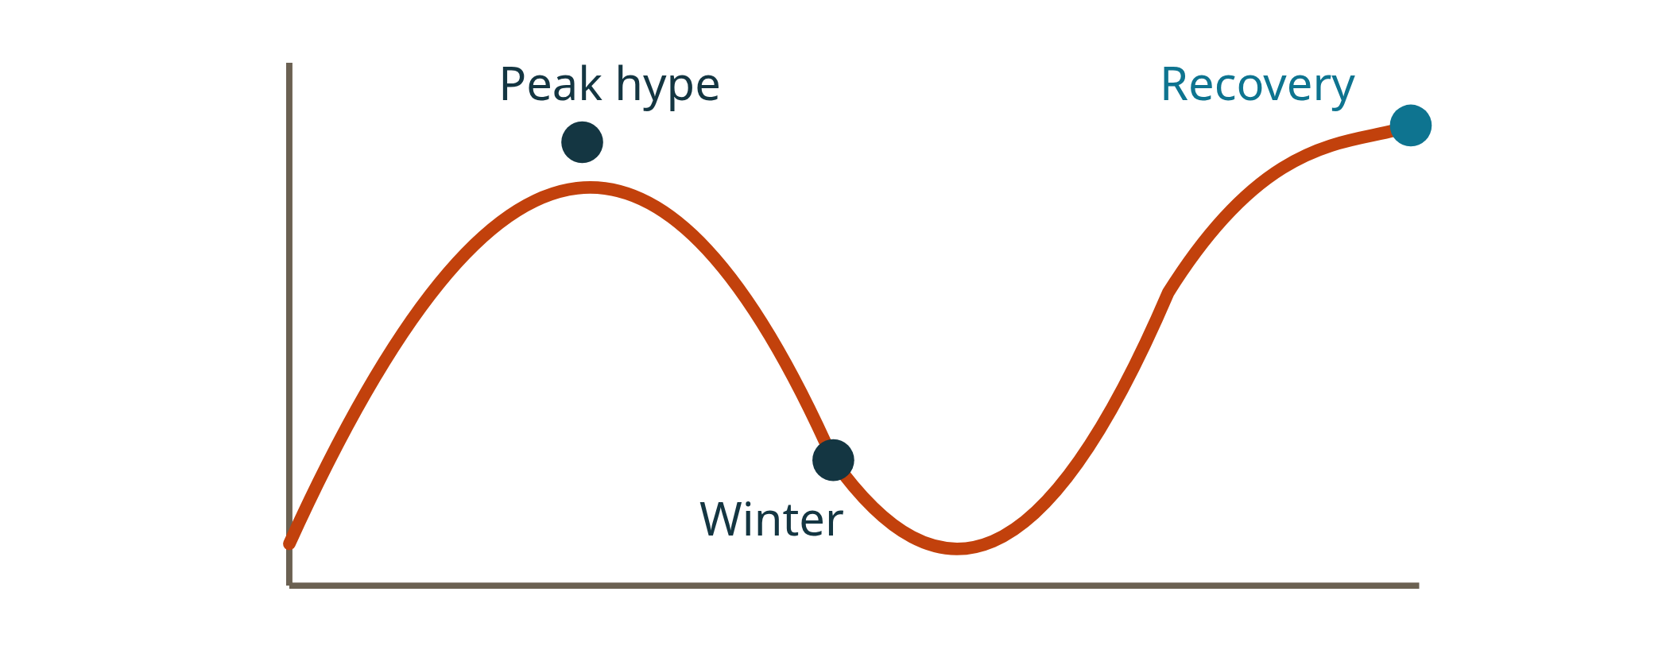
03
1960S — 1980S
Optimism and the AI Winters
1958
The Perceptron
The Cycle of Hype
Frank Rosenblatt builds an early learning machine that adjusts
its own weights.
1970s
First AI Winter
Limited computing power and unmet promises cause funding to
dry up across the field.
1980s
Expert Systems
Rule-based programs bring AI into industry — followed by a
second winter late in the decade.
Excitement, disappointment, and renewal — a pattern that repeats
throughout AI history.

Slide 5
04
1990S — 2000S
The Rise of Machine Learning
The focus shifts from hand-written rules to statistical learning from growing volumes of data.
1997
1990s
2000s
Deep Blue
Statistical ML
The Data Boom
IBM's chess computer defeats world
champion Garry Kasparov — a landmark for
machine reasoning.
Support vector machines, decision trees,
and ensembles make learning from
data practical.
The internet floods the world with data,
fueling recommendation and search systems
at scale.

Slide 6
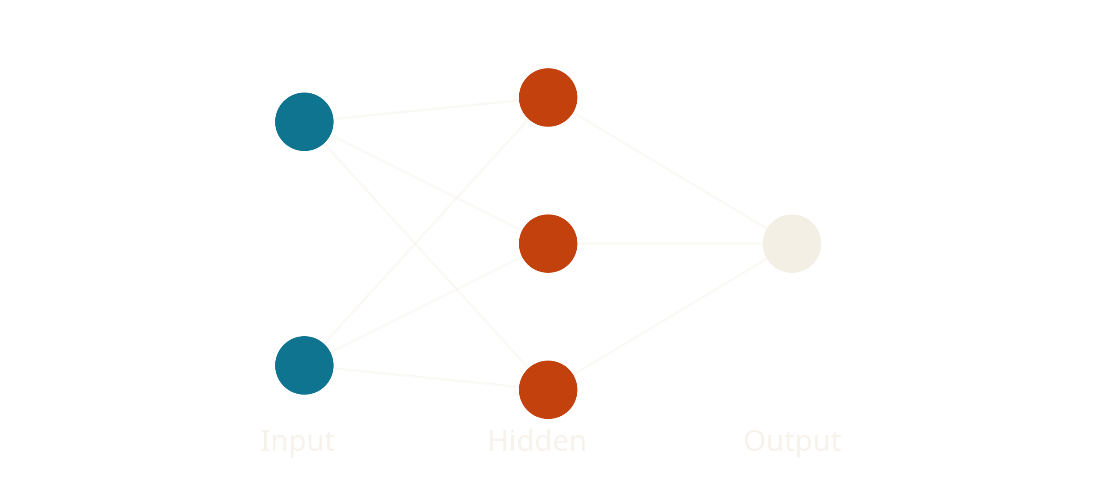
05
2010S
The Deep Learning Revolution
2012 — AlexNet
A Neural Network
A deep neural network crushes the ImageNet contest, proving deep
learning at scale.
GPU Computing
Graphics processors make training massive networks fast and affordable.
2016 — AlphaGo
DeepMind's system beats a Go world champion — a game once thought
beyond machines.

Slide 7
06
2020S — PRESENT
The Age of Generative AI
Transformer models unlock systems that write, code, converse, and create at
human scale.
2017
2022
Transformers
ChatGPT
The "Attention Is All You Need"
paper reshapes how machines
process language.
Conversational AI reaches the public
and becomes part of everyday work.
THE JOURNEY
From a single artificial neuron
to systems that create.
In seventy years, AI has moved from theory to a
technology that shapes how we live, learn, and work — and
its evolution is only accelerating.
Now
Next
Multimodal AI
Autonomous Agents
Models that understand text, images,
audio, and video together.
AI that plans and acts across tools to
complete real-world tasks.

