Slide 1
IBM University Engagement Project Submission
"FinSaathi: AI Agent for Digital Financial Literacy“
Github link- https://github.com/shiv9956/FinSaathi

Slide 2

Project Title – FinSaathi: AI Agent for Digital Financial Literacy
Domain of Project – FinTech / Financial Literacy / AI for Social Good
Student Name | Recent Passport Photo | Email ID | Mobile number [WhatsApp]
Shiv Dixit |  | shivdixit9956@gmail.com | 8318915814

Slide 3
Problem Statement -
Problem Statement No.7 – AI Agent for Digital Financial Literacy
The Challenge – An AI Agent for Digital Financial Literacy, powered by RAG (Retrieval-Augmented Generation), helps users understand and navigate essential financial tools and practices. It retrieves reliable content on using UPI, avoiding online scams, understanding interest rates, budgeting, and personal finance management from government portals, banking websites, and educational platforms.
With multilingual support, users from diverse backgrounds can interact in their preferred language and ask questions like “How do I send money via UPI?” or “What is a safe interest rate for a loan?” The agent ensures financial literacy is accessible, personalized, and culturally inclusive. This AI-driven assistant empowers users with knowledge, protects them from fraud, and builds confidence in digital finance.
Technology – Use of IBM Cloud Lite services / IBM Granite is mandatory

Slide 4
Proposed Solution – FinSaathi — RAG-Based AI Agent for Financial Literacy
FinSaathi is a Retrieval-Augmented Generation (RAG) AI agent built on IBM Granite models via watsonx.ai. It provides grounded, safe financial guidance to first-time digital banking users in India through a Streamlit-based conversational interface.
Knowledge Base & RAG Pipeline
10 curated Markdown files covering UPI safety, scams, EMI, budgeting, FD/RD/PPF, digital banking safety, Hindi glossary, loans, and investing basics — all sourced from official RBI, NPCI, SEBI, and cybercrime.gov.in URLs. Documents are chunked (~800 chars, 120 overlap), embedded using IBM Granite Embeddings (dim=768), and stored in a NumPy cosine-similarity index. No external vector DB required.
Agent Router (rule-based, no extra LLM call)
• Scam Checker: 12-indicator weighted rule engine scores 0–100 (Low/Medium/High) + IBM Granite explains verdict
• EMI Calculator: Standard reducing-balance formula, pure Python — instant, no LLM needed
• Budget Planner: 50/30/20 rule split with Granite tips
• RAG Chat: Retrieve top-k chunks → build grounded prompt → IBM Granite generates answer with source citations
Guardrails
PII masking (Aadhaar, PAN, card numbers, OTPs) before any model call. Rule-based refusal for investment/legal advice. Disclaimer + source citations + fraud helpline 1930 appended to every response.
UI — Streamlit
Three tabs: Ask FinSaathi (chat), Scam Checker (risk card + reasons + advice), Calculators (EMI + Budget). Hindi/English toggle in sidebar. Live index rebuild button. Clear MOCK MODE banner when credentials are absent — app never crashes without credentials.

Slide 5
Technology Used
1. IBM watsonx.ai — Cloud platform for deploying IBM Granite models for both text generation and embeddings. Provides AI governance, scalable inference, and API access.
2. IBM Granite Models
ibm/granite-4-h-small — Generation model for answering questions, explaining scam results, EMI breakdowns, and budget tips
ibm/granite-embedding-278m-multilingual — 768-dimensional multilingual embeddings for semantic search across the knowledge base
3. Python 3.10+ — Core language. All business logic in pure Python.
4. Streamlit — Web UI framework for the chat interface, scam checker card, and financial calculators.
5. NumPy — Powers the vector index (cosine similarity search) — no Chroma, FAISS, or LangChain used.
6. RAG (Retrieval-Augmented Generation) — Documents are chunked, embedded, and stored locally. At query time, top-k semantically similar chunks are retrieved and injected into the Granite prompt as grounded context.
7. pypdf / Docling (optional) — For PDF and DOCX document ingestion into the knowledge base.
8. python-dotenv — Secure credential management via .env file. API keys never hardcoded.
9. pytest — 56 automated tests covering tools, guardrails, retriever, chunker, and agent routing — all run offline in MOCK_MODE.

Slide 6
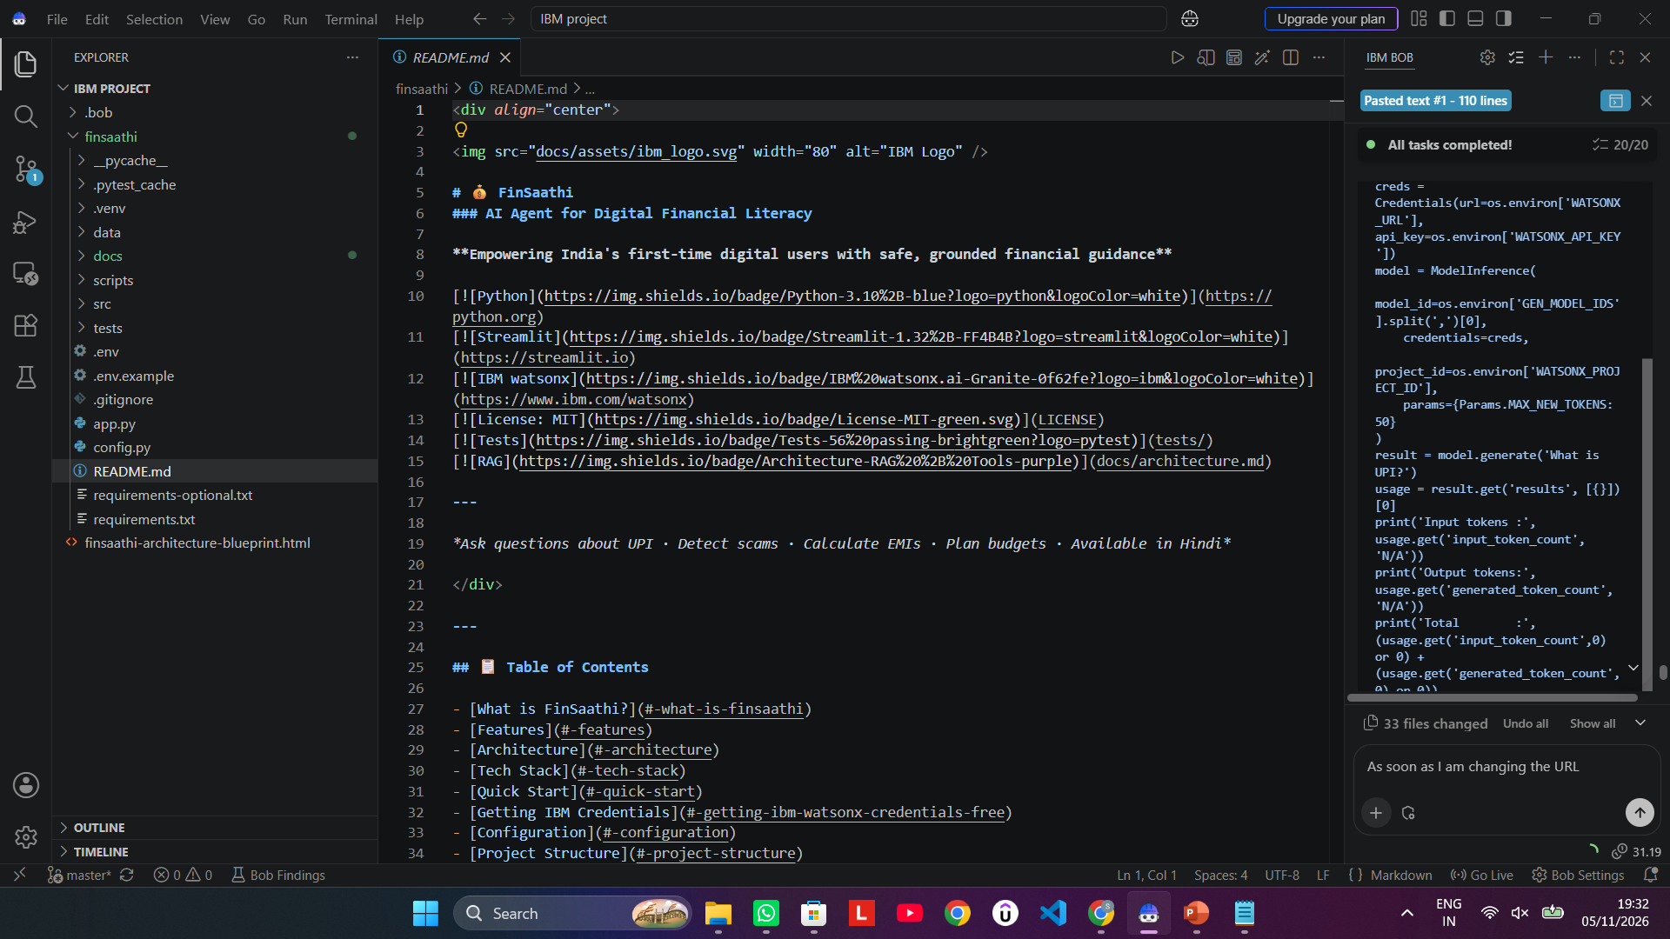
IBM BOB Screenshots

Slide 7
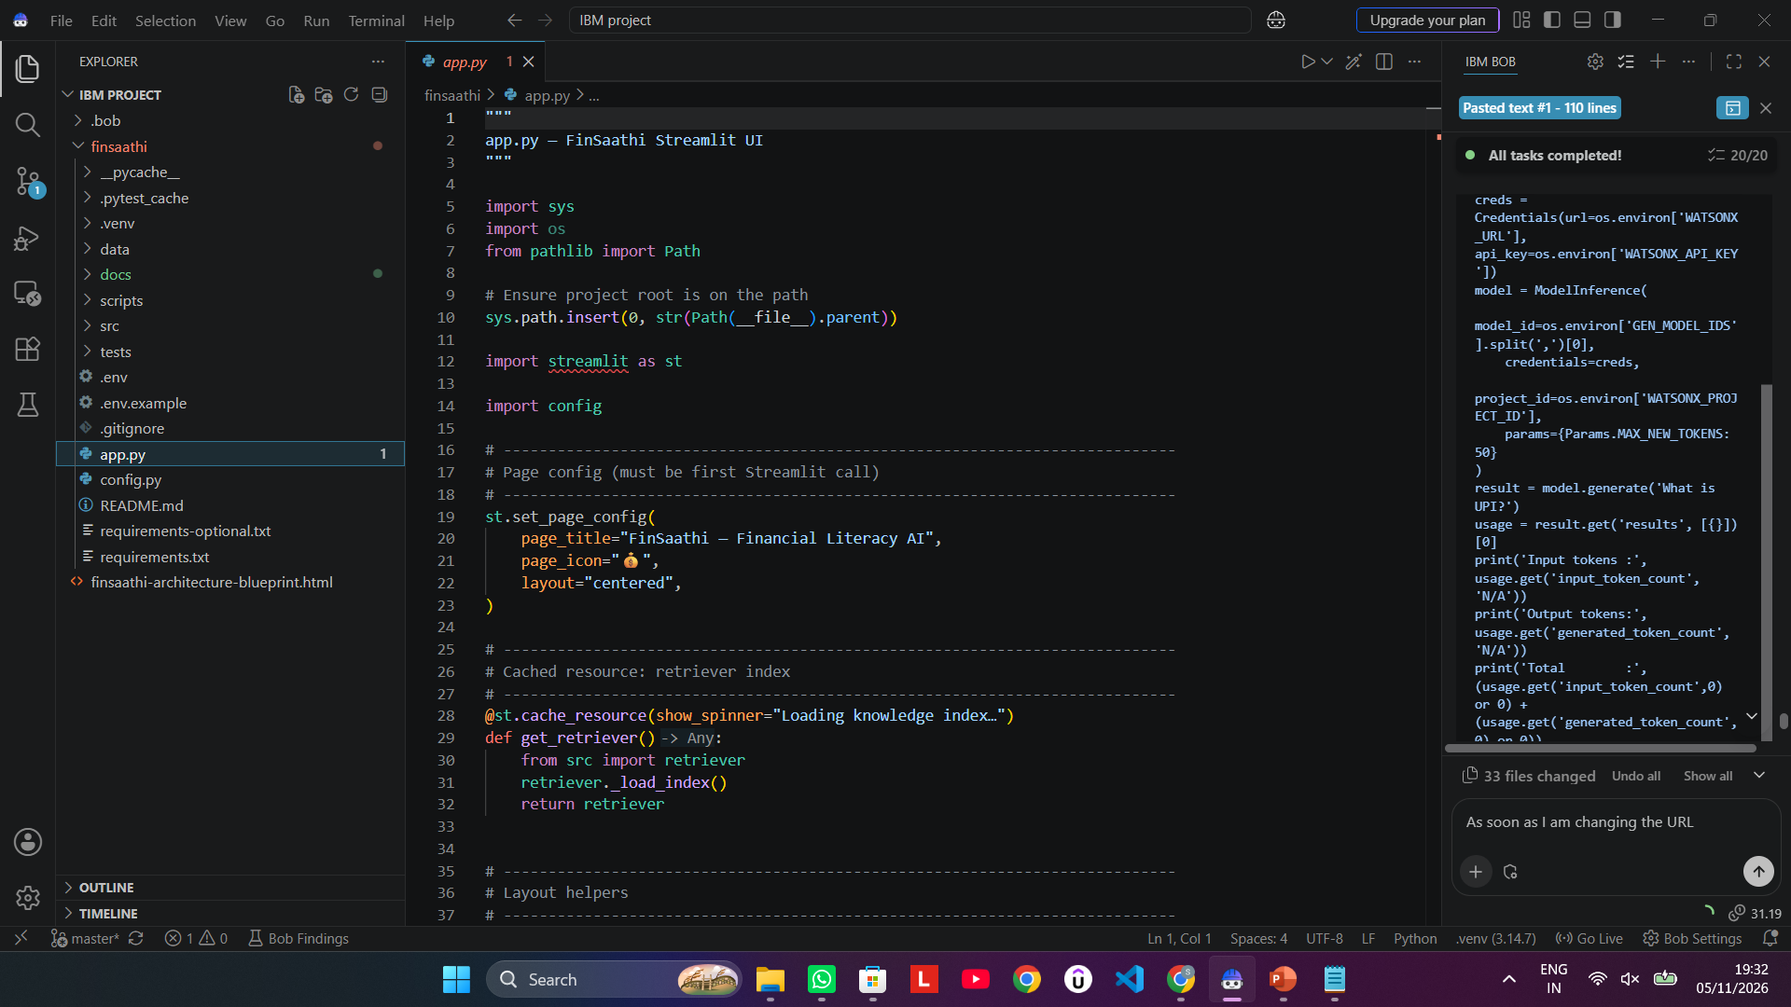
IBM BOB Screenshots

Slide 8
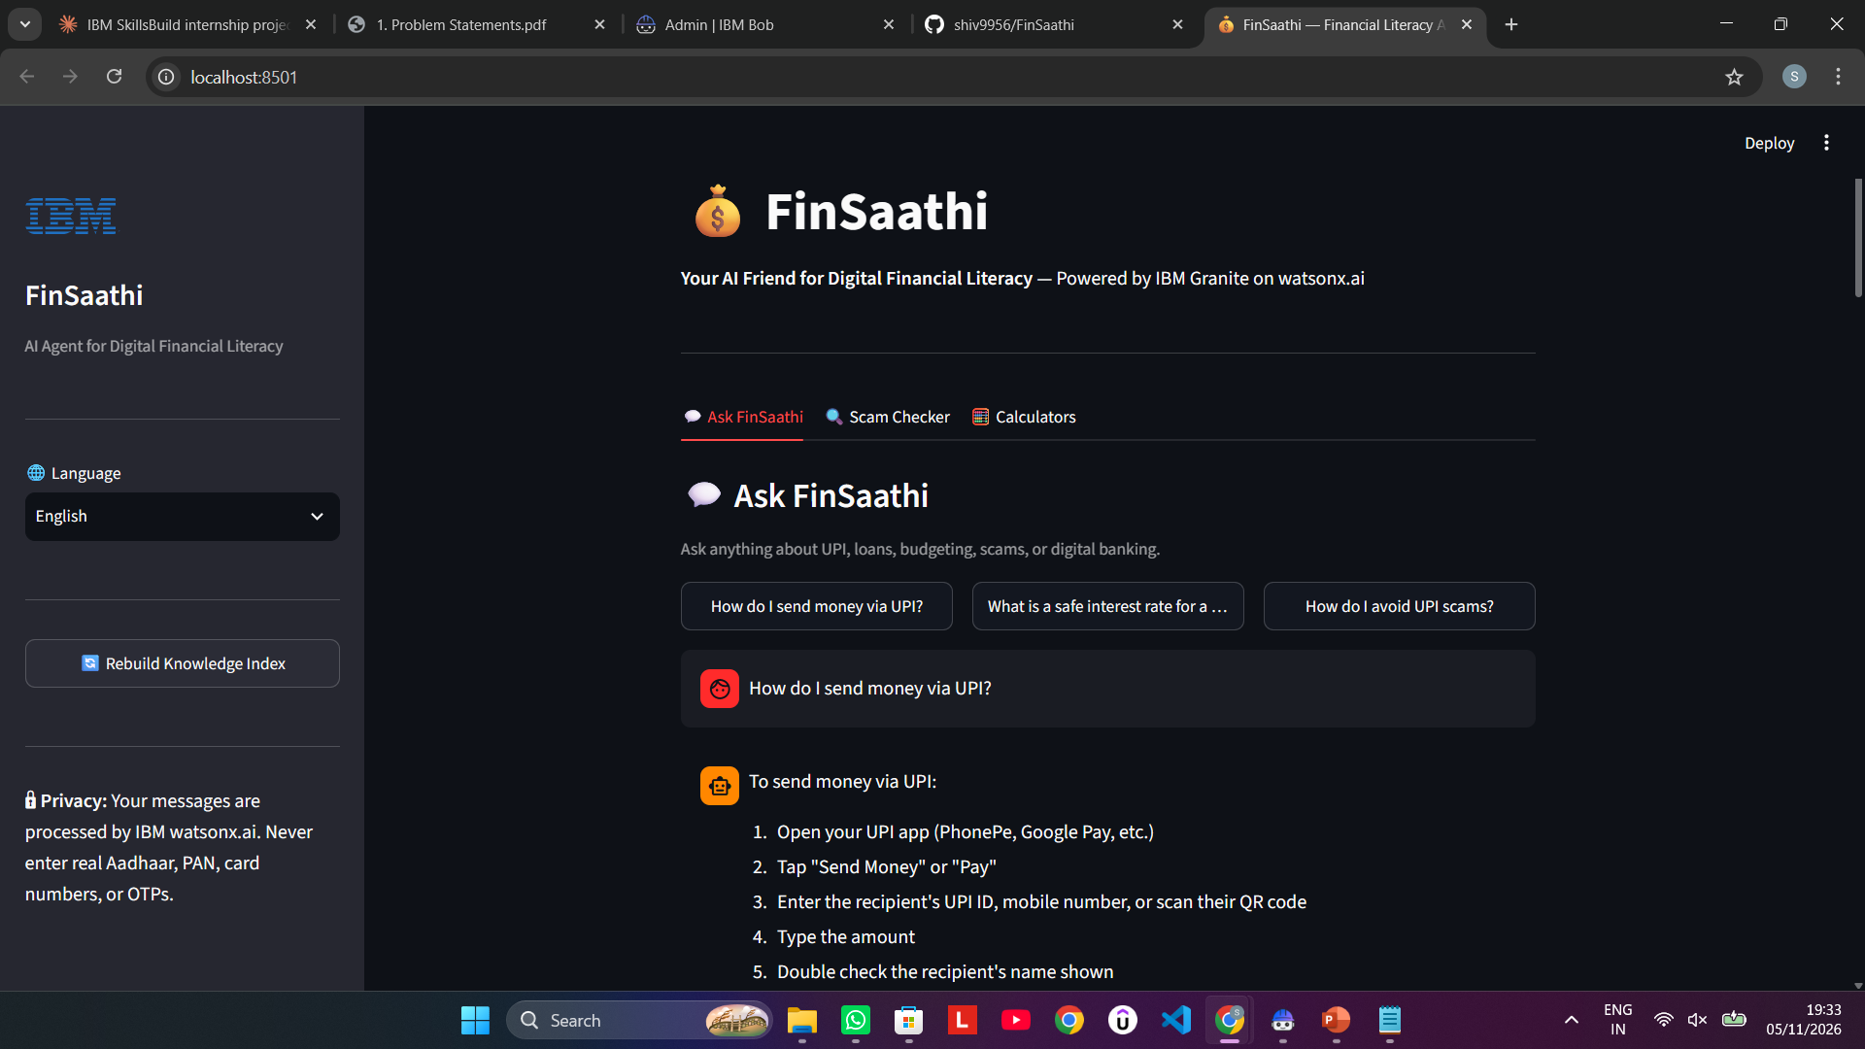
OUTPUT Screenshots

Slide 9
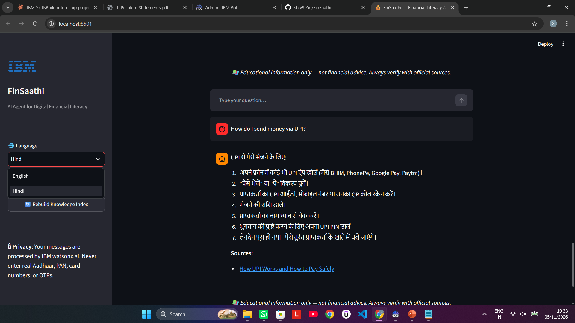
OUTPUT Screenshots

Slide 10
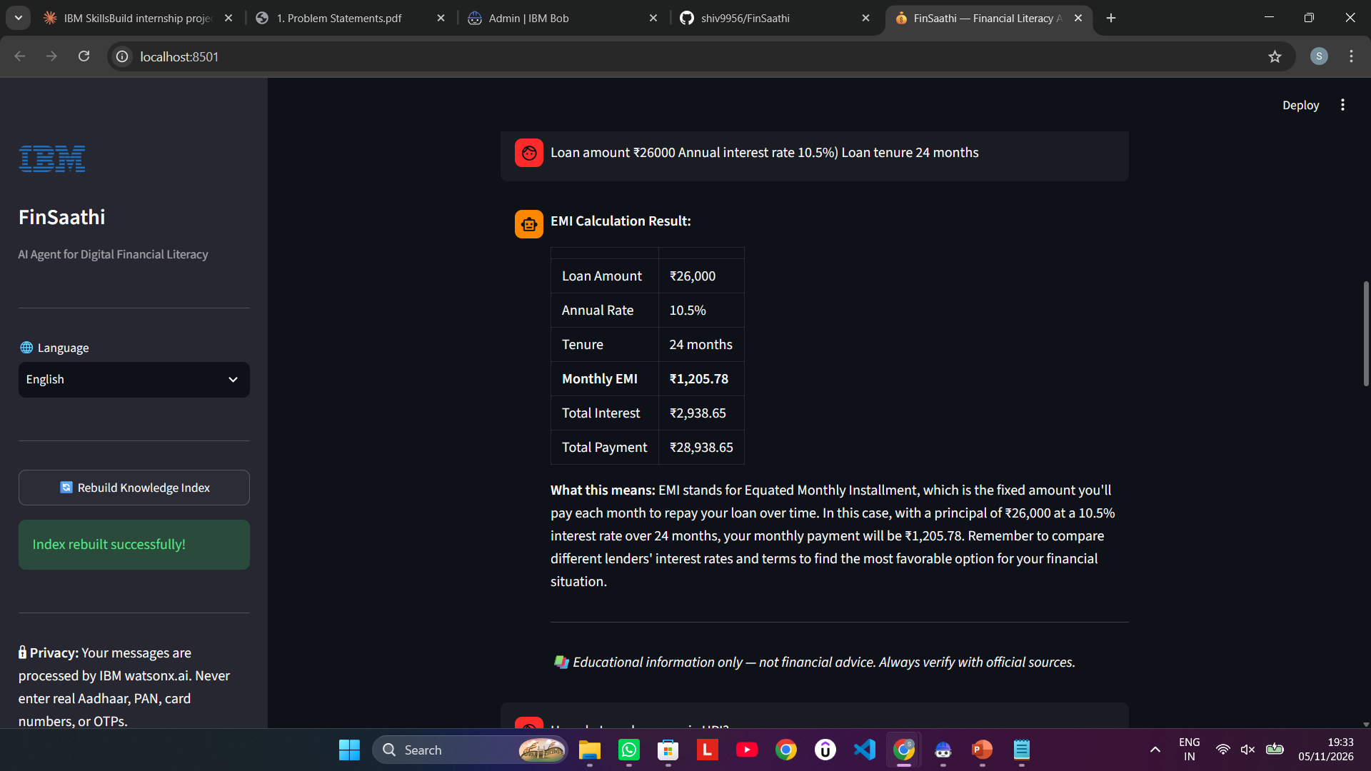
OUTPUT Screenshots

Slide 11
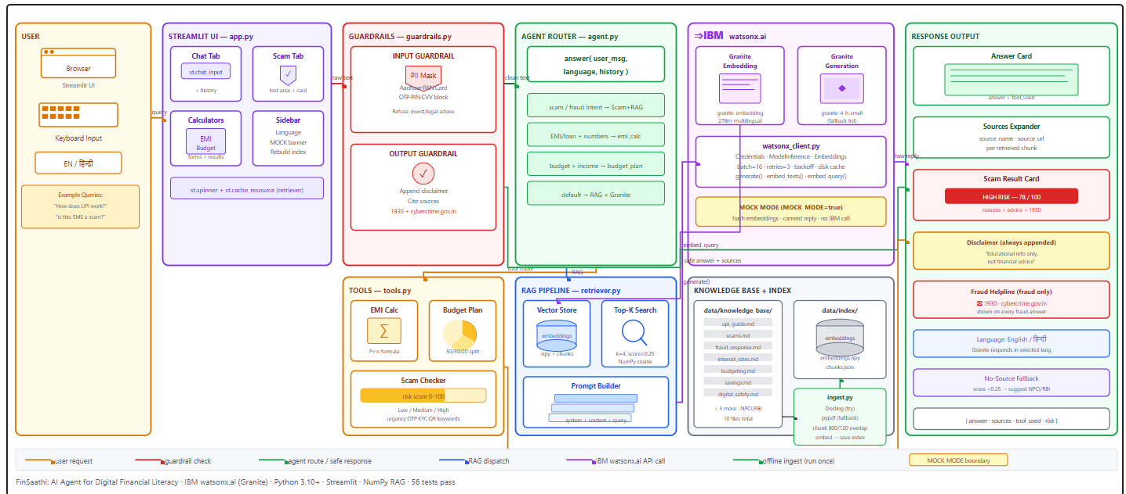
Architecture Blueprint

Slide 12

Role of Agentic AI in FinSaathi
FinSaathi demonstrates agentic AI principles through its autonomous,
goal-directed, multi-step decision making
Autonomous Routing
The agent (src/agent.py) independently decides which action to take for each
user message using rule-based intent detection. It routes to the Scam Checker,
EMI Calculator,Budget Planner, or RAG retriever without any human
instruction per query.
Tool Use
The agent calls deterministic tools (EMI calculator, budget planner, scam
checker) when calculation is more reliable than generation — a key principle
of agentic systems: use the right tool, not always the LLM.
RAG as a Memory Mechanism
The vector index acts as the agent's external memory. It retrieves relevant
knowledge before generating, grounding every answer in verified documents —
exactly as an agentic system should reference its knowledge base before acting.
Guardrail Layer as Agent Conscience
The guardrails layer (PII masking, refusal checks, disclaimer injection) acts autonomously on
every input and output, enforcing safety policies without human intervention on each request.

Slide 13
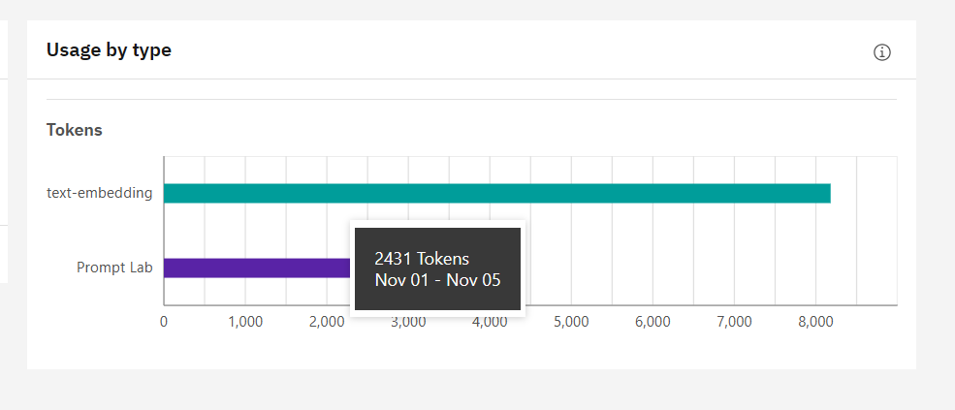
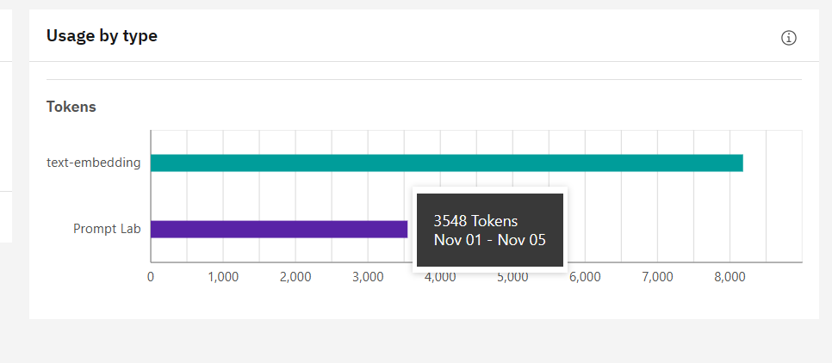
Token Usage
1117 tokens are used
Before Prompt
After the Prompt
·

Slide 14
Novelty and Uniqueness of FinSaathi
FinSaathi is uniquely positioned at the intersection of responsible AI, financial inclusion, and agentic design for underserved Indian users.
1. India-Specific Financial Literacy Focus
Built specifically for India's digital ecosystem (UPI, RBI, NPCI, SEBI, cybercrime.gov.in). All knowledge grounded in official Indian government and regulatory sources only.
2. Hybrid Agent: Rules + RAG + LLM
Uses deterministic Python tools (EMI, budget) for precision, rule-based scoring (scam checker) for reliability, and IBM Granite only where natural language generation adds value. Avoids hallucination on calculations.
3. Privacy-First by Design
Aadhaar, PAN, card numbers, and OTPs are masked BEFORE reaching the model — most AI assistants process raw PII. FinSaathi never does.
4. Zero External Dependencies for Vector Search
No Chroma, FAISS, Pinecone, or LangChain. Pure NumPy cosine similarity — fully self-contained, offline-capable, and transparent.
5. MOCK_MODE for Zero-Cost Development
Full app runs without IBM credentials using deterministic hash-based fake embeddings. Enabled 56 automated tests and offline demos with zero quota usage.
6. Automatic Model Fallback
GEN_MODEL_IDS tries each model in order at startup. When IBM deprecated Granite 3.x, app auto-detected ibm/granite-4-h-small and continued — no manual fix needed.
7. Hindi Language Support with Context Preservation
System prompt switches to simple Devanagari Hindi while keeping UPI, OTP, EMI, PIN in English — practical bilingualism for real Indian users.

Slide 15
GitHub Repository
GitHub URL: https://github.com/shiv9956/FinSaathi
Files in the repository:
• app.py — Streamlit UI (3 tabs: Ask FinSaathi, Scam Checker, Calculators)
• config.py — All settings from .env
• requirements.txt — Core dependencies (streamlit, ibm-watsonx-ai, numpy, pypdf, pytest, etc.)
• requirements-optional.txt — Docling for enhanced PDF parsing
• .env.example — Credential template (WATSONX_API_KEY, WATSONX_PROJECT_ID)
• src/ — watsonx_client.py, ingest.py, retriever.py, guardrails.py, tools.py, agent.py
• data/knowledge_base/ — 10 curated Markdown files (UPI, scams, EMI, budgeting, savings, loans, etc.)
• scripts/check_setup.py — End-to-end IBM watsonx connection verifier
• tests/ — 56 pytest tests (run offline in MOCK_MODE)
• docs/ — architecture.md (Mermaid diagrams), demo_script.md, FinSaathi_Presentation.pptx
• README.md — Full documentation with Mermaid architecture diagrams, badges, troubleshooting guide
Note --
All 56 tests pass offline: $env:MOCK_MODE='true'; pytest tests/ -v
Setup verified: python scripts/check_setup.py — IBM auth PASS, Granite PASS, Embeddings dim=768 PASS
App running at: http://localhost:8501 — streamlit run app.py

Slide 16
Future Scope
1. Official PDF Ingestion from RBI / NPCI / SEBI
Replace curated Markdown files with official PDFs from RBI, NPCI, SEBI, and cybercrime.gov.in. Docling integration is already built-in — drop PDFs in data/knowledge_base/ and re-run python -m src.ingest for production-quality grounding.
2. More Indian Regional Languages
Extend Hindi to Tamil, Telugu, Bengali, Marathi, Kannada. The ibm/granite-embedding-278m-multilingual model already supports multilingual text — only the system prompt and glossary need extending per language.
3. Voice Input / WhatsApp Integration
Add speech-to-text (Whisper) for voice queries — critical for low-literacy users. Integrate via WhatsApp Business API so users interact through a familiar channel without needing a browser.
4. Personalised Financial Profiles
Save user income, loans, and goals for personalised budget splits, loan affordability checks, and savings recommendations beyond generic calculations.
5. Real-Time Scam Database Sync
Connect the scam checker to live cybercrime.gov.in or RBI advisory feeds. New scam patterns automatically added to the rule set, keeping the detector current.
6. Enterprise / Bank White-Label
Package as an embeddable widget for Indian banks and fintech apps. The IBM watsonx.ai backbone, guardrails, and disclaimer framework already meet enterprise AI governance requirements.

Slide 17
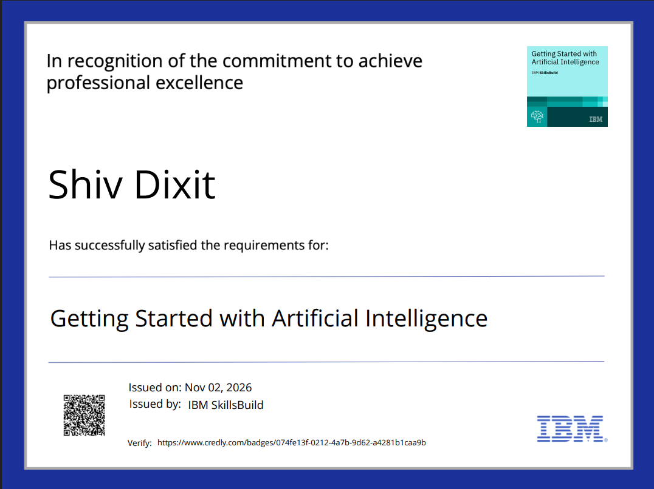
Certificates Earned:
Getting Started with AI credly certificate

Slide 18
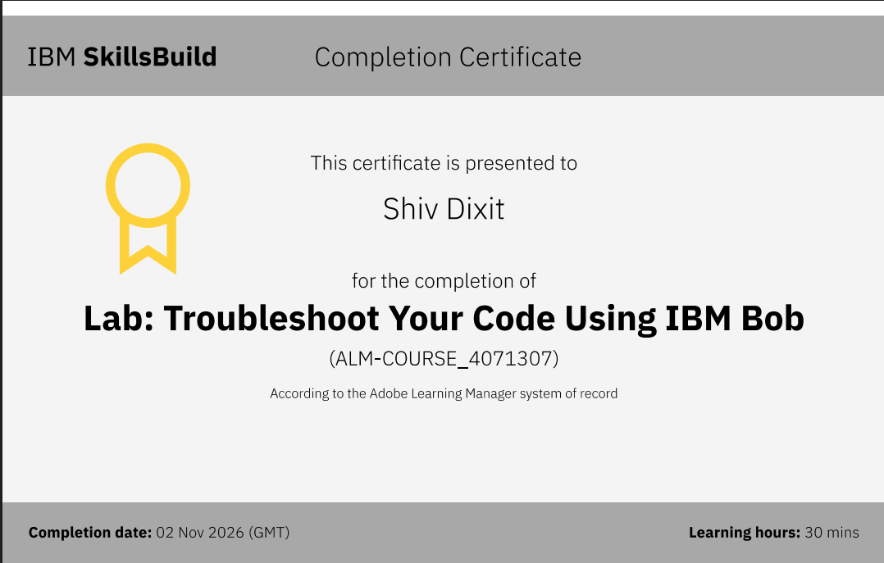
Certificates Earned:​
IBM BOB Certificate

Slide 19

Github link- https://github.com/shiv9956/FinSaathi

